Slide 1


INSTITUTE FOR ADVANCED COMPUTING AND SOFTWARE DEVELOPMENT AKURDI, PUNE
Secure E-mail Server Deployment with Malware Protection
GROUP NO: 06
KHAN MOHAMMAD WASEEM (233414)
ONKAR RASKAR (233428)
MR. KARTIK AWARI | MR. ROHIT PURANIK
PROJECT GUIDE | CENTRE CO-ORDINATOR

Slide 2
Introduction
Presenting our project: "Secure E-mail Server Deployment with Malware Protection."
In today's cyber-threat landscape, fortified communication is vital.
Our project crafts a resilient e-mail server using various tools, prioritizing confidentiality and reliability amidst rising digital risks.

Slide 3
Requirement
Software Hardware
Operating system: Ubuntu v.22.04.3 LTS
Webmail: Roundcube
Webserver: Nginx
Admin Panel: iRedMail
Database: MariaDB
Monitoring: NetData
Sr.no | Components | Minimum requirements
1 | CPU | 1 Core
2 | RAM | 2 GB
3 | Storage | 15 GB

Slide 4
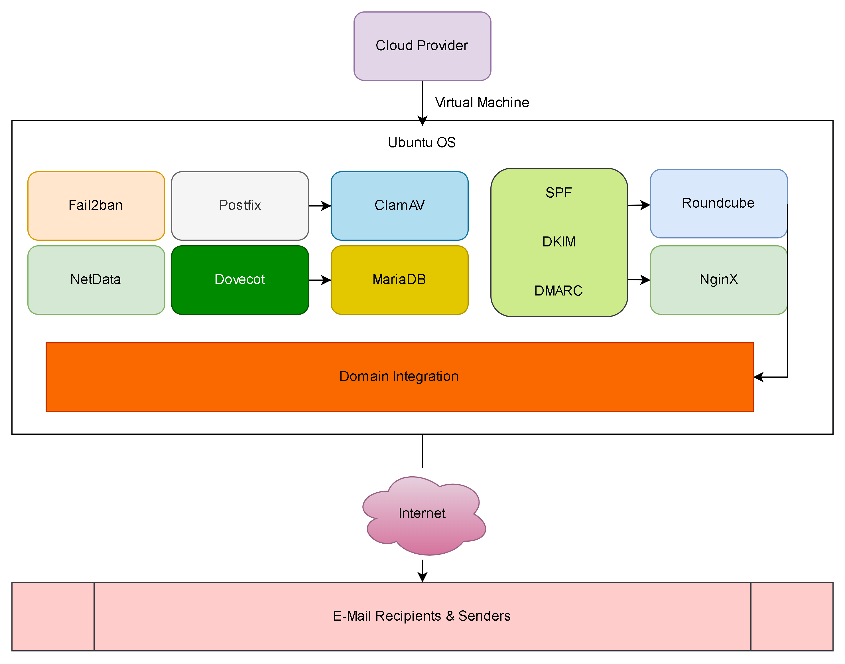
Architecture

Slide 5








Tools Used

Slide 6
Fail2ban: This intrusion prevention framework fortifies the server against brute-force attacks and unauthorized access attempts.
Postfix and Dovecot: The dynamic duo of Postfix for SMTP and Dovecot for IMAP/POP3 services ensures efficient message transfer and retrieval.
ClamAV: With its robust antivirus capabilities, ClamAV shields the e-mail server against malware-infested attachments.
MariaDB: A relational database management system underpins the user authentication and system configuration.
SPF, DKIM, and DMARC: These authentication mechanisms collectively validate the authenticity of incoming e-mails and prevent spoofing and phishing attempts.
Roundcube Webmail: A user-friendly webmail interface enables convenient access to e-mails while upholding security standards.
Nginx Web Server: Nginx serves the dual purpose of managing the admin panel and hosting the webmail interface.
Netdata Server Monitoring: Real-time monitoring ensures optimal performance and timely threat detection, minimizing potential vulnerabilities.
Tools Working

Slide 7
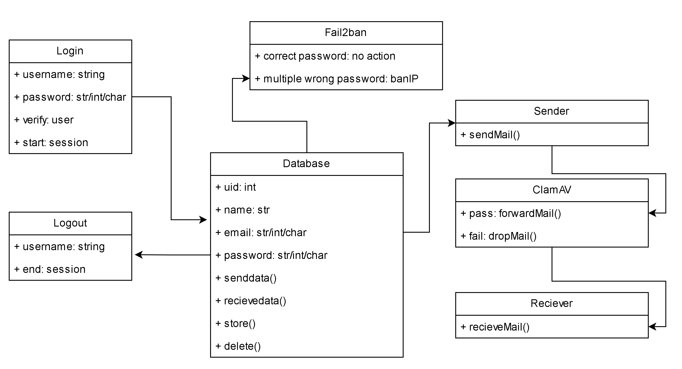
Class Diagram

Slide 8
Project Execution

Slide 9
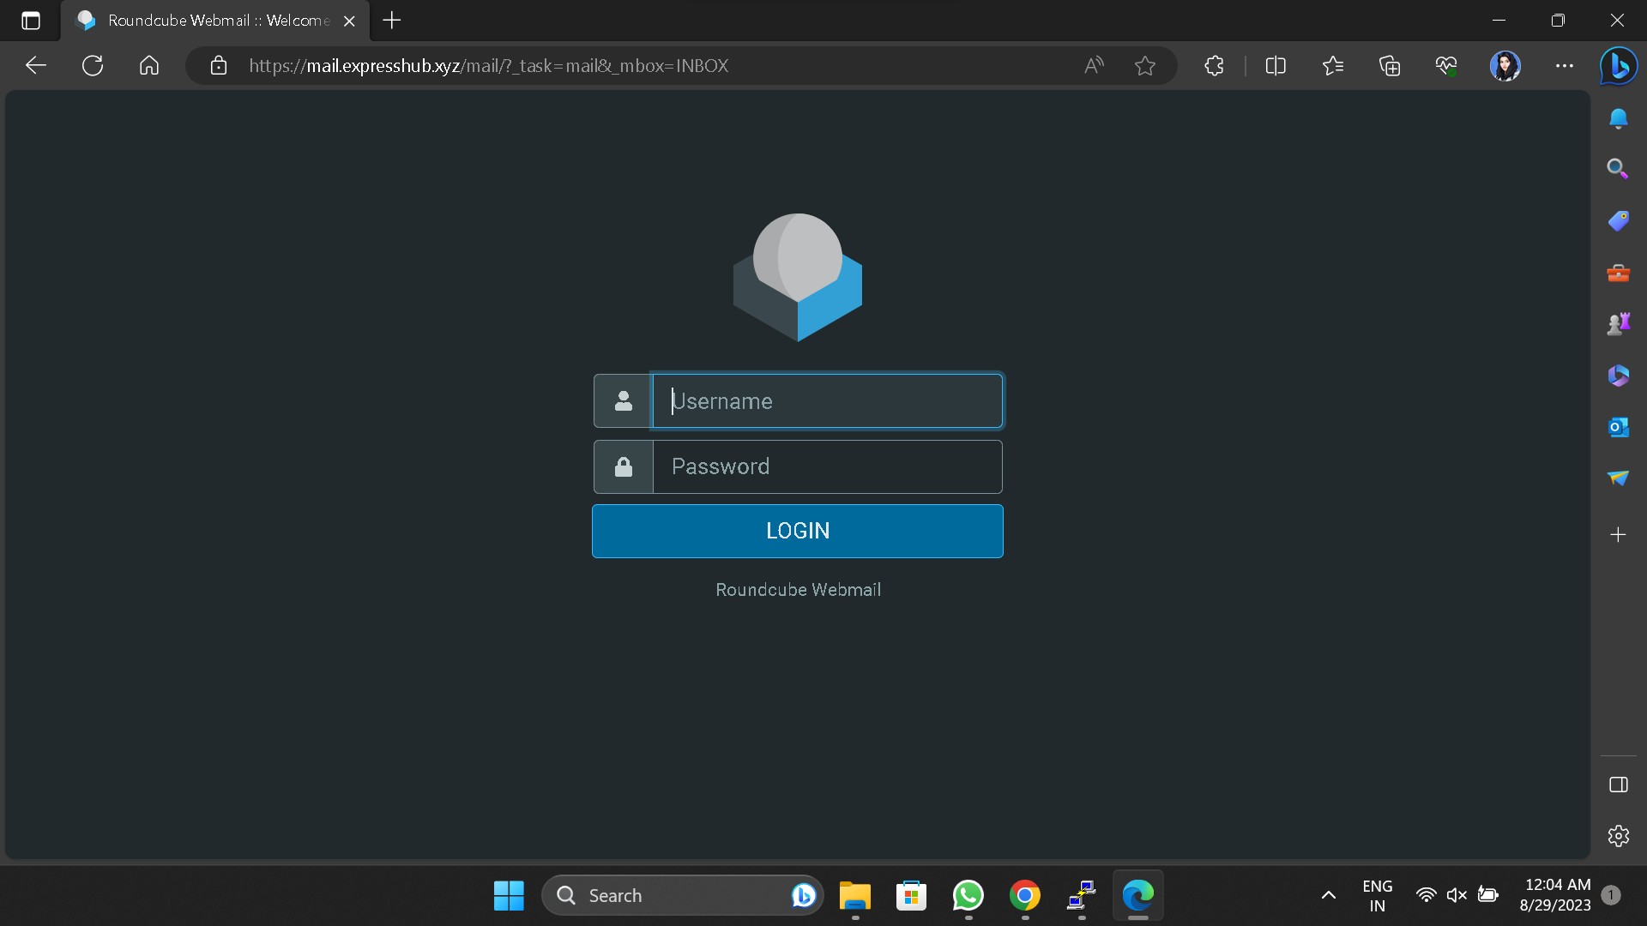
Web Panel

Slide 10
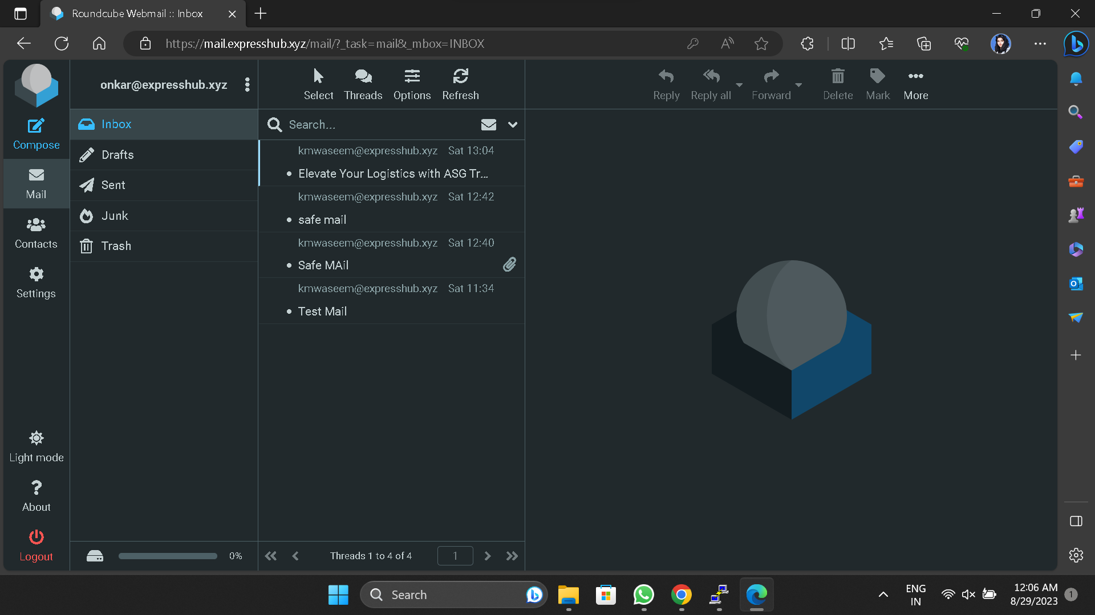
User: Logged-In

Slide 11
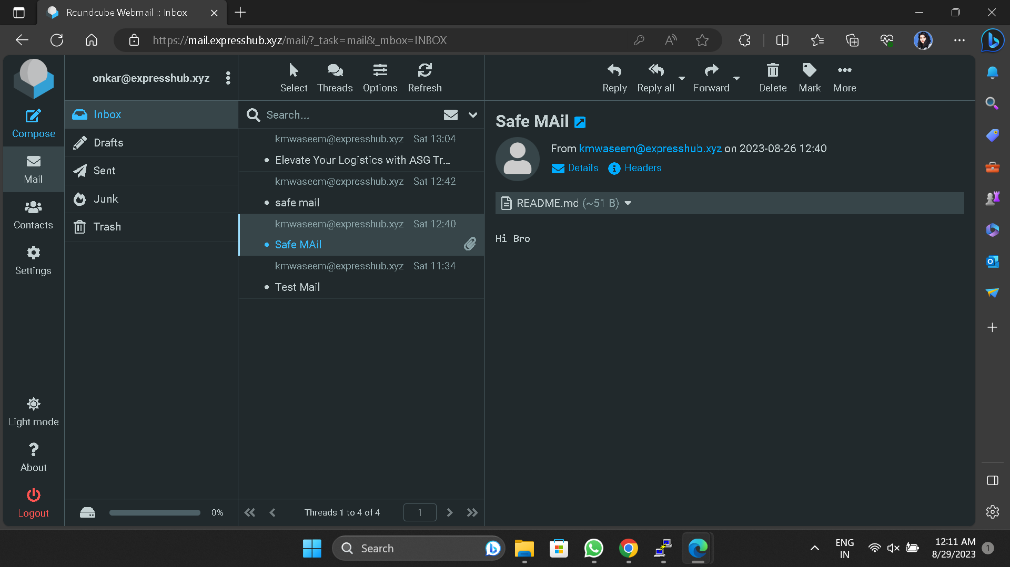
Safe Mail Received

Slide 12
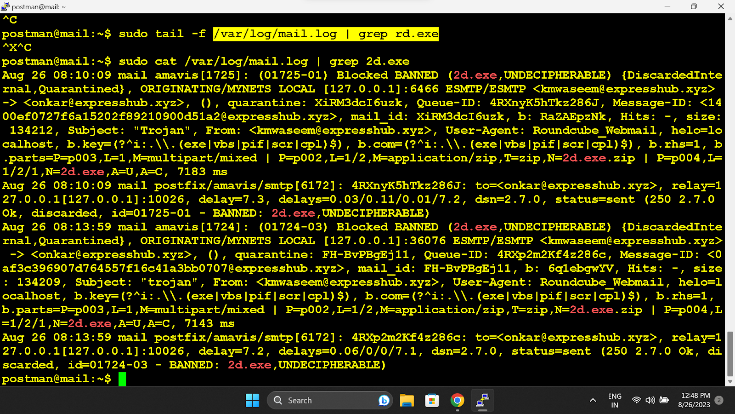
Malicious Mail Dropped: Mail Log

Slide 13
Conclusion
Our project addresses the pressing need for a robust e-mail infrastructure in today's digitally vulnerable world. By employing an arsenal of tools and technologies, we not only establish an environment fortified against malware but also champion the cause of confidential and trustworthy electronic communication.

Slide 14

THANK YOU

