Slide 1
A Kernel Test of Goodness of Fit
Liza Kiseleva, Daniil Leontyev,
Kundyz Onlabek, Mohammed Deifallah

Slide 2
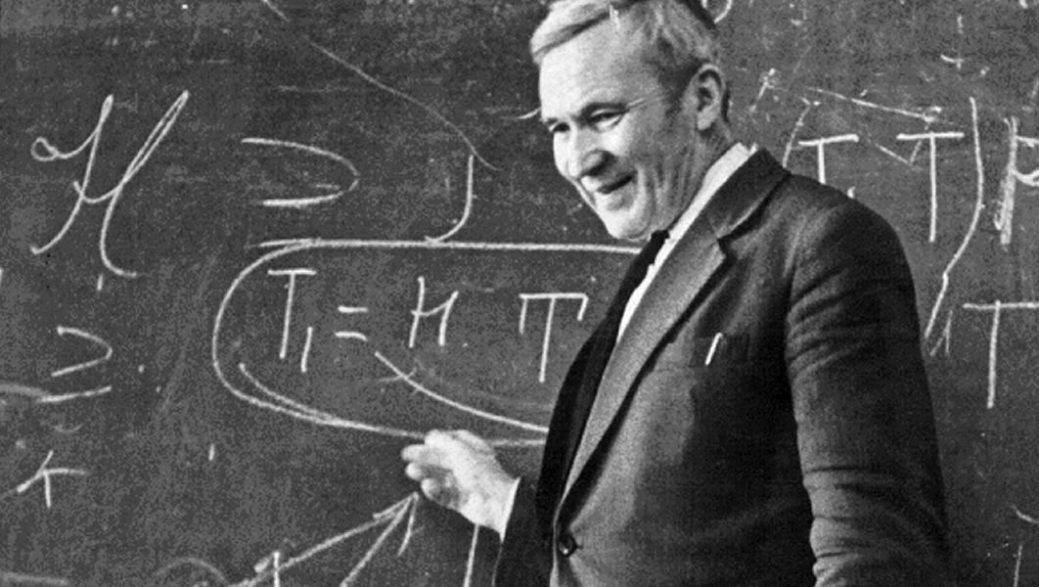

Introduction
Statistical tests of goodness-of-fit - a fundamental tool in statistical analysis, dating back to the test of Kolmogorov and Smirnov.
How likely it is that the given set of samples were generated from a target density function?

Slide 3
Introduction
Gorham and Mackey: measure of sample quality with respect to a target.
Maximum discrepancy between empirical sample expectations and target expectations over a large class of test functions, constructed by use of a Stein operator.
Determine if the empirical discrepancy measure is large enough to reject H0: the sample arises from the target distribution.

Slide 4
The problem statement
The possible approach: establish the asymptotic behaviour of the test statistic and set a test threshold at a large quantile of the asymptotic distribution.
Problems:
The asymptotic behaviour of the Sobolev Stein discrepancies is a problem, due to the complexity of the function class used.
It is not clear how to compute p-values for this statistic, or determine when the goodness of fit test would allow us to accept the null hypothesis.

Slide 5
The proposed method (Chwialkowski et al. 2016)
The measure of goodness-of-fit is a divergence constructed via Stein’s method using functions from a Reproducing Kernel Hilbert Space.
The test statistic is based on an empirical estimate of this divergence, taking the form of a V-statistic in terms of the log gradients of the target density and the kernel.
Derive a statistical test where we estimate the null distribution quantiles using a wild bootstrap procedure.
Apply the test to quantifying convergence of approximate Markov Chain Monte Carlo methods.

Slide 6
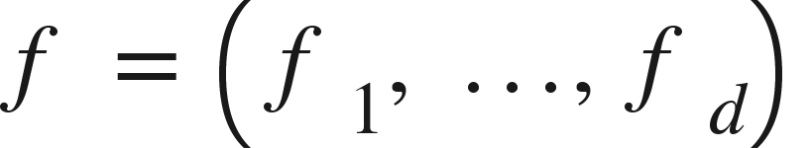
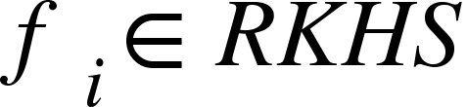
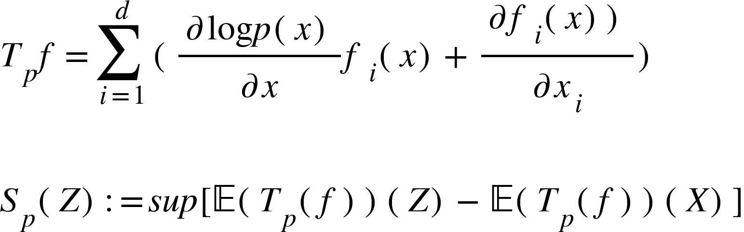
Stein operator in RKHS
Reproducing Kernel Hilbert Space
Stein operator
Stein discrepancy

Slide 7



Wild Bootstrap Testing
Test procedure for testing the null hypothesis:
Calculate the test statistic
Obtain bootstrap samples and estimate the empirical quantile of these samples
If exceeds the quantile, reject

Slide 8
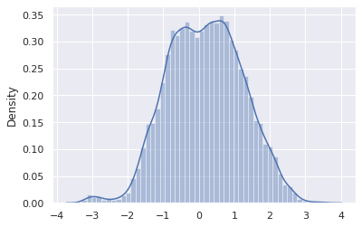
Experiments
Student-t distribution
Ho: sample comes from a Standard Normal Distribution

Slide 9
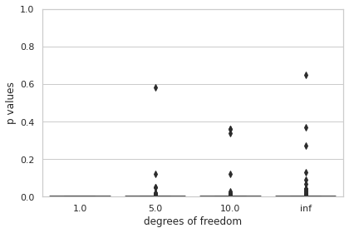
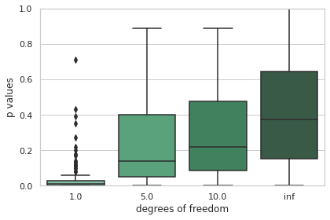
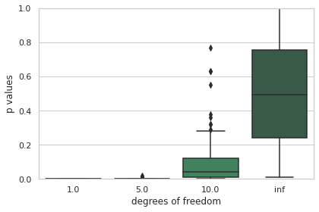
Student-t vs Normal
a_n = 0.5
a_n = 0.02
a_n = 0.1

Slide 10
Conclusion
P-value is shown to be directly related to the number of degrees of freedom
Student’s t-student is a special case of standard normal distribution
a_{n} is a hyperparameter that’s proportionally related to the data independence.

Slide 11
References
Chwialkowski, K., Strathmann, H., & Gretton, A. (2016, June). A kernel
test of goodness of fit. JMLR: Workshop and Conference Proceedings

Slide 12

THANK YOU!

