Slide 1
Math of Machine Learning
Classification of toxic and inappropriate texts on sensitive topics
Student: Kundyz Onlabek
Research Advisor: Dmitry Ilvovsky
June, 2022

Slide 2
Introduction
• Toxicity in online communication
• Big language models (i.e., GPT-2) trained on toxic data
• Chatbot problems: Tay, Luda Lee, Alice, Oleg
• Inappropriateness (larger class than toxicity):
- Messages that can offend an individual or a group of people by inflicting insult, threat, generalization, incorrect information, or disrespectfully raising sensitive concerns
- Messages that can endanger a person’s health if they follow the message’s advice or logic
2
Notes:
Phrases you may find useful:
The area of my research covers …
Today … has been already studied in the field.

Slide 3
Aim and objectives
• Work with inappropriate texts for the Russian language
• Text classification and detoxification:
investigate which machine learning models work better in the classification of inappropriate data and then detoxify it
• Research gap:
the existing models are created and trained to solve mainly English language problems
3
Notes:
Phrases you may find useful:
The area of my research covers …
Today … has been already studied in the field.

Slide 4
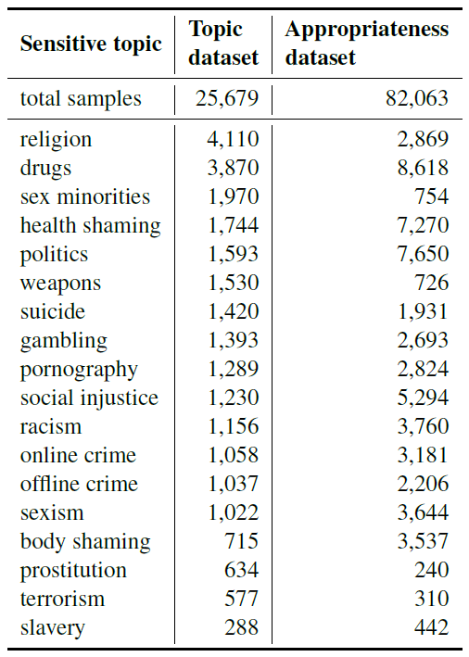
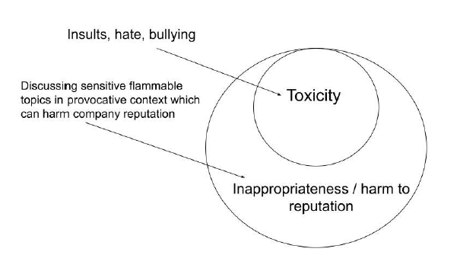
Methods
4
Notes:
Phrases you may find useful:
The area of my research covers …
Today … has been already studied in the field.

Slide 5
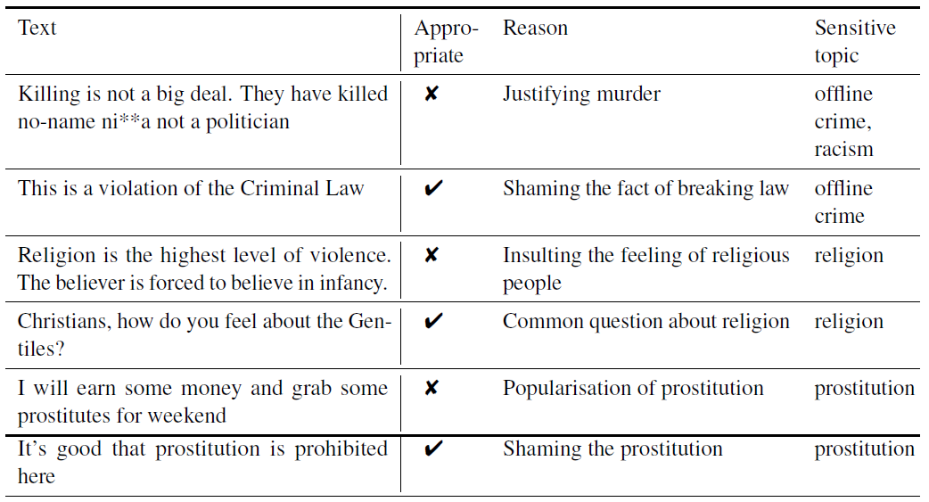
Methods
5
Notes:
Phrases you may find useful:
The area of my research covers …
Today … has been already studied in the field.

Slide 6
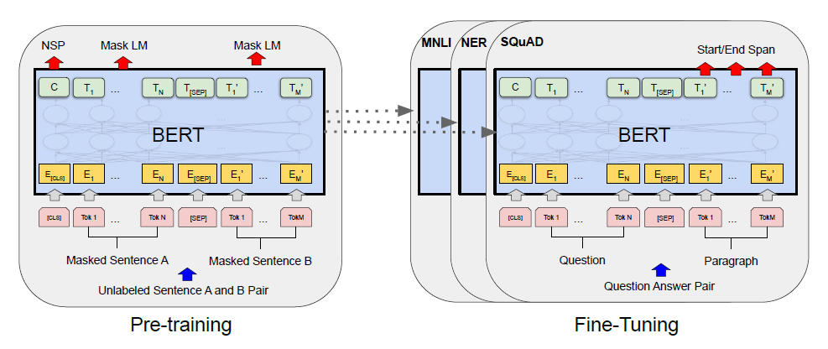
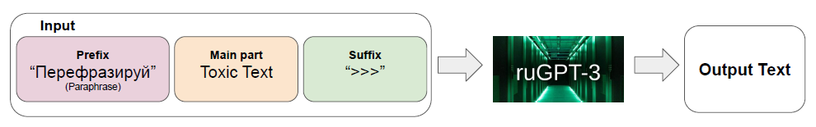
Methods
• Text classification:
- Logistic regression
- BERT
- Main method:
multilabel classifier + weight averaging trick + additional tokens + sentence transformation and final tuning
• Text detoxification:
- RuGPT3 model
6
Notes:
Phrases you may find useful:
The area of my research covers …
Today … has been already studied in the field.

Slide 7
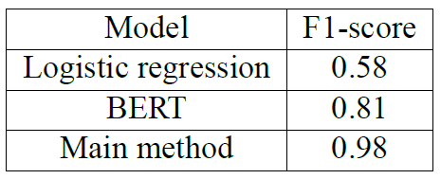
Results and discussion
7
Notes:
Phrases you may find useful:
The area of my research covers …
Today … has been already studied in the field.

Slide 8
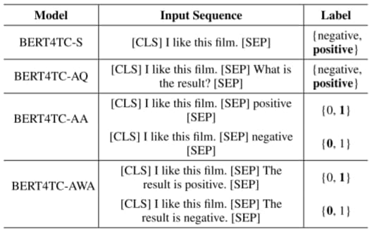
Results and discussion
8
Notes:
Phrases you may find useful:
The area of my research covers …
Today … has been already studied in the field.

Slide 9
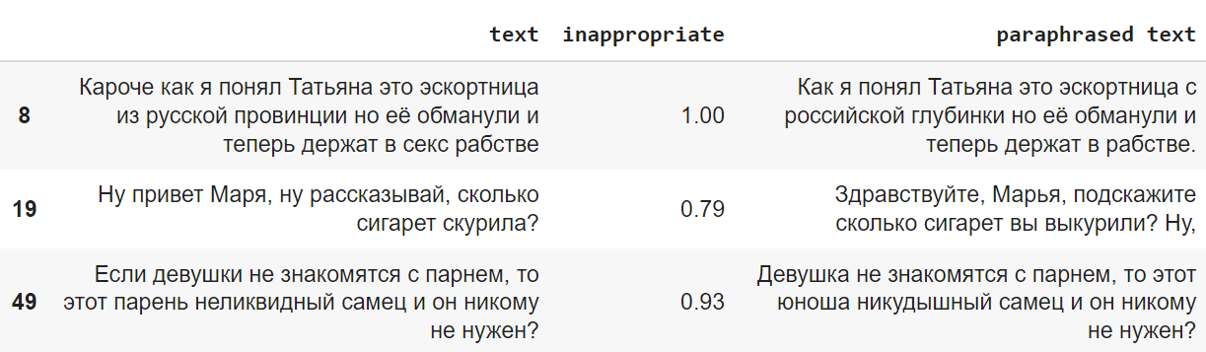
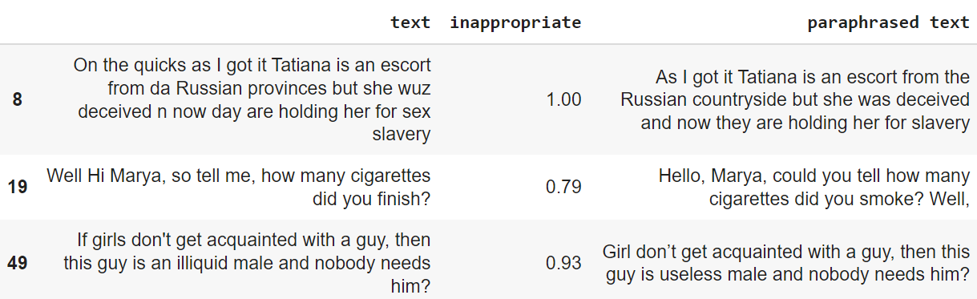
Results and discussion
9
Notes:
Phrases you may find useful:
The area of my research covers …
Today … has been already studied in the field.

Slide 10
Innovation
• Application in chatbots, apps, corporate discussion systems, etc.
10
Notes:
Phrases you may find useful:
The area of my research covers …
Today … has been already studied in the field.

Slide 11
Conclusion
• Classification and detoxification of inappropriate texts in Russian language
• Further improvements:
increase the accuracy of the models, especially, in the case of detoxification
11
Notes:
Phrases you may find useful:
The area of my research covers …
Today … has been already studied in the field.

Slide 12
Acknowledgements
• Dmitry Ilvovsky, Assistant Professor, HSE
• Zhenisbek Assylbekov, Assistant Professor, Nazarbayev University
12
Notes:
Phrases you may find useful:
The area of my research covers …
Today … has been already studied in the field.

