Slide 1

Android Application Development

Slide 2
Lesson 2
Control Flow Statements
Introduction
If Statement
If – Else Statement
If Else and Logical Operators
When Statement and Expression
For Loops
While Loops
Do-while Loops
Jump Expressions
  Break Statement
  Continue Statement
  Return Statement

Slide 3
Control Flow Statements
Operator | Name
== | Equal to
!= | Not Equal to
< | Less than
<= | Less than or equal to
> | Greater than
>= | Greater than or equal to

Slide 4
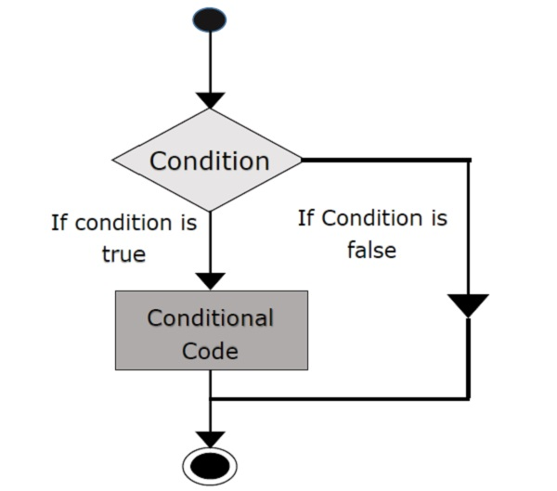
If Statement
The If statement is a programming conditional statement that, if proved true, executes the second part of the statement. Otherwise, if proved false the program will skip the execution of the second part and do something else.

Slide 5

If Statement
What is the run result of the following code ?
/**
* Created by Android ATC on 01/16/2018.
*/
fun main(args: Array<String>) {
var x=10
if (x>30)
println(" Hello, I am If statement running now ......")
println(" The End ")
}

Slide 6
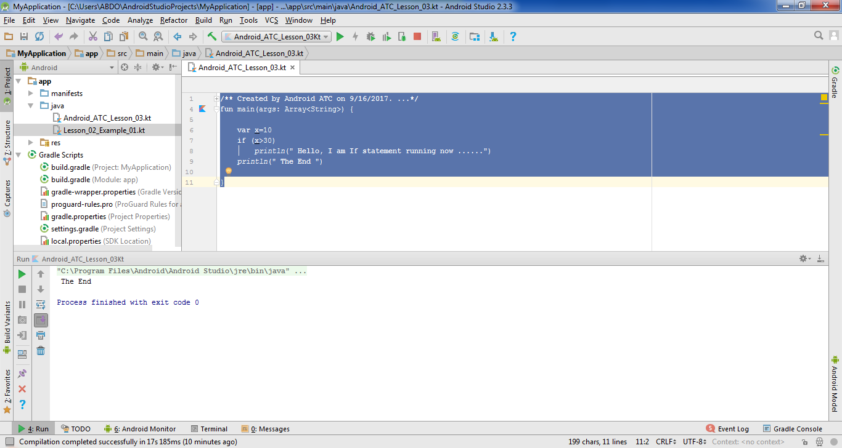
If Statement

Slide 7
If Statement
What is the run result of the following code ?
/**
* Created by Android ATC on 01/16/2018.
*/
fun main(args: Array<String>) {
var x=50
if (x>30)
println(" Hello, I am If statement running now ......")
println(" The End ")
}

Slide 8
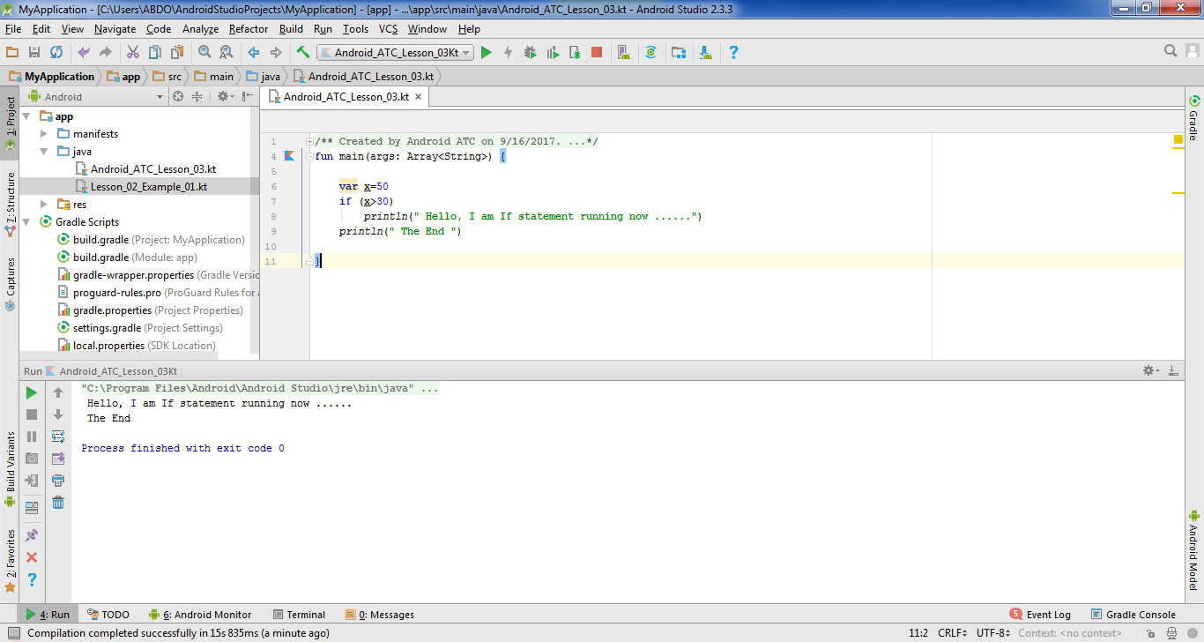
If Statement

Slide 9
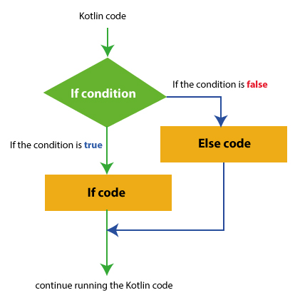
If - Else Statement
The if- else statement is the most basic of all the control flow statements. It tells your program to execute a specific section of a code only if a particular test proves to be true.

Slide 10
If - Else Statement
What is the run result of the following code ?
/**
* Created by Android ATC on 01/16/2018.
*/
fun main(args: Array<String>) {
var x=10
if (x>30)
println("Hello, I am If statement running now")
else
println("Hello, I am Else statement running now")
}

Slide 11
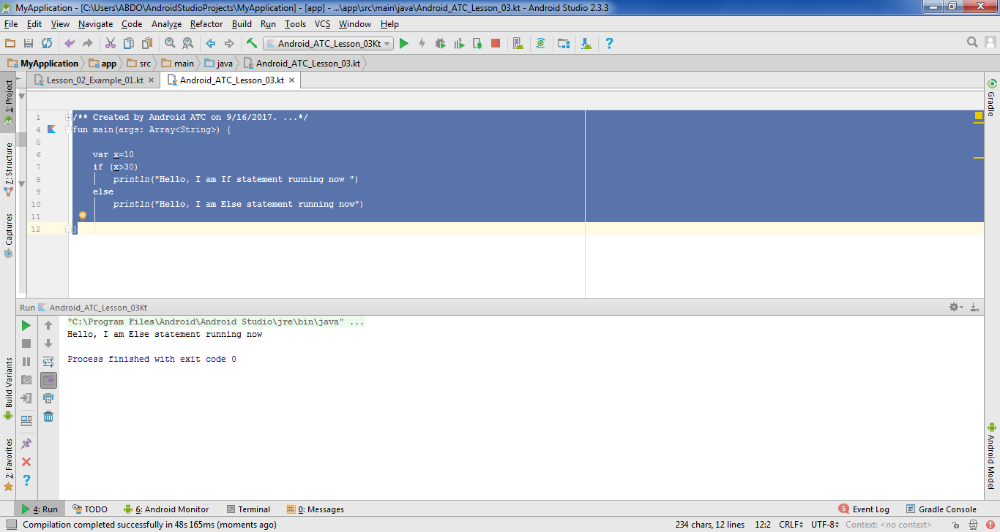
If - Else Statement

Slide 12
If…Else and Else…If... Statement
This statement is the most basic of all control flow statements. It tells your program to execute a certain section of code only if a particular test evaluates to be true.
An If-statement can be followed by an optional else-if-else statement. This is very useful when testing various conditions using a single if-else-if statement.

Slide 13
If…Else and Else…If... Statement
What is the run result of the following code ?
/**
* Created by Android ATC on 01/16/2018.*/
fun main(args: Array<String>) {
var score: Int = 80
var grade: String?=null
if(score >= 90) grade="Grade A"
else if (score >= 80 ) grade="Grade B"
else if (score >= 70 ) grade= "Grade C"
else if (score >= 50 ) grade= "Grade D"
else grade="Grade F"
println(grade)
}

Slide 14
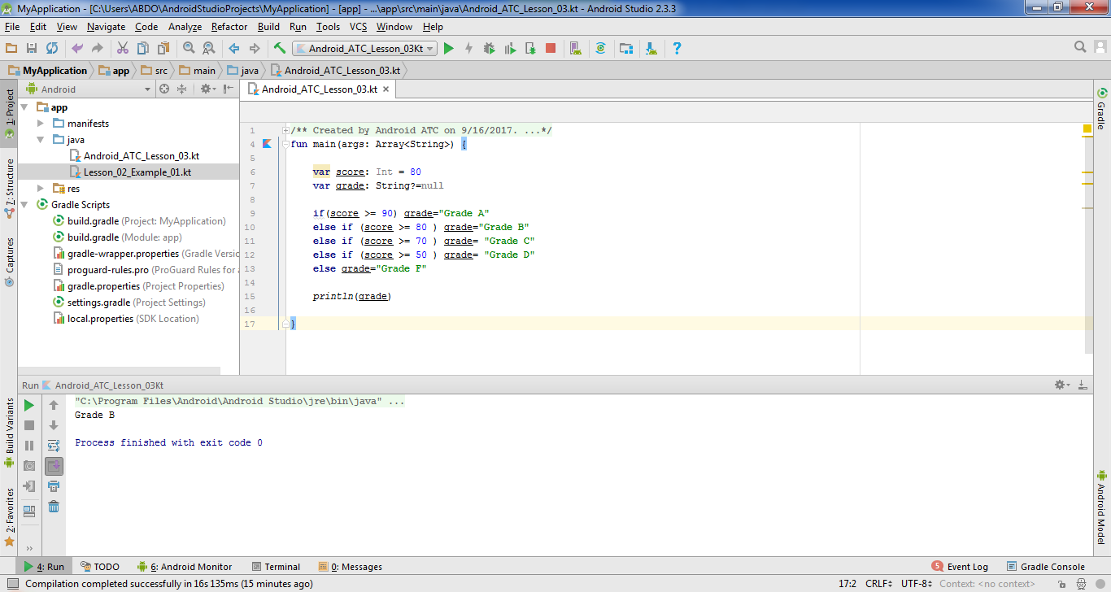
If…Else and Else…If... Statement

Slide 15
If…Else and Else…If... Statement
What is the run result of the following code ?
/**
* Created by Android ATC on 01/16/2018.*/
fun main(args: Array<String>) {
var score: Int = 40
var grade: String?=null
if(score >= 90) grade="Grade A"
else if (score >= 80 ) grade="Grade B"
else if (score >= 70 ) grade= "Grade C"
else if (score >= 50 ) grade= "Grade D"
else grade="Grade F"
println(grade)
}

Slide 16

If…Else and Else…If... Statement

Slide 17
If Else and Logical Operators
Logical operators like AND ”&&” and OR “| |” may be utilized within If Else statements. When you have two conditions (i.e. multiple Boolean expressions) where one condition should at least be satisfied, logical operators (i.e. IF statements) are used to test more than one condition at the same time.

Slide 18
If Else and Logical Operators
The following table displays the | | (OR) operator results (true or false) of the two Boolean expressions. These results will be considered by the IF statement:
Boolean Expressions (Condition): A | Boolean Expressions (Condition): B | A || B
True | True | True
True | False | True
False | True | True
False | False | False

Slide 19
If Else and Logical Operators
The following table displays the use of “&&” (AND) logical operator to guarantee that the two conditions are true:
Boolean Expressions (Condition): A | Boolean Expressions (Condition): B | A && B
True | True | True
True | False | False
False | True | False
False | False | False

Slide 20
If Else and Logical Operators
What is the run result of the following code ?
/**
* Created by Android ATC on 01/16/2018.
*/
fun main(args: Array<String>) {
var Age = 16
var DOB = 1998
if (Age >= 18 || DOB >= 1998) println("He is Authorized")
else println ("He is Not Authorized")
}

Slide 21
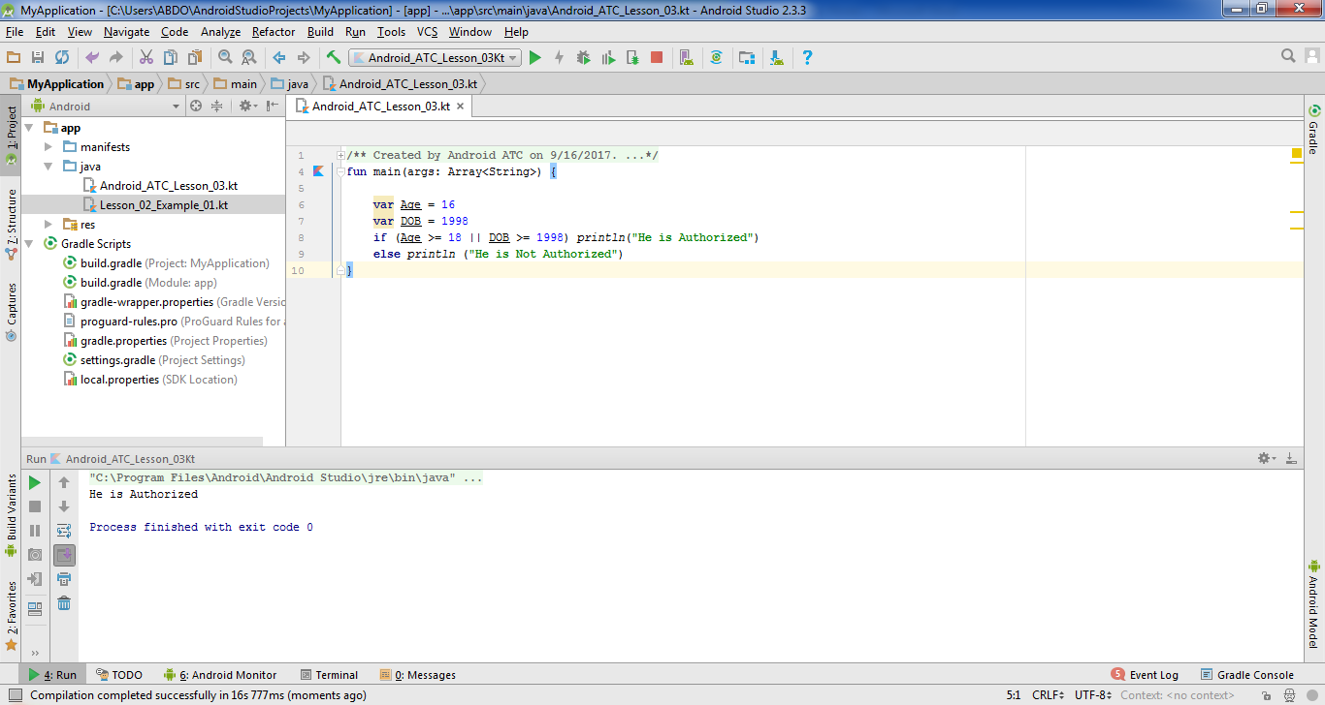
If Else and Logical Operators

Slide 22
If Else and Logical Operators
What is the run result of the following code ?
/**
* Created by Android ATC on 01/16/2018.
*/
fun main(args: Array<String>) {
var Age = 16
var DOB = 1998
if (Age >= 18 && DOB >= 1998) println("He is Authorized")
else println ("He is Not Authorized")
}

Slide 23
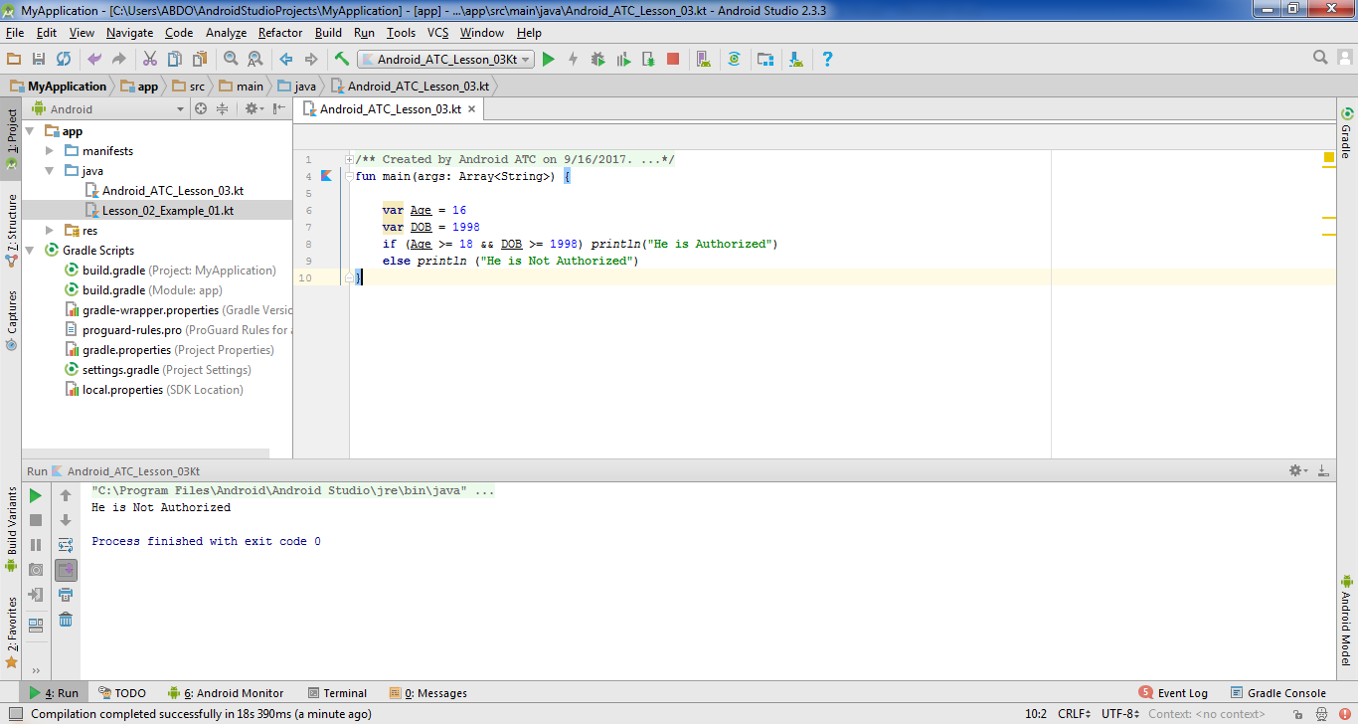
If Else and Logical Operators

Slide 24
When Statement and Expression
When statement is similar to the switch statement in other programming languages such as Java & C++. The when statement can have a number of possible execution paths.
When using When statements, we can put three options and if none of them is true, Android Studio will perform the action related to the else statement. Thus, using when statement enables you to use many conditions for the same variable.

Slide 25
When Statement and Expression
What is the run result of the following code ?
/**
* Created by Android ATC on 01/16/2018.
*/
fun main(args: Array<String>) {
println("=========== Pizza Order ==============")
println("Enter the Pizza Size : 1=> Small Size, 2=> Medium Size, 3=> Large Size")
var size= readLine()!!.toInt()
var price:Int?? =null
when (size) {
1-> price=5
2-> price=7
3-> price=10
else->println("You did not enter the correct size")
}
println("Total Price = $price" +" USD")
}

Slide 26
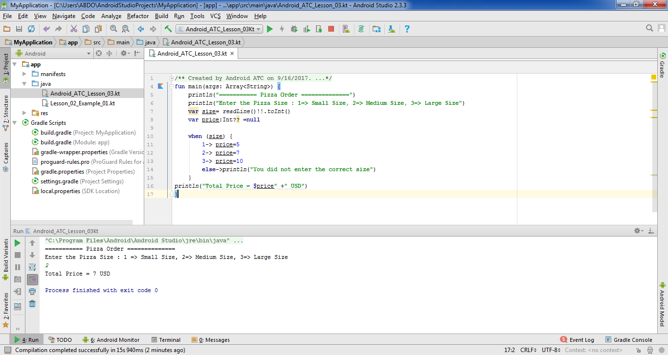
When Statement and Expression

Slide 27
For Loops
A for statement provides a compact way to iterate over a range of values. Programmers often refer to it as the “for-loop” because of how it repeatedly loops until a particular condition is satisfied.

Slide 28
For Loops
What is the run result of the following code ?
fun main(args: Array<String>) {
for (x in 0..5) {
println("x=$x")
}
}

Slide 29

For Loops

Slide 30
For Loops
What is the run result of the following code ?
fun main(args: Array<String>) {
var y=10
for (x in 0..y) {
println("x=$x")
}
}

Slide 31
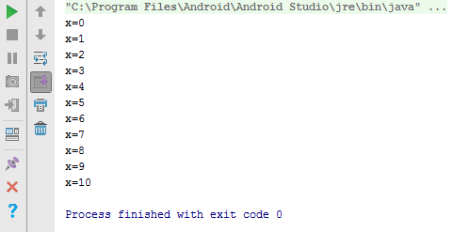
For Loops

Slide 32
For Loops
What is the run result of the following code ?
var x =arrayOf(10,20,30,40,50)
fun main (args :Array<String>){
for (index in 0..4){
println(x[index])
}}

Slide 33
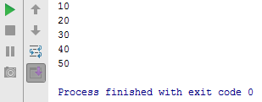
For Loops

Slide 34
For Loops
What is the run result of the following code ?
var x =arrayOf(10,20,30,40,50)
fun main (args :Array<String>){
for (index in 0..x.size){
println(x[index])
}}

Slide 35
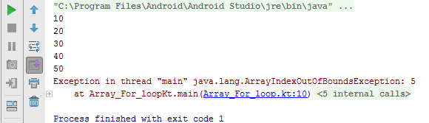
For Loops
The warning message in the run result shows that the array size is 5 and the “for” loop goes from 0 to 5 (i.e. 6 times)

Slide 36

For Loops
To solve this error , we can modify the code as follows:
var x =arrayOf(10,20,30,40,50)
fun main (args :Array<String>){
for (index in 0..x.size-1){
println(x[index])
}}

Slide 37
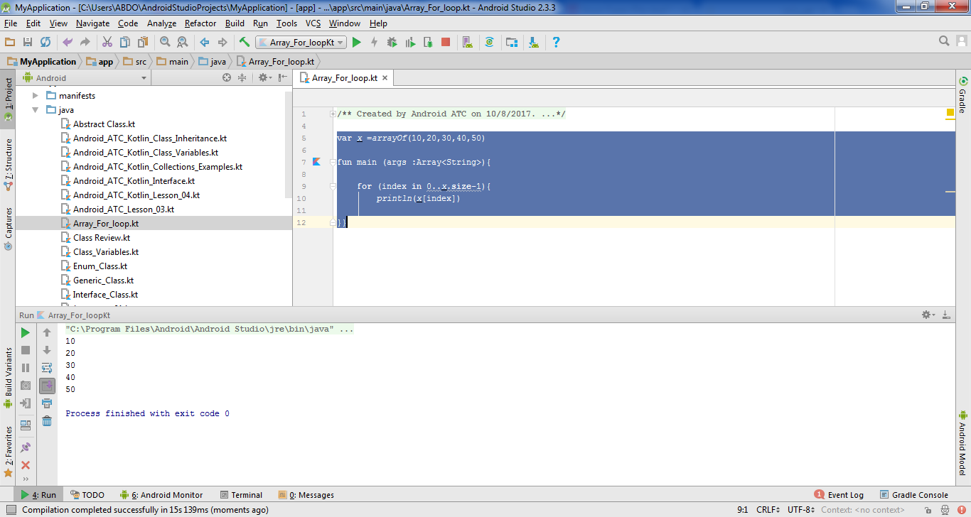

For Loops
The run result after modifying the code is as follows:

Slide 38
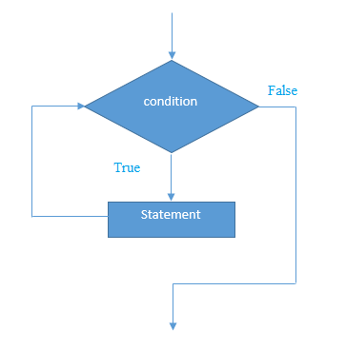
While Loops
A while-statement depends on a Boolean expression and its counter. If the expression proves to be true, the while-statement executes the statement(s) in the while block. The while-statement continues testing the expression and executing its loop until the expression is proved false.

Slide 39
While Loops
What is the run result of the following code ?
/**Created by Android ATC on 01/16/2018. */
fun main(args: Array<String>) {
var x=1
while (x<=5)
{
println("x= $x")
x++
// this is the counter for the loop means x=x+1 i.e. increment x by 1 each time
}
}

Slide 40
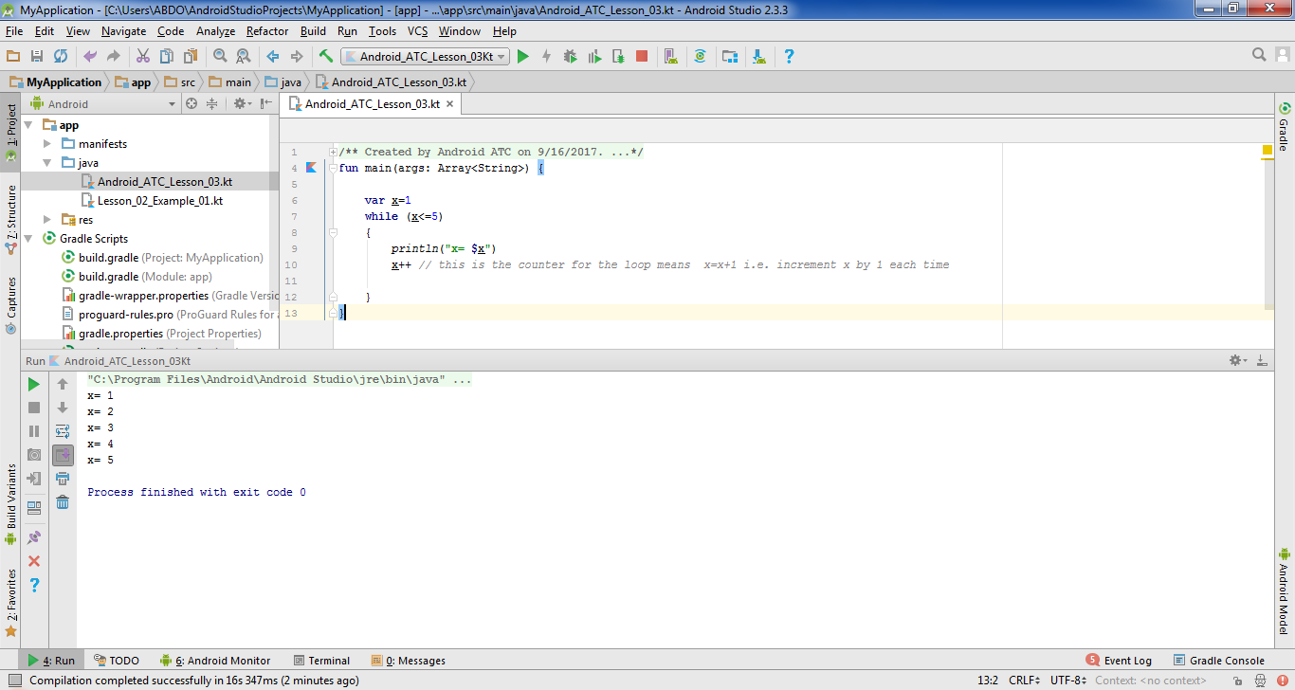
While Loops

Slide 41
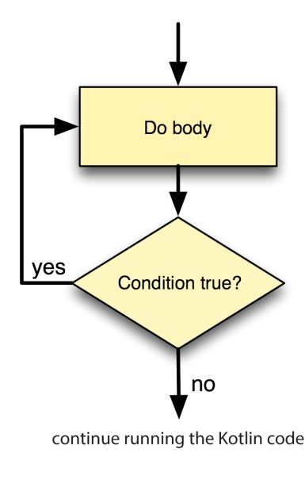
Do-while Loops
Contrary to the while-loop, the do-while loop starts evaluating its expressions from the bottom and not from the top.
The following figure displays the work flow of the Do-while loop:

Slide 42
Do-while Loops
What is the run result of the following code ?
  /**Created by Android ATC on 01/16/2018.*/
  fun main(args: Array<String>) {
  var x=1
  do {
  println("x= $x")
  x++ // this is the counter for the loop means x=x+1
  }
  while (x<=5)
  }

Slide 43
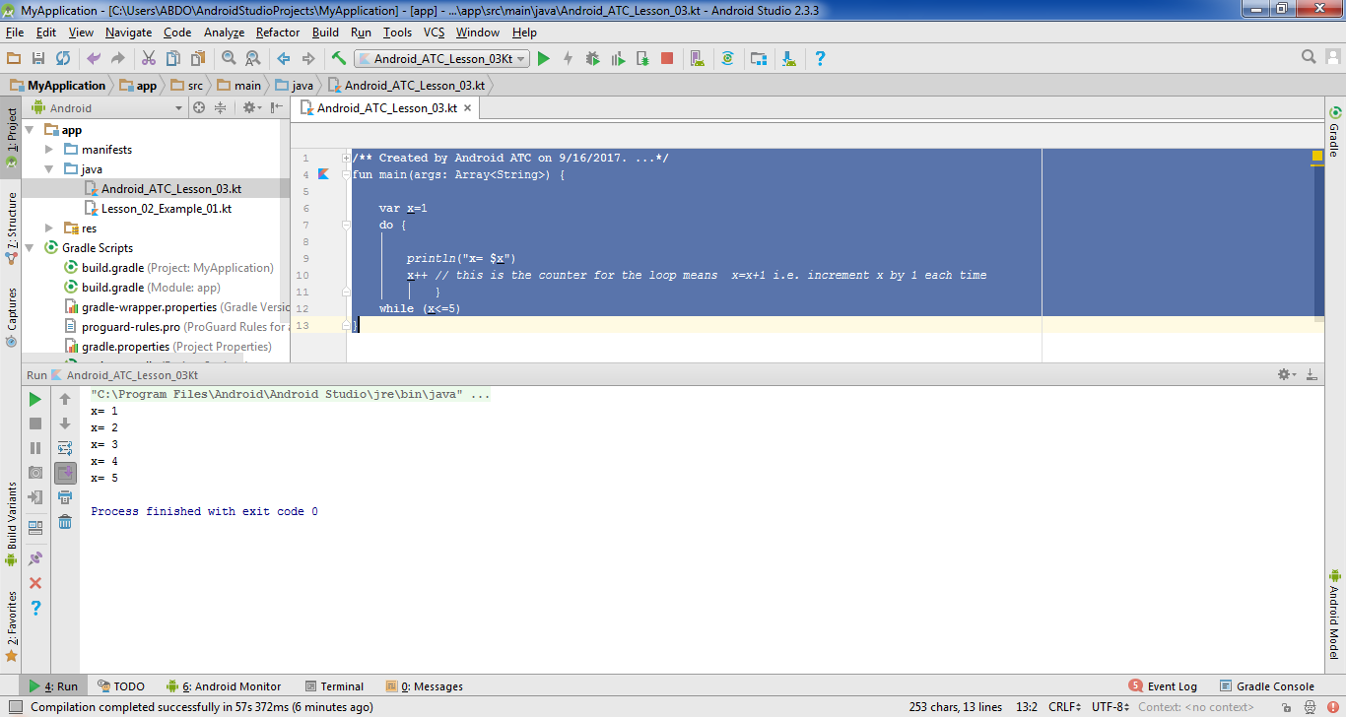
Do-while Loops

Slide 44
Jump Expressions
Kotlin has three structural jump expressions:
Break Statement
Continue Statement
Return Statement

Slide 45
Break Statement
The break statement allows you to exit a loop at any point, and overpass its normal termination expression.
When the break statement is encountered inside a loop, the loop is immediately terminated, and resumes its work starting from the statement that follows the loop. The break statement can be used in any type of loop such as the While, do-While, or for-loop.

Slide 46
Break Statement
What is the run result of the following code ?
/**Created by Android ATC on 01/16/2018.*/
fun main(args: Array<String>) {
var x=1
do {
println("x= $x")
x++ // this is the counter for the loop means x=x+1
if(x==3) break
}
while (x<=5)
}

Slide 47
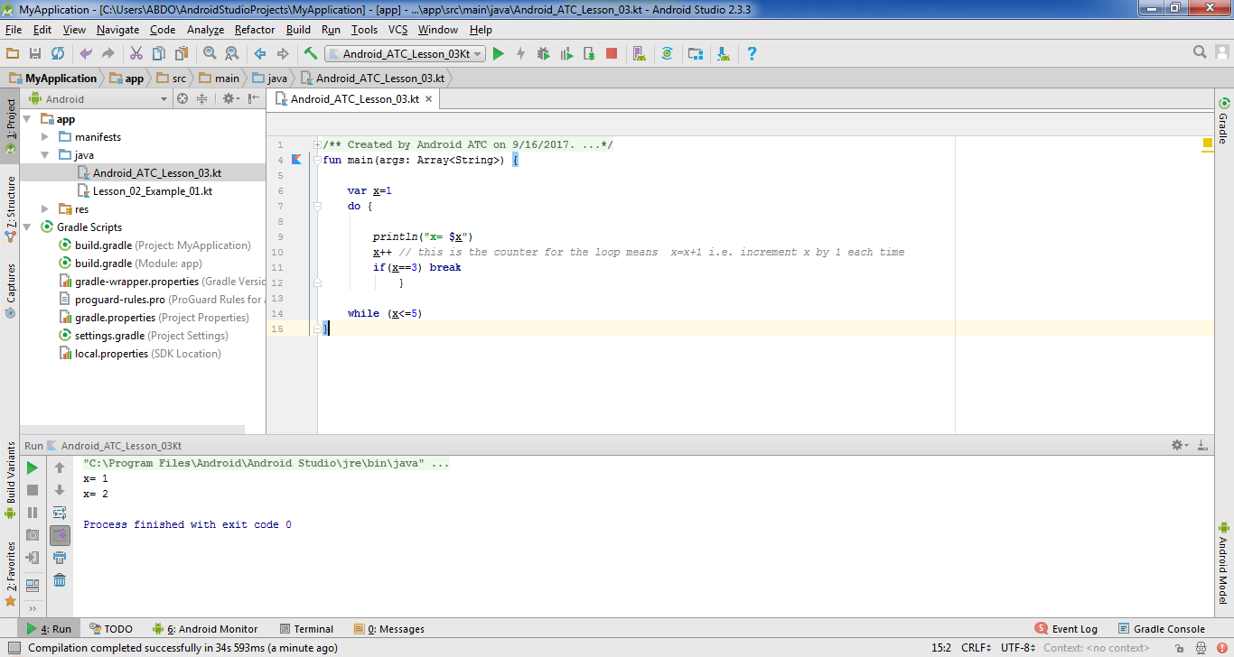
Break Statement

Slide 48
Continue Statement
The continue statement lets control go directly to the test condition and then continue the looping process. In the case of the for-loop, the increment part of the loop continues.
One good use of a continue-statement is when you want to restart or skip a statement sequence when an error occurs.

Slide 49
Continue Statement
What is the run result of the following code ?
/**Created by Android ATC on 01/16/2018.*/
fun main(args: Array<String>) {
var x=0
do {
x++
if(x==3) {continue}
println("x= $x")
}
while (x<=5)
}

Slide 50
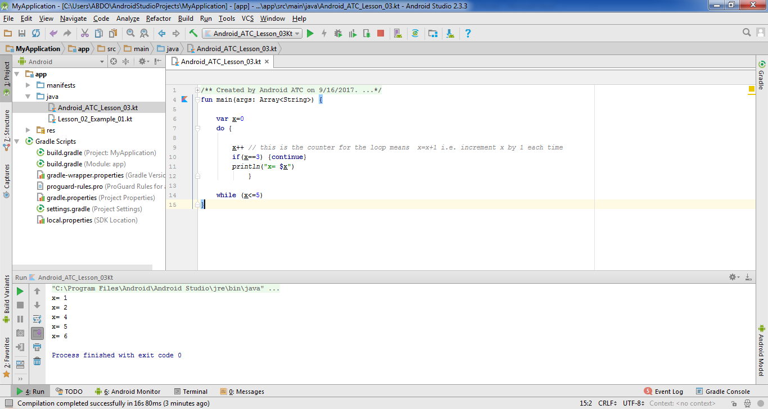
Continue Statement

Slide 51
Return Statement
The return statement will be discussed later in the book with other related topics,

Slide 52


What is a program?
ⓘ Start presenting to display the poll results on this slide.

Slide 53
Which of the following do you need to create a Kotlin program that prints a line of text?
ⓘ Start presenting to display the poll results on this slide.

Slide 54
Which keyword do you use to define a function in Kotlin?
ⓘ Start presenting to display the poll results on this slide.

Slide 55
What do you expect this Kotlin code to do? \n fun main(args: Array<String>) {
println("Hello, world!")
println("It's a sunny and warm day!")
}
ⓘ Start presenting to display the poll results on this slide.

Slide 56
Which of these options correctly calls the function, below, and passes it valid input arguments? \n fun createMessage(name: String, location: String, age: Int) {
println("My name is ${name}. I am from ${location}, and I am ${age} years old.")
}
ⓘ Start presenting to display the poll results on this slide.

Slide 57


