Slide 1

Android Application Development
Android v 12.x

Slide 2
Thank you for joining us today.
We’ve worked together with Android ATC to bring you a world-class learning experience, comprising:
Android ATC certified instructor. Your instructor is a premier technical and instructional expert who meets ongoing certification requirements.
Customer Satisfaction Guarantee. Android ATC offers a satisfaction guarantee and we are accountable for it. At the end of the course, please complete an evaluation of your experience. We value your feedback!
Certification Benefits. After training, consider pursuing an Android Certification, to help distinguish your technical expertise and experience. Ask our team about available exam promotions and discounts.
We wish you a great learning experience and ongoing career success!

Slide 3

Android Certified Trainer
Trainer Name
Trainer technical and professional experience

Slide 4



Course Book
Covers a wide range of Android development topics.
Includes step-by-step lab exercises to build Android applications.

Slide 5
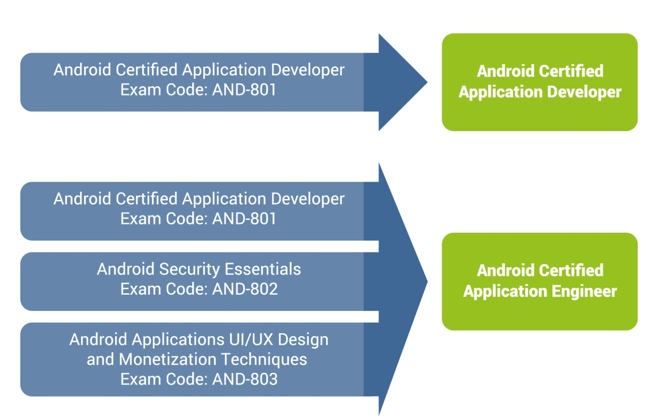
Exams and Certificates

Slide 6
Facilities
Class hours
Office hours
Rest rooms
Parking

Slide 7

Course Outline

Slide 8
Lesson 1
Introduction to Kotlin
Kotlin History
Kotlin Advantages
How Kotlin Programs Work
Kotlin Software Prerequisites
Installing Android Studio
Creating Kotlin Project Using Android Studio
Creating a Kotlin Program
Running a Kotlin Program
Writing Comments
Kotlin Variables
Kotlin Data Types
Input of Information to Kotlin Program

Slide 9
Lesson 2
Control Flow Statements
Introduction
If Statement
If – Else Statement
If Else and Logical Operators
When Statement and Expression
For Loops
While Loops
Do-while Loops
Jump Expressions
  Break Statement
  Continue Statement
  Return Statement

Slide 10
Lesson 3
Functions & Object-Oriented Programming
Functions
  Function Structure
  Creating a Function
  Functions and Variable Scope
Object-Oriented Programming
Object
Class
  Creating a Class
  Abstract Class
  Interface Class
  Generic Class
  Enum Class
  Class Variables
  Member Variables
Kotlin Collections

Slide 11
Lesson 4
Android Framework and Android Studio
Introduction
Android Platform Architecture
Android Libraries
Components of Android Application
Types of Android processes and their priorities
Android Application Development
  Android SDK platform
  Integrated Development Environment (IDE)
  Android Studio
  Gradle
  Instant Run
Lab 4: Creating Your First Application
  Create your first Android application
  Create an Android Virtual Device
  Build a “Simple Calculator” Application

Slide 12
Lesson 5
Creating User Interface
Introduction
Android Project Structure
View
Creating User Interface
  Add a text box
  Add an Image
  Add Check Box
  Add Radio Button
Lab 5: Creating a Pizza Order Application
  Create Your Application User Interface
  Configure the Android Application Code
  Run Your Application

Slide 13
Lesson 6
Android Layouts, Styles, Theme and Menus
Views
Layouts
  Constraint Layout
  Linear Layout
  Relative Layout
  TableRow Layout
  Frame Layout
  ScrowView Layout
Android Styles and Themes
  Android Styles
  Android Themes
App Manifest
Lab 6: Android Application Layouts, Styles, and Themes
  Create Your Application Layout
  Configure Your Styles and Themes
  Configure Your App Icon

Slide 14
Lesson 7
Toasts, Activities, Navigations, and Views
Context Class
Toast Class
  Positioning Your Toast
What is an Activity?
Activity Lifecycle
Android Intent
  Navigating Between Activities
  Passing Data Between Activities
Android Views
  ListView
  RecyclerView
Lab 7: Configuration of Android RecyclerView
  Adding a RecyclerView to an Activity
  Creating Your RecyclerView Adapter
  Adding Data to Your RecyclerView
  Adding Event Listeners to Each RecyclerView Row

Slide 15
Lesson 8
Android Dialogs, Snackbar, Menus, WebView and Notifications
Android Dialogs
  Alert Dialog
  ProgressBar
  SeekBar
  Date Picker Dialog
  Time Picker Dialog
Snackbar
Menus
WebView
Android Notifications
  Creating an Android Notification
  Notification Channel
Lab 8: Configuring Android Web Browser, Menu, and Notification
  Configuring Android Web Browser
  Adding Android Menu
  Creating a notification channel and a notification message

Slide 16
Lesson 9
Android Storage, SQLite and Content Providers
Android Storage Options
Shared Preferences
Internal Storage
External Storage
Network Connection
SQLite Databases
Content Providers
Sync Adapters
ORMLite
Choosing Internal or External Storage
Lab 9: SQLite Databases and Content Providers
  Creating an SQLite database
  Querying an SQLite DB Table
  Creating a Content Provider
  Utilizing ORMLite Library

Slide 17
Lesson 10
Location-Aware Apps: Using GPS and Google Maps
What is GPS and how does it work
Other Location Service Providers
Configuring Google Maps
  Map Fragment
  Getting a Google API key
  Adding a Google Map Marker
  Methods to Capture a User’s Location
  Reverse Geolocation and Geocoder Class
JSON and API
Lab 10: Location-Aware Apps Using a GPS and Google Maps
  Creating an App Interface
  Getting a Google API key
  Configuring Your App to Use Your API Key
  Configuring User App’s Permission
  Capturing Users’ Location
  Finding the Nearest Restaurants to a User’s Current Location

Slide 18
Attendance Certificate
To get your attendance certificate from Android ATC, you need to fill out the attendance certificate application form on the following link: http://www.androidatc.com/attendance
The “Book reference” available in your book is required and your training center will supply you with the “Attendance key”.
Course and training evaluation constitute an essential part of ensuring the quality of the Android ATC courses. Your feedback is absolutely important for Android ATC to improve delivery and training programs. Once you have completed the evaluation form, your attendance certificate will be sent to you by email.
Note: Attendance key is given to trainees who attend 80% attendance of the course as minimum.

