Slide 1

Android Application Development

Slide 2
Lesson 3
Functions & Object-Oriented Programming
Functions
  Function Structure
  Creating a Function
  Functions and Variable Scope
Object-Oriented Programming
Object
Class
  Creating a Class
  Abstract Class
  Interface Class
  Generic Class
  Enum Class
  Class Variables
  Member Variables
Kotlin Collections

Slide 3
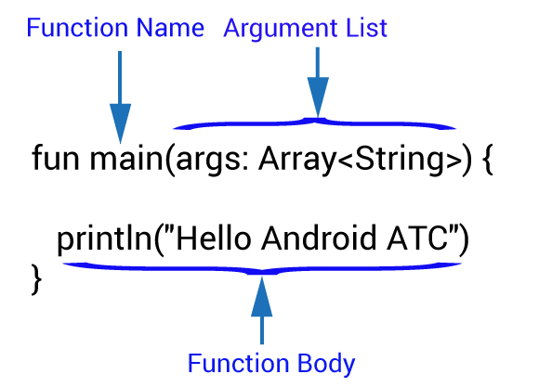
Functions
A function is any close identity which includes a certain code or a collection of statements grouped together to perform an operation. Each function has a unique name which is used to call this function inside the Kotlin program several times without the need to duplicate statements in multiple source code files.
Function Structure :

Slide 4

Creating a Function
What is the run result of the following code ?
fun main(args: Array<String>) {
println("Hello Android ATC")
}
fun sum (x:Int, y:Int)
{
var z=x+y
println("Sum Result =$z")
}

Slide 5

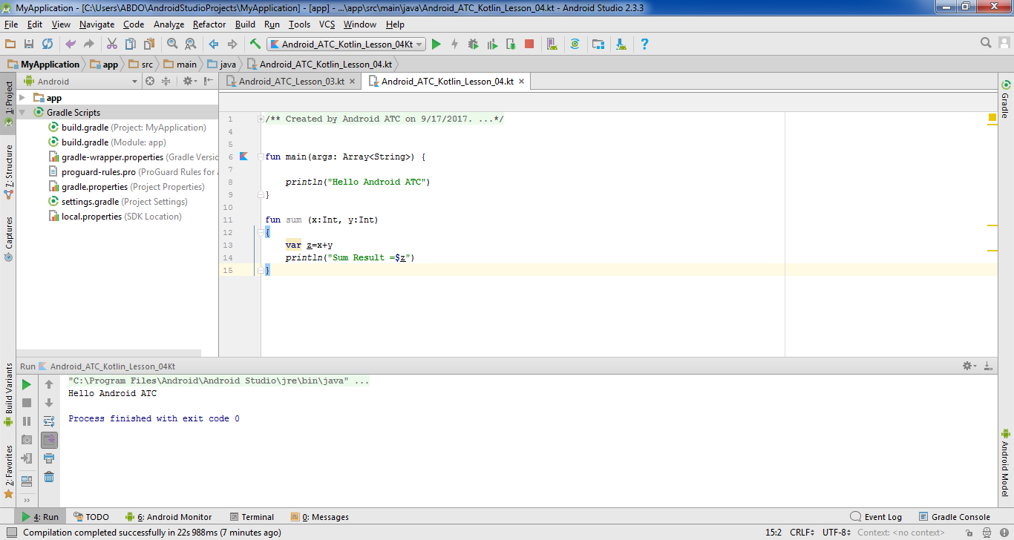
Creating a Function
When you run the Kotlin code in this example, only the code inside the main function will be executed. The result is shown in the following snapshot:

Slide 6
Creating a Function
What is the run result of the following code ?
fun main(args: Array<String>) {
println("Hello Android ATC")
sum (2,3)
}
fun sum (x:Int, y:Int)
{
var z=x+y
println("Sum Result =$z")
}

Slide 7
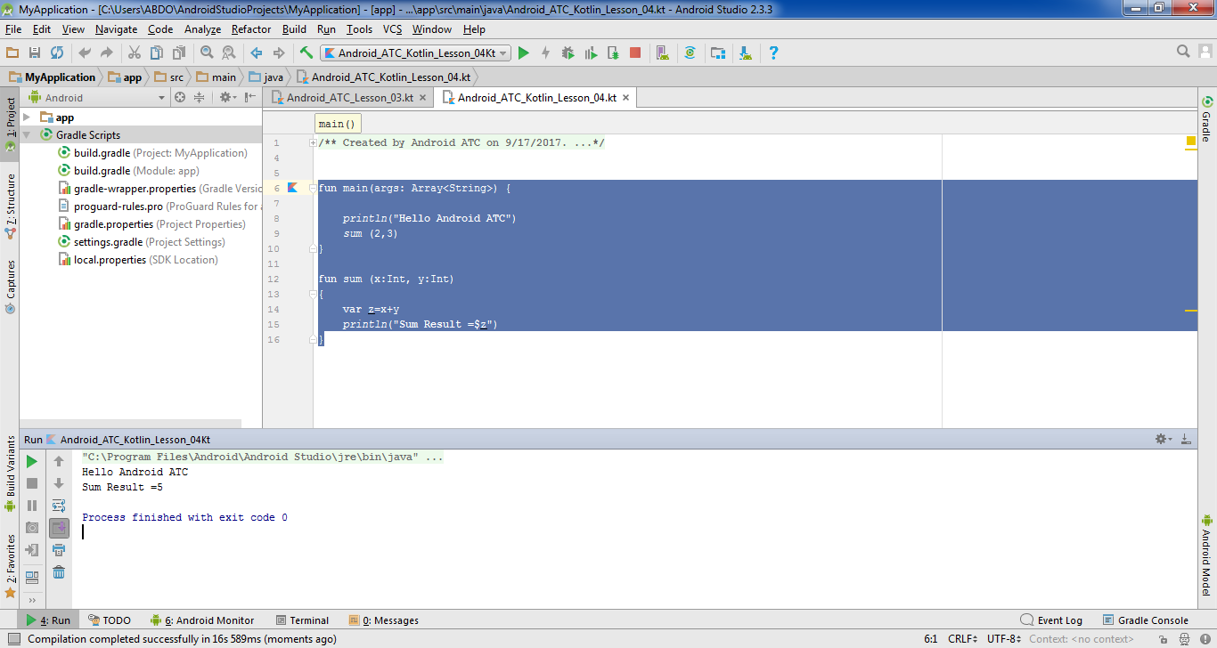

Creating a Function

Slide 8
Creating a Function
What is the run result of the following code ?
fun main(args: Array<String>) {
println("Hello Android ATC")
var result=sum (2,3)
println("Result = $result")
}
fun sum (x:Int, y:Int) :Int
{
var z=x+y
return z
}

Slide 9
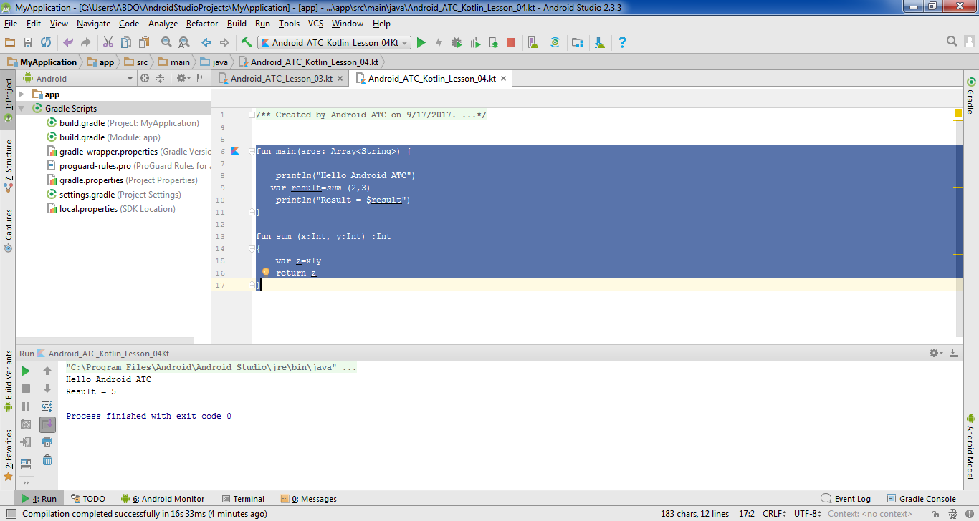
Creating a Function

Slide 10
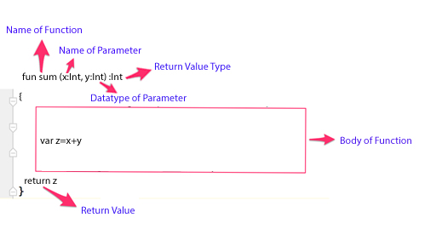
Creating a Function
The following image displays the function structure:

Slide 11
Creating a Function
What is the run result of the following code ?
fun main(args: Array<String>) {
var y= sales(4)
println(y)
}
fun sales (x:Int):Int
{
return 2*x
}

Slide 12
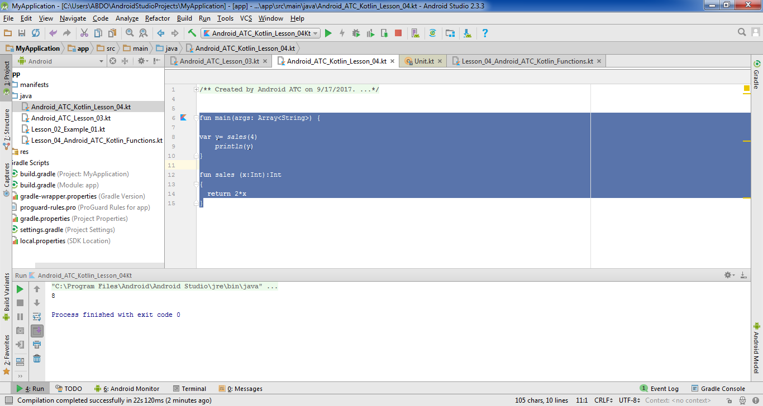

Creating a Function

Slide 13
Functions and Variable Scope
The location of variables - whether inside or outside the main function - has an important effect on the function's output. The following example displays how the program workflow will be affected if we change the location of variables inside or outside the functions:
var My_Company="Yahoo"
fun main(args: Array<String>) {
name("Android ATC")
}
fun name (My_Company:String) {
println("My Company Name is : $My_Company")
}

Slide 14
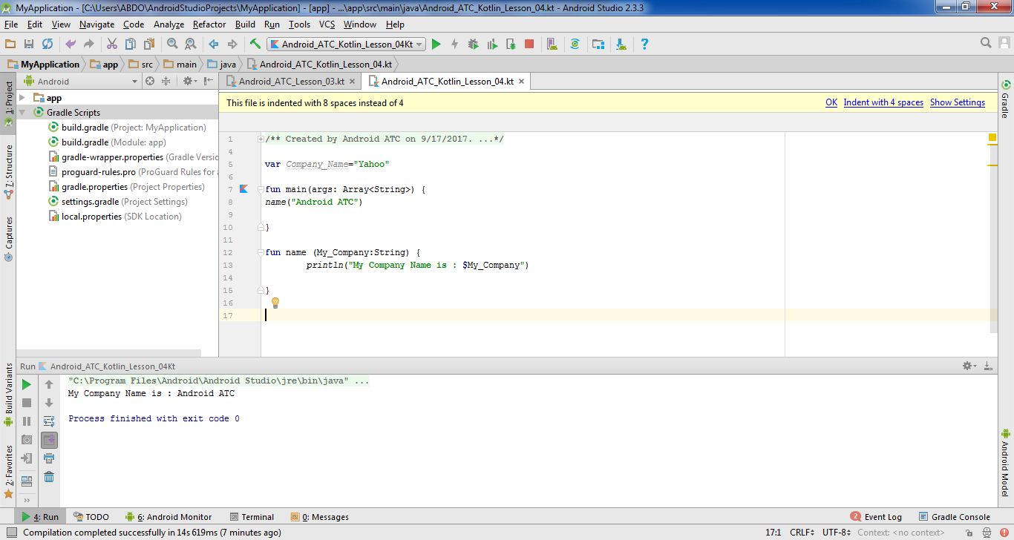
Functions and Variable Scope
The run result of this code is the following:

Slide 15
Functions and Variable Scope
What is the run result of the following code ?
fun main(args: Array<String>) {
name("Android ATC")
}
fun name (My_Company:String) {
var My_Company="Yahoo"
println("My Company Name is : $My_Company")
}

Slide 16
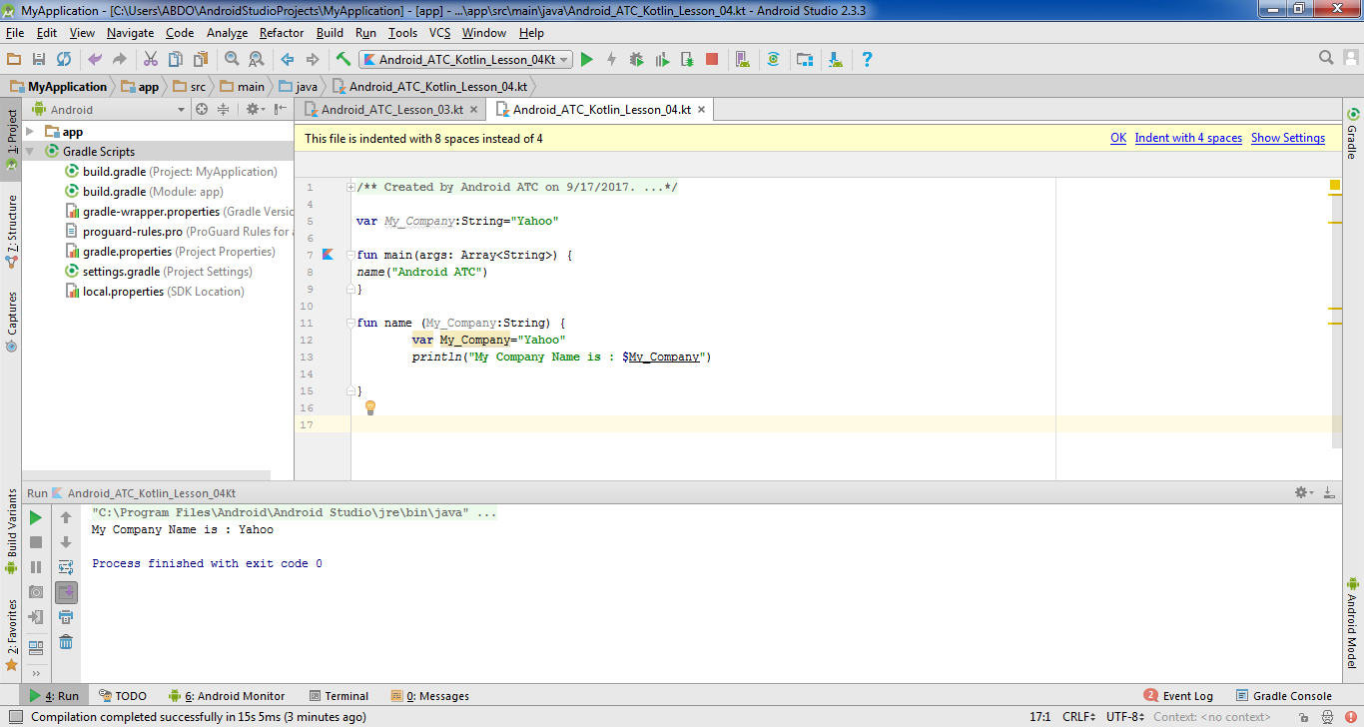
Functions and Variable Scope

Slide 17
Object-Oriented Programming (OOP)
If you have never used an object-oriented programming language before, you’ll need to learn the basic concepts before you can start coding. This lesson will introduce you to objects, classes, inheritance, interfaces, and packages. Each discussion focuses on how these concepts relate to the real world, while simultaneously providing an introduction to the syntax of the Kotlin programming language. Learning the basics of OOP is necessary before starting any Android application development.

Slide 18
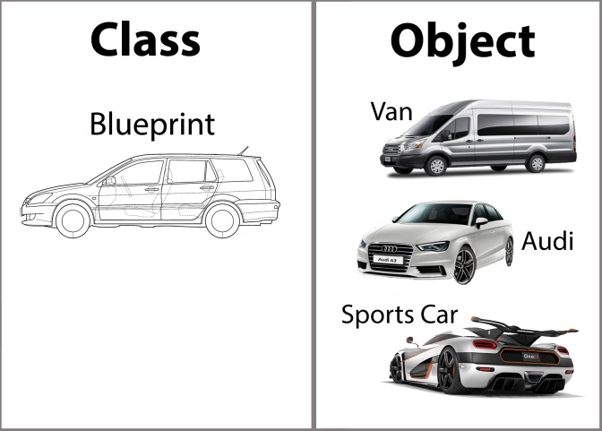
Object & Class

Slide 19

Creating a Class
class car
{
var type :String?=null
var maxspeed : Int?=null
var number_of_seats:Int?=null
}
fun main(args: Array<String>) {
var AndroidCar=car()
AndroidCar.type= "Toyota"
AndroidCar.maxspeed=200
AndroidCar.number_of_seats=4
println("Car Type: ${AndroidCar.type}")
println("Maximum Speed: ${AndroidCar.maxspeed}")
println("Number of Seats : ${AndroidCar.number_of_seats}")
}

Slide 20
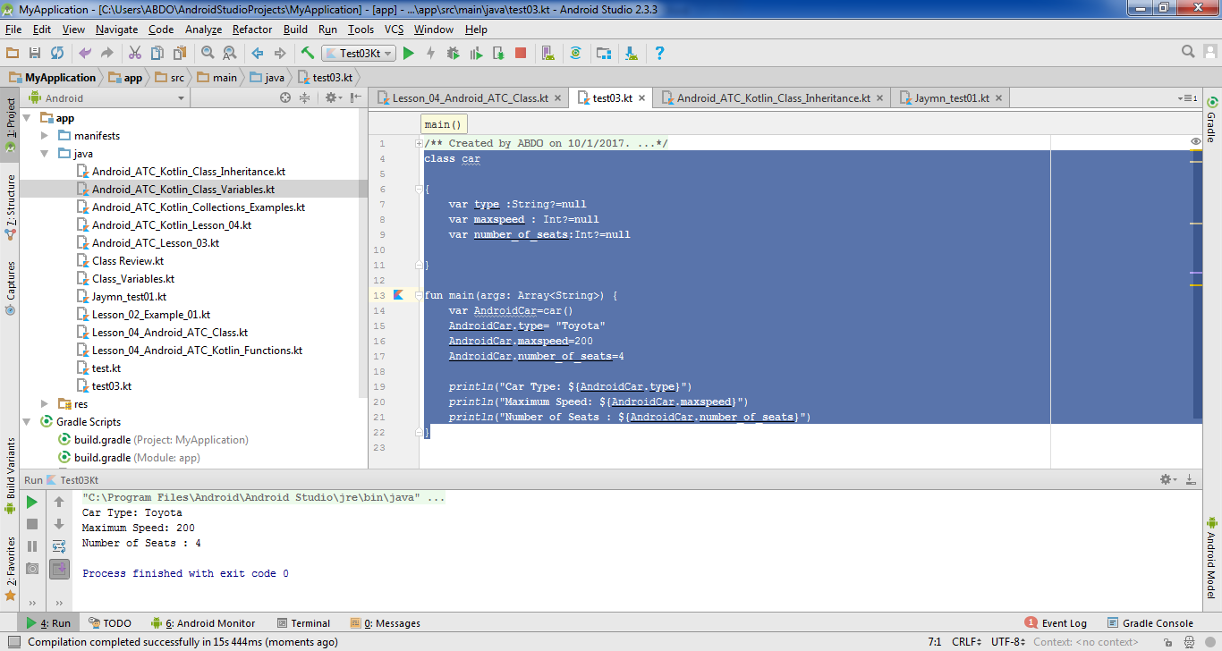
Creating a Class
The run result is displayed below:

Slide 21
/** Created by Android ATC on 01/16/2018.*/
class Student {
var Name: String? = null
var College: String? = null
var Age: Int? = null
constructor(Name: String, College: String, Age: Int) {
this.Name=Name
this.College=College
this.Age=Age
println("Name :"+ this.Name)
println("College :" +this.College)
println("Age : "+this.Age)
}
}
fun main (args: Array<String>) {
var ITStudent=Student("William","Business",19)
}

Slide 22
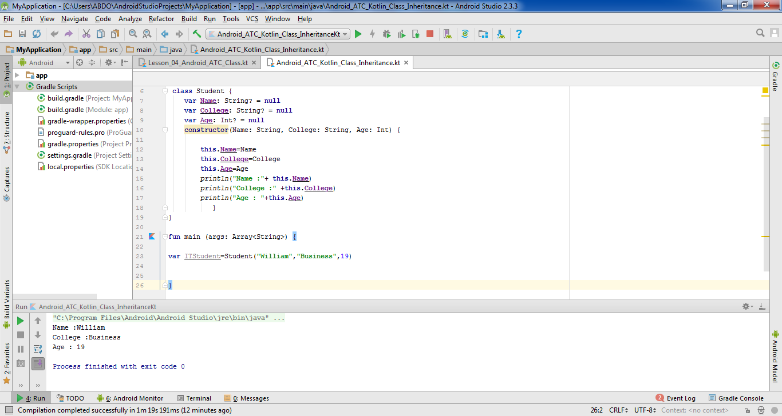
Creating a Class
The run result of this code is displayed below:

Slide 23
Class Inheritance
The idea of inheritance is simple but powerful. When you want to create a new class and there is already a class that includes some of the codes that you need, you can derive your new class from the existing class (called parent or super class). While doing this, you can reuse the properties and methods of the existing class without having to write them again.
Example:
class Teacher ():Student ()

Slide 24
open class Student() {
var Name: String? = null
var College: String? = null
var Age: Int? = null
constructor(Name: String, College: String, Age: Int):this() {
this.Name=Name
this.College=College
this.Age=Age
println("Name :"+ this.Name)
println("College :" +this.College)
println("Age : "+this.Age)
}
}
class Teacher ():Student ()
fun main (args: Array<String>) {
var IT_Teacher=Teacher()
IT_Teacher.Name ="George"
IT_Teacher.College="IT College"
println("Teacher Name: " +IT_Teacher.Name)
println("Teacher College: " +IT_Teacher.College)
}

Slide 25
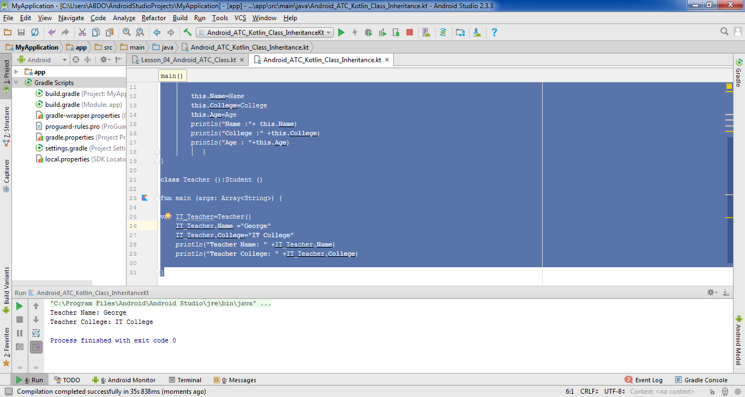
Class Inheritance

Slide 26
Overriding Properties
What is the run result of the following code ?
open class Computer {
var x: Int = 5
var y: Int = 11
}
class Tablet : Computer() {
}
fun main (args: Array<String>){
var laptop=Computer()
var machine=Tablet()
println(laptop.x)
println(machine.x)
println(laptop.y)
}

Slide 27
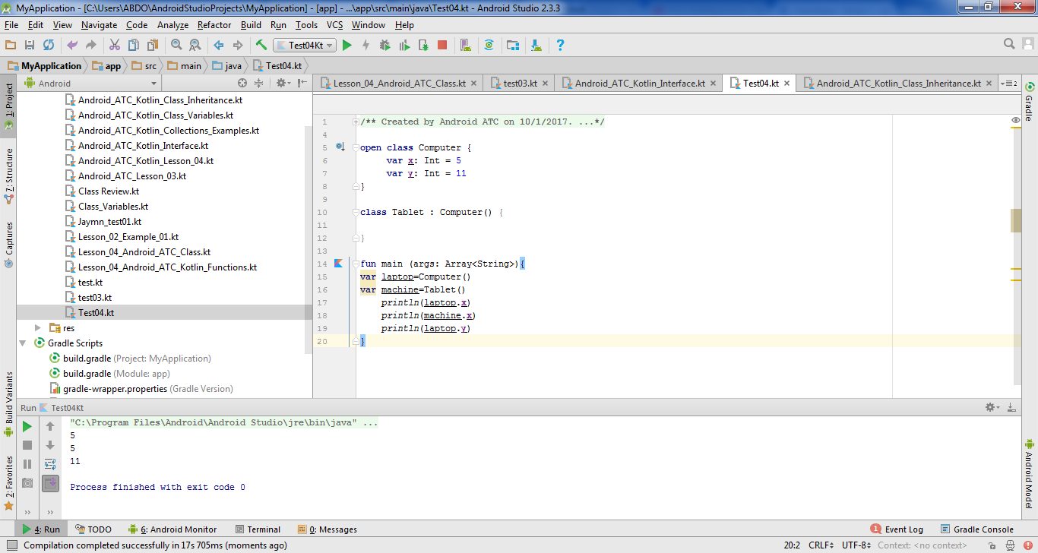
Overriding Properties

Slide 28
Overriding Properties
What is the run result of the following code ?
open class Computer {
open var x: Int = 5
var y: Int = 11
}
class Tablet : Computer() {
override var x:Int =20
}
fun main (args: Array<String>){
var laptop=Computer()
var machine=Tablet()
println(laptop.x)
println(machine.x)
println(laptop.y)
}

Slide 29
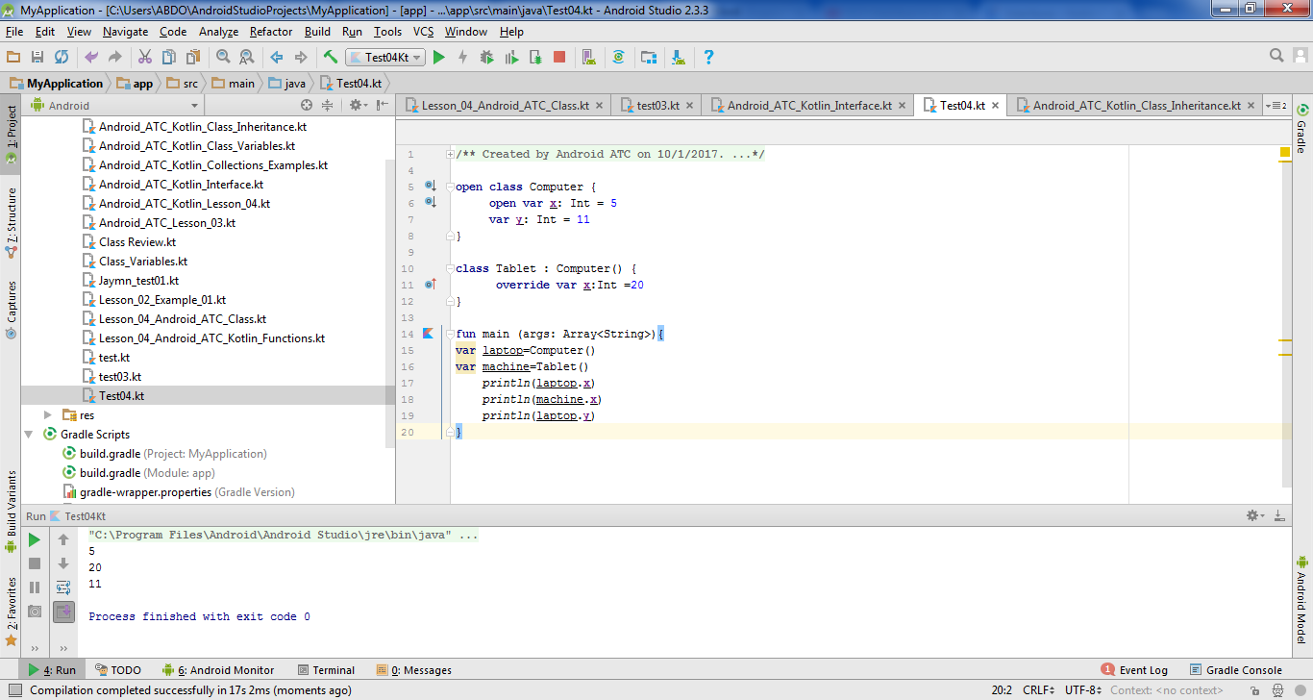
Overriding Properties

Slide 30
Abstract Class
A class is called abstract when at least one of its members does not have an implementation. It is the responsibility of the derived / child class to provide the implementation of the abstract members of the parent class. An abstract class needs to be qualified with the abstract keyword. An abstract class cannot be instantiated, and its only purpose is to be inherited. We do not need to annotate an abstract class or function with the open keyword.

Slide 31
What is the run result of the following code ?
abstract class ComputerCourse {
abstract fun courseprice()
abstract fun courseprerequisite()
}
class LanguageCourse():ComputerCourse() {
override fun courseprice() {
println("Course Price")
}
override fun courseprerequisite() {
println("Course Prerequisite")
}
}
fun main (args : Array<String>){
var x =LanguageCourse()
x.courseprerequisite()
x.courseprice()
}

Slide 32
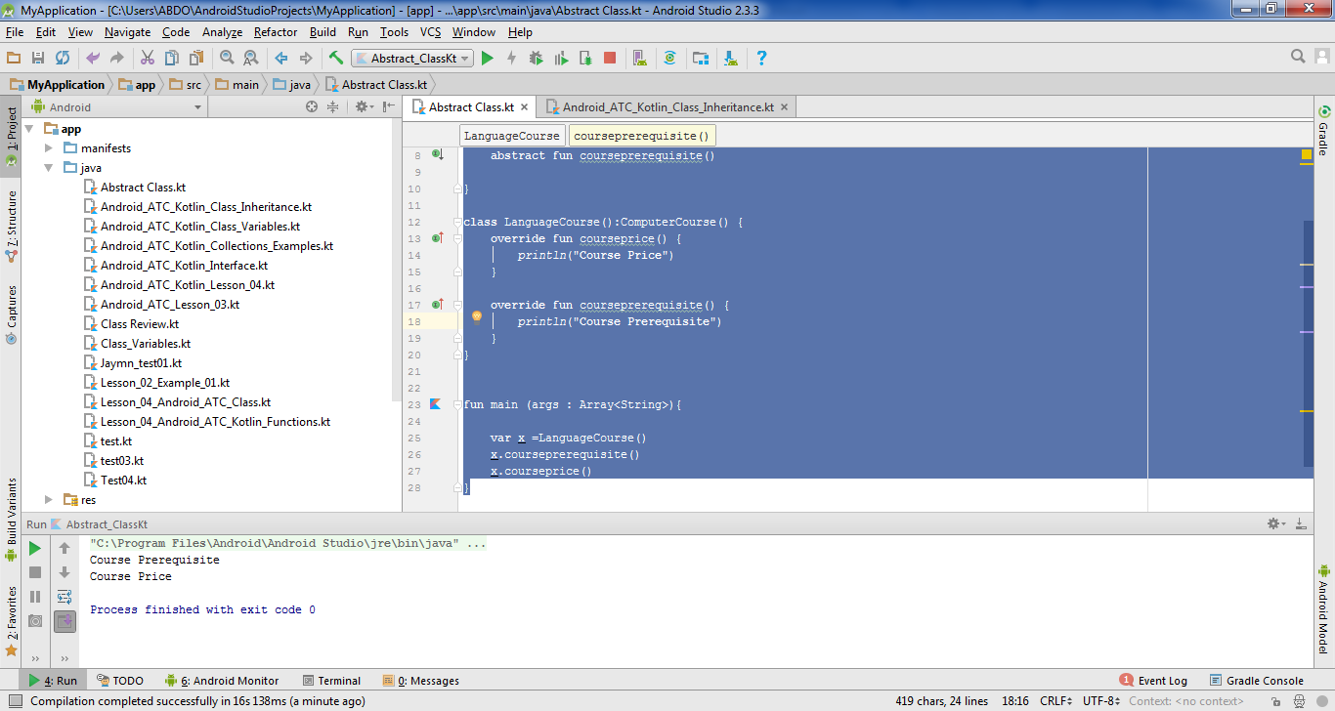
Abstract Class

Slide 33
Interface Class
An interface class is a class that consists of methods or functions without any implementations. You use an interface class when you need to use certain features of a class with another class. Here, the interface class becomes the parent class and the class which uses the features of the interface class is considered the child class.

Slide 34
interface Calc {
fun sum(x: Int, y:Int)
fun multiply(w:Int ,z:Int)
}
class Math1 :Calc {
override fun multiply(w: Int, z: Int) {
TODO("not implemented") //To change body of created functions use File | Settings | File Templates.
}
override fun sum(x: Int , y: Int) {
var sumtotal =x+y
println("Sum= $sumtotal")
}
}
class Math2:Calc {
override fun multiply(w: Int, z: Int) {
TODO("not implemented") //To change body of created functions use File | Settings | File Templates.
}
override fun sum(x: Int, y: Int) {
}
}
fun main (args :Array<String>){
var operation=Math1()
operation.sum(1,2)
}

Slide 35
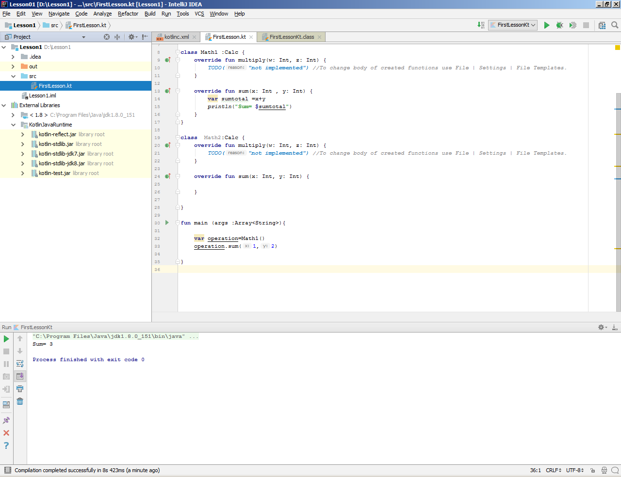
Interface Class
The run result of this code is:
We conclude that the interface class works as a main class without any implementation, and all subclasses whose implementation depends on the methods which belong to the interface class.

Slide 36
Generic Class
A generic class allows a single function to handle many types of different data as if there was a copy of the function defined for each data type. This reduces code duplication. As a result, you will be able to create various objects that have different types of data and content using the same generic class.

Slide 37
Generic Class
What is the run result of the following code ?
class Permission <T> {
var UserName:T?=null
var Password:T?=null
}
fun main (args :Array<String>){
var x =Permission<String> ()
x.UserName="William"
x.Password="Android"
println("User Name: ${x.UserName} & Password: ${x.Password}")
var y =Permission<Int> ()
y.UserName=2018
y.Password=123
println("User Name: ${y.UserName} & Password: ${y.Password}")
}

Slide 38
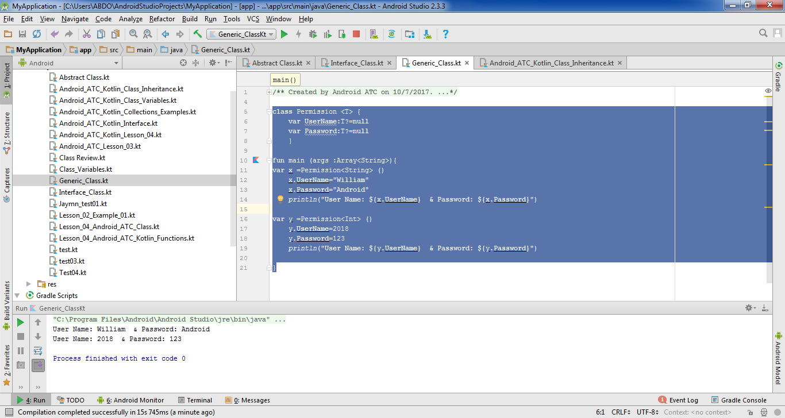
Generic Class
The run output of this code is the following:

Slide 39
Enum Class
An enum class is a special data type that enables a variable to be a set of predefined constants. The variable must be equal to one of the predefined values.

Slide 40
Enum Class
What is the run result of the following code ?
enum class Colleges {
ITCollege,
BusinessCollege,
ArtsCollege,
EngineeringCollege
}
fun main (args: Array<String>){
var major=Colleges.EngineeringCollege
println(major)
}

Slide 41
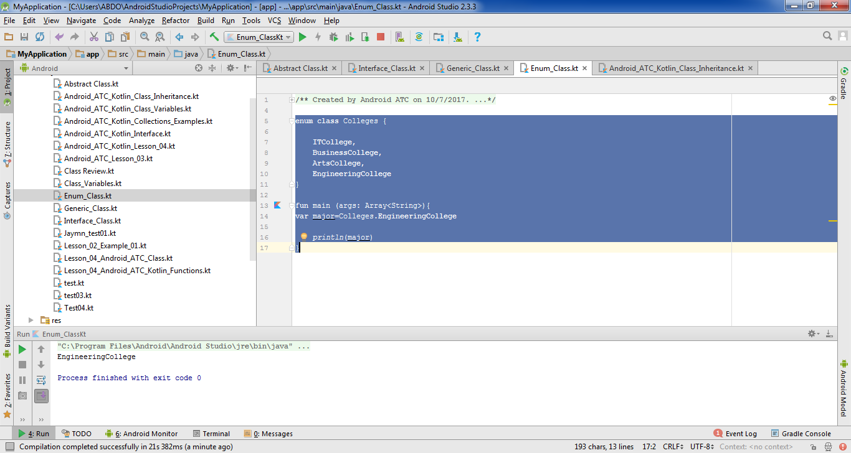
Enum Class

Slide 42
Member Variables
In Kotlin, we have three types of variables: public variables, private variables and protected variables.
1- Public variables
All variables are public by default (implicitly public) and are accessible from all classes.
2- Private variables
These variables are accessible only within their own class.
3- Protected variables
These variables are a version of public variables restricted only to subclasses. This means that only the current class and its subclasses will have access to the field or method of the protected class.

Slide 43
Class Hashmaps
This class uses a hash table to implement the Map interface. This saves the execution time of basic operations, such as get() and put(),to remain constant even for large sets.
Each value can be represented by a key. For example, the following hash table includes keys (any word) and the values they represent.
Key | Value
Ok | Okay
Y | Yes
a | Android
Abc | Google

Slide 44
Class Hashmaps
What is the run result of the following code ?
fun main (args :Array<String>){
var myhashmap =HashMap<String, String>()
myhashmap.put("Ok", "Okay")
myhashmap.put("Y", "Yes")
myhashmap.put("a", "Android")
myhashmap.put("Abc", "Google")
println(myhashmap.get("Ok"))
println(myhashmap.get("Y"))
println(myhashmap.get("a"))
println(myhashmap.get("Abc"))
}

Slide 45
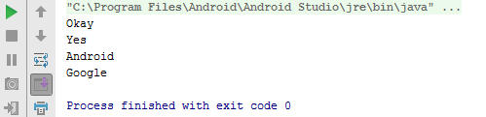
Class Hashmaps

Slide 46
Class ArrayList
The class arraylist Implements all optional list operations, and permits all elements, including null. In addition to implementing the List interface, this class provides methods to manipulate the size of the array that is used internally to store the list. Array lists are created with an initial size. When this size extends, the collection is automatically enlarged. When objects are removed, the array may shrink in size.

Slide 47
Class ArrayList
What is the run result of the following code ?
fun main (args :Array<String>){
var myArrayList=ArrayList<Int>()
myArrayList.add(20)
myArrayList.add(30)
myArrayList.add(50)
println(myArrayList)
}

Slide 48
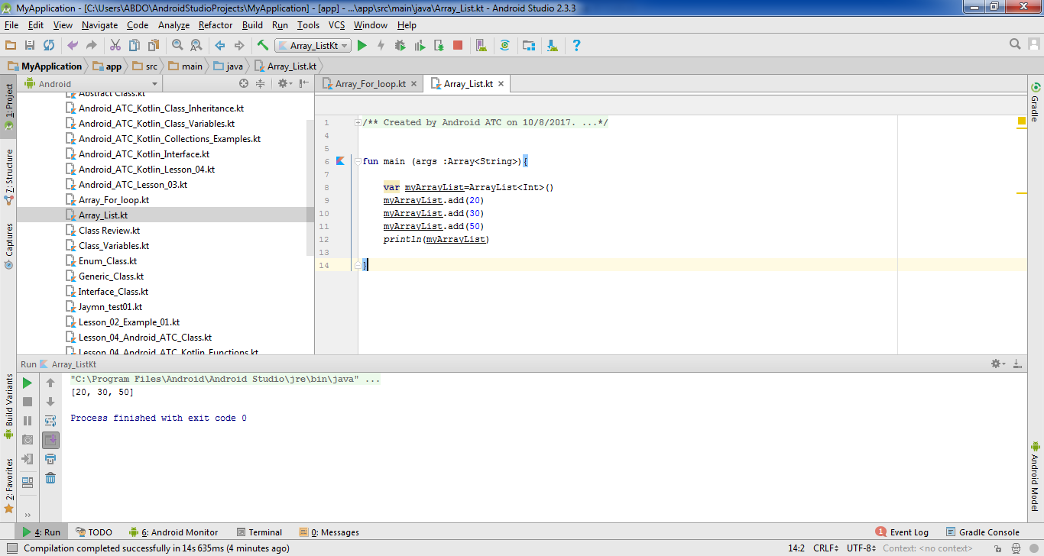
Class ArrayList

Slide 49
Class ArrayList
What is the run result of the following code ?
fun main (args :Array<String>){
var myArrayList=ArrayList<Int>()
myArrayList.add(20)
myArrayList.add(30)
myArrayList.add(50)
println(myArrayList.get(0))
}

Slide 50
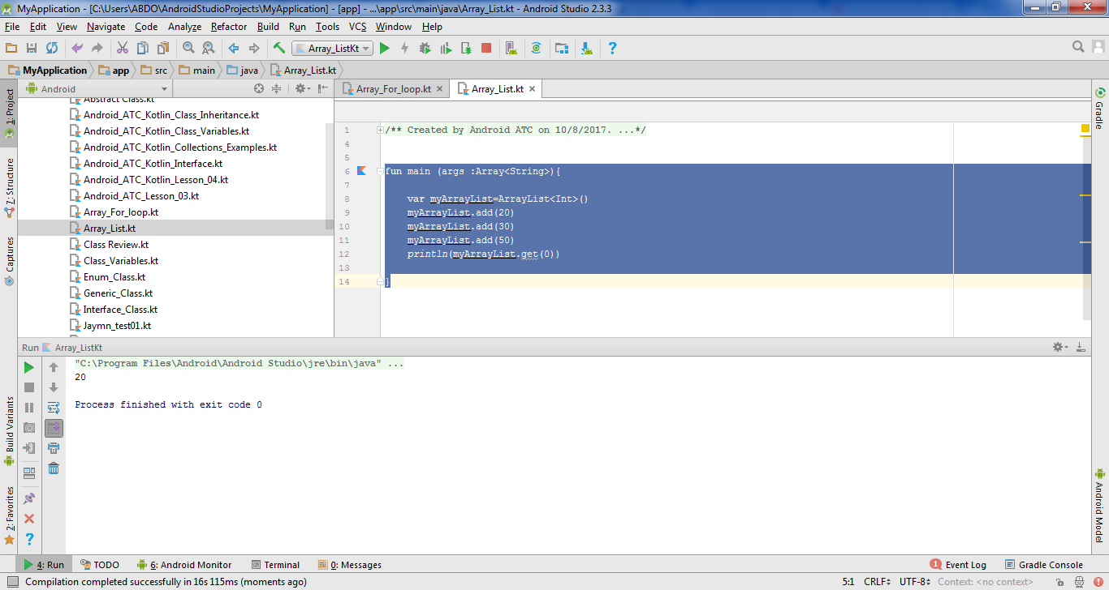
Class ArrayList

Slide 51
Class ArrayList
What is the run result of the following code ?
fun main (args :Array<String>) {
var myArrayList=ArrayList<Int>()
myArrayList.add(20)
myArrayList.add(30)
myArrayList.add(50)
for (number in myArrayList) {
println(number)
}
}

Slide 52
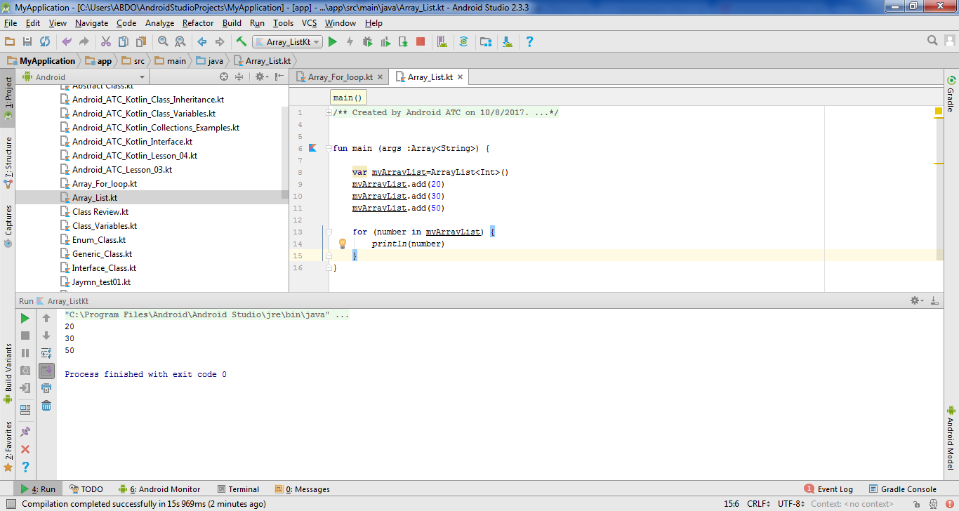
Class ArrayList

Slide 53


