Slide 1

Android Application Development

Slide 2
Lesson 4
Android Framework and Android Studio
Introduction
Android Platform Architecture
Android Libraries
Components of Android Application
Types of Android processes and their priorities
Android Application Development
  Android SDK platform
  Integrated Development Environment (IDE)
  Android Studio
  Gradle
  Instant Run
Lab 4: Creating Your First Application
  Create your first Android application
  Create an Android Virtual Device
  Build a “Simple Calculator” Application

Slide 3
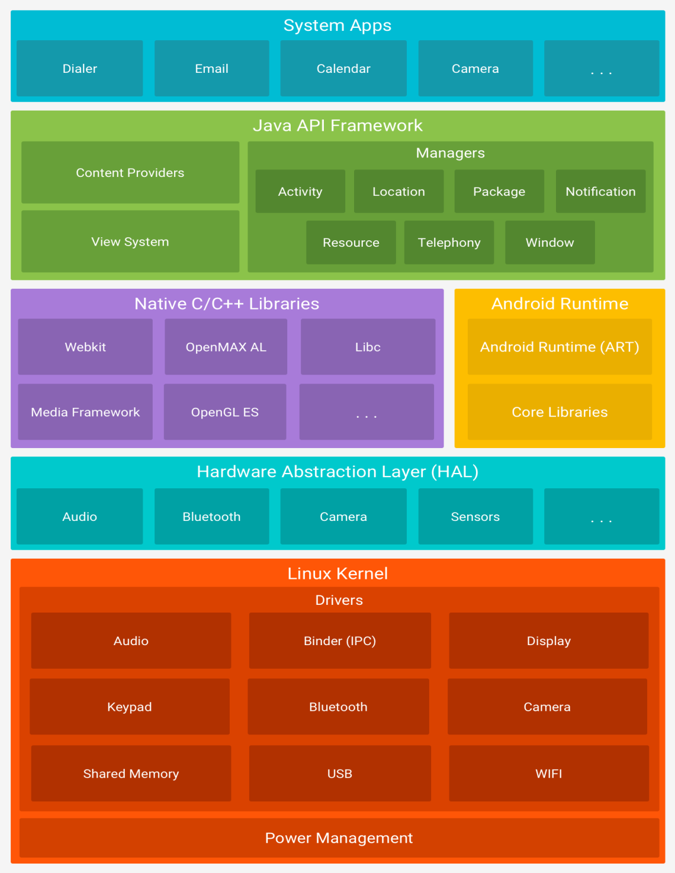
Android Platform Architecture

Slide 4
Components of Android Applications
Activities
Activity is the application’s user interface. Every screen in an application extends the activity class. The user interface for each activity is made up of several Views.
Services
A service is the invisible part of the application that runs in the background. Service doesn’t have any user interface of its own. Services are used to perform continuous processing in the background even when activities are not visible or active.
Content Providers
Content providers are used to manage and share application databases. They are the preferred way of sharing data between applications. You may also write your content provider to share your application’s data with other apps. For example, Android exposes some databases such as contacts and call logs using content providers.

Slide 5
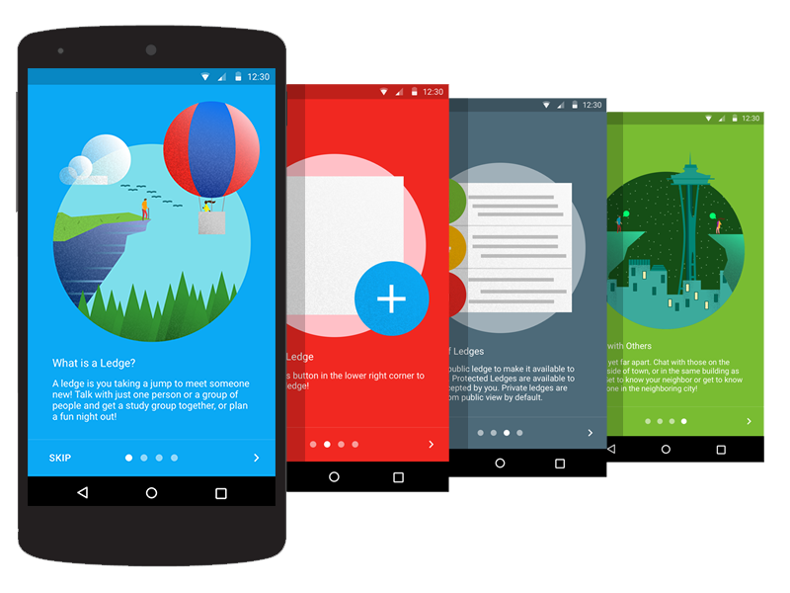
Components of Android Applications
Broadcast Receivers
Broadcast Receivers are used to receive messages broadcasted by Intents. When a broadcast receiver is added to your application for any specific Intent, then whenever that Intent occurs, your application will receive a message which has data from that Intent.
Views
Views are objects that are drawn on the screen. A view is the parent class of all activity user interface components. Each activity is made up of a set of views grouped together within a layout.

Slide 6
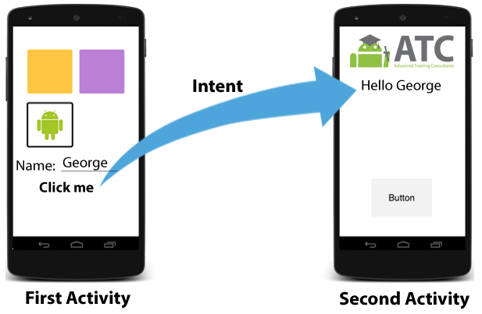
Components of Android Applications
Intents
Intents are objects used to send messages across the whole Android system. They are used to broadcast messages, start an activity, or start a service, including an intention to have an action performed. It’s the system’s duty to interpret the message and determine the target(s) that will perform the actions required.

Slide 7
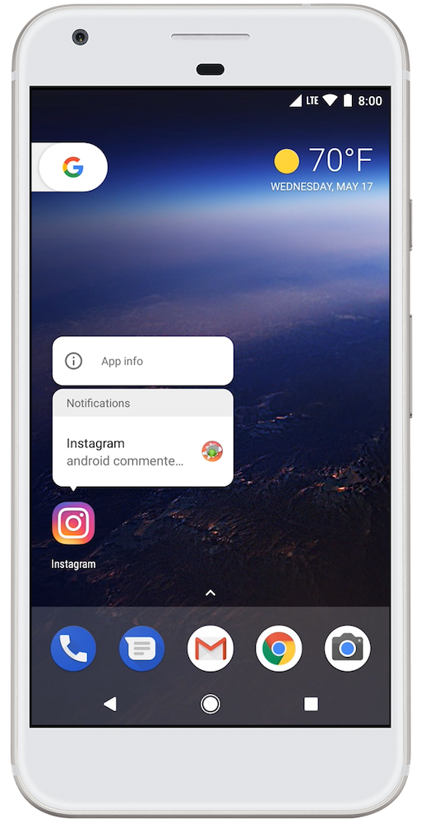
Components of Android Applications
Notifications
Notifications are used to alert the user of an event without stealing the focus or interrupting the user’s ongoing interaction or activity. That's why they appear on the status bar at the top of the screen. They are popup style messages from other applications such as Instagram or Facebook.
Examples of notifications can be notifications of received SMS, missed calls or notifications from any other application installed on the device. With Android O (Android 8) notifications are now part of the operating system.
Later in this course, there will be a separate lesson about notifications and the new various features and capabilities which Android 8 has added for users and developers.

Slide 8
Types of Android processes and their priorities
1- Foreground Process
2- Visible Process
3- Service Process
4- Background Process
5- Empty Process

Slide 9
Android Application Development
Android SDK platform
Android SDK platform is a set of libraries and APIs that provide necessary classes, methods and interfaces to develop Android applications and allow you to compile your code.
Integrated Development Environment (IDE)
This is the official IDE for developing Android applications. You will use Android Studio throughout this course.
Android SDK Tools: A software component that includes a complete set of development and debugging tools for Android SDK.
Android SDK build tools: This is the software component that is required to build an Android application code after a developer finishes building the application. The built tools are continuously running during development to facilitate the testing process for the developer.

Slide 10
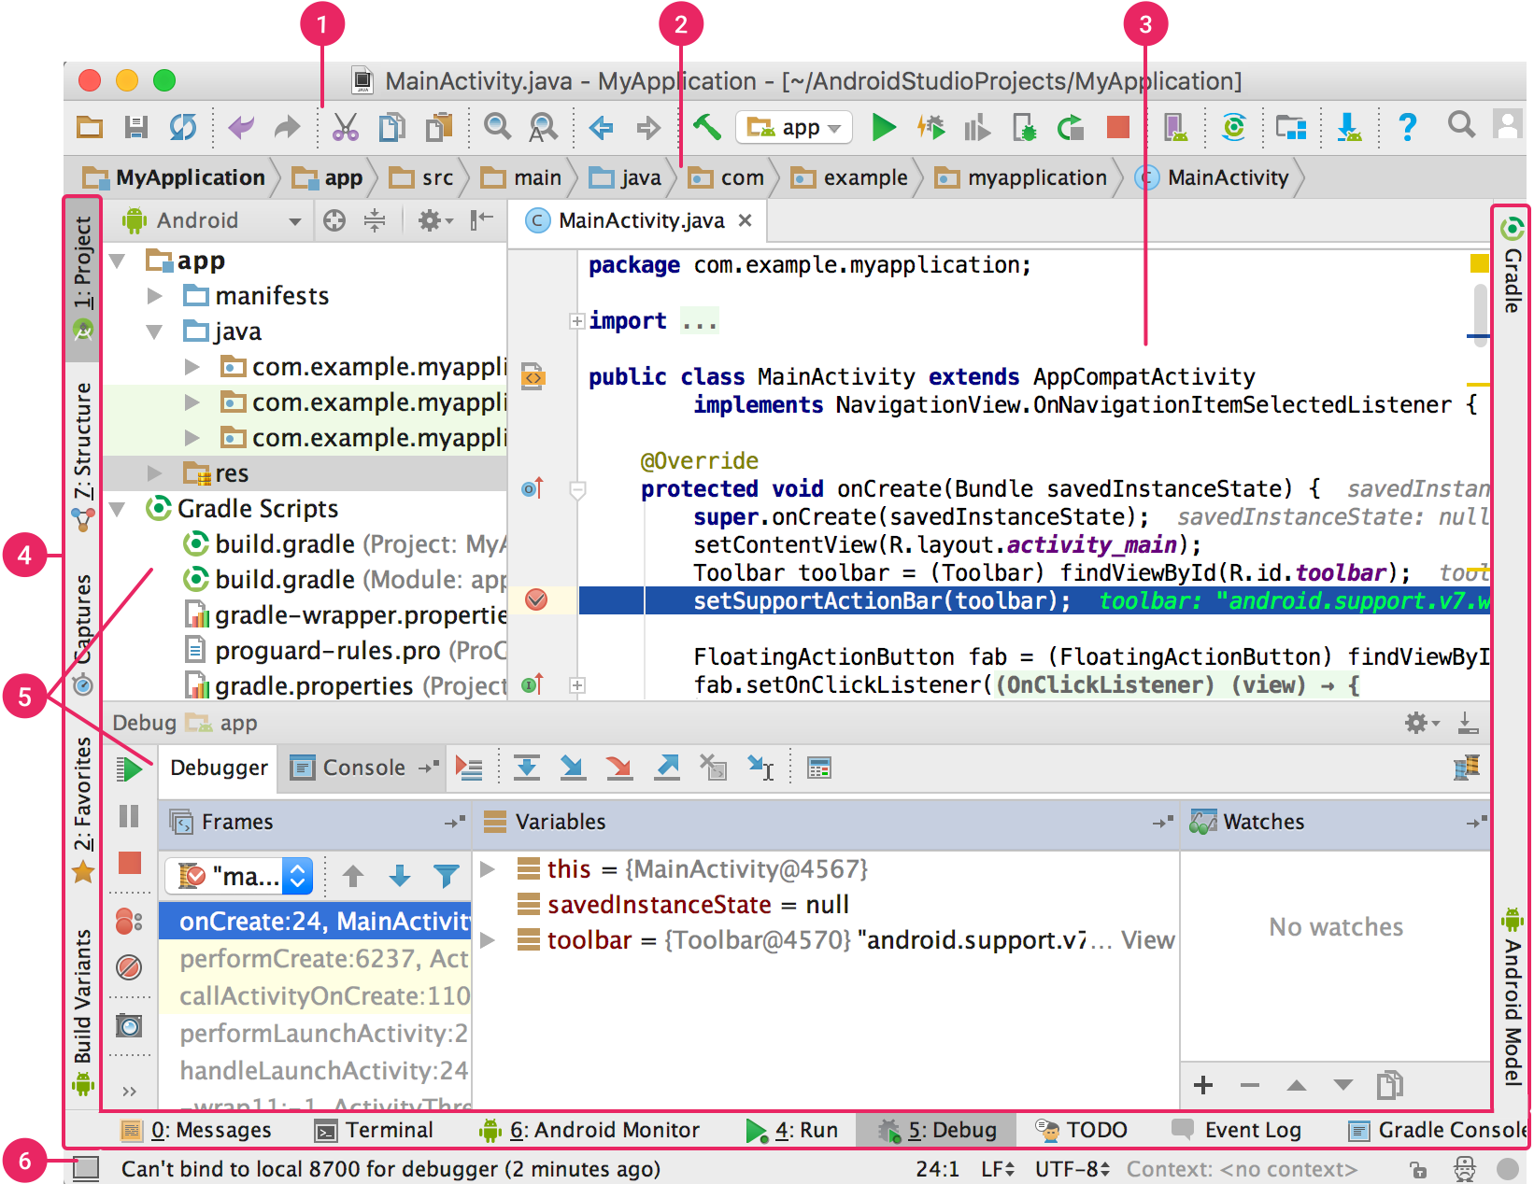
Android Studio

Slide 11

Gradle
Android Studio uses Gradle as a build system – a toolkit you use to build, run, test and package your applications. Gradle is a build automation system that combines the power, flexibility, and Ant scripting with library and dependency management capabilities to provide developers with powerful build methods.
Using Gradle in Android development allows you to customize the build process, create multiple APKs (Android Package Kit) with different features each, and reuse resources across different project modules.

Slide 12
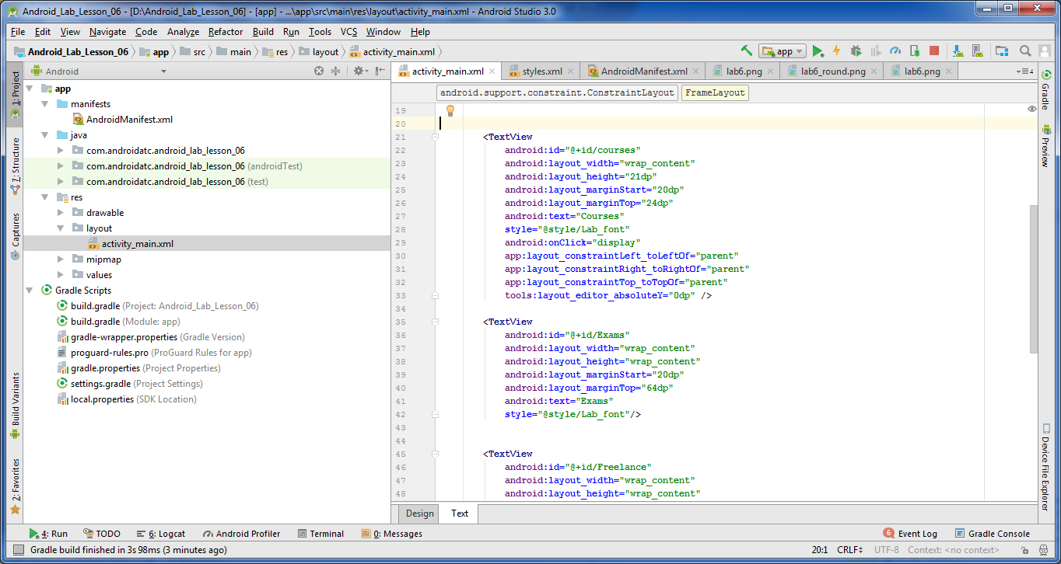



Instant Run
In Android Studio 2.3 and higher, Instant Run significantly reduces the time it takes to update your app with code and resource changes.
Run
Debug
Apply Changes

Slide 13
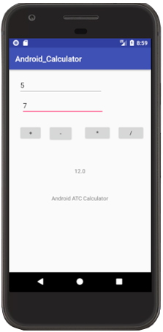
Lab 4
Creating Your First Application
Objectives:
Create your first Android application
Create an Android Virtual Device
Build a “Simple Calculator” Application
Open Page 4-12 in Android Application Development book v8 and Start
your lab step by step.

Slide 14


