Slide 1

Android Application Development

Slide 2
Lesson 5
Creating User Interface
Introduction
Android Project Structure
View
Creating User Interface
  Add a text box
  Add a Button
  Add an Image
  Add a Check Box
  Add a Radio Button
Lab 5: Creating a Pizza Order Application
  Create Your Application User Interface
  Configure the Android Application Code
  Run Your Application

Slide 3
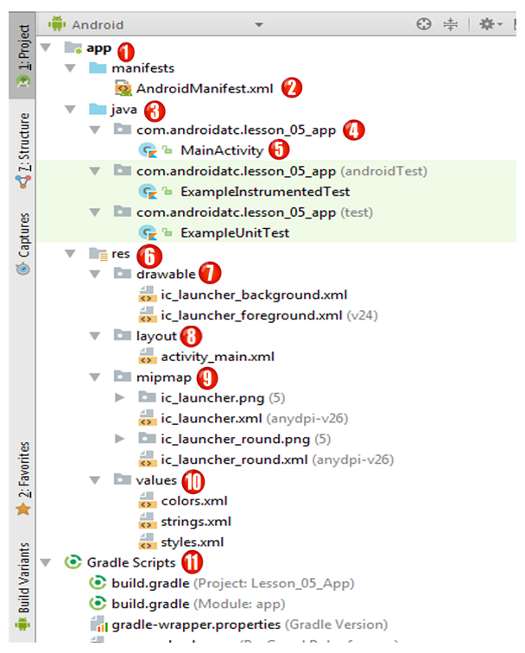
Android Project Structure
Check the example on page 5-2

Slide 4
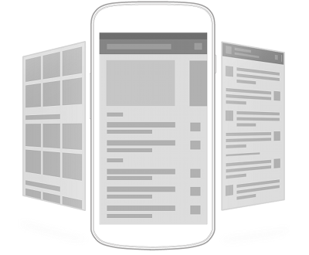
View
All user interface elements in an Android application are built using View and ViewGroup objects. A View is a public class that draws something on the screen that the user can interact with. View is the base class for widgets, which are used to create interactive user interface components (buttons, text fields, etc.). All of the views in a window are arranged in a single tree. You can add views either from code or by specifying a tree of views in one or more XML layout files.

Slide 5
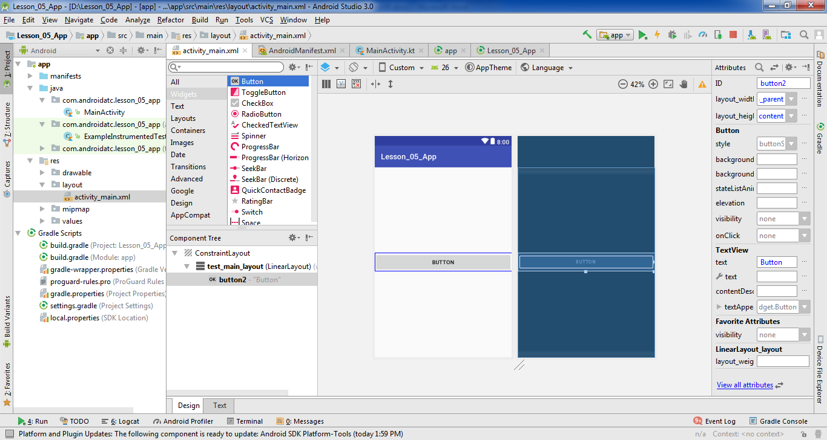
Adding a view using activity layout design mode
Check the example on page 5-8

Slide 6
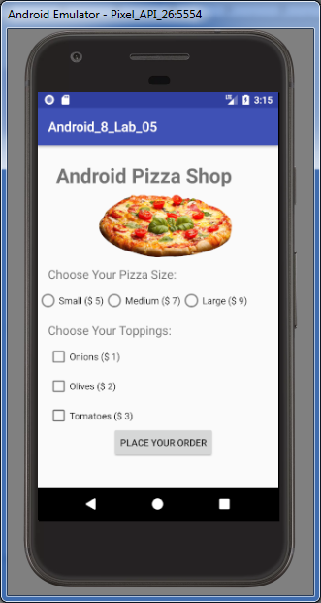
Creating User Interface
Add a text box
Add a Button
Add an Image
Add a Check Box
Add a Radio Button

Slide 7
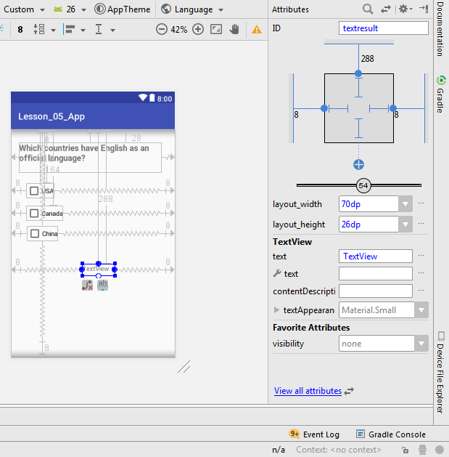
Creating User Interface
Adding user interface elements can be done by adding the widgets from the palette panel using drag and drop technique, and then configure the attribute values of these widgets .

Slide 8
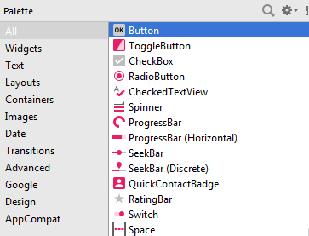
Add a Button
Add a Button to your app activity layout from a palette using drag and drop technique.
Check the example on page 5-12

Slide 9
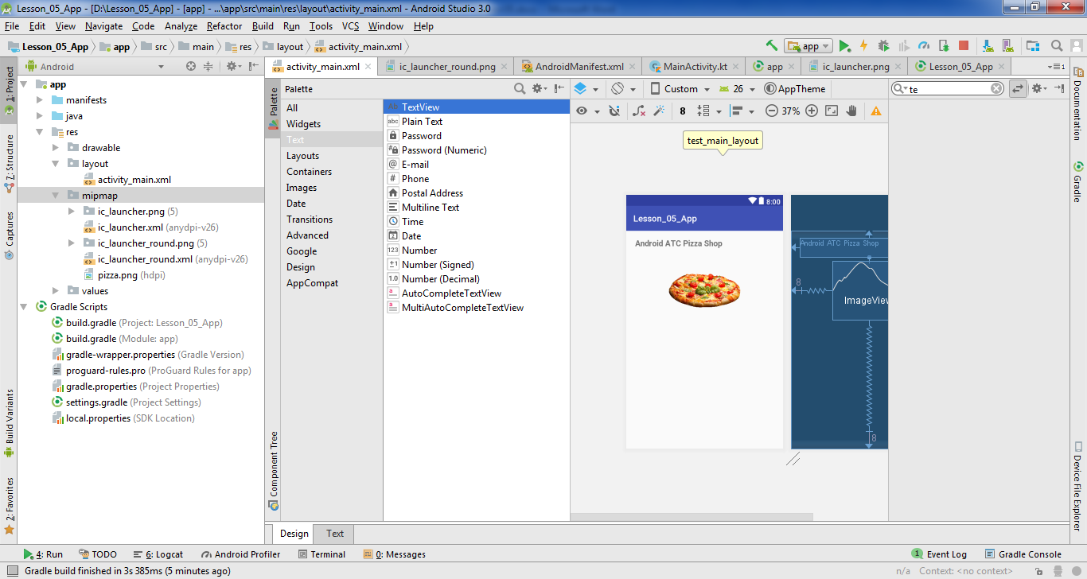
Add a text box
From the palette panel, select “TextView” then drag it to the Activity Layout.
Check the example on page 5-13

Slide 10
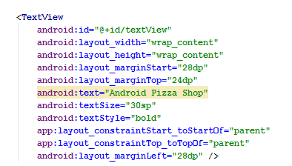
Add a text box
Using Activity Layout Text Mode (XML code):

Slide 11
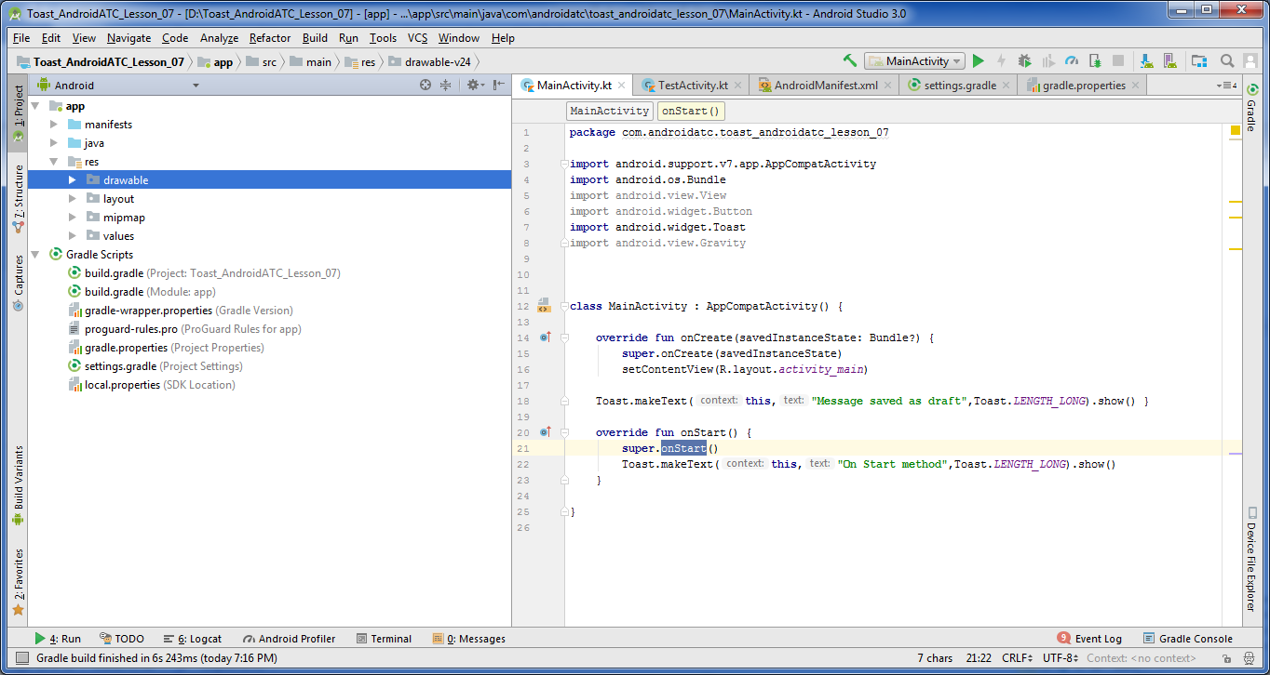
Add an Image
Adding an image to the Android application adds value to your application where the image can be a company logo, icon or just to add interactivity to your activity layout.
You can add an image to your Android app by simply copying the image from the folder where it is stored in your computer, and pasting it to the images location on the Android Studio: app\res\drawable folder
Check the example on page 5-16

Slide 12
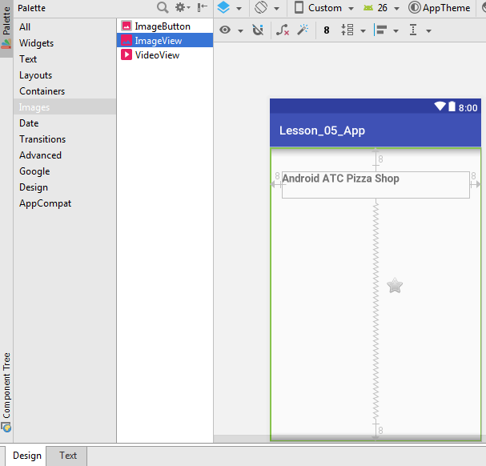
Add an Image
To insert this image into your app, drag and drop ImageView from the palette panel to your activity layout

Slide 13
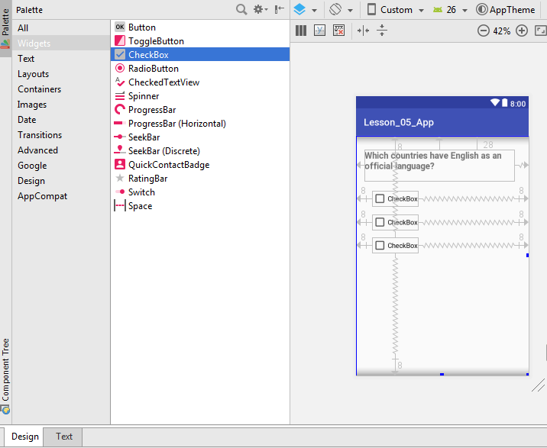
Add a Check Box
Checkboxes allow users to select one or more options from a set of options. In Android Studio 3.0, checkbox is available to drag-and-drop from the palette panel.
Check the example on page 5-19

Slide 14
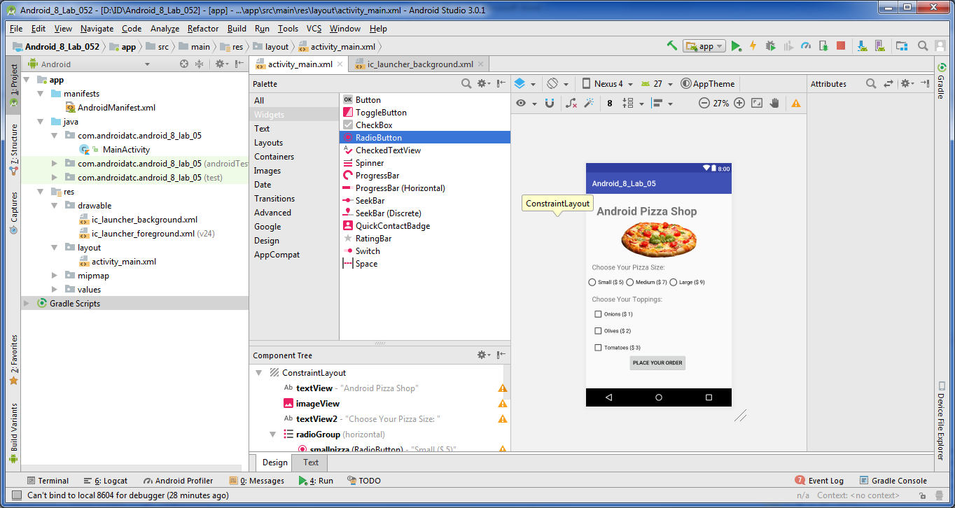
Add a Radio Button
In Android development, radio buttons are mainly used together in a RadioGroup. By using a radio group, you can only check one radio button from a group of radio buttons which belong to the same radio group.
Check the example on page 5-27

Slide 15
Add a Radio Button
RadioGroup and RadioButton Configuration:
<RadioGroup
android:layout_width="wrap_content"
android:layout_height="wrap_content"
android:orientation="horizontal">
<RadioButton
android:id="@+id/radioYes"
android:layout_width="wrap_content"
android:layout_height="wrap_content"
android:text="Yes"/>
<RadioButton
android:id="@+id/radioNo"
android:layout_width="wrap_content"
android:layout_height="wrap_content"
android:text="No"/>
</RadioGroup

Slide 16
Lab 5
Creating a Pizza Order Application
Objectives:
Create Your Application User Interface
Configure the Android Application Code
Run Your Application
Open Page 5-32 in Android Application Development book v8 and Start
your lab step by step.

Slide 17


