Slide 1

Android Application Development

Slide 2
Lesson 6
Android Layouts, Styles, Theme and Menus
Views
Layouts
  Constraint Layout
  Linear Layout
  Relative Layout
  TableRow Layout
  Frame Layout
  ScrowView Layout
Android Styles and Themes
  Android Styles
  Android Themes
App Manifest
Lab 6: Android Application Layouts, Styles, and Themes
  Create Your Application Layout
  Configure Your Styles and Themes
  Configure Your App Icon

Slide 3
Views
A view in Android applications is the basic component for a user-interface. In Android SDK, the class is called View. It is the highest-level class for any user interface component or widget you may use in your applications. All user interface widgets that you have seen before like Button and TextView are subclasses of class View.

Slide 4
Layouts
A layout defines the visual structure for a user interface, such as the user interface for an activity or app widget. You can declare a layout in two ways:
1- Declare user elements in XML: Android provides a straightforward XML vocabulary that corresponds to the View classes and subclasses, such as those for widgets and layouts.
2- Instantiate layout elements at runtime: Your application can create View and ViewGroup objects (and manipulate their properties) programmatically.

Slide 5
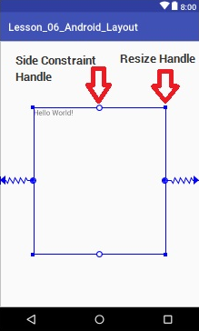
Layout Types
Constraint Layout:
Constraint Layout is a powerful new layout engine released as a part of Constraint Layout library in Android Studio 2.2 and later versions. It is fully integrated with Android Studio’s layout editor so you can build the full layout without the need to edit the XML manually.
This layout allows us to specify constraints that would decide the position of each sub element within the layout.
Check the example on page 6-2

Slide 6
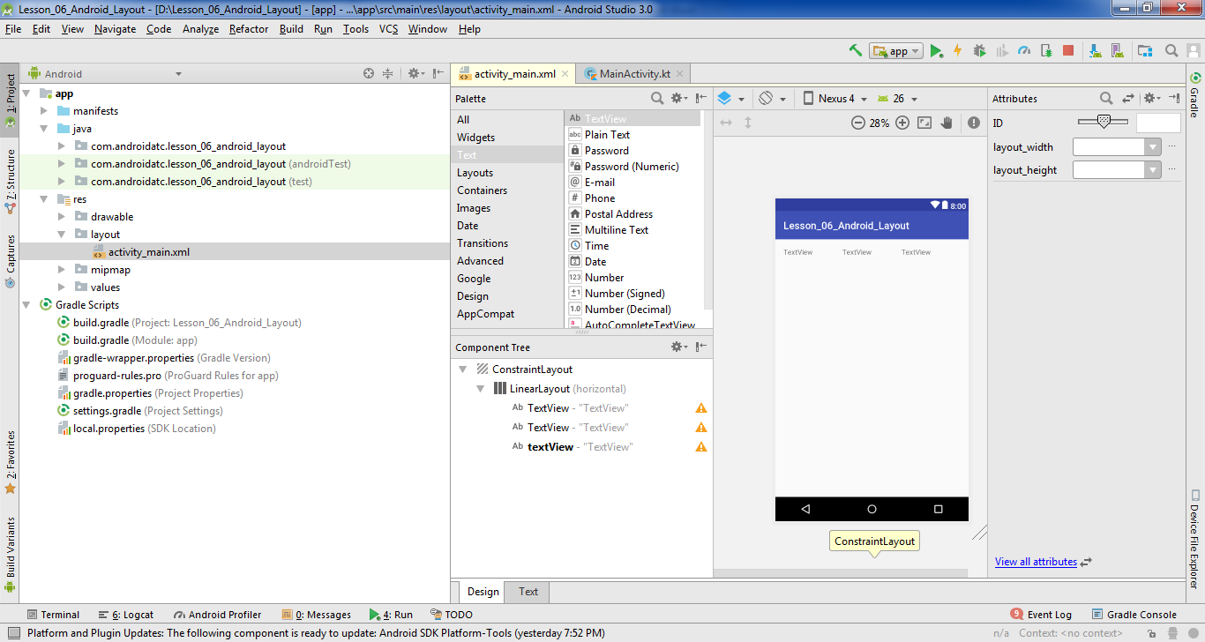
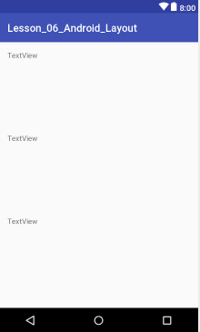
Layout Types
Linear Layout
A Linear Layout is a layout that arranges other views either horizontally in a single column or vertically in a single row.
Check the example on page 6-6

Slide 7
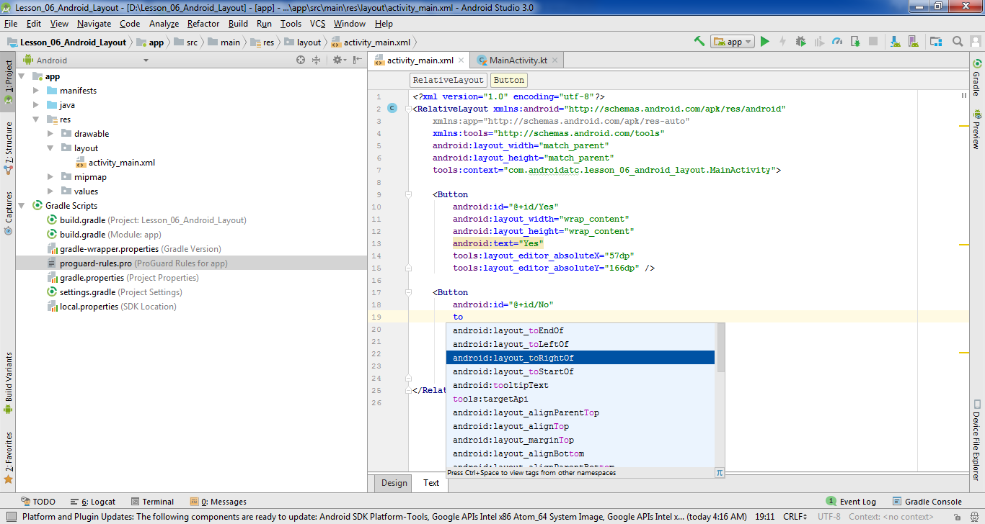
Layout Types
Relative Layout
The RelativeLayout arranges widgets in positions relative to each other. For example, you may position a button on the layout to the left, right or on top of another button.
Check the example on page 6-10

Slide 8
Layout Types
Table Layout
Table Layout arranges views into rows and columns.
<TableLayout
android:layout_width="368dp"
android:layout_height="495dp"
app:layout_constraintBottom_toBottomOf="parent"
app:layout_constraintLeft_toLeftOf="parent"
app:layout_constraintRight_toRightOf="parent"
app:layout_constraintTop_toTopOf="parent">
<TableRow
android:layout_width="match_parent"
android:layout_height="match_parent" />
<TableRow
android:layout_width="match_parent"
android:layout_height="match_parent" />
</TableLayout>
Check the example on page 6-15

Slide 9
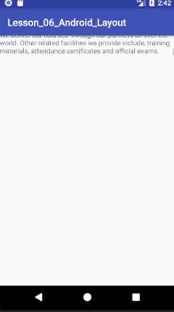
Layout Types
ScrollView Layout
ScrollView is a view group that allows the view hierarchy placed within it to be scrolled.
<ScrollView
android:layout_width="wrap_content"
android:layout_height="40dp">
<TextView
android:layout_width="wrap_content"
android:layout_height="16dp"
android:text“ x x x x x x x " />
</ScrollView>
Scroll
Check the example on page 6-19

Slide 10
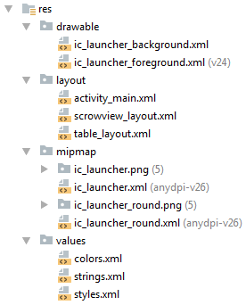
Android Styles and Themes
Building your Android application requires more than just writing a Kotlin code. As you have already seen, you need to build the layout of your activities to provide the user interface. These layout files are XML files saved under /res/layout and are just one example of the many resource files you may add to your Android application.
If you need static and contact data (images, strings…etc.), you should add them as resources in your application i.e. externalize them. Adding your application’s resources in a separate folder improves your development experience and yields a more robust application for several reasons such as maintaining and debugging your application .

Slide 11
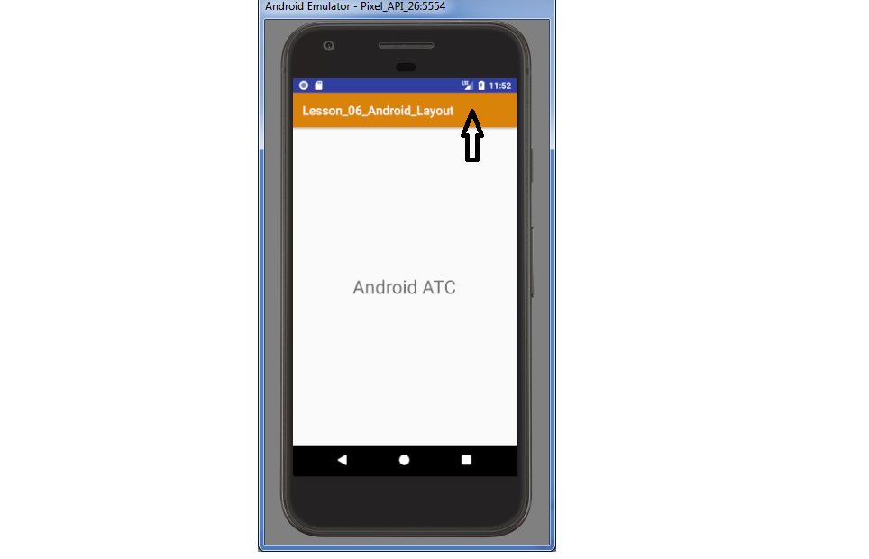
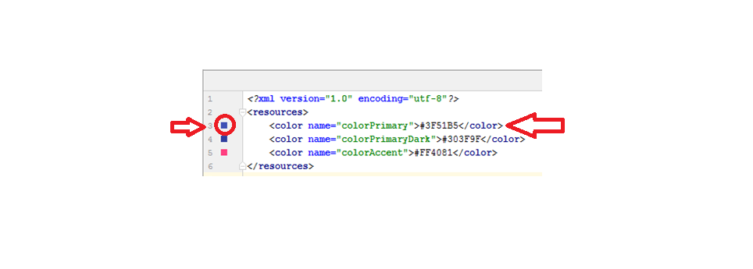
Android Styles
Android style is a collection of attributes that specifies the look and format of a View or window. A style can specify attributes such as height, padding, font color, font size, background color, and much more. A style is defined in an XML resource separate from the XML that specifies the layout.
Check the example on page 6-22

Slide 12
Android Themes
When a resource is used to define the style of the whole activity or application, it is called a theme. This is available for apps that target Android 5.0 (API level 21) or higher.
AndroidManifest.xml
<application
android:allowBackup="true"
android:icon="@mipmap/ic_launcher"
android:label="@string/app_name"
android:roundIcon="@mipmap/ic_launcher_round"
android:supportsRtl="true"
android:theme="@style/AppTheme">
<activity android:name=".MainActivity">
<intent-filter>
<action android:name="android.intent.action.MAIN" />
<category android:name="android.intent.category.LAUNCHER" />
</intent-filter>
</activity>
</application>
Check the example on page 6-31

Slide 13
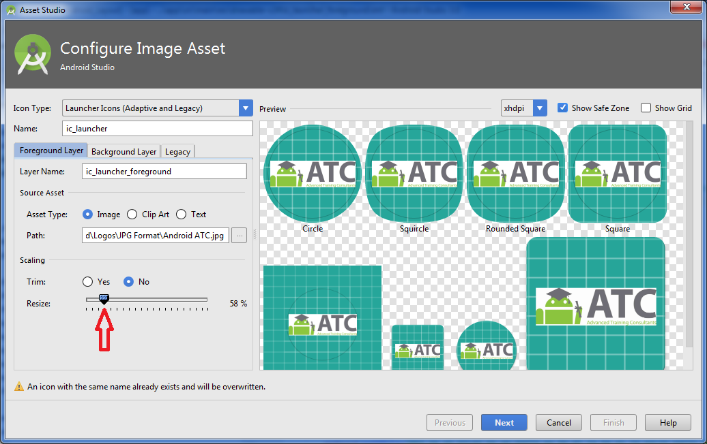
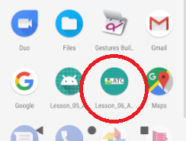
Adaptive Icons
Android 8.0 (API level 26) introduces adaptive launcher icons, which can display a variety of shapes across different device models. Each device provides a mask, which the system uses to render all the adaptive icons of the same shape. An adaptive launcher icon is also used in shortcuts, settings app, sharing dialogs, and the overview screen
Check the example on page 6-37

Slide 14
Lab 6
Android Application Layouts, Styles and Themes
Objectives:
Create Your Application Layout
Configure Your Styles and Themes
Configure Your App Icon
Open Page 6-41 in Android Application Development book v8 and Start
your lab step by step.

Slide 15


