Slide 1

Android Application Development

Slide 2
Lesson 7
Toasts, Activities, Navigations, and Views
Context Class
Toast Class
  Positioning Your Toast
What is an Activity?
Activity Lifecycle
Android Intent
  Navigating Between Activities
  Passing Data Between Activities
Android Views
  ListView
  RecyclerView
Lab 7: Configuration of Android RecyclerView
  Adding a RecyclerView to an Activity
  Creating Your RecyclerView Adapter
  Adding Data to Your RecyclerView
  Adding Event Listeners to Each RecyclerView Row

Slide 3
Context Class
Context is an abstract class (model) that is provided by Android SDK. You will use this class with many other classes such as Toast class – a class you will get to learn more about its importance in the next topic. You will also know how Toast class will use the Context class in its operation to collect information about the activity or application then use it to display this information. Typically, you call the Context class to get information regarding another part of your application (activity and package/application).
There are about 52 classes that implement Context class such as Activity, ActivityGroup, Application, CallScreeningService, CameraPrewarmService, and others.

Slide 4
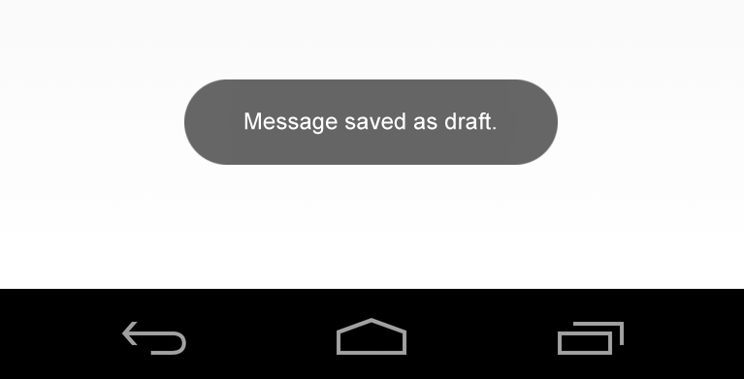
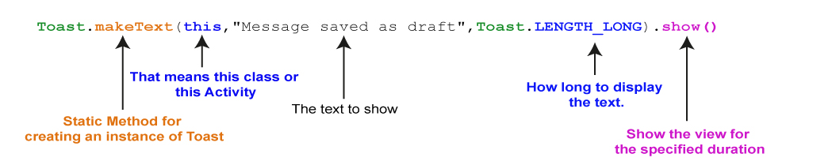
Toast Class
Toast is a public class that is displayed to show a quick brief message to the user. A toast provides a simple feedback about an operation in a small popup. It only fills the amount of space required for the message while the current activity remains visible and interactive. Toasts automatically disappear after a timeout.
Check the example on page 7-3

Slide 5
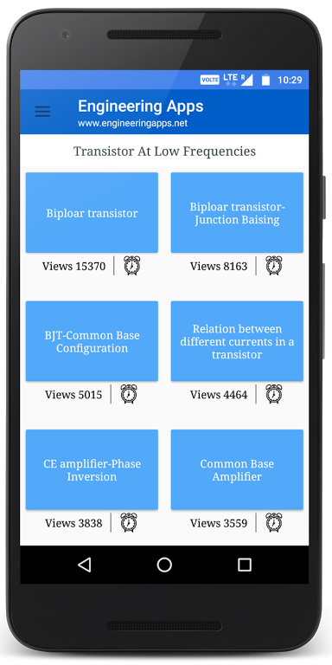
What is an Activity?
An activity is the entry point for interacting with the user. It represents a single screen with a user interface. The app consists of one or more activities, and the user can navigate between them through buttons, menus, images, back button and other navigation tools.
The Activity class is designed to facilitate this paradigm. This class includes all methods, variables and other classes which operate together to produce a specific function.
An activity provides the window in which the app draws its user interface. This window typically fills the screen, but it may also be smaller than the screen and float on top of other windows. Generally, one activity implements one screen in an app. For instance, one of the activities of an app may implement a Preferences screen, while another activity may implement a Select Photo screen.

Slide 6
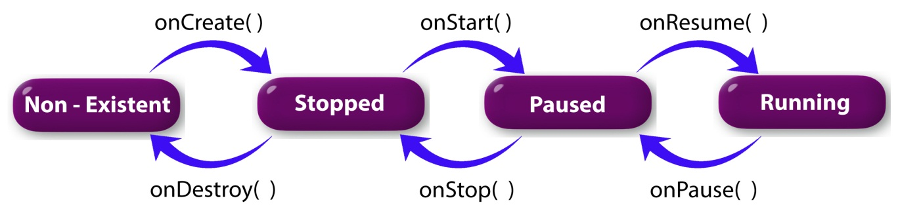
Activity Lifecycle
Activities in the system are managed as activity stack. When a new activity starts, it is placed on the top of the stack and becomes the running activity -- the previous activity always remains below the new one in the stack, and will not return to the foreground until the new activity exits.
An activity has essentially four states:
Check the example on page 7-13

Slide 7
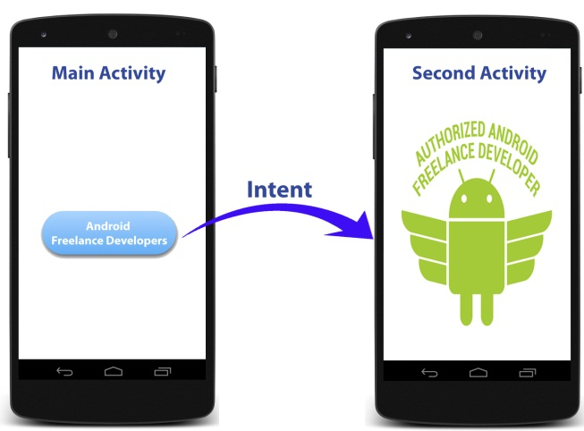
Android Intent
Android application components can connect to other Android applications. This connection is based on a task description represented by an Intent object. Android Intent is an abstract class description of an operation to be performed. Intents are asynchronous messages which allow application components to request functionality from other Android components. Intents allow you to interact with components from the same applications as well as with components contributed by other applications.
Check the example on page 7-23

Slide 8
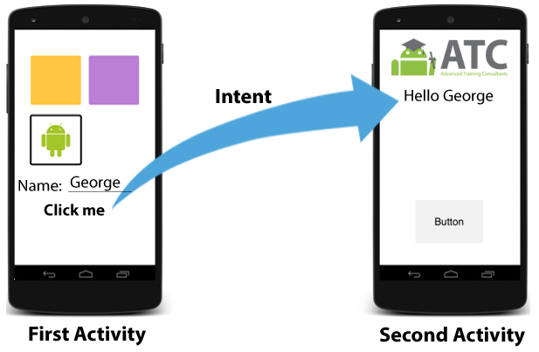
Android Intent
It is very likely that you may need to transfer some data to the activity you want to start through Intent. Android SDK provides this option by using extras methods. You can attach data to your intent by using Intent’s method putExtra() to include extra data in calling activity or the getExtra()method to retrieve data from the called activity; for example, sending one piece of data from First Activity to Second Activity when it starts.
An Intent object is a bundle of information used by the component that receives the intent as well as information used by the Android system.
Check the example on page 7-29

Slide 9
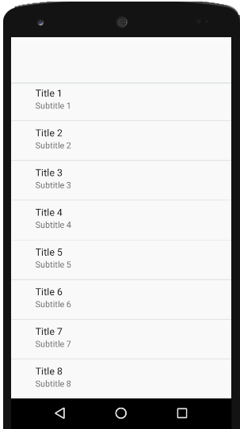
Android Views
List View
ListView is a view group that displays a list of scrollable items. The list items are automatically inserted using an Adapter that pulls content from a source such as an array or database query and converts each item result into a view that is placed into the list.
Check the example on page 7-34

Slide 10
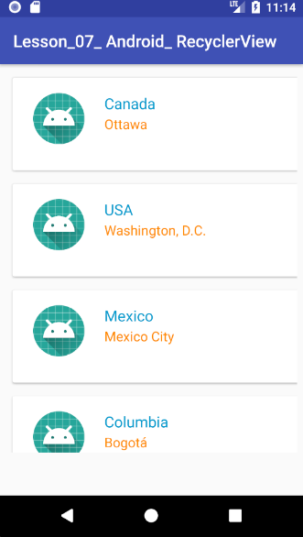
Recycler View
The RecyclerView widget is a more advanced, efficient, powerful and flexible version of the ListView. This widget is a container for displaying large data sets that can be scrolled very efficiently by maintaining a limited number of views. You use the RecyclerView widget when you have data collections whose elements change at runtime based on user action or network events.
The RecyclerView solves the problem of including a complex layout within a list if you were to use a ListView.
In lab 7, you will create a new Android project to create and configure a RecyclerView step by step.

Slide 11
Lab 7
Configuring Android RecyclerView
Objectives:
Adding a RecyclerView to an Activity
Creating a CardView
Creating Your RecyclerView Adapter
Adding Data to Your RecyclerView
Running and Testing Your RecyclerView
Adding Event Listeners to Each RecyclerView Row
Open Page 7-42 in Android Application Development book v8 and Start
your lab step by step.

Slide 12


