Slide 1

Android Application Development

Slide 2
Lesson 8
Android Dialogs, Snackbar, Menus, WebView and Notifications
Android Dialogs
  Alert Dialog
  ProgressBar
  SeekBar
  Date Picker Dialog
  Time Picker Dialog
Snackbar
Menus
WebView
Android Notifications
  Creating an Android Notification
  Notification Channel
Lab 8: Configuring Android Web Browser, Menu, and Notification
  Configuring Android Web Browser
  Adding Android Menu
  Creating a notification channel and a notification message

Slide 3
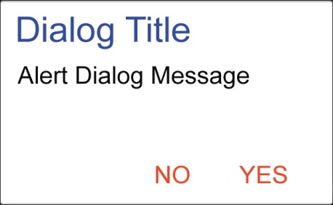
Android Dialogs
Dialogs constitute an important part of Android applications. A dialog is a small window that prompts the user to make a decision, enter additional information, or give a feedback. It does not take the full screen but part of it and asks users to take a specific action before they can proceed.

Slide 4
Android Dialogs
Dialog sub-classes
Android provides a set of Dialog sub-classes that you can utilize to interact with users. These sub-classes are:
AlertDialog
ProgressBar
Seekbar
DatePickerDialog
TimePickerDialo

Slide 5
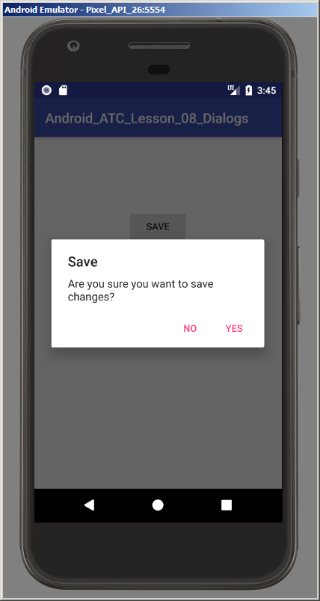
AlertDialog
This dialog consists of a title, a number of buttons, and/or a list of selectable items that may include checkboxes or radio buttons. The Alert Dialog is capable of constructing most dialog user interfaces; therefore, it is the generally suggested dialog type.
Check the example on page 8-2

Slide 6
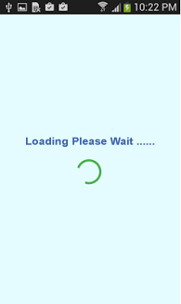
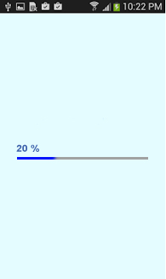
Progress Bar (ProgressBar)
Android developers use the Progress Bar class to get a circular or a horizontal progress bar. The purpose of this bar is to make the user wait for a period of time until a specific process is completed.
Check the example on page 8-10

Slide 7
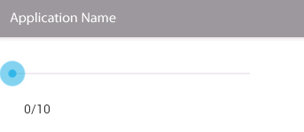
SeekBar
A SeekBar is an extension of the ProgressBar with a draggable thumb. The user can touch the thumb and drag it left or right to set the current progress level or he/she can use the arrow keys. Placing focusable widgets to the left or right of a SeekBar is discouraged.
Check the example on page 8-18

Slide 8
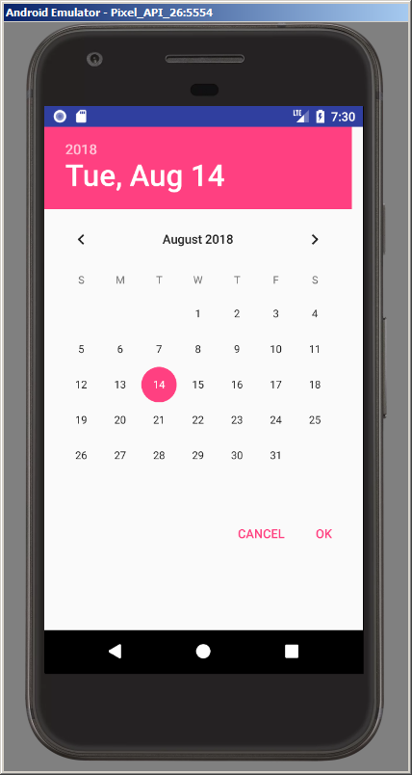
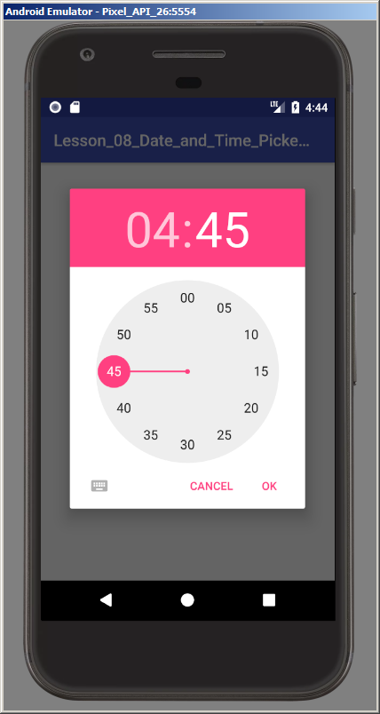
Date and Time Picker Dialog
Android provides controls for the user to pick a date or time as ready-to-use dialogs. Each picker provides controls for selecting each part of the date (month, day, year) or time (hour, minute, AM/PM). Using these pickers helps ensure that your users can pick a time or date that is valid, formatted correctly, and adjusted to the user's locale.
Check the example on page 8-24

Slide 9
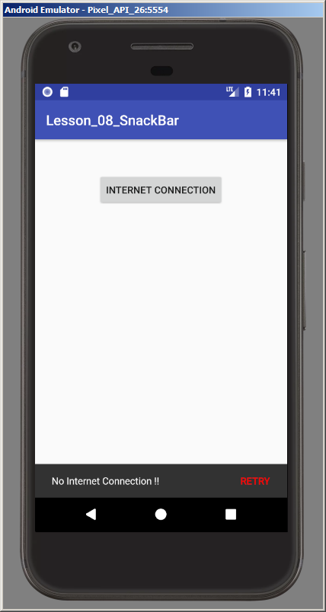
Snackbar
The Snackbar class provides a lightweight feedback about an operation. Snackbars show a brief message at the bottom of the screen on smart devices and lower left on larger devices
Check the example on page 8-32

Slide 10
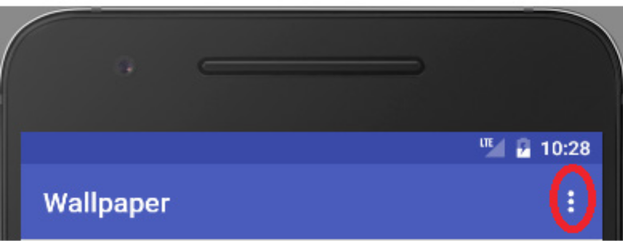
Menus
Menus are common user interface components used to provide user actions and
oth­er options in your activities. As of Android 3.0, menus are provided as a part of an action bar of the activity. Each activity in an application can get its own options' menu – the main collection menu items for an activity. Prior to Android 3.0, menus were accessed by pressing the dedicated menu button.
The user can access the options menu from the action bar by pressing on the three dots icon.
Check the example on page 8-34

Slide 11
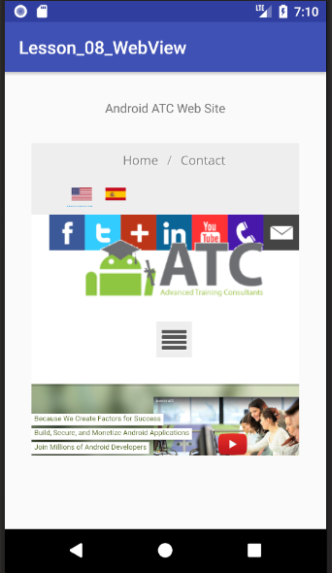
WebView
You can embed a web browser inside your application using web views. A WebView class is a crucial component for many applications that need to display a website without worrying about using Android’s native views.
Check the example on page 8-38

Slide 12
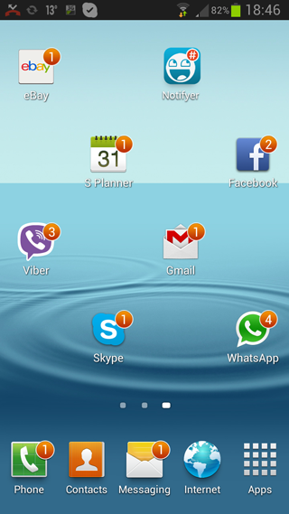
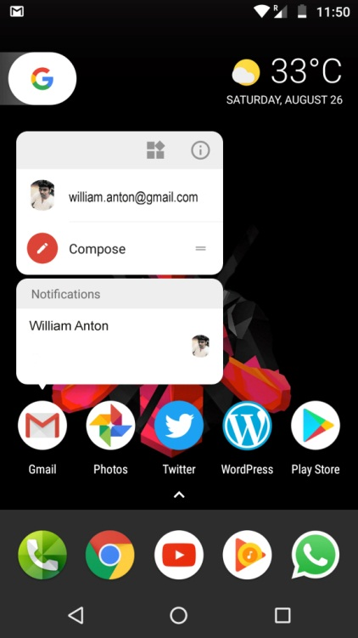
Android Notifications
A notification is a message you display to the user outside of your app's regular user interface. When your app sends a notification to the Android operation system, the notification manager service (Android service) receives your app notification and issues it.

Slide 13
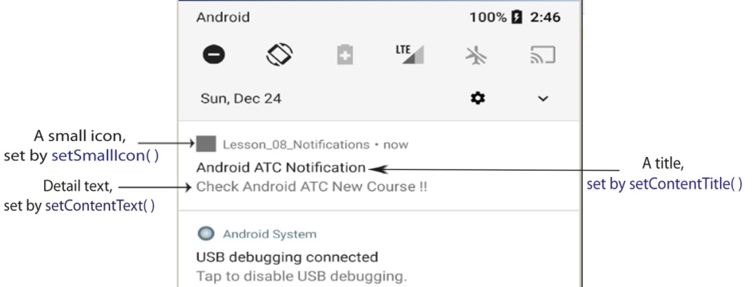
Android Notifications
Creating an Android Notification
Any Android notification must contain four main objects :
A small icon, set by setSmallIcon().
A title, set by setContentTitle().
Detail text, set by setContentText().
Notification Channel.
Check the example on page 8-46

Slide 14
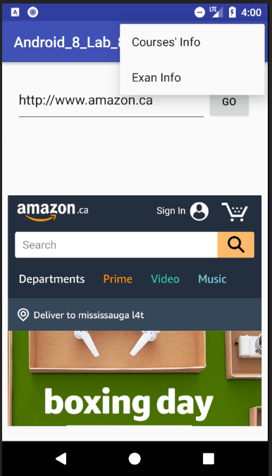
Lab 8
Configuring Android Web Browser, Menu, and Notification
Objectives:
Configuring Android Web Browser.
Adding Android Menu.
Creating a notification channel and a notification message.
Open Page 8-52 in Android Application Development book v8 and Start your lab step by step.

Slide 15


