Slide 1

Android Application Development

Slide 2
Lesson 9
Android Storage, SQLite and Content Providers
Android Storage Options
Shared Preferences
Internal Storage
External Storage
Network Connection
SQLite Databases
Content Providers
Sync Adapters
ORMLite
Choosing Internal or External Storage
Lab 9: SQLite Databases and Content Providers
  Creating an SQLite database
  Querying an SQLite DB Table
  Creating a Content Provider
  Utilizing ORMLite Library

Slide 3
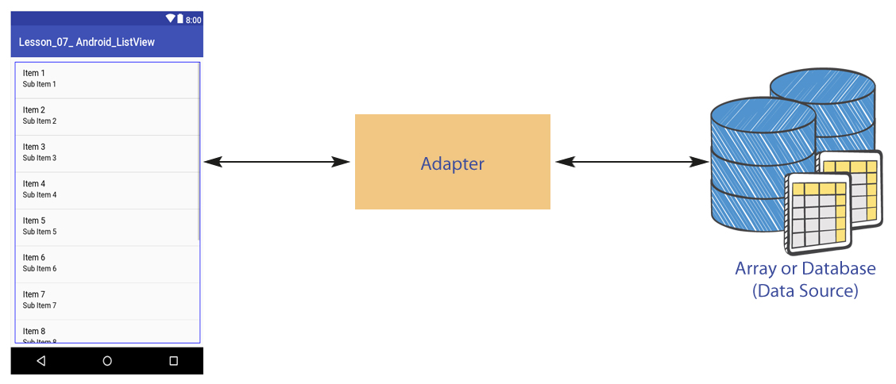
Android Storage Options
Android uses a file system similar to the disk-based file systems on other operating systems.
A File object is suited to reading or writing large amounts of data in start-to-finish order without skipping around.

Slide 4
Android Storage Options
The following are your data storage options:
1- Shared Preferences: This technique stores application-specific primitive data in key-value pairs.
2- Internal Storage: Store private data on the device memory using file I/O technique. This data will not be accessible by other applications).
3- External Storage: Store public data on the shared external storage (such as an SD card).
4- Network Connection: Store data on the web using your own network server.
5- SQLite Databases: Store structured data in a private database on the phone.

Slide 5
Shared Preferences
The SharedPreferences class provides a general framework that lets you save and retrieve persistent key-value pairs of primitive data types. You can use SharedPreferences to save any primitive data: booleans, floats, Ints, longs, and strings. This data will persist across user sessions (even if your application is killed).
Check the example on page 9-2

Slide 6
Internal Storage
You can save files directly on the device's internal storage. By default, files saved to the internal storage are private to your application (private mode) and cannot be accessed by other applications. When the user uninstalls your application, these files are removed.
To use the internal storage to write some data in the file, call the openFileOutput() method with the name of the file and the mode. The mode could be private, public etc.
Check the example on page 9-8

Slide 7
External Storage
Every Android-compatible device supports a shared "external storage" that you can use to save files. This can be a removable storage media (such as an SD card) or an internal (non-removable) storage. Files saved to the external storage are world-readable and can be modified by the user when they enable USB mass storage to transfer files to a computer.
Check the example on page 9-16

Slide 8
Network Connection
You can use the network connection - when available - to read and save data through your own web services. Using HTTP connections enables your Android application to communicate with a web service to read, synchronize, and save data on the server rather than on the device. This would require developing RESTful services which are outside the scope of this course and are more related to back-end development.

Slide 9
SQLite Databases
Android provides full support for SQLite databases. Any databases you create will be accessible by name to any class in the application, but not outside the application.
SQLite is an Open Source Database system embedded into every Android device.
Using a SQLite database in Android does not require any database setup or administration. You only have to define the SQL statements for creating and updating the database. Afterwards the database is automatically managed by the Android platform. SQLite is a good choice because it is a mobile-embedded database system, lightweight, and open source.

Slide 10
Content Providers
Content providers are one of the building blocks of Android applications. They manage access to a central repository of data. Usually Android applications keep the data private and hide it from other applications.
Check the example on page 9-24

Slide 11
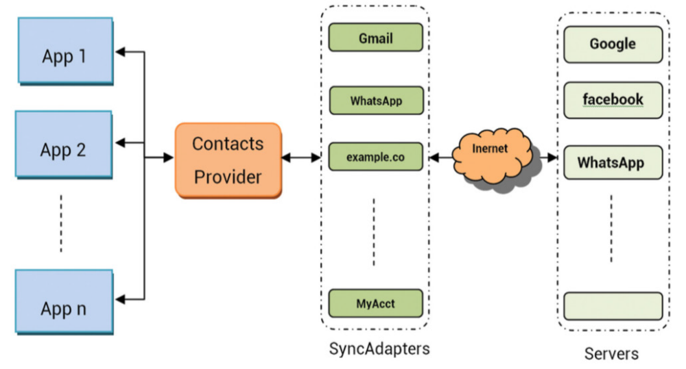
Sync Adapters
There is often a need to send data to and from a mobile device to a server.

Slide 12
ORMLite
ORMLite stands for Object Relational Mapping Lite. It is a third-party library that provides a simple and lightweight functionality of persisting objects to SQL databases.
The following are some advantages of using ORMLite:
Simple setup of classes by adding annotations.
Easy construction of simple and complex queries.
Support of a wide variety of database technologies like MySQL, PostgreSQL, Microsoft SQL Server, etc...
Automatic generation of SQL to create & drop tables.
Making native calls to Android SQLite database APIs.

Slide 13
Choose Internal or External Storage
Internal Storage | External Storage
It's always available. | It's not always available, because the user can in some cases mount an external storage such as a USB storage, and then remove it from the device.
Files saved here are accessible by your app only. | It's world-readable, so files saved here may be read out of your control.
When the user uninstalls your app, the system removes all your app's files from the internal storage. | When the user uninstalls your app, the system removes your app's files from here unless you saved them in the directory getExternalFilesDir().
It is your best option when you want to be sure that neither the user nor other apps can access your files. | It is the best place to save files that don't require access restrictions and files that you want to share with other apps or allow the users to access from a computer.

Slide 14
Lab 9
SQLite Databases and Content Providers
Objectives
Creating an SQLite database.
Querying a SQLite DB table.
Creating Content Provider.
Utilizing ORMLite Library .
Open Page 9-30 in Android Application Development book v8 and Start your lab step by step.

Slide 15


