Slide 1

AI

Slide 2
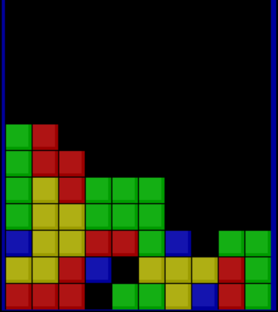
Our Work
Introduction:
The classical game of Tetris where you put blocks on top of one another to create a rectangular structure within a particular area or you lose.
We used a genetic algorithm as requested. We built a virtual chromosome where a chromosome here represents a player, each chromosome has some attributes of which the most important are the genes, genes are just numbers that act like weights that calculate the score for a move based on the board heuristics.

Slide 3
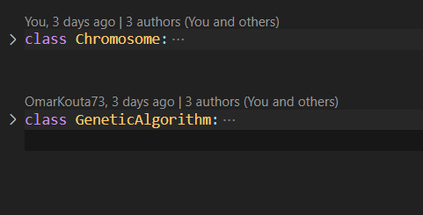
Our Work
Solution:
We have created 2 classes:
Chromosome class which houses the genes and contains other methods that help in deciding the best move based on the current board, current piece, and the next piece.
GeneticAlgorithm class is responsible for evolving the population to fit the current problem best, making a Tetris AI.

Slide 4
Our Work
Solution:
Chosen Values:
Percentage of Mutation: 20%
Percentage of Selection: 35%
Population Size: 15
Chosen Seed: 42
GOAL SCORE: 500,000

Slide 5
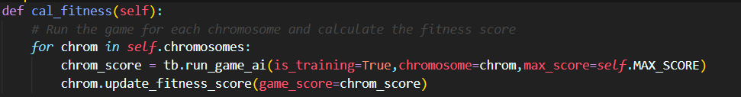
Our Work
Solution (Genetic Algorithm Implementation):
Fitness Calculation: the fitness score for each chromosome in the current population is the score that the chromosome gets after ending a full Tetris game whether that would be winning or losing.

Slide 6
Our Work
Solution (Genetic Algorithm Implementation):
Selection: in the selection process we choose the top 30% out of the population after sorting.

Slide 7
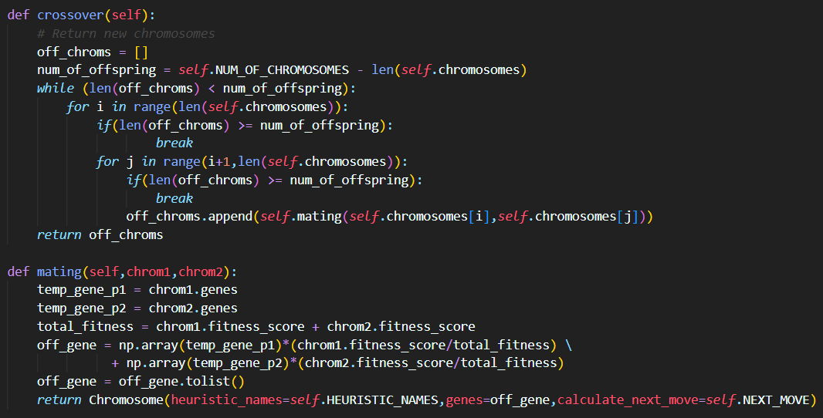
Our Work
Solution (Genetic Algorithm Implementation):
Crossover: we simply get all possible combinations between two parents and then get the weighted average of their genes based on their fitness score.

Slide 8
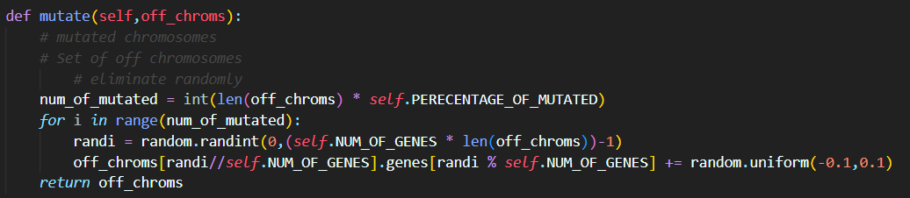
Our Work
Solution (Genetic Algorithm Implementation):
Mutation: randomly choose the genes we are going to mutate based on the mutation percentage then mutate the gene by generating a random number between 0.1 and -0.1.

Slide 9
Our Work
Solution (Calculated Heuristics):
Aggregate Height: the total of the height of each column
Completed Line: the number of completed lines
Number of Holes: the number of holes
Bumpiness: the measure of how bumpy the surface is by calculating the absolute difference between each column and its adjacent one.
Hole Segments: the number of independent hole segments in each column
Max Height: the max height from the entire board
Empty Columns: the number of empty columns
One Rows: the number of rows that are full except in one position
Two Rows: the number of consecutive two rows that are full except in one position that they both share
Three Rows: the number of consecutive three rows that are full except in one position that they both share
Four Rows: the number of consecutive four rows that are full except in one position that they both share

Slide 10
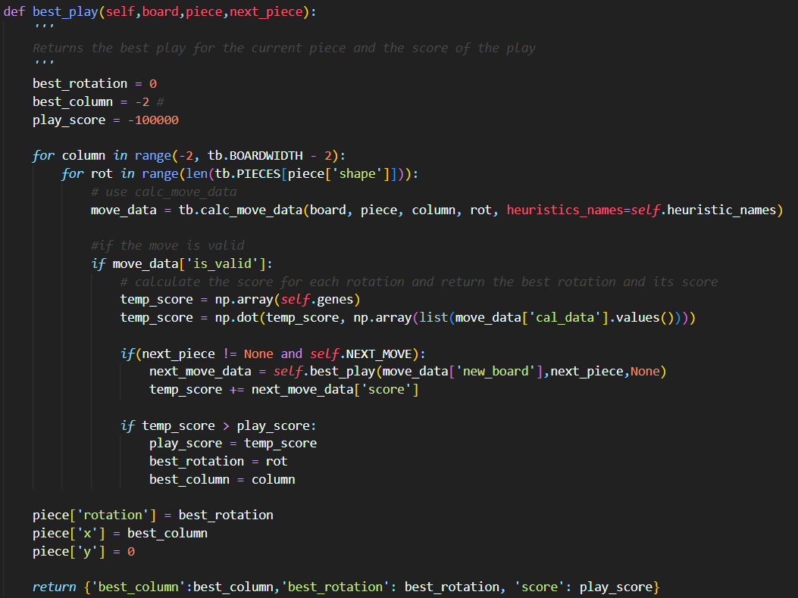
Our Work
Solution (Calculate Best Move):
We calculate the best move by iterating through all possible combinations of column position and rotation for the given piece. While doing so, we also calculate the best move of the next piece after the current move by calling the function again but on a new board.

Slide 11
Our Work
Experimenting:
Model 1:
Chosen Heuristics: ['aggregate_height', 'complete_lines', 'holes', 'bumpiness']
Calculate Next Move: False
Model 2:
Chosen Heuristics: ['one_rows', 'two_rows', 'three_rows', 'four_rows']
Calculate Next Move: False
Model 3:
Chosen Heuristics: ['aggregate_height', 'complete_lines', 'holes','bumpiness',’hole_segment’,’max_height’,’empty_columns’,'one_rows', 'two_rows', 'three_rows', 'four_rows']
Calculate Next Move: False
Model 4:
Chosen Heuristics: ['aggregate_height', 'complete_lines', 'holes', 'bumpiness',’four_rows’]
Calculate Next Move: False
Model 5:
Chosen Heuristics: ['aggregate_height', 'complete_lines', 'holes','bumpiness',’hole_segment’,’max_height’,’empty_columns’,'one_rows', 'two_rows', 'three_rows', 'four_rows’]
Calculate Next Move: True

Slide 12
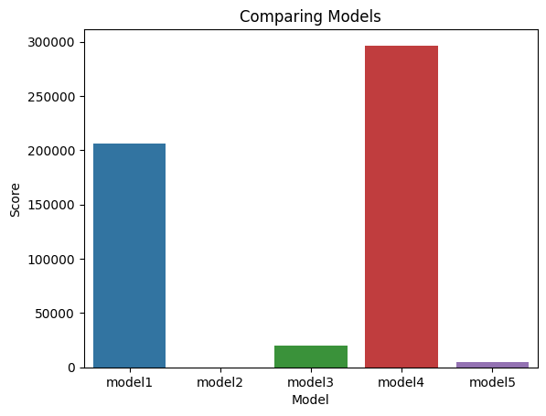
Our Work
Experimenting:

Slide 13
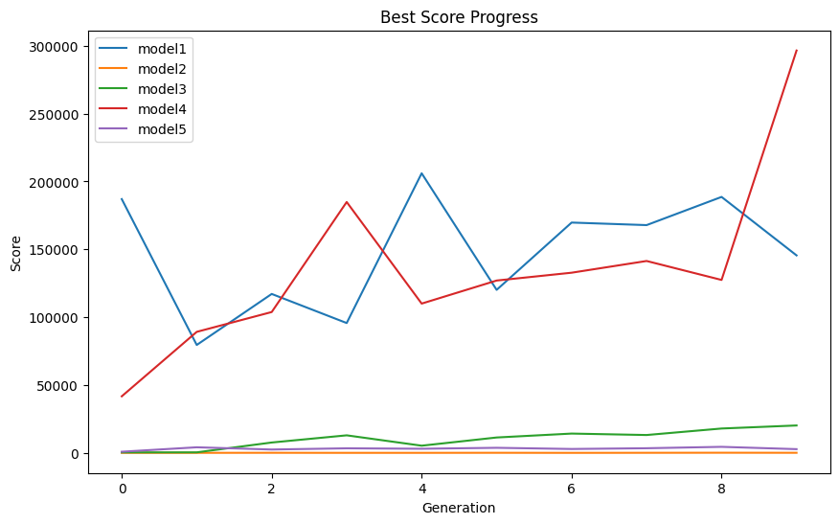
Our Work
Experimenting:

Slide 14
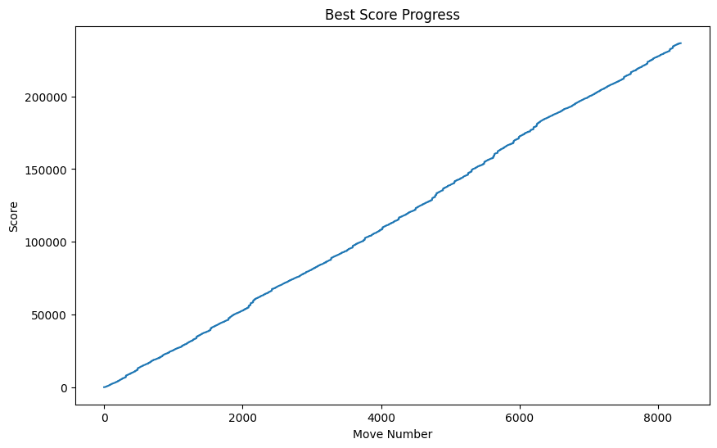
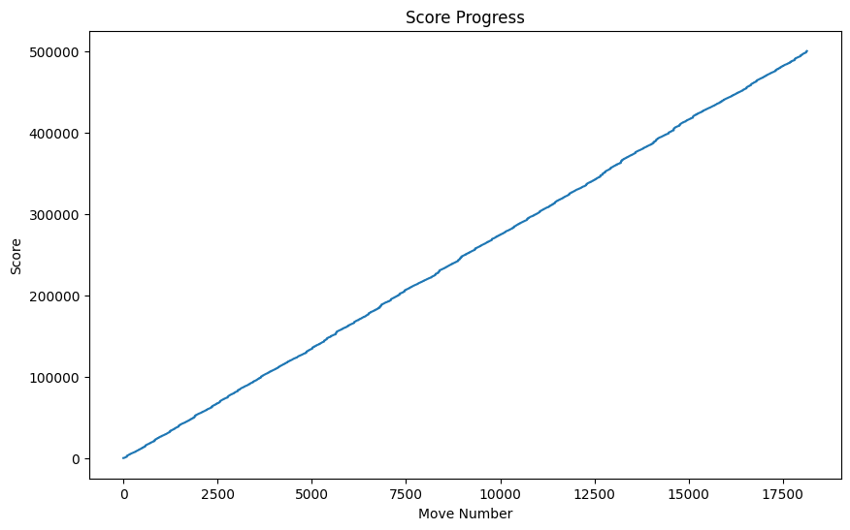
Our Work
Experimenting (Best two Chromosome from Model 4):
[5.522078466021565,3.865153526785135,-3.5865905986090034,-6.719837436623738,8.408346626937025] with Score: 296465
[5.387269303109375,3.8794766494803907,-3.6804923867413235,-6.709630184000435,8.339967392082738] with Score: 141408
Rerun of both chromosomes
FAILED
GOAL ACHIEVED!

Slide 15
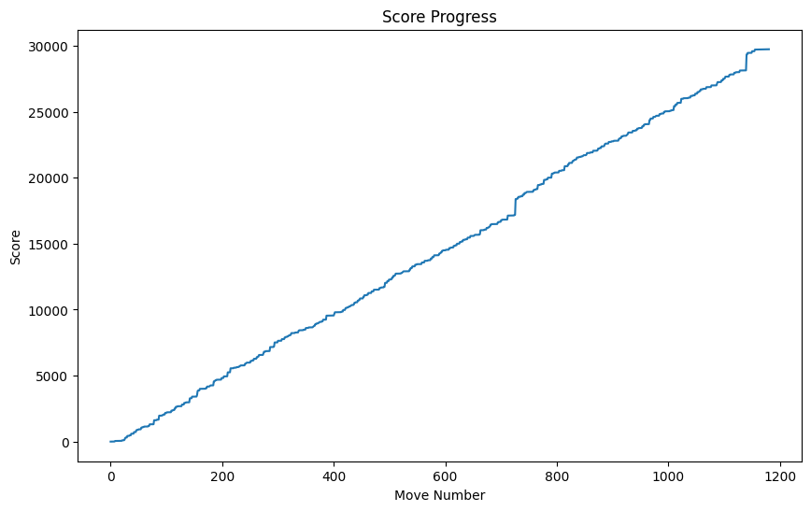
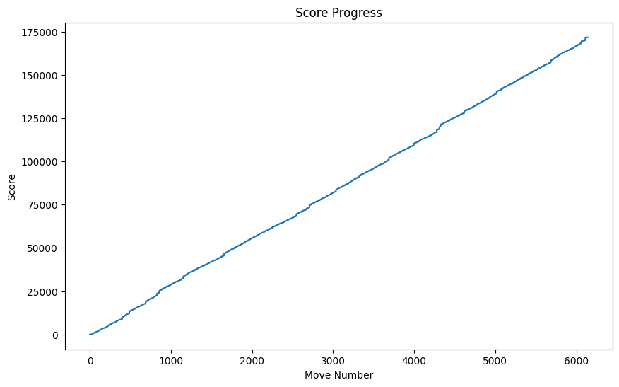
Our Work
Experimenting (Best two Chromosome from Model 1):
[5.934778276089621,3.9432161697030246,-3.2543266900829693,-6.826623928690194] with Score: 206012
[6.116385036656158,3.962787899764537,-3.1949896696401625,-6.890410003764369] with Score: 186992
Rerun of both chromosomes
FAILED
FAILED

Slide 16
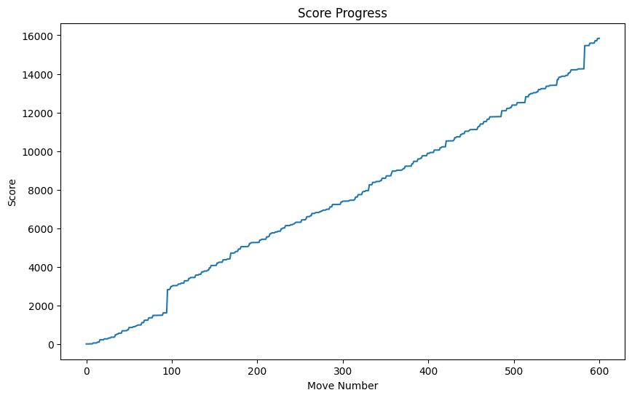
Requested Statistics
Chosen Seed: 42
Optimal Chromosome:
5.387269303109375,
3.8794766494803907,
-3.6804923867413235,
-6.709630184000435,
8.339967392082738]
Score: [500039]
Final test run with 600 iterations/moves with a Score of 15840

Slide 17
References
https://github.com/camilanovaes/tetris-ai/tree/master?tab=readme-ov-file
https://codemyroad.wordpress.com/2013/04/14/tetris-ai-the-near-perfect-player/

