Slide 1
Simultaneous Learning of Class Label and Hierarchy for Multi-class Classification of Omics Data
谢介民
Oct 29, 2023

Slide 2
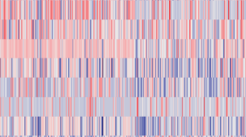
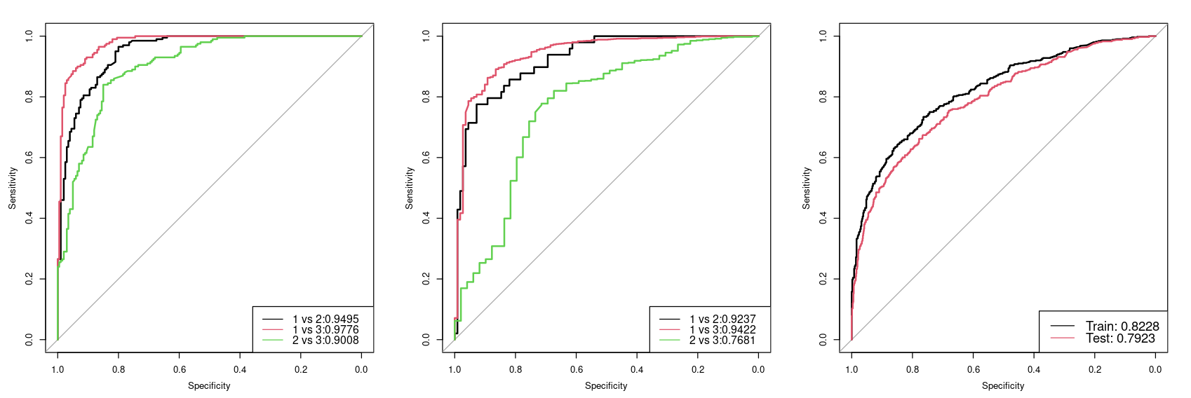
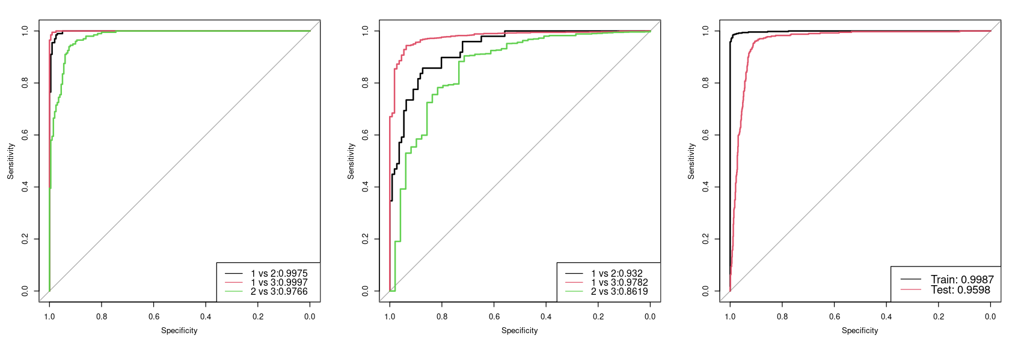
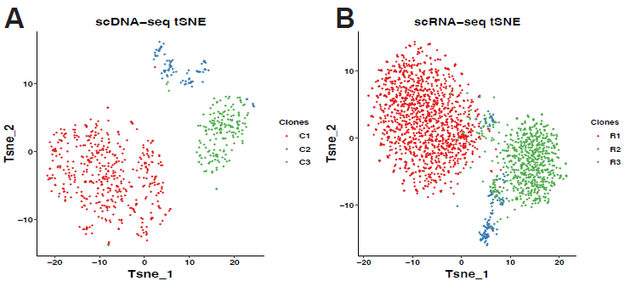
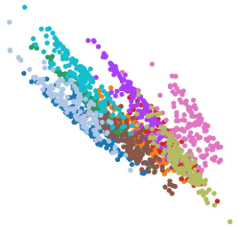
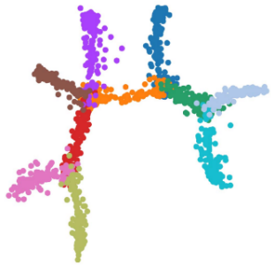
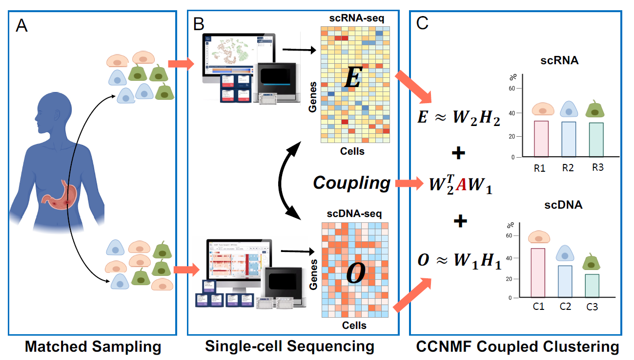
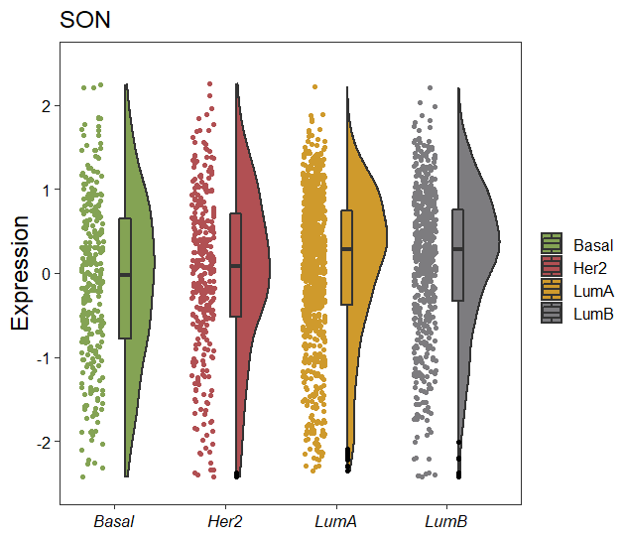

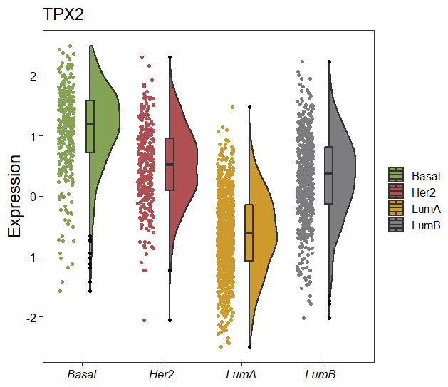
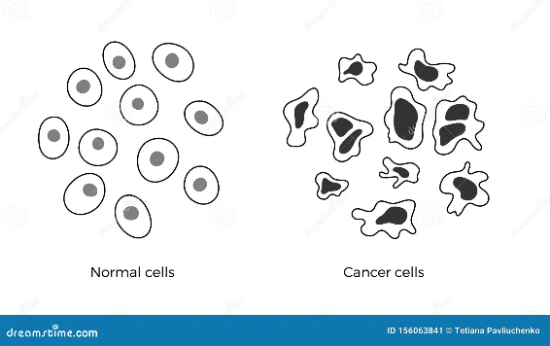





Biomedical Multi-class Classification Tasks
OmiHier Framework
Expected Inference
Complex disease subtyping
Better prediction of sample class
Possible hierarchies:
Class similarity matrix
①
A
B
C
D
A
B
E
②
T1
T2
T3
T4
……
A B C D
A
B
Single-cell state inference
Update label tree based on classification loss
Better inference of class hierarchy
· C1
· C2
· C3
Possible hierarchies:
F
①
C
A
E
C
D
B
E
②
C1
C2
C3
……
E C D
A
B
C
Microbiome disease association
Update label tree based on classification loss
Better identification of class biomarkers
AAGGAAC…
Possible hierarchies:
D
F
k-mer1
C
AAGGA
①
A
k-mer2
AGGAA
B
k-mer3
GGAAC
②
F
D
E
……
Normal
Benign
Malignant
③
F D
A
B
C
D
……
Notes:
disease

Slide 3
OmiHier iteratively merges the most similar classes
1) merges the active classes that are most similar to encourage their separation at lower hierarchy reduce tree loss
2) updates the confusion and affinity matrices accordingly and moves up until all classes have been merged
Update Affinity Matrix
E
E
C
A
B
D
A
B
D
E
E
C
D
C
update
F
D
A
B
F
A
B
C
D
E
C
F
C
A
B
D
C

Slide 4
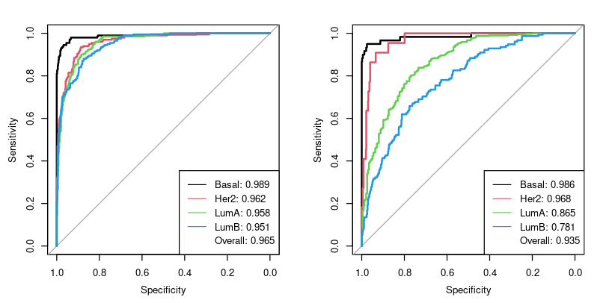
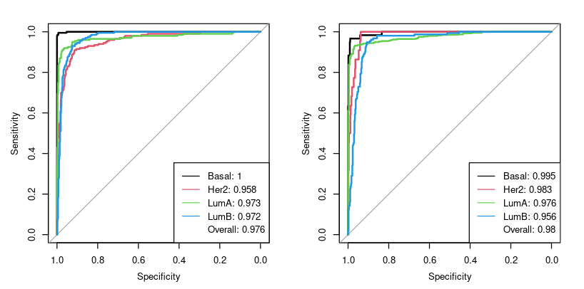
a
BRCA_direct
Train_ROC
Test_ROC
AUC | 0.935
Accuracy | 0.714
F1 | 0.725
Precision | 0.714
Recall | 0.752
Basal
Her2
LumA
LumB
b
BRCA_OmiHier
AUC | 0.98
Accuracy | 0.883
F1 | 0.893
Precision | 0.883
Recall | 0.917
Basal
Her2
LumA
LumB

Slide 5
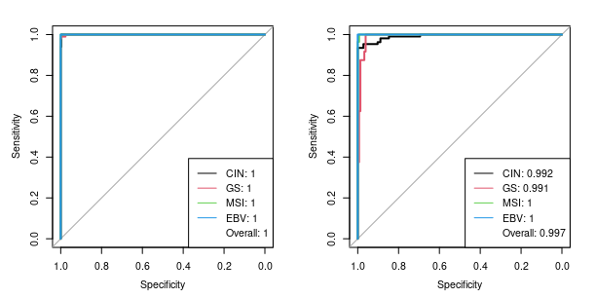
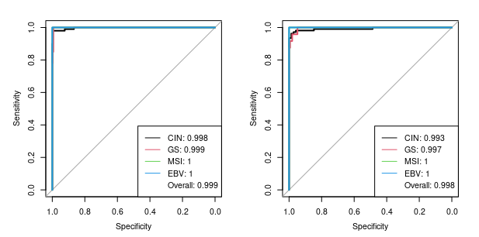
GC_direct
AUC | 0.997
F1 | 0.952
Precision | 0.950
Recall | 0.961
EBV
MSI
GS
CIN
GC_OmiHier
AUC | 0.998
F1 | 0.957
Precision | 0.955
Recall | 0.963
EBV
MSI
GS
CIN

Slide 6
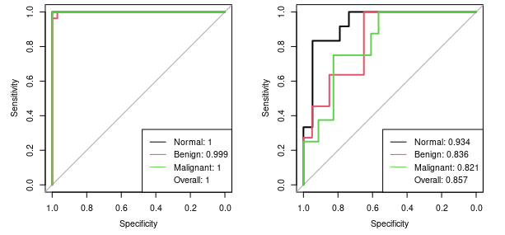
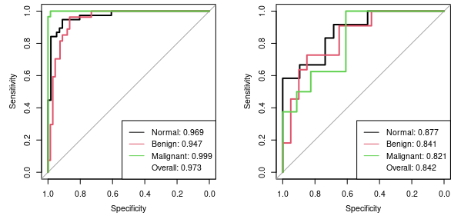
Faecal_OmiHier
AUC | 0.857
Accuracy | 0.677
F1 | 0.667
Precision | 0.677
Recall | 0.670
Malignant
Benign
Normal
Faecal_other
AUC | 0.842
Accuracy
F1 | 0.664
Precision | 0.677
Recall | 0.694
Malignant
Benign
Normal

Slide 7
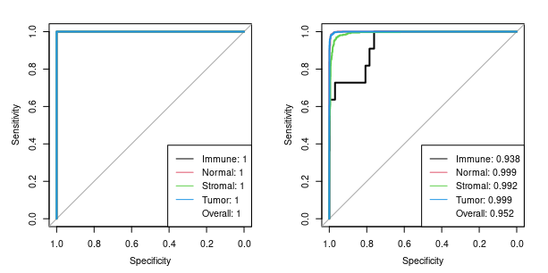
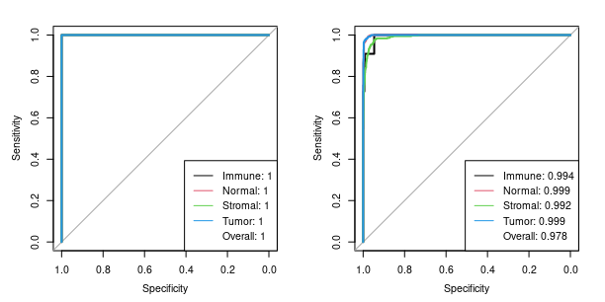
HCC_direct
AUC | 0.952
Accuracy | 0.964
F1 | 0.963
Precision | 0.964
Recall | 0.964
Tumor
Normal
Immune
Stromal
HCC_OmiHier
AUC | 0.978
Accuracy | 0.960
F1 | 0.958
Precision | 0.960
Recall | 0.960
Tumor
Normal
Immune
Stromal

Slide 8
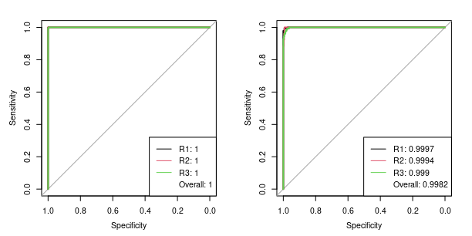
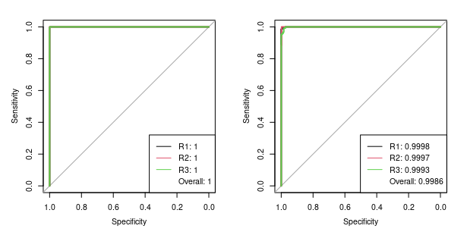
NCIRNA_direct
AUC | 0.998
Accuracy | 0.982
F1 | 0.972
Precision | 0.972
Recall | 0.973
R1
R2
R3
NCIRNA_OmiHier
AUC | 0.999
Accuracy | 0.979
F1 | 0.979
Precision | 0.979
Recall | 0.979
R1
R2
R3

Slide 9
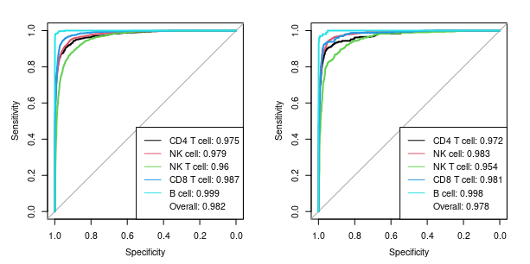
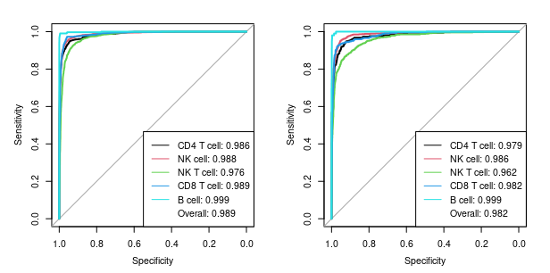
Lymphoid_direct
AUC | 0.978
Accuracy | 0.882
F1 | 0.882
Precision | 0.882
Recall | 0.882
B
CD8T
CD4T
NKT
NK
Lymphoid_OmiHier
AUC | 0.982
Accuracy | 0.887
F1 | 0.886
Precision | 0.887
Recall | 0.886
B
CD8T
CD4T
NKT
NK

Slide 10
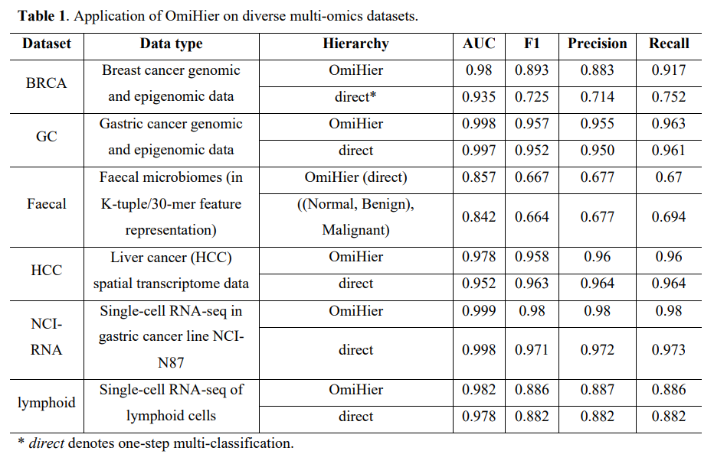

Slide 11
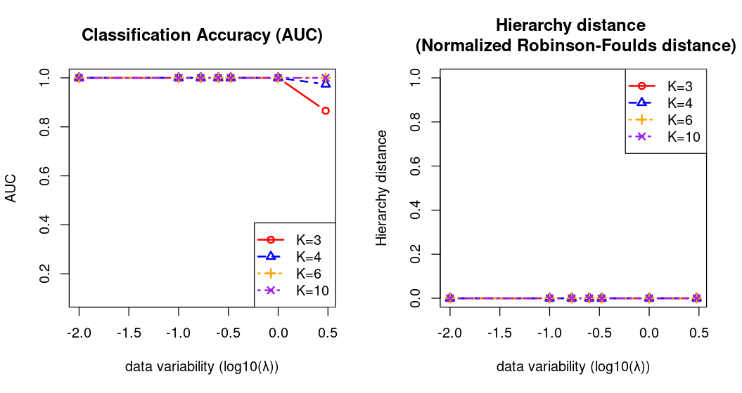
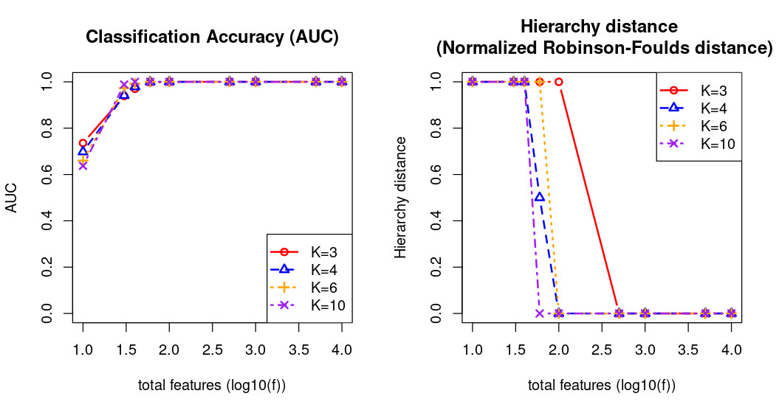
a
b

Slide 12
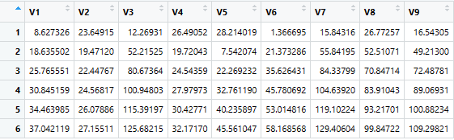
data~N(means,sd)
type1 | x1 | x2 | x3 | ……
 | data₁
 | data₂
 | data₃
 | ……
type2
……
means | ① means[1, ] <- runif(num_features, min = 0, max = x) ② means[2, ] <- runif(num_features, min = 0, max = y) ③ diff <- abs(means[i-1, j] - means[i-2, j]) - runif(1, min = 0, max = abs(means[i-1, j] - means[i-2, j])) ④ means[i, j] <- means[i-1, j] + diff
sd | 0,1,2,8,10,15,20,30,50,100,200,300
type | 3 | 4 | 6 | 10
x | 10 | 10 | 30 | 100
y | 20 | 20 | 60 | 200

