Slide 1
CMRC 2018
Yang XueFeng，ZHUI YI
2018-10-19

Slide 2
Outline
Background
Data Preparation
Model Description
Evaluation

Slide 3
Background
Span-Extraction Reading Comprehension
Chinese Wikipedia
One passage per query
Queries: 19K，trial 1k, train 10k，dev 3k，test 5k
Answers: Span of words
Model Evaluation: EM & F1

Slide 4
Data Preparation / cleaning
Filter query is None or answer is None
Answer length limit
<300 | 11107
300 ~ 400 | 23
400 ~ 1000 | 12
>1000 | 2
total | 11144
Notes:
扔掉训练集答案超过300个字的QA对

Slide 5
Data Preparation / analysis
Query type
Answer length norm
范廷颂是什么时候被任为主教的？ VS 九广铁路小童储值票是何时停止使用的？
1963年 1990年9月停止使用
Who | 谁，什么人，… | Where | 哪里，在哪，什么+地方， …
When | 什么+时候，哪*年，… | How | 怎样 ，…
Num | 多高，多远，多重，… | Why | 为什么，什么+原因， …
How long | 多久，多长时间，… | …

Slide 6
Data Preparation / feature
ELMo
Contextual:
The representation for each word depends on the entire context in which it is used.
Deep:
The word representations combine all layers of a deep pre-trained neural network.
Ours:
Stroke based，Word based
Pre-trained on a large text corpus (Chinese Wikipedia)
LSTM hidden size / Output size , 4096 / 512

Slide 7
Model Description
Embedding
a. ELMo
b. pos embedding
c. query type embedding
d. word match(wo stopwords)
ELMo
Embedding
POS
query_type
word_match
Notes:
共现特征，去除stopwords的影响

Slide 8
Model Description
Encoding
Bidirectional GRU, multi-layers
y1
y2
Pointer network
Attention
Attention
Extra gate for query
encoding
1 layers GRU
Attention
Prediction
pointer network
prob = start * stop
encoding
3 layers GRU
Embedding
Embedding
Embedding
Embedding
Embedding
Embedding
context
query

Slide 9
Model Description
Training
△EM / Step 0
Step 1: +0.57
Step 2: +0.31
Step 3: ≈Step 2
ref: Born-Again Neural Networks

Slide 10
Experiment
Implementation details
Ablation study on devset
 | EM / F1 | △/-
Complete Model | 68.437 / 85.719
Self-distill | 67.56 / 84.78 | 0.88 / 0.94
pos + query type | 66.81 / 84.56 | 0.75 / 0.22
Attention + | 66.20 / 84.25 | 0.61 / 0.31
ELMo | 64.41 / 83.70 | 1.79 / 0.55
 | Details
hidden | 100
optimizer | Adam
learning rate | Cosine
dropout | 0.6

Slide 11
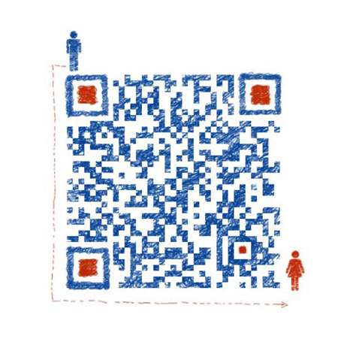
Thanks

