Slide 1


SPECIALLY ABLED PEOPLE FEEDBACK FORM
BOOSTING COLLABORATION BY IMPROVING ACCESSIBILITY AND USER EXPERIENCE
TEAM SHOURYA

Slide 2
Problem Statement
SHOURYA
Despite the significant advancements in technology and awareness, there is a notable gap in providing an inclusive and accessible feedback mechanism for individuals with special abilities. The current feedback systems often lack the necessary accommodations to cater to the diverse needs of this demographic, hindering their ability to effectively express their opinions and experiences. The absence of a tailored feedback form that considers various types of disabilities, such as visual, auditory, cognitive, or motor impairments, further exacerbates the issue. There is a pressing need to address this gap and create a specialized feedback form that ensures a seamless and accessible experience for individuals with special abilities. The goal is to develop a platform that takes into account different assistive technologies, communication preferences, and usability requirements to enable this demographic to provide valuable feedback in a user-friendly and inclusive manner.

Slide 3
Solution Overview
SHOURYA
Designing a feedback form for individuals with special abilities requires careful consideration of accessibility, usability, and inclusivity. Here are some key features and considerations for creating an effective and inclusive feedback form:
Screen Reader Compatibility Time Considerations
Keyboard Navigation Usability Testing
Contrast and Color. Awareness and Education:
Voice Input Visual and Tactile Elements
Text-to-Speech Feedback Confirmation
Clear and Simple Language Continuous Improvement
Cognitive Support.
Error Handling

Slide 4
Impact and Benefits
SHOURYA
Accessibility and Inclusivity: By designing a feedback form application that accommodates various disabilities, such as visual, auditory, motor, or cognitive impairments, it promotes inclusivity. Features like screen reader compatibility, voice commands, adjustable font sizes, and intuitive navigation make it accessible to a broader range of users.
Empowerment and Engagement: Offering a platform for specially abled individuals to provide feedback empowers them to voice their opinions, concerns, and suggestions. This engagement fosters a sense of inclusion, enabling them to actively participate in discussions and decisions that affect them directly.
Improved User Experience: Tailoring the application to accommodate diverse needs enhances the overall user experience for all participants. The features and functionalities developed to assist specially abled individuals often translate into a more user-friendly, intuitive interface for everyone.

Slide 5
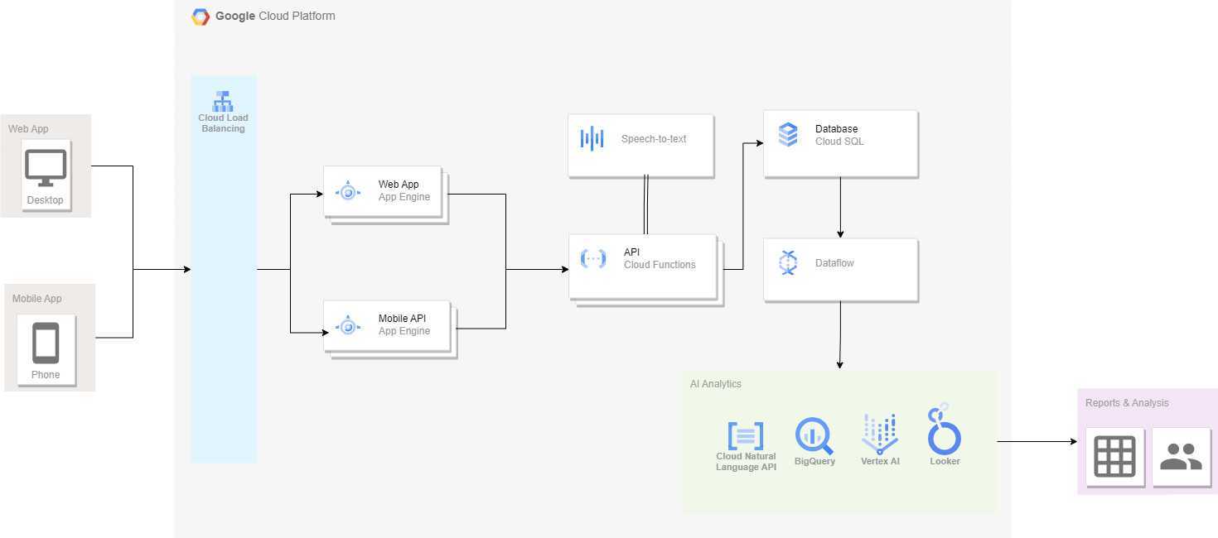
Architecture
SHOURYA

Slide 6
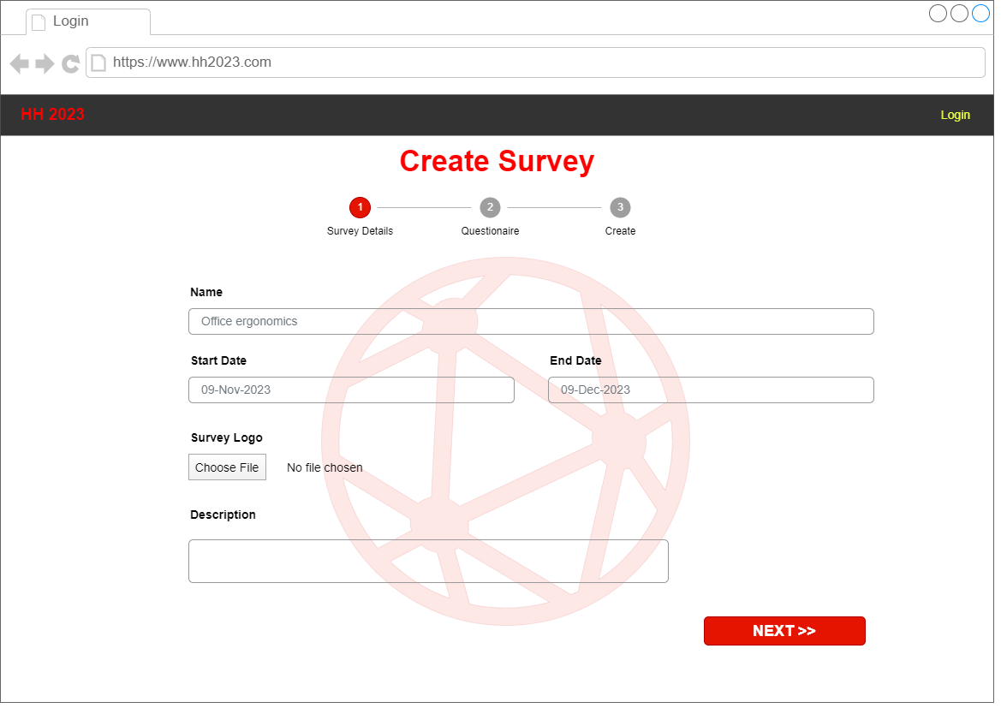
Demo
SHOURYA

Slide 7
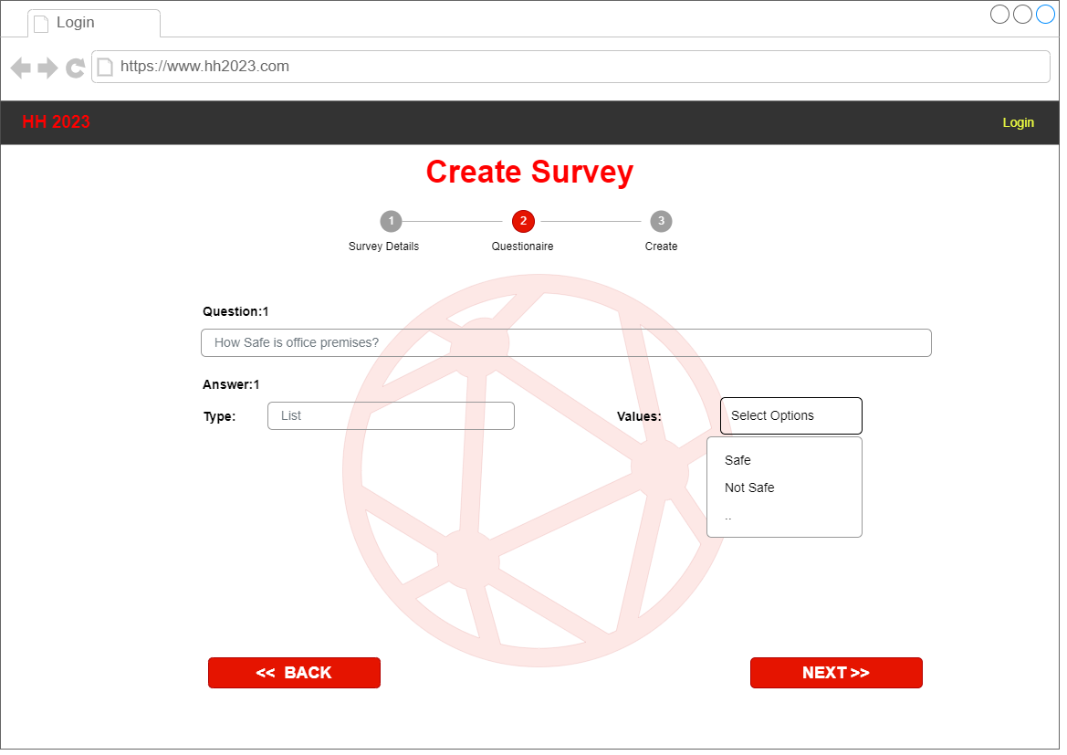
Demo
SHOURYA

Slide 8
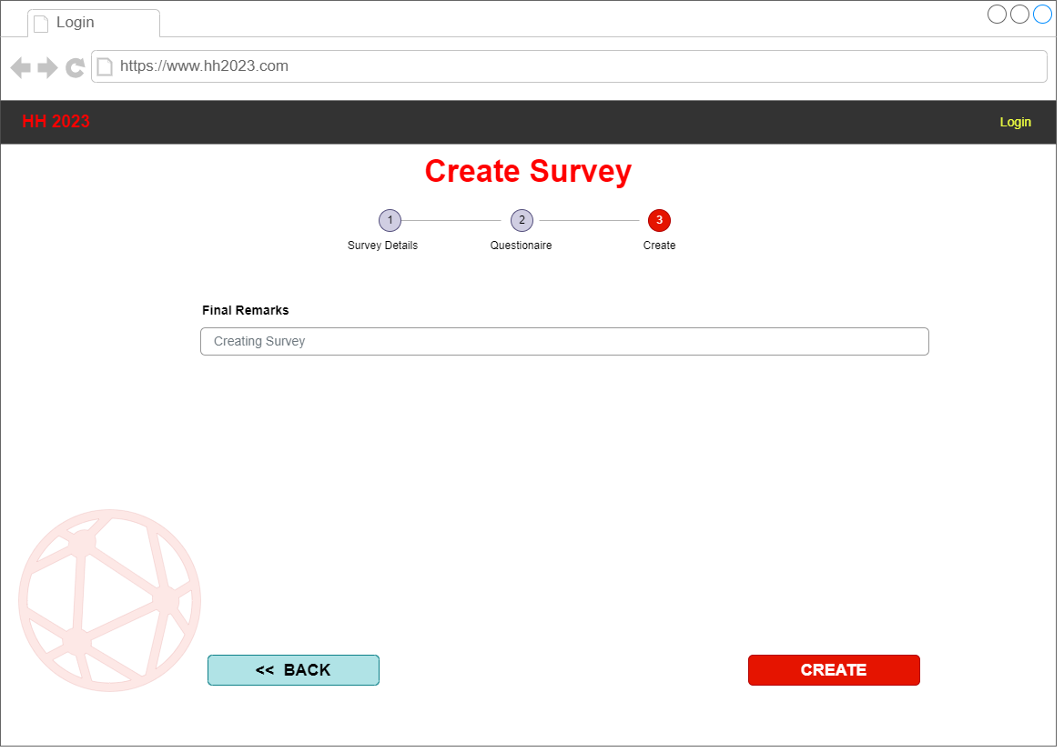
Demo
SHOURYA

Slide 9
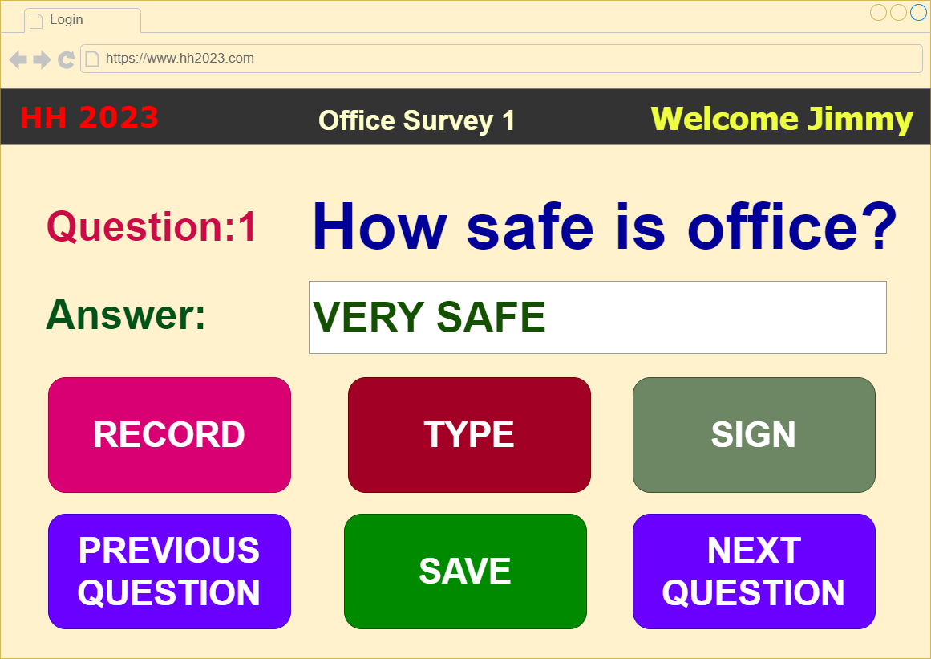
Demo
SHOURYA

Slide 10
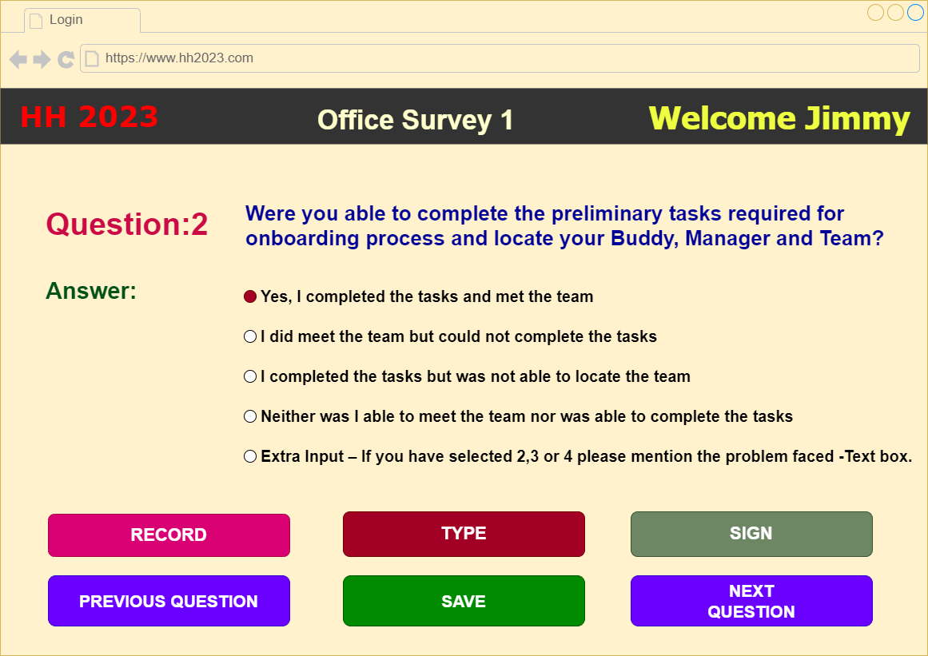
Demo
SHOURYA

Slide 11
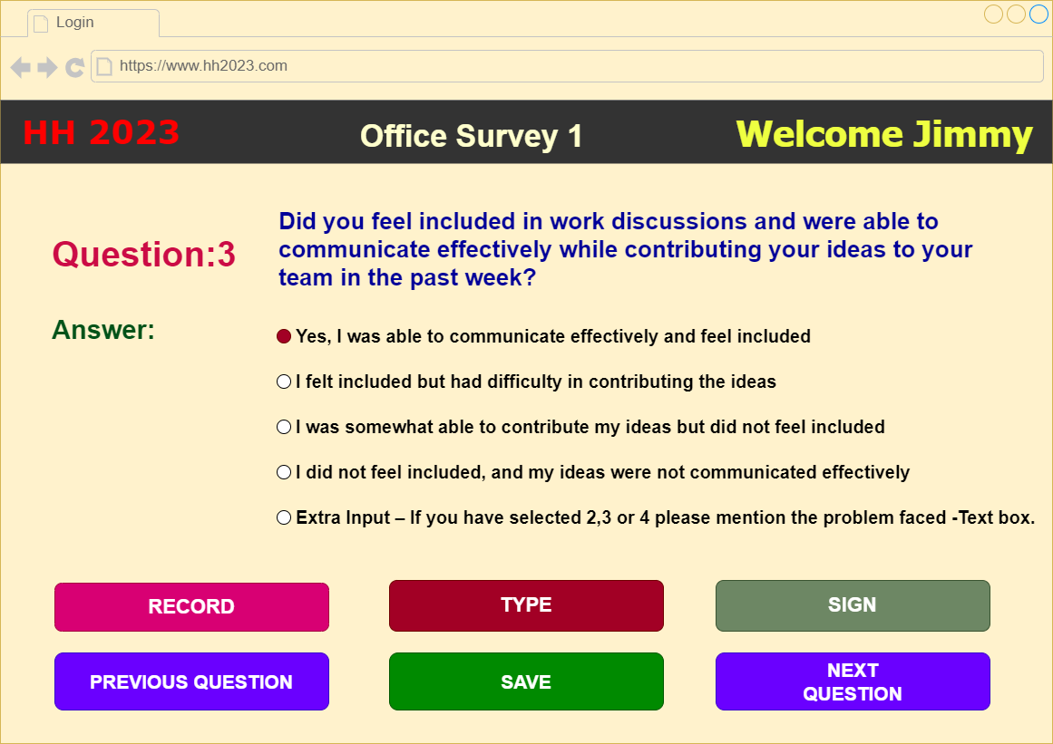
Demo
SHOURYA

Slide 12
Future Improvements
SHOURYA
Multi-Modal Feedback Options: Offer multiple ways for individuals to provide feedback, such as through text, voice recordings, or even video submissions. Include alternative formats for those who may have difficulty with traditional written feedback.
Clear and Simple Language: Use plain language to make questions and instructions easily understandable. Avoid jargon or complex terminology that might be confusing.
Customization Options: Allow users to customize the feedback form based on their preferences and needs. For example, they may choose the color scheme or layout that is most comfortable for them.
Assistance and Guidance: Include assistance options, such as live chat support or a helpline, for those who may need help filling out the form.
Multi Languages Support: Offer multiple languages to submit feedback form.

Slide 13
Thank You
SHOURYA
Members of Team SHOURYA
Reshma Bhale
Jitendra Solanki
Abhinav Sharma
Abhinav Tyagi
Sagar Babaleshwar
Mohnish Singh

