Slide 1

MACHINE LEARNING-POWERED PORTFOLIO ALLOCATION SYSTEM
by:
Aryan Parmar (241B048)
Shivam Saxena (241B334)
Arnav Purohit (241B043)
Under the supervision of:
Dr. Amit Kumar Rathi
Jaypee University of Engineering & Technology, Guna

Slide 2
Portfolio Allocation Platform — Project Overview
Platform Overview
Production-Grade Research Platform: Engineered specifically for Indian equity markets (NSE), replicating institutional quant research infrastructure.
Full Lifecycle Coverage: Covers data ingestion, strict validation, cleaning, feature engineering, and multilevel ML modelling, signal generation, backtesting, and portfolio analytics.
Hedge Fund Architectural Discipline: Replaces brittle ad-hoc scripts with transactional db layers, partitioned data lakes, and automated verification.
Core Objective & Engineering Principles
Core Objective: Build a modular, institutional-style research environment supporting the complete quantitative research.
Data Infrastructure as Foundation: Prioritize enterprise data infrastructure before predictive modeling to ensure all downstream research is mathematically valid.
Institutional Quality Standards: Multi-tier Parquet lake for high-speed time-series analytics paired with PostgreSQL 15 and Alembic for relational schema versioning.

Slide 3
Problem Statement — The Financial ML Reliability Gap
The Prevalent Pitfall in Financial ML
Rush to Predict: Most student and retail projects jump directly to training models (e.g. LSTM/Random Forest) on raw CSV downloads without data engineering.
Zero Schema Discipline: Absence of formal relational databases, schema constraints, or type validation allows corrupted and shifted records to enter training sets.
Data Leakage & Snooping: Uncontrolled feature preprocessing introduces lookahead bias and survivorship bias, making models appear profitable in theory only.
Why it Matters: Profitable Quant
Garbage In, Garbage Out: Any predictive model built on unvalidated, inconsistent data is worthless regardless of algo-complexity.
False Alpha & Illusory PnL: Data errors distort backtests into reporting unrealistic returns that collapse under real execution costs and clean data feeds.
Heavy Institutional Investment: Top quant firms allocate >70% of engineering bandwidth to data ingestion & cleaning.

Slide 4
Literature Review & Technical Gap Analysis
1. Existing Retail Platforms & Open-Source Limitations
Architectural Deficits: Tools like basic backtesting.py scripts and Kaggle notebooks lack persistent relational databases, schema constraints, and transaction safety.
Missing Pipeline Segregation: Typically bundle ingestion, cleaning, and model evaluation into single scripts without decoupled data lake tiers (raw vs. processed vs. features).
2. Institutional Quant Research Infrastructure Practices
Decoupled Stage Discipline: Industry platforms universally separate data ingestion, point-in-time validation, cleaning, and feature engineering into independently testable modules.
Dual Analytical/Transactional Tiers: Pair columnar time-series storage (Apache Parquet) for multi-gigabyte backtests with relational ORMs (PostgreSQL) for transactional state and metadata.
3. Explicit Technical Gaps Addressed by This Platform
Alembic Versioning & Idempotent Upserts: Enforces schema version migrations via Alembic and PostgreSQL ON CONFLICT DO UPDATE upserts to prevent data duplication.
Transaction-Isolated Verification: Implements automated repository test suites operating inside isolated database transactions with zero persistent test pollution.

Slide 5
Project Work Plan — 13-Week Roadmap
Week & Work | Status
Week 1 — Database Design & Schema Setup | COMPLETED
Week 2 — NSE Data Collection | COMPLETED
Week 3 — Data Validation & Cleaning Pipeline | COMPLETED
Week 4 — Data Storage & Processing Layer | COMPLETED
Week 5 — Feature Engineering Pipeline | COMPLETED
Week 6 — Database Repository Layer & Testing | COMPLETED
Week 7 — ML Dataset Construction & Model Training | IN PROGRESS
Week 8 — Model Evaluation & Prediction Pipeline | PENDING
Week 9 — Signal Generation System | PENDING
Week 10 — Backtesting Engine | PENDING
Week 11 — Portfolio Construction | PENDING
Week 12 — Performance Analytics & Dashboard | PENDING
Week 13 — Automation & Production Readiness | PENDING

Slide 6
Individual Contribution & Responsibilities
Member Name | Enrollment No. | Contribution
Shivam Saxena | 241B334 | Built NSE data ingestion (yfinance connector with retry logic) and data validation/cleaning enforcing quality gates.
Aryan Parmar | 241B048 | Built the feature engineering pipeline that defines the exact inputs and prediction targets for machine learning models.
Arnav Purohit | 241B043 | Designed the PostgreSQL schema and built the parquet-based data lake storage layer.

Slide 7
Work Done So Far — System Architecture
Start
ML Model Training
(Ridge, XGBoost, LightGBM + MLflow)
Ingest NSE data via yfinance
Prediction Pipeline
Raw Parquet storage
Signal Generation
(threshold-based, rank-based)
Validation & Cleaning
Processes storage
(returns computed)
Backtesting Engine
Portfolio Construction
(equal-weight, vol-weighted, mean-variance optimization)
Feature Engineering
(trend, momentum, volatility, mean-reversion, volume & targets
Performance Analytics
(Sharpe, Sortino, drawdown, benchmark comparison)
PostgreSQL Metadata & Repository Layer
(assets, prices, features, signals, trades, portfolio_metrics)
Dashboard & Visualization
End-to-End Pipeline
End

Slide 8
Work Done So Far — Dataset Details & Storage
Data Source & Ingestion Connector
Market Source: National Stock Exchange of India (NSE) equities and benchmark indices.
Connector Interface: yfinance API wrapper enhanced with automated retry logic and rate-limiting.
Ingestion Resilience: Exponential backoff handling network throttling and non-trading holidays.
Data Type & Schema Specification
Series Type: Daily OHLCV (Open, High, Low, Close, Adjusted Close, Volume) time-series.
Numeric Precision: 64-bit floating point for price fields; 64-bit integer for trading volumes.
Temporal Integrity: Timezone-aware normalized timestamps with strict market open/close alignment.
Universe Scope & Historical Depth
Equity Universe: NIFTY 500 equity universe (fully configurable YAML/JSON definitions).
Benchmark Indices: Key indices integrated: NIFTY 50 & NIFTY BANK
Historical Range: Multi-year historical daily bars enabling robust cross-sectional and temporal modeling.
Dual Analytical & Transactional Storage
Parquet Data Lake: Snappy-compressed partitioned storage across raw, processed, and feature tiers.
PostgreSQL Relational DB: ACID-compliant storage for asset metadata, price audit logs, and signal tables.
Migration Control: Alembic-managed db migrations guaranteeing 100% env parity.

Slide 9
Work Done So Far — Pipeline Methodology
Validation, Cleaning & Return Metrics
Strict Validation Rules:
Asserts High >= Low, Low <= Open/Close <= High; rejects negative volumes, missing dates, and abnormal price spikes.
Cleaning & Alignment:
Deduplicates records on symbol + date; aligns trading calendars; flags historical trading gaps.
Idempotent Persistence:
Upserts clean metrics directly into PostgreSQL and appends to processed Parquet lake.
5 Technical Feature Families Computed
1. Trend Indicators: Simple Moving Averages (SMA 20/50/200), EMA (12/26), MACD line, signal line, and histogram.
2. Momentum Indicators: Relative Strength Index (RSI 14), Rate of Change (ROC 10/20), Stochastic %K and %D oscillators.
3. Volatility Indicators: Bollinger Bands (20-day, ±2σ), Average True Range (ATR 14), Rolling Return Volatility.
4. Mean-Reversion Factors: Price Z-Scores relative to 20/50-day windows; normalized distance from major moving averages.
5. Volume Dynamics: Volume Moving Average (VMA 20), On-Balance Volume (OBV), Volume Z-Score surge indicators.

Slide 10
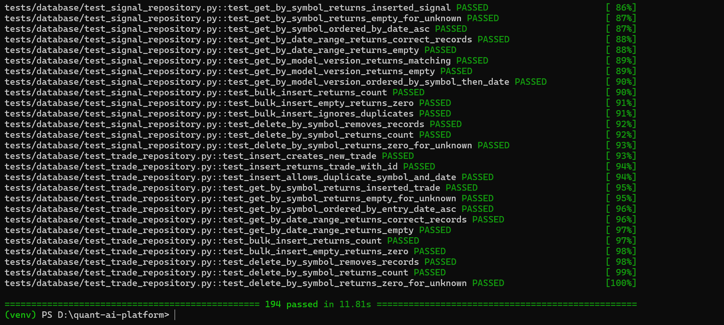
Work Done So Far — Validation Results
194 / 194
TOTAL PLATFORM TESTS |
100% Automated Test Pass Rate
91 / 91
REPOSITORY CRUD TESTS | Verified Against Live PostgreSQL
5 / 5
DATA LAKE TIERS | End-to-End Round-Trip Verified

Slide 11
Work to be Done — Predictive Engine (Weeks 7–13)
1. Machine Learning & Experiment Tracking
Predictive Models: Train Ridge/Lasso, XGBoost, and LightGBM models for forward return forecasting.
Chronological Splitting: Walk-forward train/test splits strictly preserving time-series causality (no lookahead bias).
MLflow Integration: Centralized tracking of model hyperparameters, feature importance, loss, and metrics.
2. Signal Generation & Backtesting Engine
Alpha Signal Strategies: Threshold-based triggers and cross-sectional percentile ranking across universe.
Event-Driven Backtest Engine: Realistic execution engine modeling fill delays, order queues, and market liquidity.
Transaction Costs & Slippage: Incorporate brokerage, Securities Transaction Tax (STT), stamp duty, and dynamic slippage.
3. Portfolio Construction & Risk Control
Allocation Schemes: Equal-Weighting, Inverse Volatility Weighting, and Markowitz Mean-Variance Optimization.
Risk & Exposure Limits: Maximum position limits and sector concentration constraints
Rebalancing Logic: Periodic calendar rebalancing paired with volatility-triggered rebalance thresholds.
4. Performance Dashboard & Deployment
Institutional Tear Sheets: Automated calculation of Sharpe, Sortino, Calmar ratios, Maximum Drawdown, and Win Rate.
Automated Production Scheduling: Scheduler executing daily market ingestion, feature updates, and signal logs.

Slide 12
Conclusion & Expected Outcomes
Weeks 1–6:
Enterprise Foundation Established
Foundation: Completed the failure-prone phase of quantitative modeling: robust, production-grade data infrastructure.
6 Operational Architectural Layers: Successfully implemented and validated database schema, ingestion connectors, validation rules, parquet lake, feature engineering, and repository CRUD.
194 Verified Automated Tests: 100% test coverage across db operations, transaction rollback isolation, and data pipeline consistency.
Elimination of Pitfalls: Eliminated unvalidated data, lookahead leakage due unstructured CSV sprawl.
Week 7-13:
Expected Outcomes
End-to-End Quantitative Platform: An institutional-grade research platform capable of ingesting market feeds, generating machine learning forecasts, and executing realistic backtests.
Realistic Alpha Evaluation: Event-driven simulation accounting for brokerage, slippage, and STT guarantees backtest results reflect true market tradeability.
Demonstration of Software Rigor: Serves as a credible demonstration of production-grade financial ML engineering, architectural discipline, and reproducible science.

Slide 13
References
Re
References
Y. Hilpisch, Python for Finance: Mastering Data-Driven Finance, 2nd ed. Sebastopol, CA, USA: O'Reilly Media, 2018.
SQLAlchemy Documentation, "SQLAlchemy 2.0 ORM Guide," SQLAlchemy Project, 2024. [Online]. Available: https://docs.sqlalchemy.org/
Alembic Documentation, "Database Migrations for SQLAlchemy," 2024. [Online]. Available: https://alembic.sqlalchemy.org/
Apache Software Foundation, "Apache Parquet Documentation," 2024. [Online]. Available: https://parquet.apache.org/
yfinance Contributors, "yfinance: Yahoo Finance Market Data Downloader," GitHub Repository, 2024. [Online]. Available: https://github.com/ranaroussi/yfinance
National Stock Exchange of India, "NSE Market Data," 2024. [Online]. Available: https://www.nseindia.com/

