Slide 1
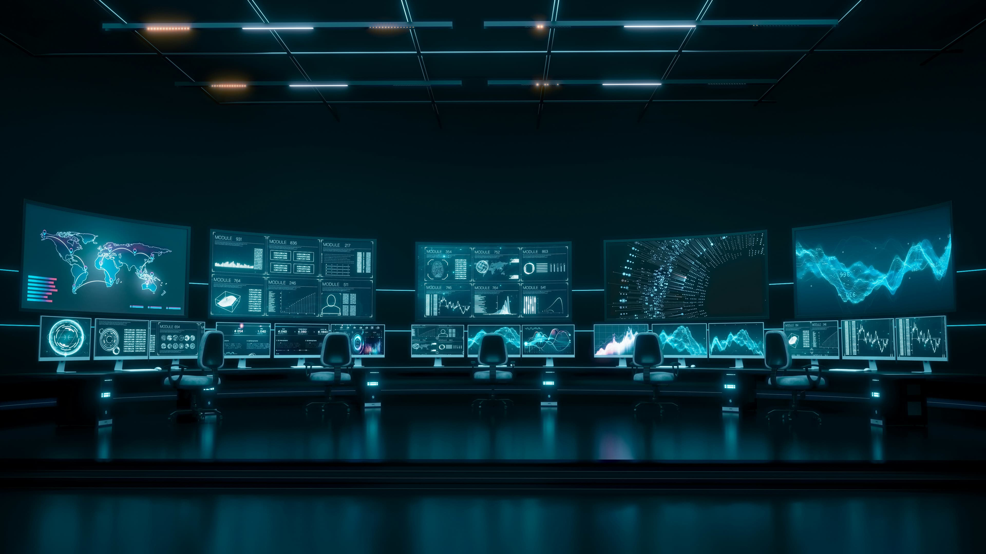


LIVE THREAT INTELLIGENCE // MISSION WALL
CyberShield
Real-time cyber threat intelligence — aggregated, scored and explained as it happens.
19
10
4 MIN
SELF-HOSTED // FREE-HOST READY
LIVE SOURCES
THREAT CATEGORIES
CACHE REFRESH

Slide 2
WHAT IT IS
One live wall for the world’s cybersecurity reporting.
CyberShield is a self-hosted threat-intelligence dashboard. It pulls cybersecurity news from 19 trusted research streams into a single real-time feed — automatically scoring every story for severity, classifying it into threat categories, and explaining what it means on demand with an AI analyst verdict.
✦
AGGREGATOR
◯
EXPLAINER
✦
AWARENESS LAYER
19 streams, one deduplicated wall, refreshed every 4 minutes.
AI verdicts in SOC format: threat class, severity, immediate actions.
Not a scanner or firewall — it keeps you informed, not the network patched.
⚿
RUNS ON A FREE HOSTING TIER — NO PAID SERVICES REQUIRED.

Slide 3


WHY IT EXISTS
Threat intel is scattered. Decisions are slow.
⚠
WITHOUT CYBERSHIELD
⛨
WITH CYBERSHIELD
01
Reporting scattered across dozens of blogs, vendor advisories and government feeds
01
One wall: 19 streams merged, deduplicated and cached
02
Triage means opening 10+ tabs every morning
02
Machine-speed scoring: every story rated CRITICAL / HIGH / ELEVATED / MODERATE
→
03
Severity is guesswork — a scary headline is not a severity score
03
10 threat categories for instant triage
04
Non-specialists freeze at jargon and CVE soup.
04
Plain-language AI verdict tells you what happened, why it matters, what to do.

Slide 4

HOW IT WORKS
From raw feeds to decisions in five stages.
01
02
03
04
05
AGGREGATE
DISTILL
SCORE
CLASSIFY
SERVE
Fetches 19 XML streams directly; public-converter relay is the automatic fallback.
Deduplicates stories, picks the best thumbnail, distills an analyst lede.
Keyword-and-signal engine rates every story CRITICAL / HIGH / ELEVATED / MODERATE with a 0-100 score.
Sorts stories into 10 threat categories from Ransomware to AI Security.
Caches the snapshot: 4-minute fresh window, 30-minute stale-safe serve while a background refresh runs.
→
→
→
→
✦
STACK — NEXT.JS APP ROUTER · PRISMA + SQLITE CACHE · 5 API ENDPOINTS · ZERO DATABASE SERVERS

Slide 5
CORE FEATURE 01
Every stream that matters, on one wall.
The aggregation engine monitors 19 research streams — direct XML first, with a public-converter relay as automatic fallback so a blocked host never blanks the wall.
BPC
BleepingComputer
THN
The Hacker News
TPOST
Threatpost
KREBS
Krebs on Security
SECWK
SecurityWeek
HNS
Help Net Security
INFOMAG
Infosecurity Magazine
SCOOP
CyberScoop
RECORD
The Record
CLULEY
Graham Cluley
MBLabs
Malwarebytes Labs
SECLST
Securelist
U42
Unit 42
MSFT
Microsoft Security
S1
SentinelOne Labs
SCHNEIER
Schneier on Security
ARS
Ars Technica Security
ZDI
Zero Day Initiative
CISA
CISA Advisories
🏛
✓
Duplicate collapse across outlets
✓
Best-thumbnail extraction per article
✓
Per-story severity + read-time

Slide 6


CORE FEATURE 02
An AI analyst reads every story with you.
AI ANALYST VERDICT // REPORT
THREAT CLASS
Ransomware Campaign
Open any article and the GLM model distills a SOC-grade verdict in seconds: what happened, why it matters, and the three actions to take first. Verdicts are cached in SQLite keyed by article URL, so a repeat investigation is instant — and REANALYZE re-runs it on demand.
SEVERITY RATING
CRITICAL
92/100
— active exploitation of unpatched edge devices
WHAT HAPPENED
3-LAYER UPLINK RESILIENCE
2-3 punchy sentences of concrete facts only.
L1
Live credentials — direct model call
WHY IT MATTERS
L2
Forwarded auth — gateway-injected fresh headers
defender impact in one or two lines.
L3
Offline analyst — deterministic heuristic verdict, never dead-ends.
IMMEDIATE ACTIONS
▸ patch exposed services
▸ hunt for IOCs
▸ force credential rotation
CACHED VERDICTS · FORCE REANALYZE · NO INVENTED FACTS

Slide 7
CORE FEATURE 03
Known-exploited vulnerabilities, checked mid-investigation.
CyberShield serves the official CISA Known Exploited Vulnerabilities (KEV) catalog server-side. When a story mentions a CVE, the drawer cross-checks it against the catalog — so you know within seconds whether a flaw is not just published, but actively exploited in the wild.
▦
1.7 MB CATALOG — memory-cached
✓
PRIMARY: cisa.gov
✦
FALLBACK: 1:1 auto-synced mirror
RECENCY SCALE
CRITICAL
— added to KEV ≤ 30 days
HIGH
— added ≤ 180 days
WATCH
— older entries
03
⇄
Mirror fallback keeps the wall alive if the official edge rejects datacenter traffic.

Slide 8

CORE FEATURE 04
See the world’s threat activity, not just a list.
01
02
03
◯
✦
▦
3D THREAT GLOBE
RADAR BOOT SEQUENCE
JARVIS VOICE GREETING
A WebGL globe plots global reporting in space — instantly grasp where activity concentrates, powered by three.js with GSAP-driven motion.
Every session starts with a cinematic threat-radar sweep and an honest terminal boot log — the wall is verified live before you read it.
An optional voice assistant greeting announces the session; audio unlocks only after a user gesture and is one toggle away from silence.
THREE.JS · GSAP MOTION
CINEMATIC SWEEP · BOOT LOG
USER-GESTURE AUDIO UNLOCK
WEBGL GLOBE·GSAP CHOREOGRAPHY·PRIVACY-SAFE AUDIO TOGGLE·REDUCED-MOTION SUPPORTED

Slide 9



CORE FEATURE 05
From headline to hands-on in one click.
Click any story to open the investigation drawer: the full AI verdict, the story’s category context, a KEV cross-check for mentioned CVEs, and a clean link out to the original source.
10 CATEGORY FILTERS
All Signals
Ransomware
Zero-Days & CVEs
Data Breaches
APT & Nation-State
Malware
Phishing & Scams
AI Security
Cloud & Enterprise
Mobile & IoT
SEVERITY
→
→
→
CRITICAL
HIGH
ELEVATED
MODERATE
Triage a full day of global reporting in minutes — filtering beats scrolling.

Slide 10

WHO IT'S FOR
Built for anyone who needs to know first.
SEGMENTS // 06
⛨
01
☻
02
✦
03
SOC & SECURITY TEAMS
IT MANAGERS
ANALYSTS & RESEARCHERS
A shared live wall for the ops room — everyone reads the same scored feed.
Vendor-neutral awareness: know what is being exploited before it lands in your stack.
Cross-source dedupe and KEV cross-checks speed up open-source investigations.
▿
04
✎
05
◆
06
EDUCATORS & STUDENTS
NEWSLETTER & CONTENT CREATORS
EXECUTIVES
Real cases, real severity scores — the threat landscape as living course material.
The five-minute morning read: highest-severity items first, plain-language verdicts.
Never miss the story: 19 streams, deduplicated, with thumbnails ready to quote.

Slide 11

HOW TEAMS USE IT
Four scenarios, four wins.
INPUT → OUTPUT // 04
01
MORNING BRIEFING
02
INCIDENT TRIAGE
Open the wall → scan scored headlines → read only CRITICAL/HIGH verdicts.
Paste a live article → AI verdict returns class, severity, 3 immediate actions.
RESULT
situational awareness before the first coffee
RESULT
defensible next steps in under a minute
03
VULNERABILITY WATCH
04
TEAM AWARENESS
A CVE appears in a story → KEV cross-check shows exploit status + recency tone.
Put the wall on the ops-room display → globe, ticker and severity tones keep everyone oriented.
RESULT
patch priorities that reflect reality
RESULT
one shared picture of the threat landscape

Slide 12


RUN IT YOUR WAY
Free-tier friendly by design, not by accident.
SERVERLESS // DOCKER // SELF-HOST
60s
function ceilings baked into every route — survives Vercel Hobby limits
DEPLOYMENT PATHS
VERCEL
push, import, deploy; time limits pre-configured in the route files
DOCKER
single Dockerfile, .dockerignore included
0
paid dependencies — public RSS, converter relay and mirror fallbacks only
SELF-HOST
any Node/Bun runtime; portable .env with a relative database path
DATA OWNERSHIP
self-host and your reading history stays yours.
1
file SQLite database — copy the folder, move the deployment
✦
NO VERCEL.JSON NEEDED — DURATIONS LIVE IN THE ROUTES · POSTINSTALL RUNS PRISMA GENERATE

Slide 13

CYBERSHIELD
Stay ahead of the threat.
Aggregated intelligence, machine-speed scoring, plain-language verdicts — on a wall you own.
19 SOURCES
AI VERDICTS
KEV CROSS-CHECK
3D THREAT GLOBE
VOICE GREETING
FREE-HOST READY
Download the package → deploy to your platform → informed in under five minutes.
CYBERSHIELD // REAL-TIME CYBER THREAT INTELLIGENCE

