Slide 1
Lending Club Case Study
Prepared By:
Chaitra Hegde
Neeraj Kumar

Slide 2
Objectives
Identifying the driving factors which can indicate if a loan is likely to be a charge off (borrowers who don’t repay the loan amount)
Providing recommendations to investors so that they can decide on whether to approve loan for applicant or not.

Slide 3
Variable Analysis
Driving Factors: Individual variables
Interest rate
Purpose
Term
Grade
Annual Income
Address State
Home Ownership
Public Bankrupcies

Slide 4
Variable Analysis
Driving Factors: Combination of variables
Loan amount vs Home ownership
Loan amount vs Purpose
Annual Income vs Purpose
Interest Rate vs Purpose
Loan amount vs Grade

Slide 5
Variable Segemntation for Analysis
Ordered Catagorical Variables
loan_amnt
int_rate
grade
sub_grade
emp_length
home_ownership
annual_inc
dti
delinq_2yrs
mths_since_last_delinq
pub_rec_bankrupcies
Unordered Categorical Variables
term
purpose
addr_state
verification_status
Quantitative Variables
loan_amnt
int_rate
installment
annual_inc
dti
delinq_2yrs
mths_since_last_delinq
pub_rec_bankruptcies

Slide 6
Exploratory Data Analysis
Data Cleaning:
It was observed that data has null features and some features have more than 75% null values. These features do not add value to the analysis and were removed.
Next step was to do data imputation, where two attributes (mths_since_last_delinq & pub_rec_bankruptcies) had a few null values. It is safe to assume that both of the above features wherever they have null values, do not have any deliquencey or bankrupcy reported. Hence replacing their number values to 0 and also converted them to int type.

Slide 7
Exploratory Data Analysis
Data Transformation:
Removed % from int_rate.
Extracted only integer from emp_length
Extracted only year from issue_d
Transformed loan_status values to 0 / 1 => Fully Pain = 1, Charged off = 0

Slide 8
Conclusion
Observations from Quantitative Analysis:
75% of the loans have been under $14000. Average interest charged on the loans is 11.9%. 50 percentile of dti is at 13 which means that loan amounts sanctioned had good coverage in terms of the income of the borrower.
Total number of Charged off records are 5627 (~ 15%) and Total number of Fully Paid records are 32950 (~ 85%)
Number of Loans approved increasing every year. Pecentage of charged off loan is around 15% for last three years.
Conclusions from Data Analysis:
Issue data analysis tells us that largest percentage of defaults happend in loans issued in year 2007.
Continued...

Slide 9
Conclusion
Conclusions from Data Analysis:
Percentage of defaults in loans having 60 months term is almost double of 36 months term. Club should negotiate for smaller term repayments for its loan.
Going by the purpose of the loan, default in small business loans is highest followed by loans taken for 'renewable energy'.
Larger percentage of default customer's loan interest rate was between 15% to 24%
Customers whose purpose of loan is small_business had large ticket loans as compared to other categories. other than loan purpose of type 'home'.
Larger percentage of default is in loan category grade as 'G' and 'F'
Grade 'F' loans are defaulting at the higher loan amounts ,charged off loans median = $18000, while fully paid loans have the median of approx $15000 median of charged off loans for remaining grades is either same or lower than the median of fully paid off loans.
Continued...

Slide 10
Conclusion
Conclusions from Data Analysis:
Going by the percentage of default customers, Nebraska has the highest rate of default (~ 60%).
Approximate 40% of default customers have two public bankrupcies.
Customers who have a mortgage loan are least likely to default.
Largest percentage of loan defaults are from customers whose home_ownership category is Other.
Customers who have taken more loans with high interest rate for debt consolidation have high default rate.
Continued...

Slide 11
Recommendations
Customers from Nebraska be reimbursed only for high grade customers.
Customers having two or more than two public bankrupcies may be denied loans.
Customers who have a mortgage loan but not taking loans for debt consolidation may be awarded preferences.
Customers whose home_ownership category is Other and are taking loan for debt consolidation are most liekly to default and be avoided.
Customers asking for 36 months term loan be preferred over 60 months term loans.
Customers whose purpose of loan is small_business should be verified for source of income and preferred if they have a mortgage for a 36 months term loan.
LC assigned grade as 'G' and 'F' may be approved for smaller ticket size loans and charged higher interest rate as risk of default is high.
Continued...

Slide 12
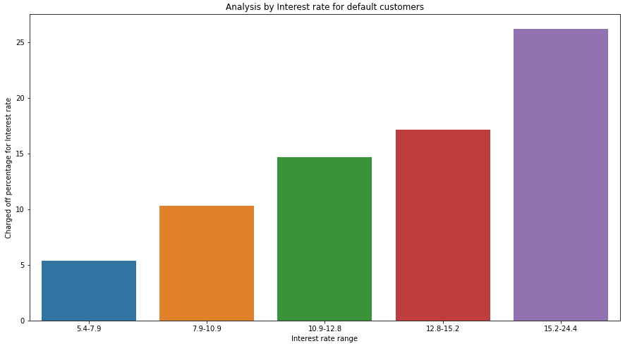
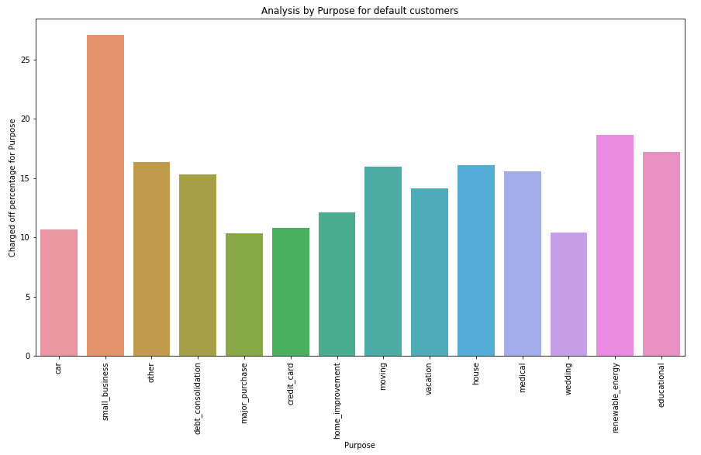
Exploratory Data Analysis Plots:
From here on you can enjoy various plots done to reach the conclusions and recommendations.
1.Interest Rate: Charged off percentage is more for higher interest rate.
2. Purpose: Default percentage is more for “Small Business” and “Renewable Energy” purpose.
Purpose of the loan should be a driving factor for new applicants

Slide 13
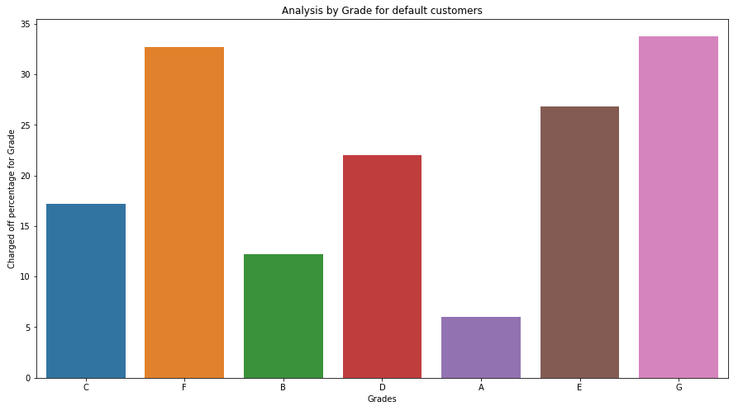
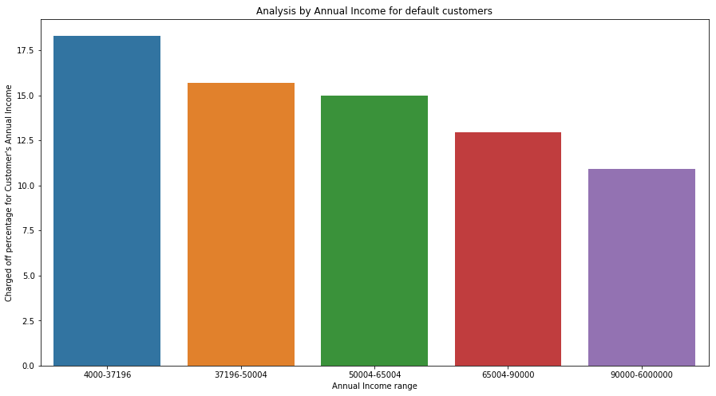
3. Grade: Default percentage is more for Grade G and F. For new applicants, Grade should be one of the driving factor
4. Annual Income: Charged off percentage is more for customers with lower income

Slide 14
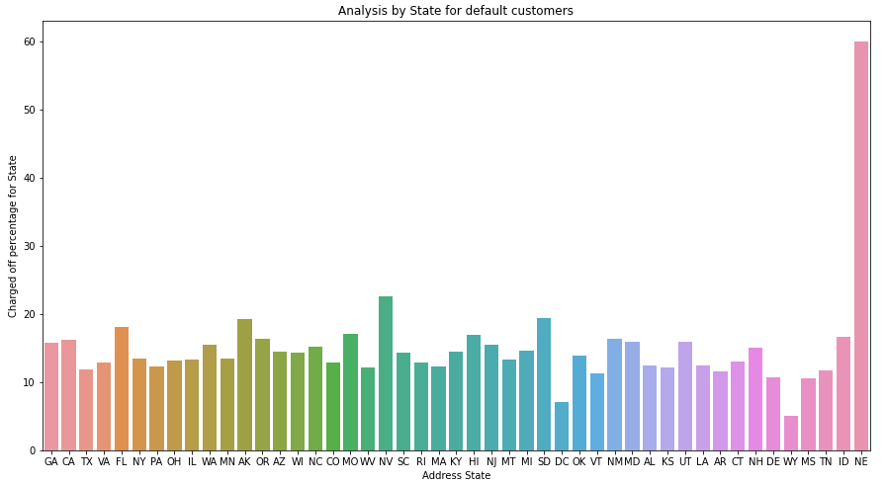
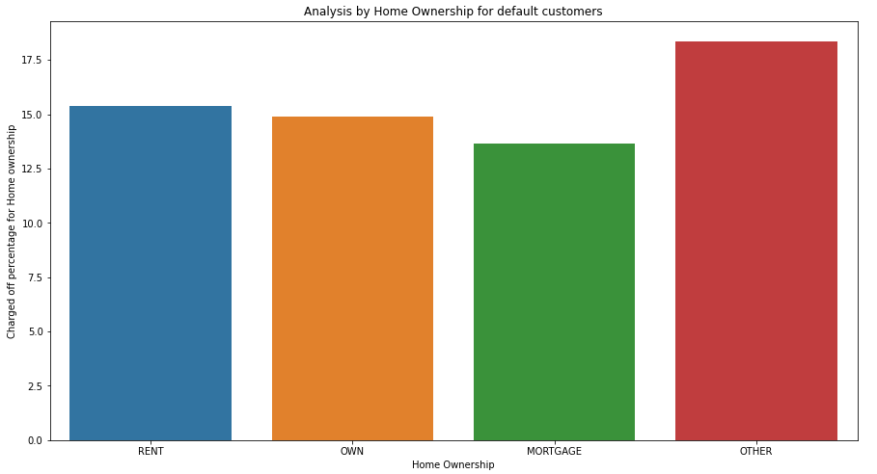
5. Address State: When the applicant is from the state NE or NV, he/she most likely to default
6. Home Ownership: Default percentage is more for the category “Other”. When the new applicant’s home ownership is “Other”, it should be taken into notice before approving the loan

Slide 15
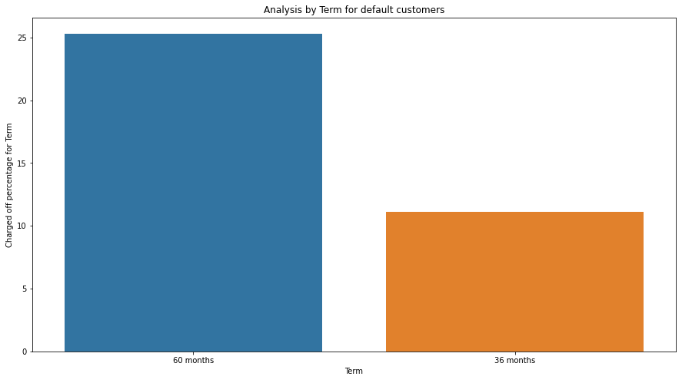
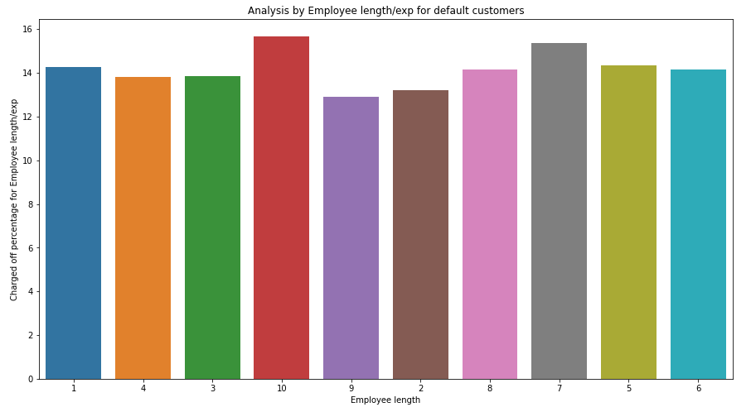
7. Term: When compared to 36 months tenure, customers with 60 months tenure defaulted more.
So, tenure should be taken into notice for new applicants
8. emp_length: Customers with 7 and 10 year experience defaulted mostly.

Slide 16
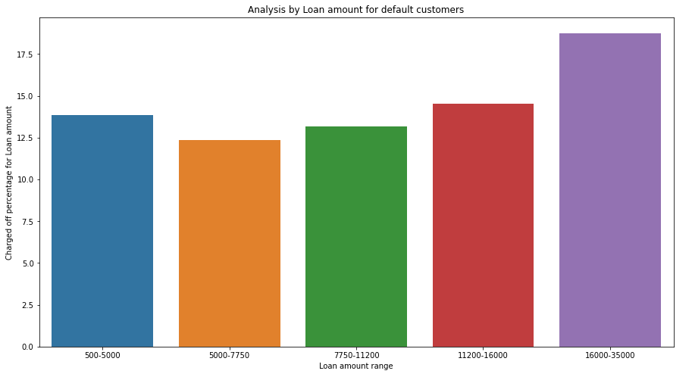
9. Loan Amount: Default percentage is more for larger loan amount i.e. 16k to 35k

Slide 17
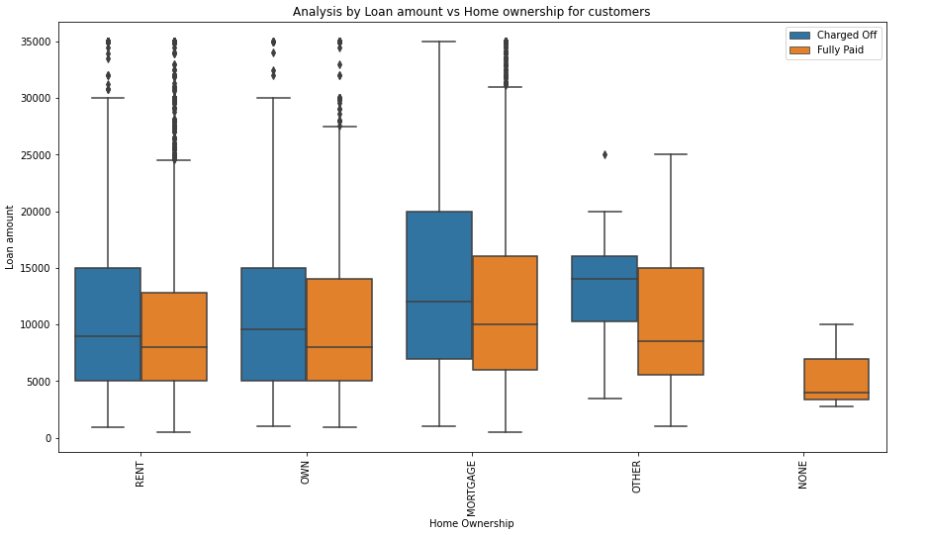
Loan amount vs Home ownership:
In the loan defaulted customers, customers whose home_ownership is OTHER have median of defaulted loans around 11000.

Slide 18
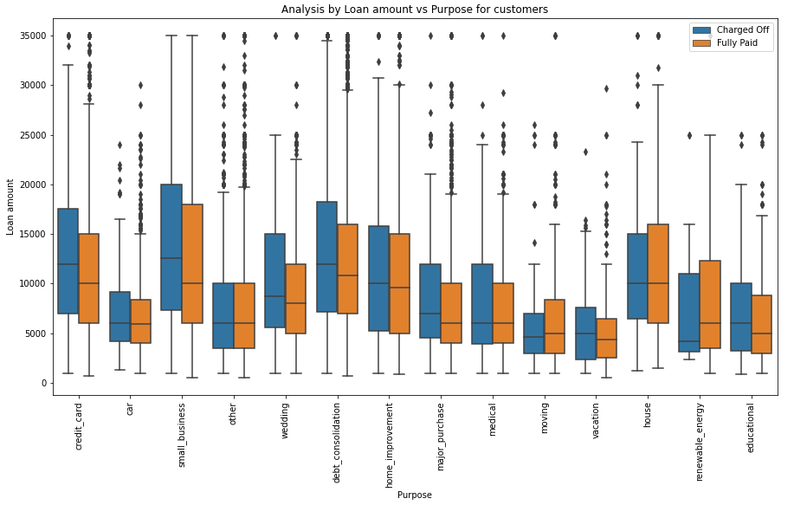
Loan amount vs Purpose:
Customers whose purpose of loan is small_business had large ticket loans as compared to other categories. other than loan purpose of type 'home'

Slide 19
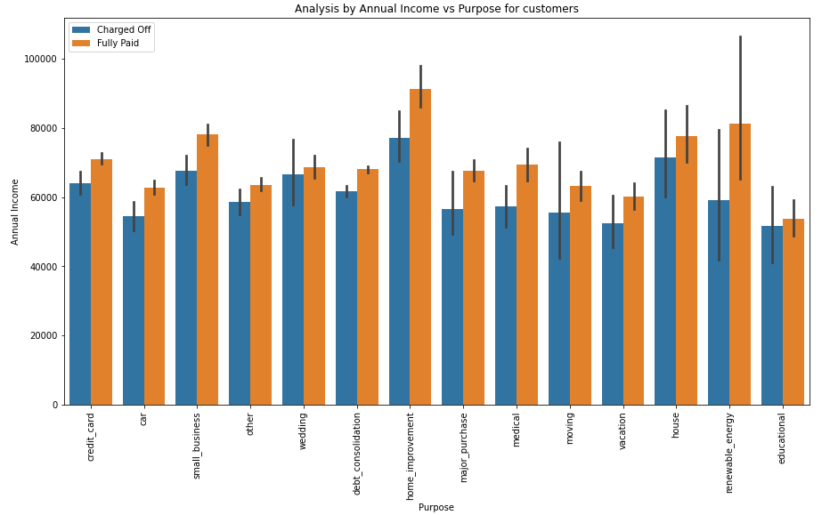
Annual Income vs Purpose:
In default customers, Customers with more annual income took loan for home_improvement. But wrt to loan default, there is no pattern.

Slide 20
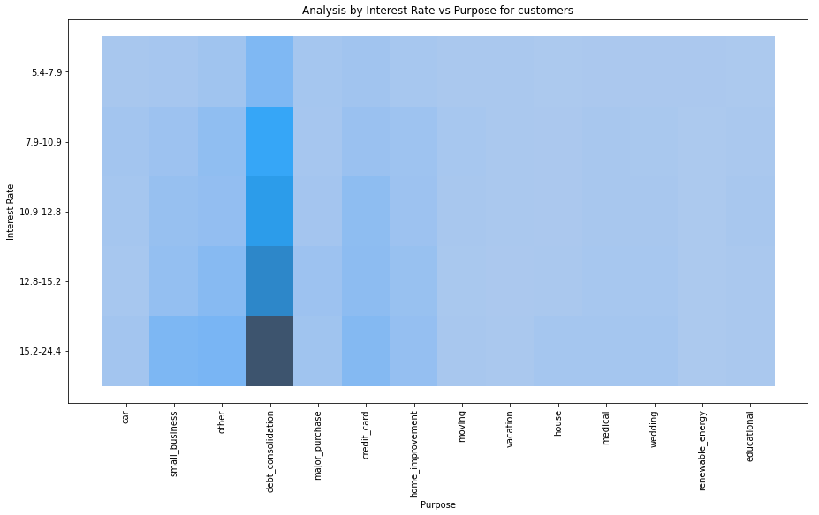
Interest rate vs Purpose:
Customers who have taken more loans with high interest rate for debt consolidation have high default rate.

Slide 21
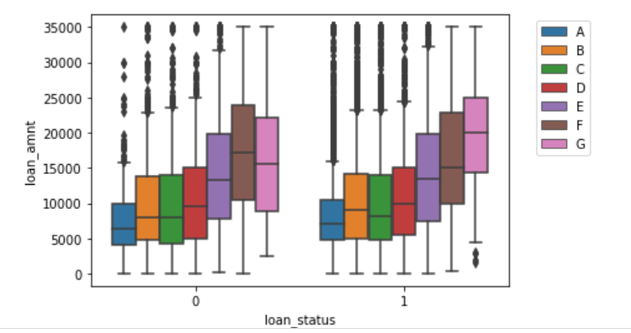
loan amount vs Grade
Grade F loans are defaulting at the higher loan amounts ,charged off loans median = $18000, while fully paid loans have the median of approx $15000.
Median of charged off loans for remaining grades is either same or lower than the median of fully paid off loans.

