Slide 1

Exploratory Data Analysis
Project Title:G2M insight for Cab Investment Firm
Report date: March 17,2023
Internship Batch: LISUM19
Name:Gladys Kalas

Slide 2

Agenda
Executive Summary
Problem Statement
Approach
EDA
EDA Summary
Recommendations

Slide 3
Problem statement and Objective:
Problem Statement :
XYZ is a private firm in the US. Due to the remarkable growth in the Cab industry company XYZ is planning for an investment in the Cab industry. The industry is not an easy ordeal with many potential competitors and market conditions hence based on their Go-to-Market(G2M) strategy, the company intends to understand the market and execute the final decision of investing in the right firm.
Objective:
Use of analytical approaches and hypotheses to produce meaningful unique insights to present to firm XYZ who is planning on investing in the right Cab company.

Slide 4
Approach
Steps in the analysis:
Study and investigate the given data sets.
Understand field names and data types
Transformation of features according to analysis.
To identify relationships and merging the right data sets.
Clean data free from duplicates and null values.
Exploratory data analysis
Hypothesis testing

Slide 5
Data set Analysis
Data sets:
File format-CSV Files
Cab_Data:
Features-7
Observations- 359392
Size-20.1 MB
2. Transaction_ID:
Features-3
Observations- 440098
Size-8.58 MB
3. Customer_ID :
Features-4
Observations- 49171
Size-1 MB
4. City:
Features-3
Observations- 20
Size-4 KB

Slide 6
Data set Analysis
Cab_Data
Transaction_ID
Customer_ID
City
Masterdata
Masterdata
Features-19 including 5 features gleaned from the given data sources
Observations-355032
Given time frame- 31/01/2016 to 31/12/2018
File type-CSV

Slide 7
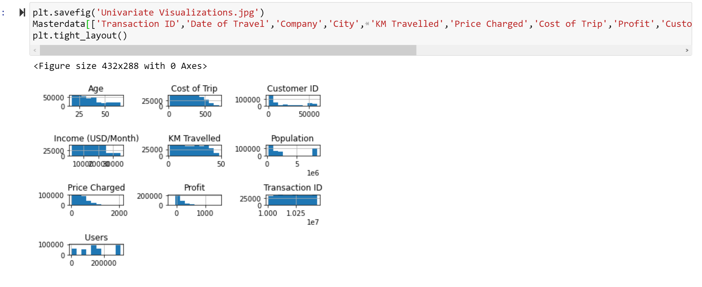
Univariate visualization:

Slide 8
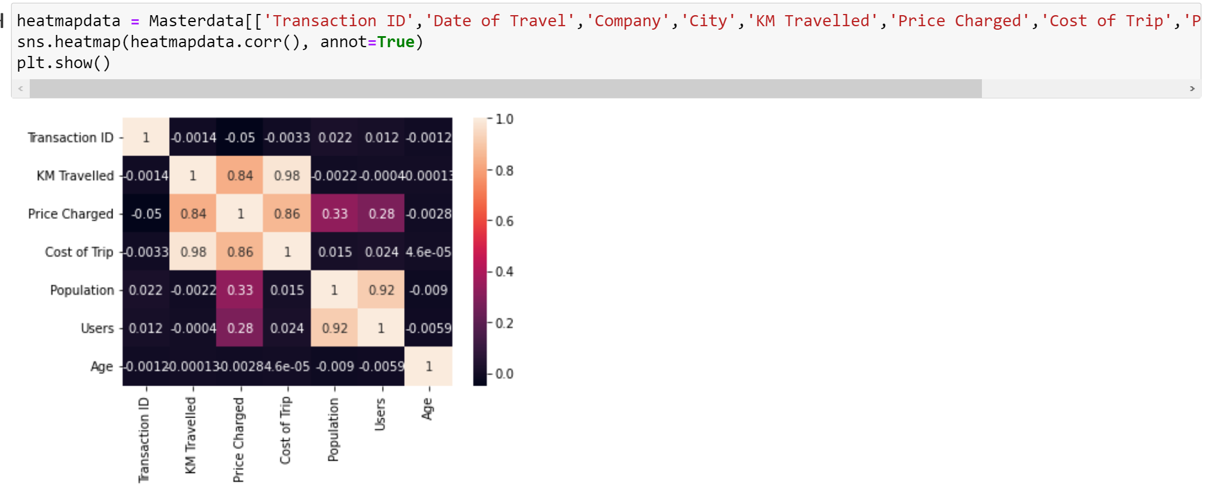
A linear positive correlation between * features KM Travelled, Price Charged, Cost of Trip and * features Population and Users

Slide 9
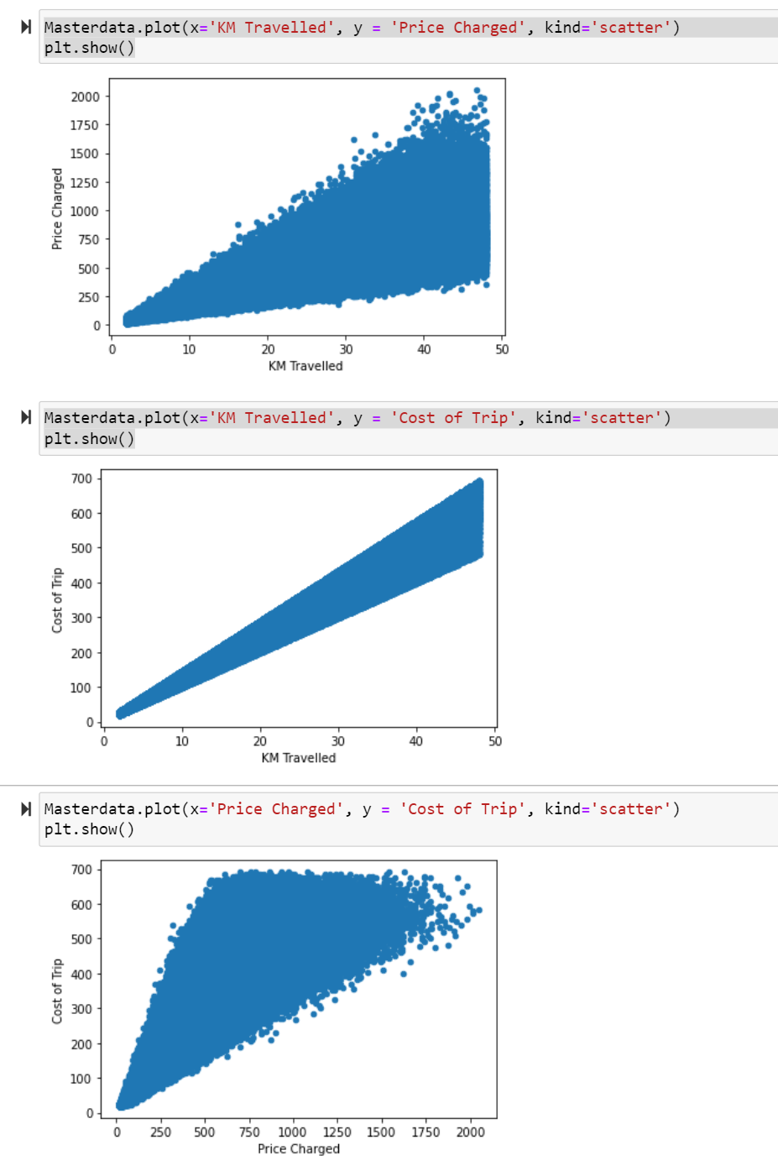
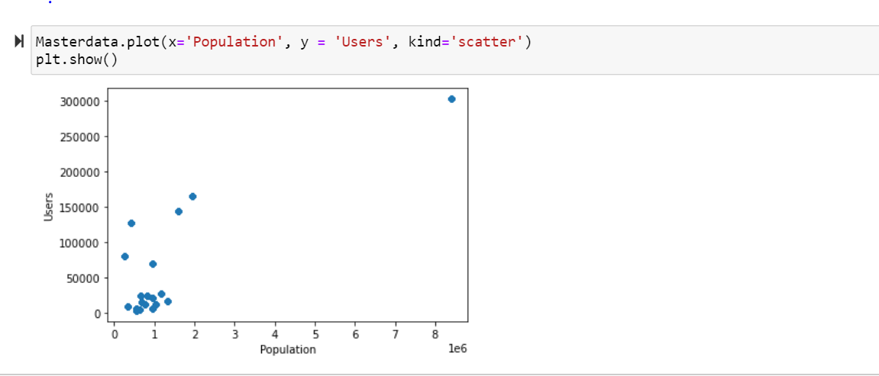
Scatter plots indicating positive correlation between features

Slide 10
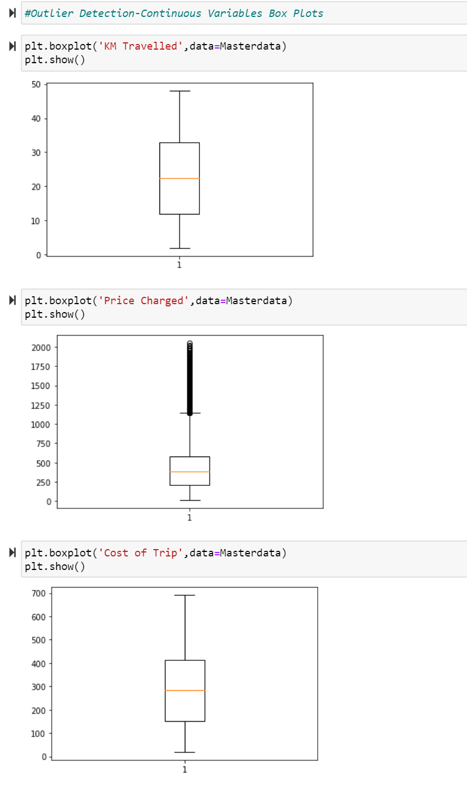
Outliers:
Feature(column) 'Price Changed' contains Outliers. These observations will not deleted as they might be required in further analysis.

Slide 11
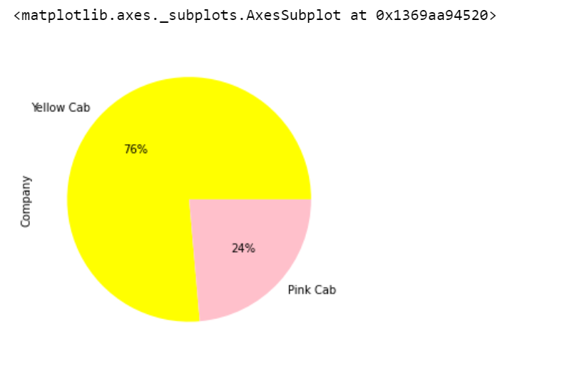
Company: Yellow cab and Pink cab
Yellow cab has majority coverage with 76%

Slide 12
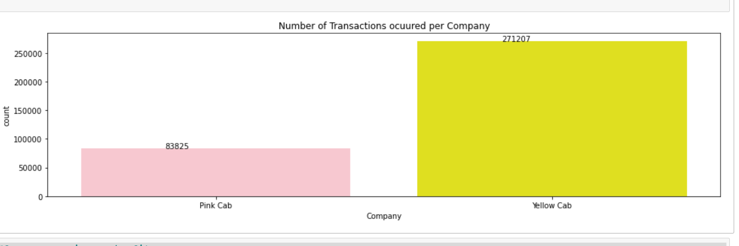
Transaction per Company:
Yellow cab company exceeds in the number of transactions occured

Slide 13
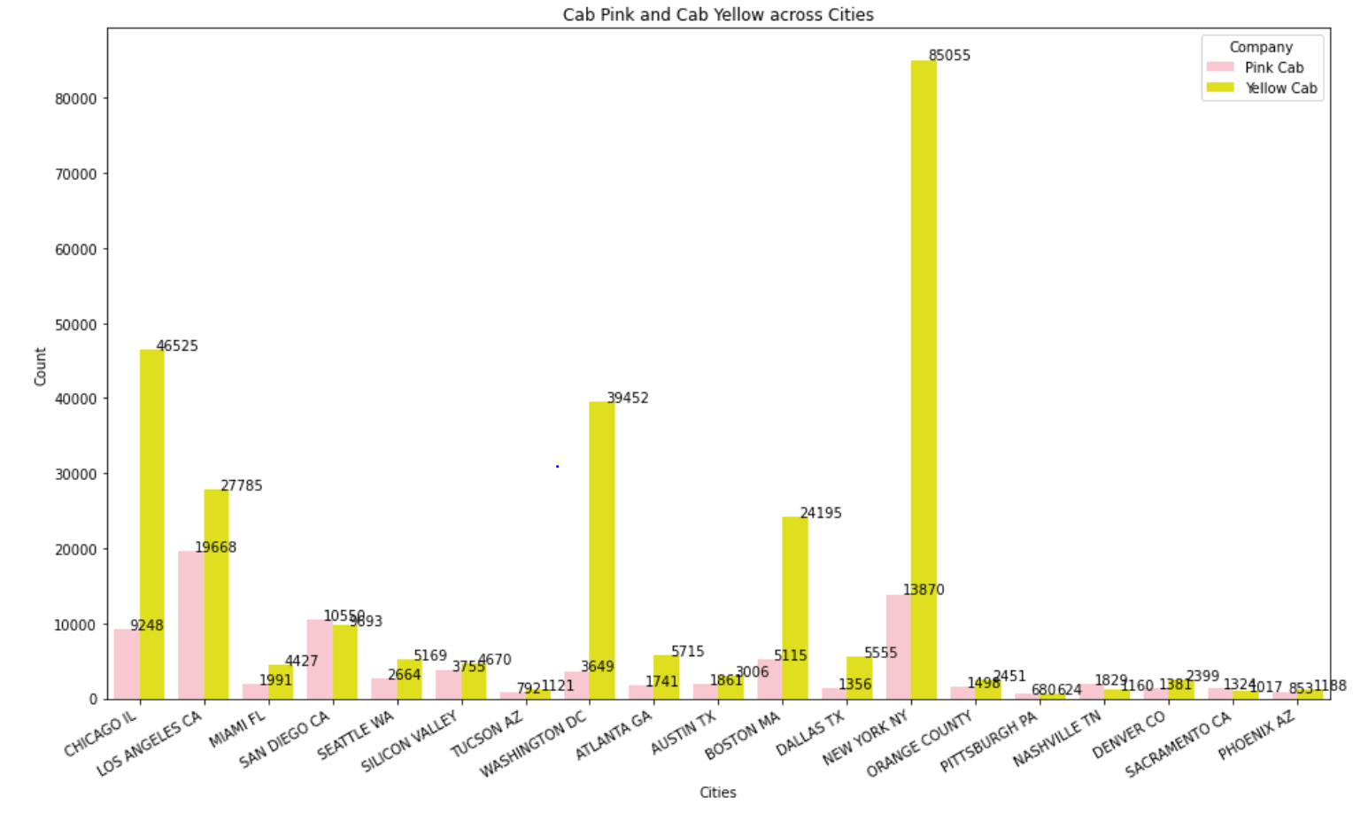
Cab companies across cities:
New York City NY state ,Washington DC,Chicago IL,Los Angeles CA and Boston MA cities have the highest Cab presence and Yellow Cab is of prefered over Pink Cab in most of the cities .
Pink Cab is higher in cities –San Diego,Nashville,Sacramento,Pittsburg

Slide 14
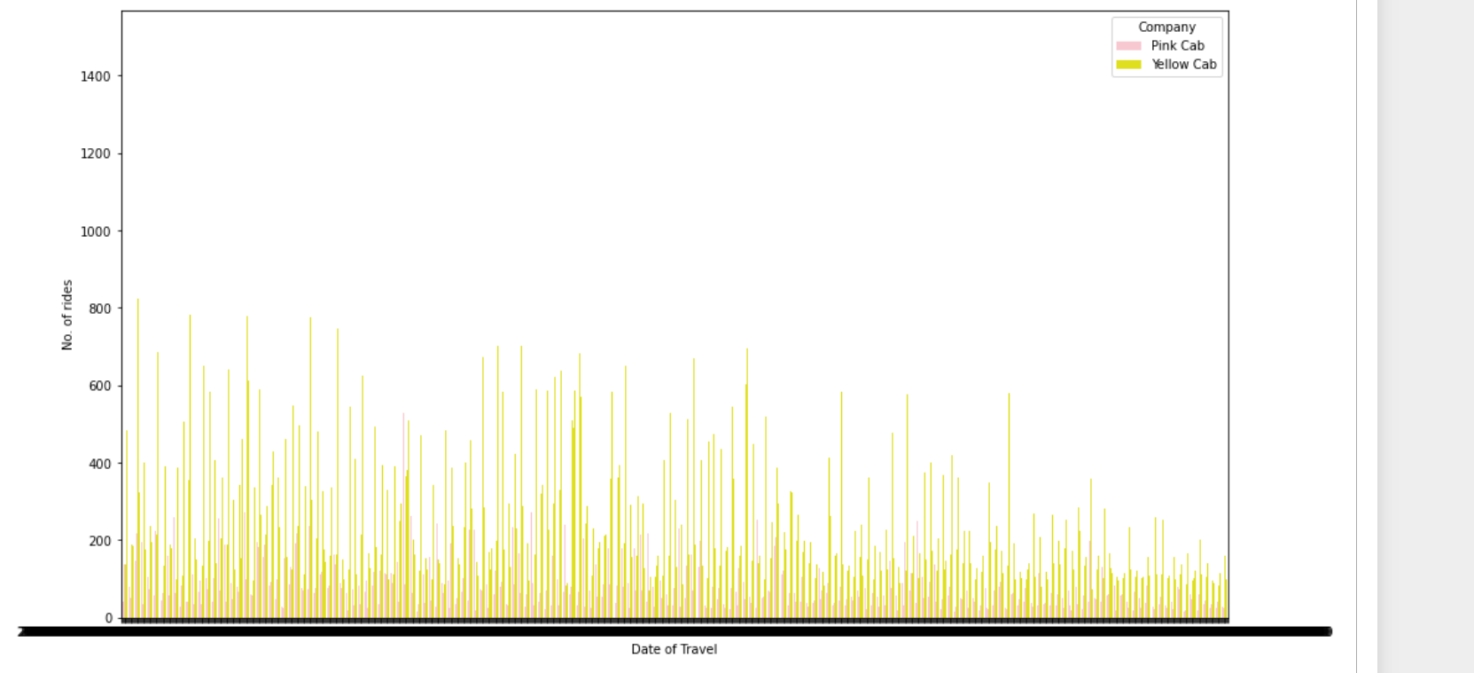
Cab rides on different dates:
Yellow Cabs seem to have more number of rides during days of travel.

Slide 15
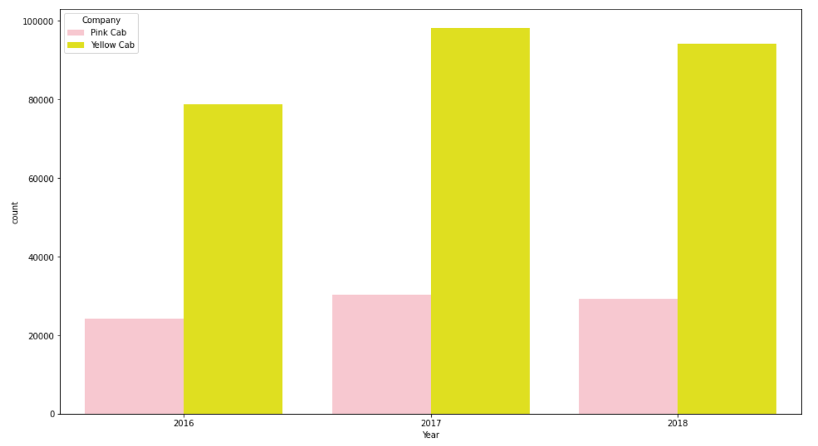
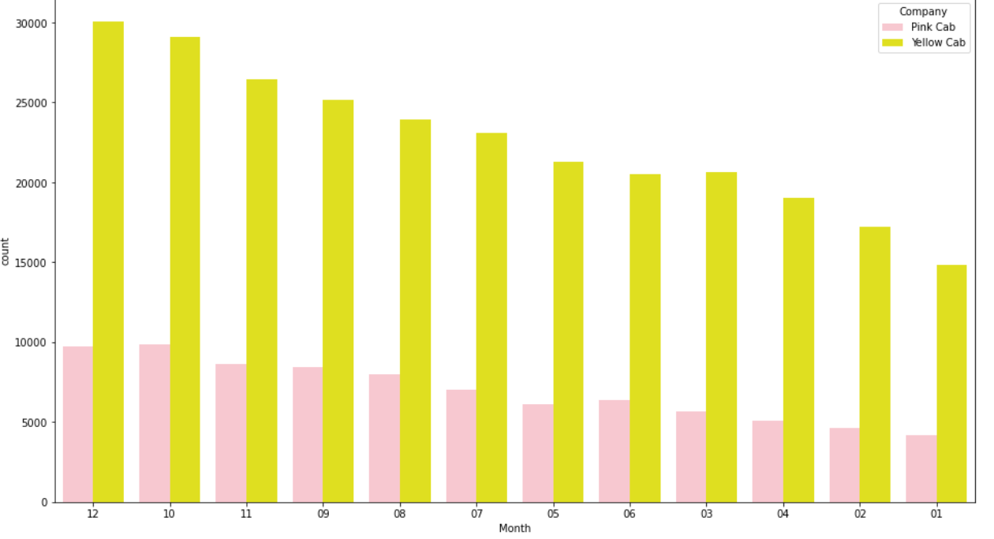
Cab rides Yearly, Monthly and Days of week:
Yellow Cab company have out passed Pink Cab all the years 2016-2018 and highest rides in 2017.
Cabs are at peak usage during December, October and November months and Yellow cabs are mostly preferred

Slide 16
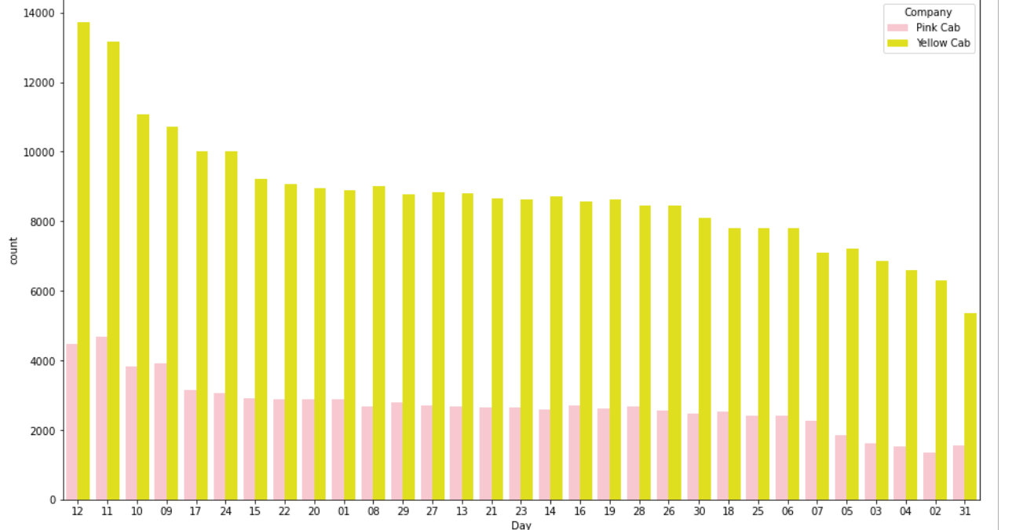
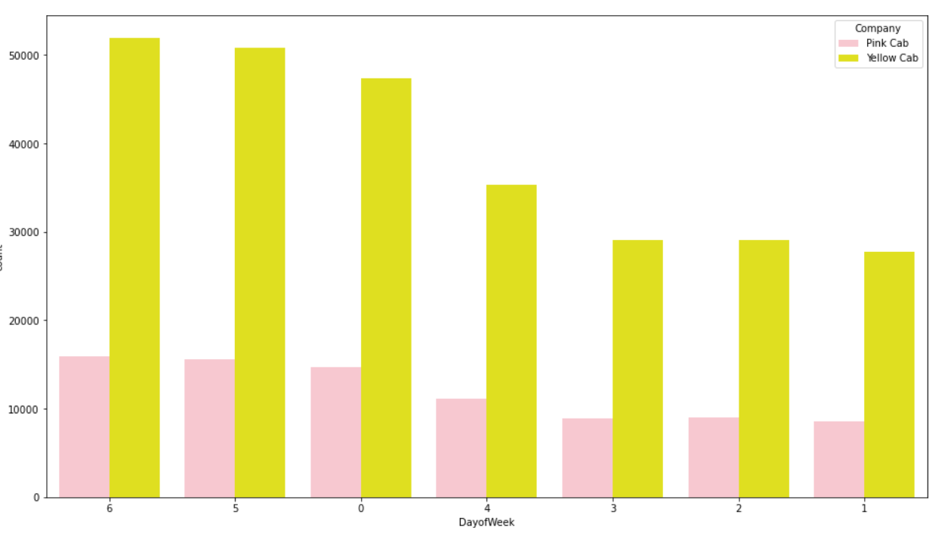
Cabs rides are higher during the 12th, 11th, 10th of the month
Cab rides clearly peak during the weekend(6-Sunday,5-Saturday,0-Monday) and Mondays

Slide 17
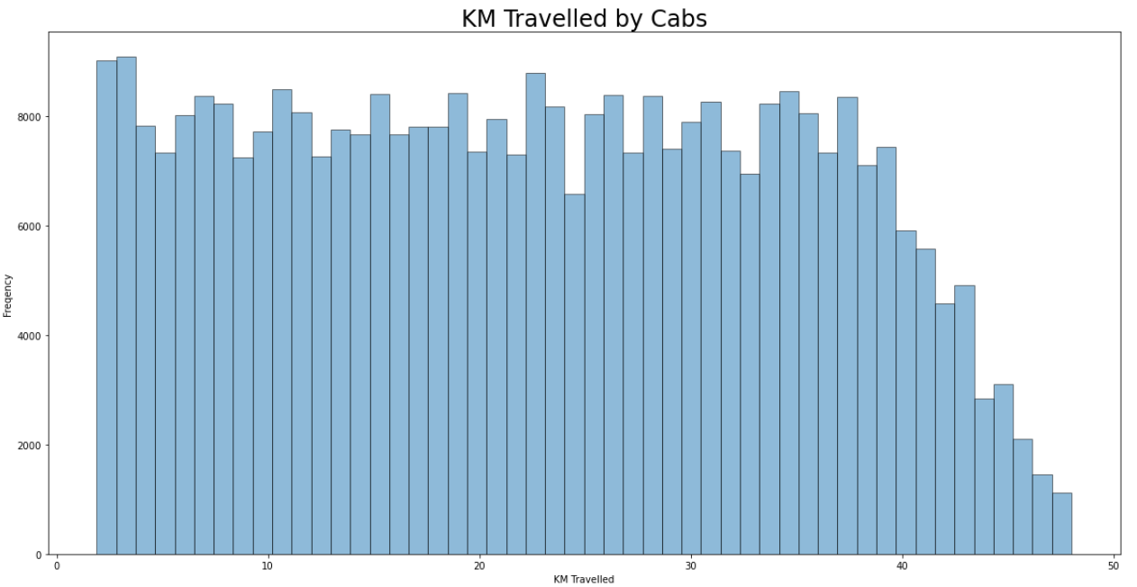
Average KM Travelled-22.56 miles with a max of 48 miles and min of 1.9 miles

Slide 18
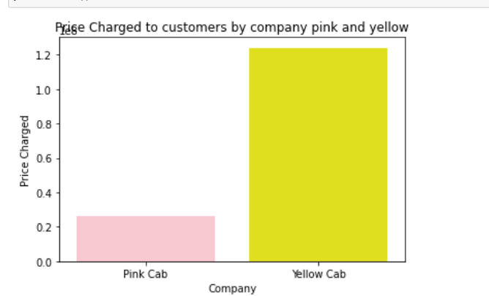
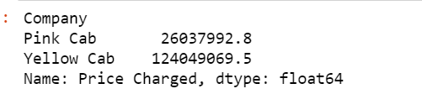
Price Charged by respective Cab companies:
Yellow Cab company’s Price total is greater than Pink Cab company.

Slide 19
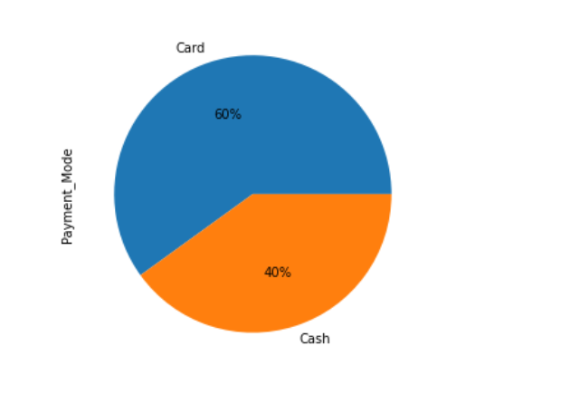
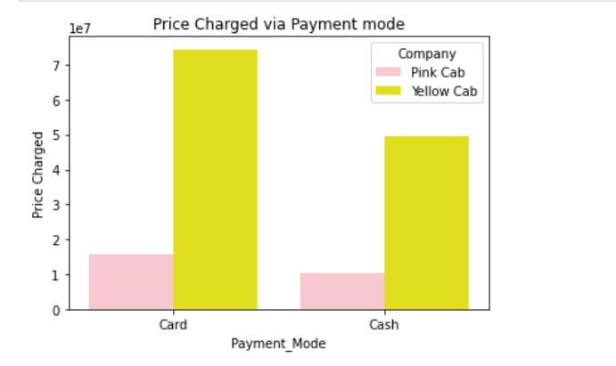
60% Customers pay for Cab rides via Card mode and 40% prefer paying by Cash
Among the mode of payment Yellow cab company have higher number of customers paying by Card and Cash

Slide 20
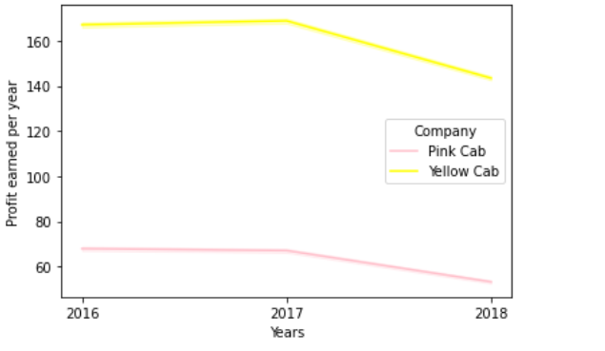
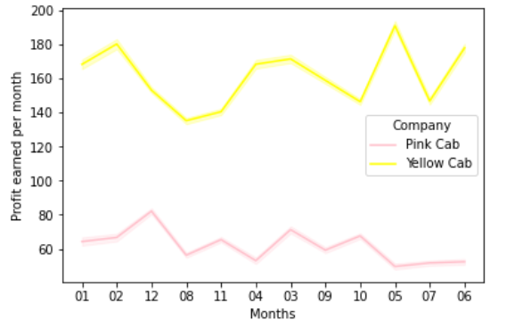
Profit by Year and Month:
Yellow Cab have higher profit over Pink Cab but both companies see a dip in profit after year 2017
Yellow Cab company soars profit during May and sees a low dip during August while Pink cab profits are high during month December and lows during May
Yellow cab has higher profit margin over pink cab company

Slide 21
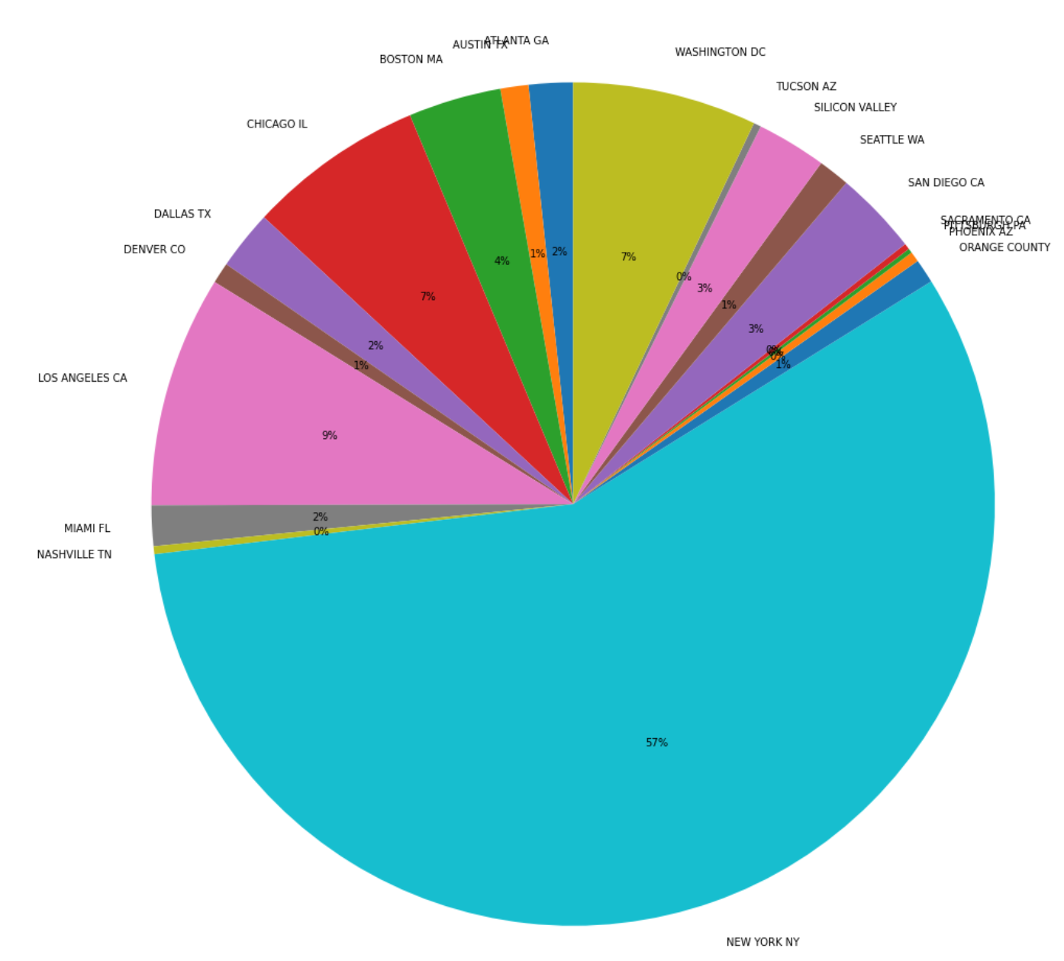
Profit from each City:
The highest Profit grossing City is NEW YORK NY 27617219.6 and the lowest profit wrt City is from PITTSBURGH PA 83197.7

Slide 22
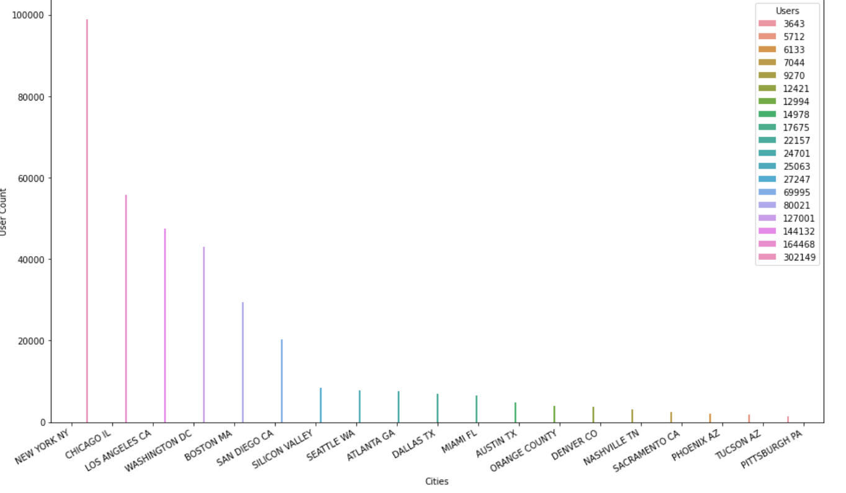

Slide 23
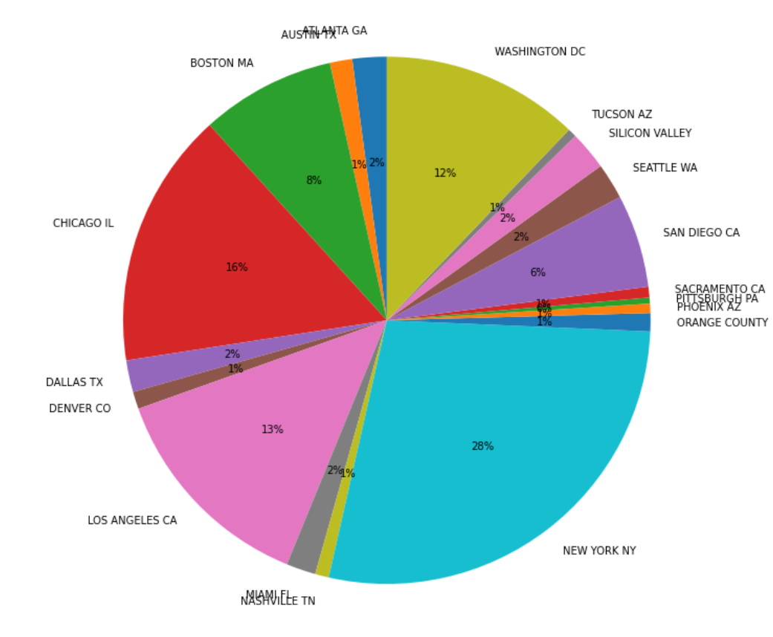
Cab users from different Cities:
New York NY,Chicago IL,Los Angeles CA and Washington DC contribute to the higher number of users riding cabs

Slide 24
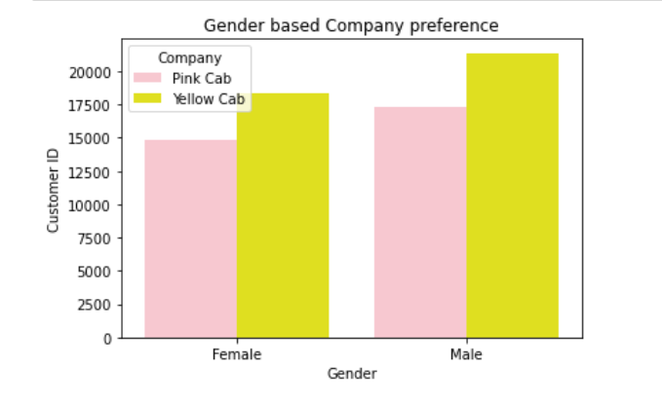
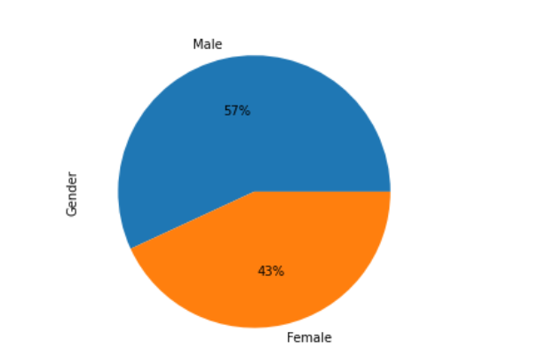
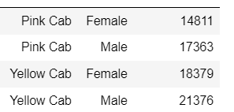
57 % are Male cab service users and 43% users are Female riders

Slide 25
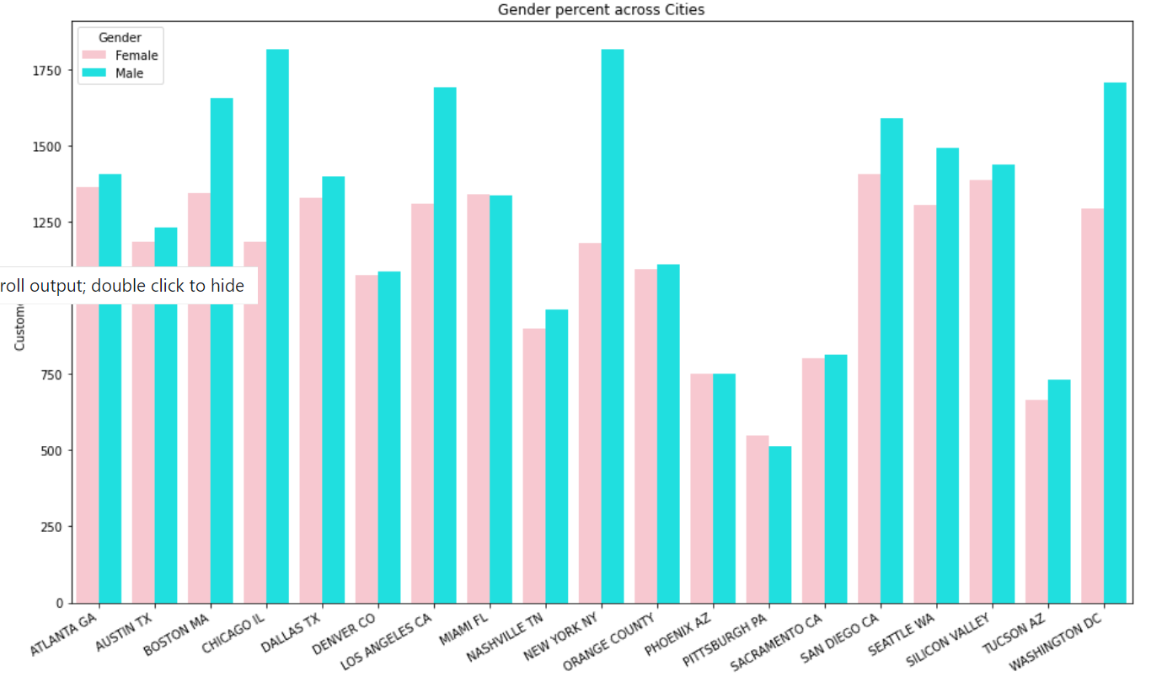
Cab users (gender across cities):
Max users Male, city-New York,NY
Max users Female, city-San Diego,CA
Min users Male, city-Pittsburgh,PA
Min users Female, city-Pittsburgh,PA

Slide 26
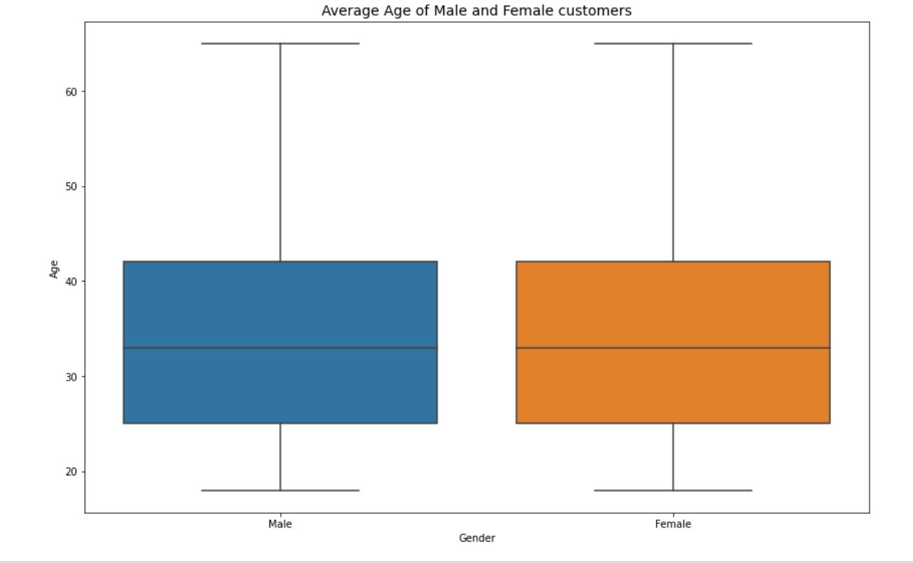
Average age:
Average age of cab users is 35 years.

Slide 27
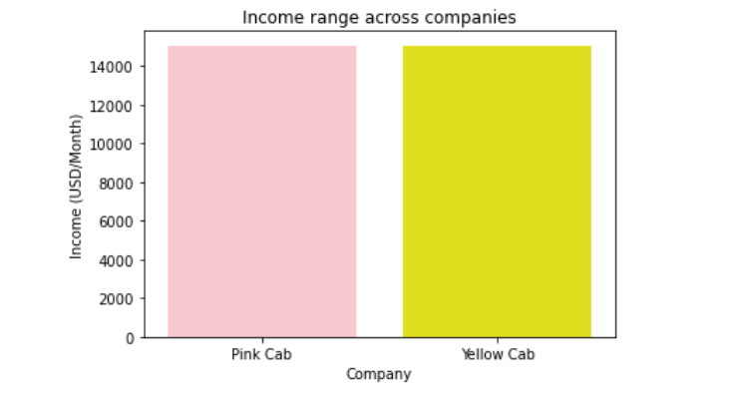
Income :
Average income of users is $15015.63

Slide 28
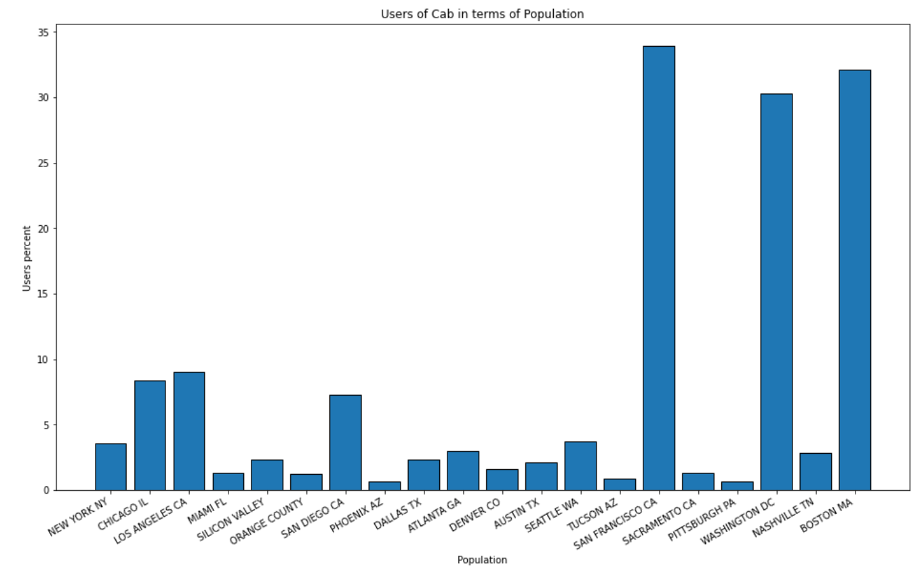
Cab users in terms of Population:l
In terms of population demographics
San Francisco CA,
Boston MA and Washington DC are higher

Slide 29


Hypothesis testing:
H0: Age does not have significant effect on the Compnay chosen
H1:Age does have significant effect on the Compnay chosen
H0: Gender does not have significant effect on the Compnay profit
H1:Gender does have significant effect on the Compnay profit

Slide 30
Insights and Recommendations:
Insights and Recommendations:
Maximum Transactions :Yellow Cab
Company prominence across cities: Yellow Cab
Price Charged(Affordability): Pink Cab
Higher profit earned: Yellow Cab
Yellow Cabs have more users every month, year and days compared to Pink
Yellow cabs have more outreach in both metropolitan and small cities compared to pink cab which exceeds in only 4 cities.
Hence, based on the entire analysis it is visualized that Yellow cabs are popular, profitable, advanced and have a good number of users . All these qualities project for a successful venture in the investment business, therefore Yellow cab company is recommended for investment

Slide 31
Thank You

