Slide 1

USB Mass Storage Class
bhlee
2005. ... ..

Slide 2


Overview
USB Mass Storage Class
SD interface
CBW – DATA - CSW
Uses STALL for Sync
Bulk Out – Write
BULK IN - Read
Control - Enumeration
USB Protocol Layer
USB

Slide 3
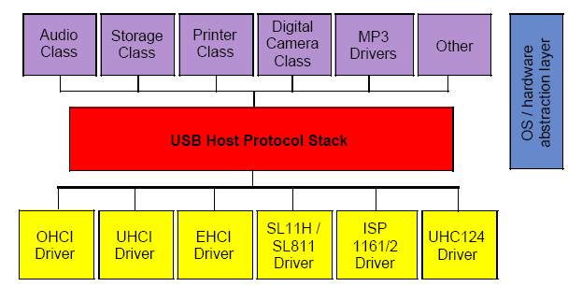
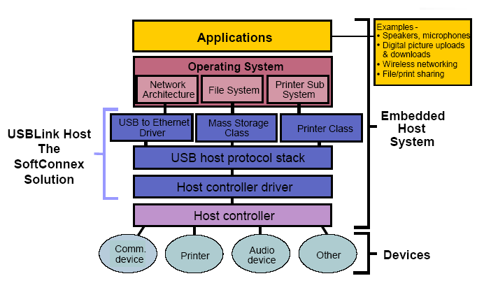
USB Host Architecture

Slide 4
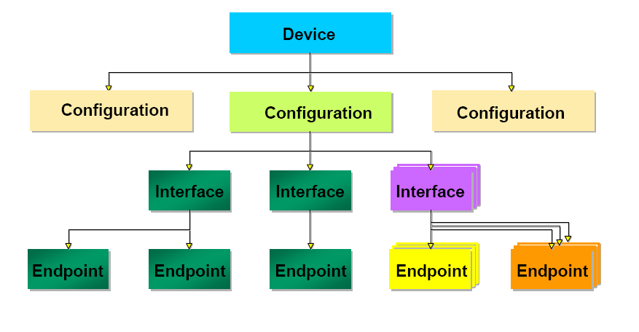
Elements Of a USB Device
Who am I ?
Vendor, Manufacture, serial Num
Numbers of Interfaces,
configuration ID,
power of device
What class spec?
How Many endpoints?

Slide 5
Types Of USB Transfers
Control Transfer (thru Endpoint 0, mandatory for all devices)
  Host Command requests to device
  Small amount of data transfer
Interrupt Transfer ( e.g. keyboards, joysticks, mouse, …)
  Small bursty & guaranteed latency data transfer
Isochronous Transfer ( e.g. audio, video, …)
  Bursty, and high bandwidth asynchronous data transfer
Bulk-Only Transfer( e.g. printer, scanner, still image camera, …)
  Guaranteed latency and bandwidth synchronous data transfer

Slide 6
Class Specifications
USB Devices are segmented into device classes that have similar data transport requirements
Class specification defines common behavior and protocols
Devices can share a single class driver
Each class has got a class code
Each class may have sub-class codes
A USB device may be a single class type or composed of myltiple classes

Slide 7
Mass storage class
USB Mass Storage Class Specification Overview
  Control/Bulk/Interrupt protocol (CBI) Transport
  Bulk-Only Transport
    Removal Drives
  UFI Command Specification
    Floppy Drives
  Bootability Specification
      ZIP Drives
  Compliance Test Specification
SCSI Primary Commnads-2 (SPC-2)
T10/1240-D Revision 20 (RBC)
SFF-8070i

Slide 8
HOST Support
Both Transports Supported
  “Bulk Only” Transport
  “CBI”
Supported MS(W2k, ME, XP)
Apple(OS9, OS X)
Linux
Vendors provide drivers for Win98

Slide 9
Small Computer System Interface
SCSI is:
  a Specification
        SCSI-1: Uses an 8-bit bus, and supports data rates of 4 MBps
        SCSI-2: Same as SCSI-1, but uses a 50-pin connector instead of a 25-pin connector,
        and supports multiple devices. This is what most people mean when they refer to plain SCSI.
        Wide SCSI: Uses a wider cable (168 cable lines to 68 pins) to support 16-bit transfers.
        Fast SCSI: Uses an 8-bit bus, but doubles the clock rate to support data rates of 10 MBps.
        Fast Wide SCSI: Uses a 16-bit bus and supports data rates of 20 MBps.
        Ultra SCSI: Uses an 8-bit bus, and supports data rates of 20 MBps.
        SCSI-3: Uses a 16-bit bus and supports data rates of 40 MBps. Also called Ultra Wide SCSI.
        Ultra2 SCSI: Uses an 8-bit bus and supports data rates of 40 MBps.
        Wide Ultra2 SCSI: Uses a 16-bit bus and supports data rates of 80 MBps.
  a Bus
  a Protocol

Slide 10
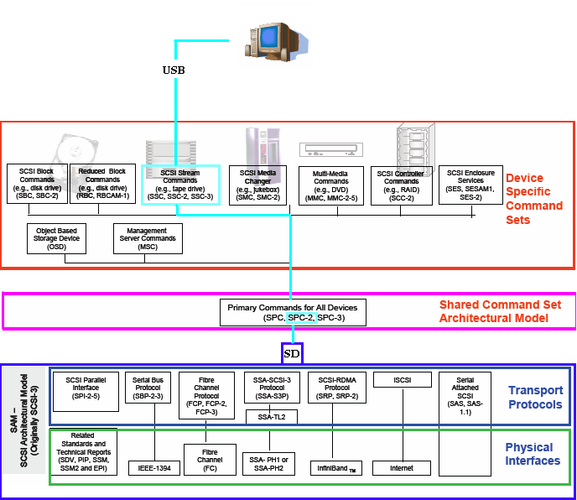
SCSI-3

Slide 11
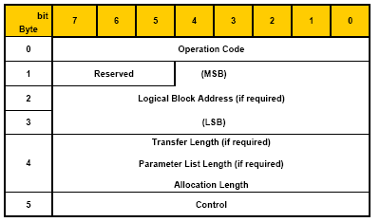
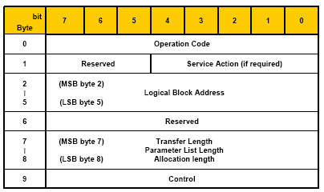
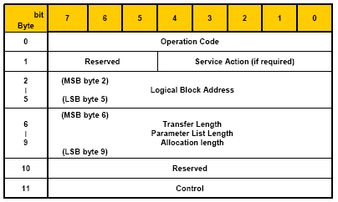
SCSI Command Format
Scsi command (6byte)
Scsi command (10 byte)
Scsi command (12 byte)

Slide 12
SCSI Terms
Initiator: A SCSI device that requests an operation to be
performed by another SCSI device.
Host Adapter: A Controller Board that translates host I/O requests
into SCSI requests.
Target: A SCSI device that performs an operation as requested
by an initiator.
Logical Unit: A Physical or Virtual device addressable through a
target.
LUN: Logical Unit Number. An encoded three-bit identifier
for the logical unit.
SCSI Device: A Host Adapter or Intelligent Peripheral which
can be attached to a SCSI bus.

Slide 13
SCSI Configuration
* Single Initiator, Single Target
LUN0
Initiator
Target
LUN1
SCSI Bus
LUN2

Slide 14
SCSI Status Byte
Sent during Status Phase, prior to Command Complete Message,
to indicate success or failure of the command sequence.
GOOD [0x00]
- Cmd completed without error
CHECK CONDITION [0x02]
- Cmd complete with error, see Sense Data for details
BUSY [0x08]
- Unable to process command at present time (Try again later)

Slide 15
USB Bulk Only Transport
USB Mass Storage Class – Bulk Only Transport
  EndPoint Requirements
    Control endpoints
    One IN Bulk endpoint
    One OUT Bulk endpoint
  Class Specific Requests( SETUP Command)
    Bulk-only mass storage reset
    Get Max LUN(Number of Logical Device)
  Command Block Wrapper(CBW)
    31 Byte Data Command Block sent Out From Host
  Command Status Wrapper(CSW)
    13 Byte Data return By device

Slide 16
Class Specific Request Flow
Host OUT
GET MAX LUN
(bRequest = 0xFE)
Bulk Only Mass Storage Reset
(bRequest = 0xFF)
Other
Device IN
LUN
Call Device Reset Routine
Call Request Routine

Slide 17
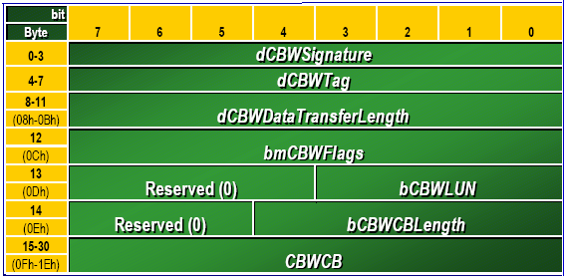
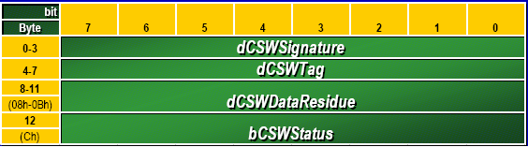
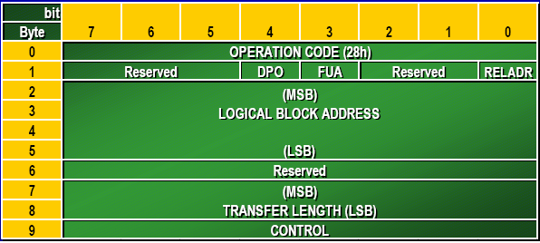
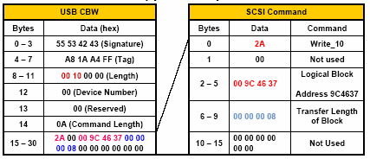
CBW (Command Block Wrapper) CSW (Command Status Wrapper)
Command Block Wrapper Example

Slide 18
Bulk-Only Command Data Status Flow
READY
Host to transmit data
Host to receive data
HOST SENDS OUT CBW
HOST SENDS OUT CBW
HOST SENDS OUT CBW
No Data
No Data
Yes
More data to send ?
More data to send ?
Yes
No
No
HOST SENDS IN CSW

Slide 19
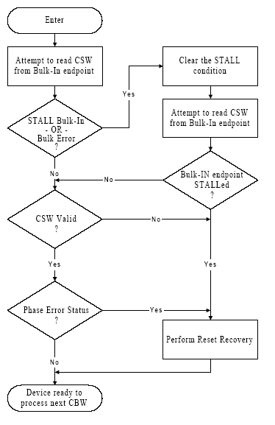
Status Transport Flow

Slide 20
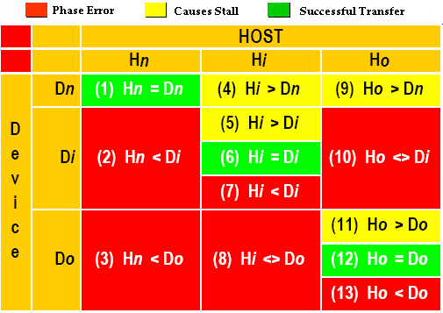
Host/Device Data Transfer
* Error Handling

Slide 21
SCSI Command
SCSI Command | Code | Data (Byte)
Inquiry | 0x12 | 36
Mode Sense 6 | 0x1A | 4
Mode Select 6 | 0x15 | 4
Read 10 | 0x28 | Value
Read Capacity | 0x25 | 21
Request Sense | 0x03 | 18
Test Unit Ready | 0x00 | N
Verify 10 | 0x2F | N
Read Format Capacity | 0x23 | 20
Write 10 | 0x2A | value

Slide 22
SCSI Command 2
Inquiry [0x12]
  Returns Target ID packet (Device Type, Vendor, Model, etc.)
Log Sense/Select [0x4D/0x4C]
  Sets/Reports Logged Statistical Information (soft error rates)
Mode Sense(6,10)/Select(6,10) [0x1A,0x5A/0x15,0x55]
  Sets/Reports Configuration and Runtime Parameters
Request Sense [0x03]
  Returns Sense Data to Initiator
Test Unit Ready [0x00]
  Returns Target readiness to accept I/O commands

Slide 23
SCSI Command 3
Read (6,10) [0x08, 0x28]
  - Read disk, transfer data to Initiator
Read Capacity [0x25]
  - Returns size of disk, in # LBAs
Start/Stop Unit [0x1B]
  - Command to spin up/down disk
Verify [0x2F]
  - Verify LBA(s) on disk with passed data
Write (6,10) [0x0A, 0x2A]
  - Write specified LBA(s) with passed data

