Slide 1
Project: IEEE P802.15 Working Group for Wireless Personal Area Networks (WPANs)
Submission Title: [Add name of submission]
Date Submitted: [11 July 2000]
Source: [Tom Siep] Company [Texas Instruments]
Address [12500 TI Blvd, m/s 8723, Dallas, TX 75243, USA]
Voice:[214.480.6786], FAX: [972.761.5581], E-Mail:[Siep@ti.com]
Re: [Original document.]
Abstract: [Tutorial on 802.15.1 SDL]
Purpose: [Illustrate uses and usefulness of formal constructs for Standards.]
Notice: This document has been prepared to assist the IEEE P802.15. It is offered as a basis for discussion and is not binding on the contributing individual(s) or organization(s). The material in this document is subject to change in form and content after further study. The contributor(s) reserve(s) the right to add, amend or withdraw material contained herein.
Release: The contributor acknowledges and accepts that this contribution becomes the property of IEEE and may be made publicly available by P802.15.
Slide <number>

Slide 2
Working Group 802.15
SDL Tutorial
Allen Heberling, Kodak
Tom Siep, Texas Instruments

Slide 3
Topics
Overview
  Purpose of Tutorial
  Why 802.15 is using SDL
SDL primer
Architectural Overview
  Component Decomposition
  Example Benefit – Link Manager description
Examples of SDL State Machines
  L2CAP
  Baseband
Summary

Slide 4
SDL Primer
Definition
Why SDL was created
Overview of the various SDL symbols

Slide 5
Specification and Description Language
Unambiguous graphical language used to specify and describe complex systems
Developed by CCITT (now ITU-T Z.100)
Specifically concerned with
  Behavior
  Structure
  Data
Can be Implementation Independent
Ability to analyze the correctness and completeness of specifications

Slide 6
Why SDL was created
First defined 1976
  Informal until 1984 when structure and data added
  Grew through use
Common Telecommunications medium of understanding
Ability to analyze correctness and completeness of specifications
Suitability for the use of computer-based tools

Slide 7
Overview of various SDL symbols
Block Types
Process Types
Procedures
Signal Paths
Signal Types (Input, Output)
Task Symbols
Create Processes

Slide 8
Block Reference Symbol
Sync_sig
Block_Z
Fundamental unit of lexical scope and structural hierarchy.
Each block contains
  Other blocks
  Processes
  Procedures
  Data declarations
Implicit or Explicit channels (signals) in the to/from the environment

Slide 9
Process Reference Symbol
Parent_Sig
Out_sig
Process_A (1,1)
Processes specify dynamic behavior using extended finite state machines.
Processes operate concurrently, communicating by means of signals and remote variables.
After the process name is the number of process instances at startup and the maximum number of instances.
For processes created dynamically, the dashed arrow connects the parent process to the offspring.

Slide 10
Procedure Reference Symbol
Procedure_Name
A procedure is defined and called in the process where this symbol appears.
If declared "remote" the procedure may be imported for calling from other processes.
A value-returning procedure, callable in assignment statements, is defined using the "returns" keyword in the formal parameter list.

Slide 11
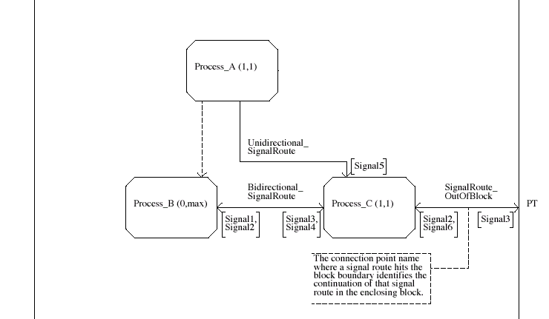
Signal Paths

Slide 12
Signal Types
In_Signal
Out_Signal
Symbols
  Inputs
  Outputs
May face left or right
Input signal transition occurs upon receipt of named signal
Output signal transition is zero time, but receipt is non-deterministic

Slide 13
Task Symbols
X := 2.4
Used to assign a new value to a variable
Part of a transition

Slide 14
Creating Processes
Processes either created at initialization or by other processes in the same block
When created, all variables of the process are also created
Initial value may be specified for variables

Slide 15
802.15.1 SDL
(live demo)

Slide 16
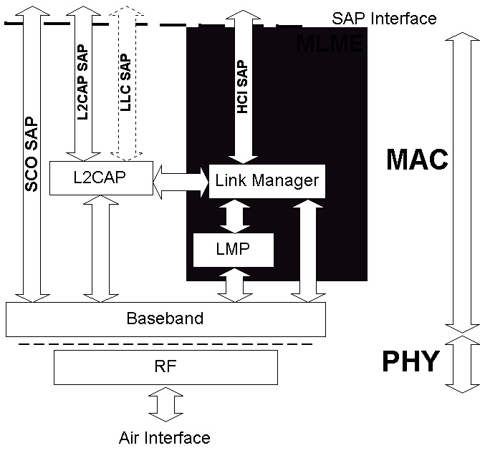
Product of SDL Activities

Slide 17
802.15.1 Summary
Derived a picture of what the structure of the BT spec is in IEEE terms.
Helped to uncover holes in existing spec
Enables bench testing and validating of components
Provides a common language between the SIG and the IEEE
Generation of TTCN from SDL is possible

Slide 18
Implications for the future of Standards
Normative SDL makes an unambiguous Standard
Working SDL models can be used to extend currently working Standards, minimizing the danger of breaking the protocol
SDL makes the relationship between Standards and Test Suites explicit

