Slide 1
Project: IEEE P802.15 Working Group for Wireless Personal Area Networks (WPANs)
Submission Title: [IEEE 802.15.1 Tutorial]
Date Submitted: [11 July 2000]
Source: [Tom Siep] Company [Texas Instruments]
Address [12500 TI Blvd, m/s 8723, Dallas, TX 75243, USA]
Voice:[214.480.6786], FAX: [972.761.5581], E-Mail:[Siep@ti.com]
Re: [Original document.]
Abstract: [Tutorial on 802.15.1, including an explanation of SDL]
Purpose: [Inform WG voters about origin, form and content of Draft]
Notice: This document has been prepared to assist the IEEE P802.15. It is offered as a basis for discussion and is not binding on the contributing individual(s) or organization(s). The material in this document is subject to change in form and content after further study. The contributor(s) reserve(s) the right to add, amend or withdraw material contained herein.
Release: The contributor acknowledges and accepts that this contribution becomes the property of IEEE and may be made publicly available by P802.15.

Slide 2
IEEE P802.15.1
Tutorial
Tom Siep, Texas Instruments
Chatschik Bisdikian, IBM

Slide 3
Topics
Introduction
History of IEEE → 802 → 802.15 →TG1
Specifications vs. Standards
Background on Bluetooth™
Bluetooth Architecture (Chatschik Bisdikian)
Construction of the Draft
SDL
Q&A

Slide 4
Introduction
Tom Siep
  Chief Technical Editor, IEEE802.15
  Lead Technical Editor, IEEE802.15.1
  Bluetooth Specification Section Owner, L2CAP
  Editorial interface between BSIG and 802.15.1
  Author
    "An IEEE Guide: How to Find What You Need in the Bluetooth Spec"
    http://standards.ieee.org/catalog/press/index.html#Bluetooth

Slide 5
IEEE: An Overview
Established in 1884 (AIEE & IRE)
Membership was 334,811 Dec98;
66% USA & 33% Non-USA
Produces 30 percent of the world's published literature in electrical engineering, computers and control technology,
Holds annually more than 300 major conferences
Has more than 800 active standards with 700 under development.

Slide 6
IEEE 802 Standards Principals
Due Process through established rules and procedures
Consensus highly desired, near unanimity is generally the rule
Openness where all individuals, world-wide, have access to the process
Balance maintained by having balloting group include both developers and users
Right to Appeal both procedural and technical issues at any time during the process

Slide 7
IEEE Project 802 Local and Metropolitan Area Network Standards Committee
Accredited by ANSI, Sponsored by IEEE Computer Society
  Ethernet, Token Ring, Wireless, Cable Modem Standards
  Bridging, VLAN, Security Standards
Meets three times per year
(400 individuals, 15% non-US)
Develops equivalent IEC/ISO JTC 1 standards
  JTC 1 series of equivalent standards are ISO 8802-nnn
IEEE URLs
  802 http://grouper.ieee.org/groups/802/
  802.15 http://grouper.ieee.org/groups/802/15/

Slide 8
IEEE 802.15
Wireless Personal Area Networks (WPANsTM)
  Short-range
  Low Power
  Low Cost
  Small networks
  Communication of devices within a Personal Operating Space

Slide 9
History of WG15/TG1
Predates public announcement of Bluetooth
Decided to become WG in Jan99
First WG meeting July99
Call for Response ended July99
  Many SIGs solicited
  Bluetooth was only respondent

Slide 10
Specification versus Standard
versus
Notes:
Page <number>

Slide 11
The Specification Artist
Helps people see the world in a new way.
Notes:
Page <number>

Slide 12
The Standards Engineer
Codifies well-understood phenomena
and
applies them to
well-known problems
Notes:
Page <number>

Slide 13
Specification vs. Standard
Starts with a blank canvas
Free format
Usually evolves
Often describes an implementation
Says many (perhaps different) things to many people
Sometimes “you had to be there”
Inspires
Starts with defined goal
Format dictated by Standard
Evolution by formal means
Implementation Independent
Unambiguous
All you need to know is right there (or in the references)
Communicates

Slide 14
Background on Bluetooth™ SIG
Bluetooth Special Interest Group (BSIG)
  Formed May 1998
    Nine “Promoter” Companies
    ~100 Associate Companies
    ~2000 Adopter Companies
  Has been “Virtual”
  Becoming a not-for-profit entity
  Major purpose in life is Quality Control

Slide 15
Bluetooth Architecture Presentation
Chatschik Bisdikian
IBM Research

Slide 16
Topics
What does Bluetooth do
Bluetooth Positioning: PAN, LAN and WAN.
How does it work: piconets, scatternets, security, protocols, and profiles.

Slide 17


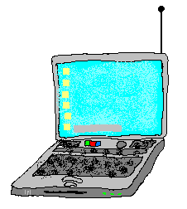

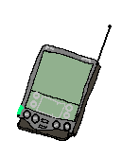




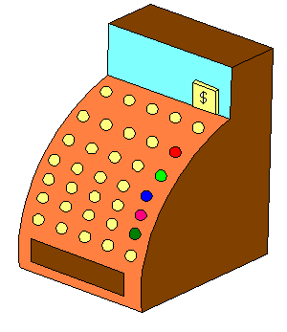
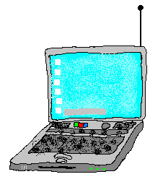

What does Bluetooth do for me?
Landline
Cable Replacement
Data/Voice Access Points
Personal Ad-hoc Connectivity

Slide 18
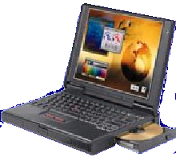




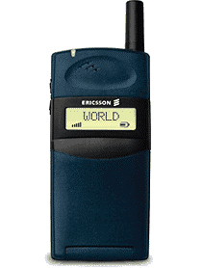
Usage scenarios: Headset
User benefits
Multiple device access
Cordless phone benefits
Hand’s free operation
Wireless Freedom…

Slide 19
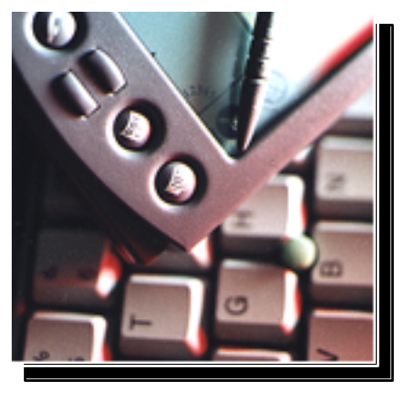
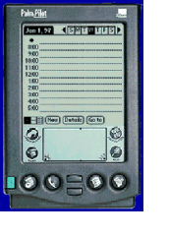
Usage scenarios: Synchronization
User benefits
Proximity synchronization
Easily maintained database
Common information database
Sharing Common Data…

Slide 20

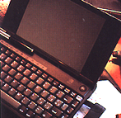

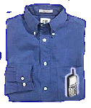
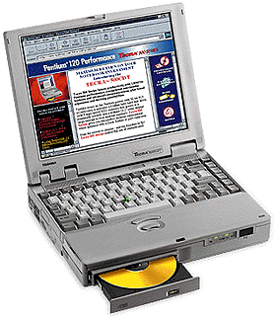
Usage scenarios: Data access points
PSTN, ISDN,
LAN, WAN, xDSL
User benefits
No more connectors
Easy internet access
Common connection experience
Remote Connections...

Slide 21



Wireless Positioning
Wireless LAN
On-campus: Office, School, Airport, Hotel, Home
Bluetooth
Person Space: Office, Room, Briefcase, Pocket, Car
Short Range/Low Power
Voice AND Data
Low-cost
Small form factor
Many Co-located Nets
Universal Bridge
Cellular
Off-Campus Global Coverage

Slide 22
Characteristics
Operates in the 2.4 GHz band at a data rate of 720Kb/s.
Uses Frequency Hopping (FH) spread spectrum, which divides the frequency band into a number of channels (2.402 - 2.480 GHz yielding 79 channels).
Radio transceivers hop from one channel to another in a pseudo-random fashion, determined by the master.
Supports up to 8 devices in a piconet (1 master and 7 slaves).
Piconets can combine to form scatternets.

Slide 23
What is a Piconet?
A collection of devices connected in an ad hoc fashion.
One unit will act as a master and the others as slaves for the duration of the piconet connection.
Master sets the clock and hopping pattern.
Each piconet has a unique hopping pattern/ID
Each master can connect to 7 simultaneous or 200+ inactive (parked) slaves per piconet
S
M
P
S
SB
S
P
M=Master
S=Slave
P=Parked
SB=Standby

Slide 24
What is a Scatternet?
A Scatternet is the linking of multiple co-located piconets through the sharing of common master or slave devices.
A device can be both a master and a slave.
Radios are symmetric (same radio can be master or slave)
High capacity system, each piconet has maximum capacity (720 Kbps)
S
M
P
S
SB
S
P
P
SB
M
S
M=Master
S=Slave
P=Parked
SB=Standby

Slide 25
Bluetooth Architecture
Applications
Other
TCS
RFCOMM
SDP
Application Framework and Support
Data
Control
Host Controller Interface
Audio
L2CAP
Link Manager and L2CAP
Link Manager
Baseband
Radio & Baseband
RF

Slide 26
The Bluetooth “lower” layers
Radio (RF)
  The Bluetooth radio front-end
    2.4GHz ISM band; 1Mbps
    1,600hops/sec; 0dBm (1mW) radio (up to 20dBm)
Baseband (BB)
  Piconet/Channel definition
  “Low-level” packet definition
  Channel sharing
Link Management (LM)
  Definition of link properties
    encryption/authentication
    polling intervals set-up
    SCO link set-up
    low power mode set-up

Slide 27
Baseband link types
Polling-based (TDD) packet transmissions
  1 slot: 0.625msec (max 1600 slots/sec)
  master/slave slots (even-/odd-numbered slots)
Synchronous connection-oriented (SCO) link
  “circuit-switched”, periodic single-slot packet assignment
  symmetric 64Kbps full-duplex
Asynchronous connection-less (ACL) link
  packet switching
  asymmetric bandwidth, variable packet size (1,3, or 5 slots)
      max. 721 kbps (57.6 kbps return channel)
      108.8 - 432.6 kbps (symmetric)
M
S
M
S
0 1 2 3 4 5 6 7 8 9 10 11 12 13 14 15 16 17 18 19 20 21 22

Slide 28
Security: Key generation and usage
PIN
PIN
User Input
(Initialization)
E₂
E₂
Authentication
(possibly)
Permanent
Storage
Link Key
Link Key
E₃
E₃
Encryption
Encryption Key
Encryption Key
Temporary
Storage

Slide 29
Bluetooth protocols
Host Controller Interface (HCI)
  Provides a common interface between the Bluetooth host and a Bluetooth module
    Interfaces in spec 1.0: USB; UART; RS-232
Link Layer Control & Adaptation (L2CAP)
  A simple data link protocol on top of the baseband
    connection-oriented & connectionless
    protocol multiplexing
    segmentation & reassembly
    QoS flow specification per connection (channel)
    group abstraction

Slide 30
Bluetooth protocols
Service Discovery Protocol (SDP)
  Defines an inquiry/response protocol for discovering services
RFCOMM (based on GSM TS07.10)
  emulates a serial-port to support a large base of legacy (serial-port-based) applications
Telephony Control Protocol Spec (TCS)
  call control (setup & release)
  group management for gateway serving multiple devices
Legacy protocol reuse
  reuse existing protocols, e.g., IrDA’s OBEX, or WAP for interacting with applications on phones

Slide 31
Profiles
Represents default solution for a usage model
Vertical slice through the protocol stack
Basis for interoperability and logo requirements
Each Bluetooth device supports one or more profiles
Applications
Protocols
Profiles

Slide 32
Profiles
Generic Access Profile
Service Discovery Application Profile
Serial Port Profile
  Dial-up Networking Profile
  Fax Profile
  Headset Profile
  LAN Access Profile (using PPP)
  Generic Object Exchange Profile
    File Transfer Profile
    Object Push Profile
    Synchronization Profile
TCS_BIN-based profiles
  Cordless Telephony Profile
  Intercom Profile

Slide 33
Summary
Bluetooth is a global, RF-based (ISM band: 2.4GHz), short-range, connectivity solution for portable, personal devices
  it is not just a radio, it is an end-to-end solution
The Bluetooth spec comprises
  a HW & SW protocol specification
  usage case scenario profiles and interoperability requirements
IEEE 802.15 is working on standardizing the PHY and MAC layers in Bluetooth
To learn more: http://www.bluetooth.com
Notes:
It's not just a radio, it's an end-to-end solution

Slide 34
Construction of the IEEE Draft Standard

Slide 35
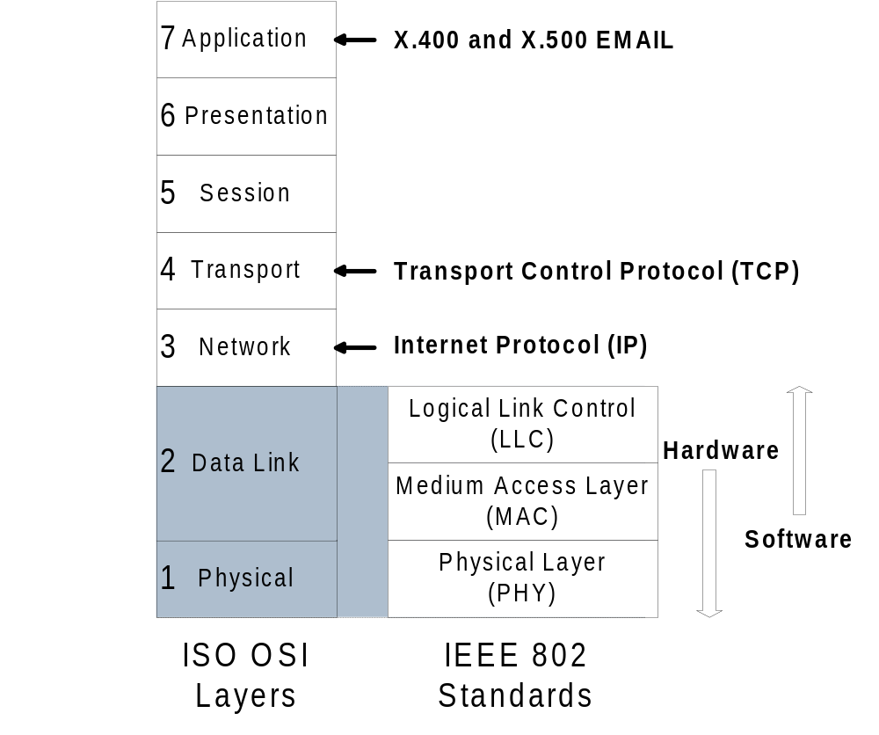
What IEEE Project 802 Covers

Slide 36
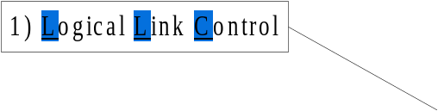
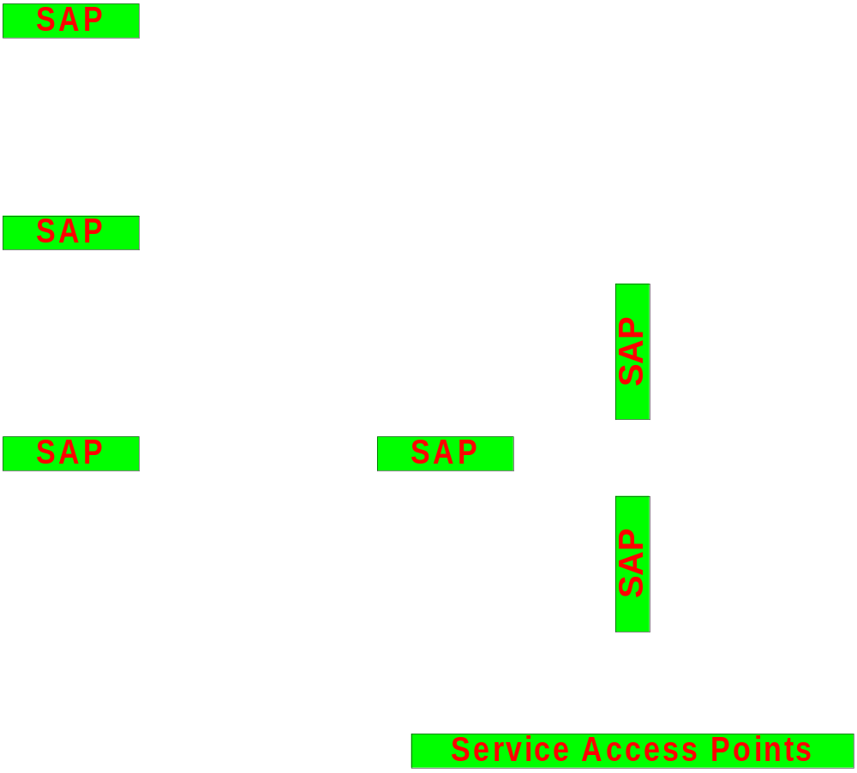
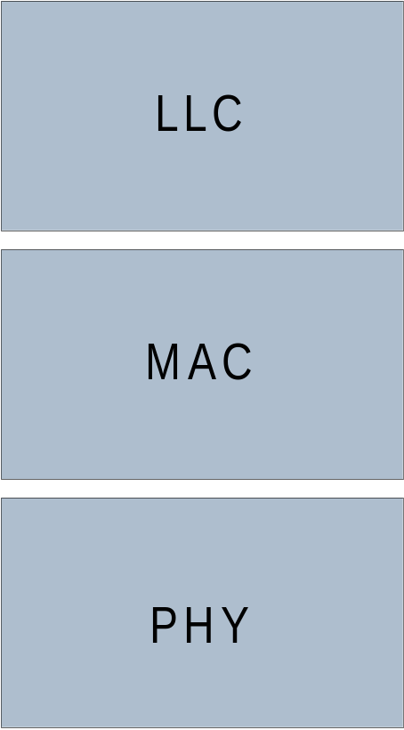
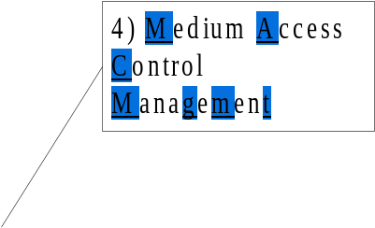
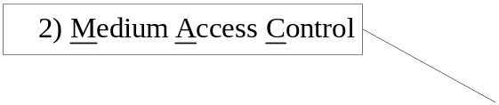
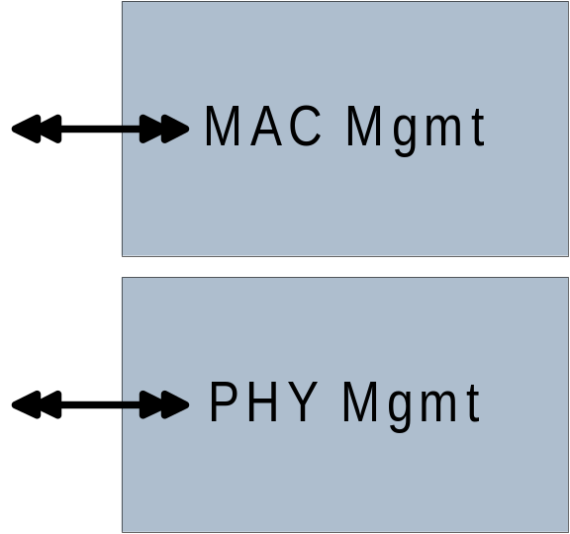

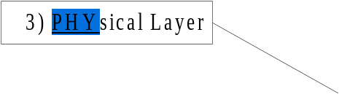
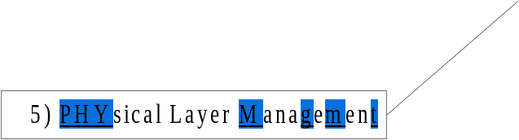
More Detail of IEEE P802 Structure

Slide 37
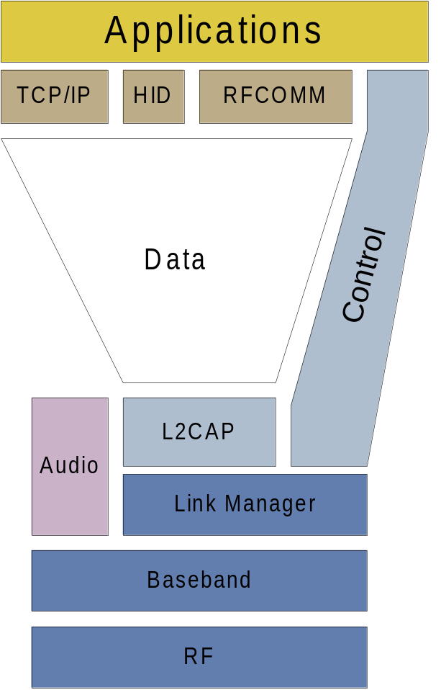

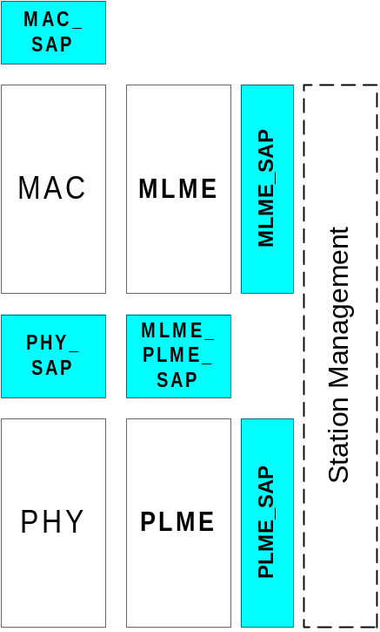




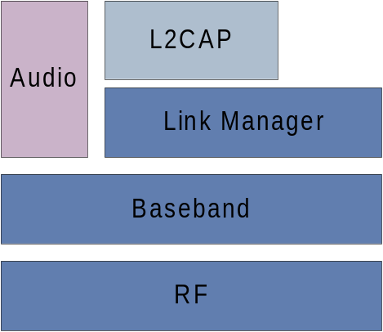

How Does That Relate to Bluetooth?
Bluetooth
IEEE

Slide 38
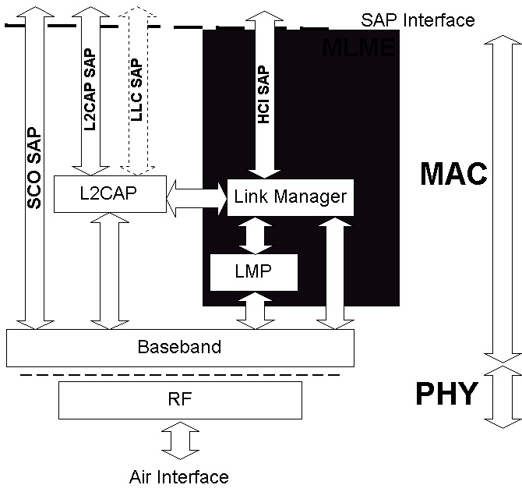
Real Structure of Bluetooth Protocol

Slide 39
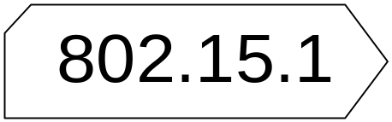
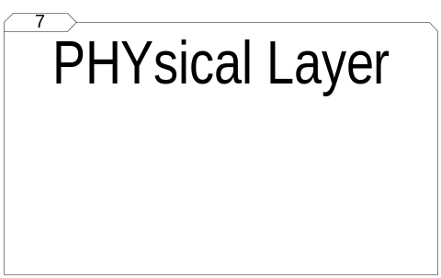
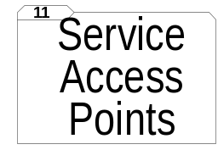



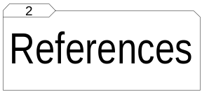
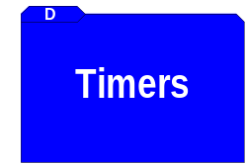


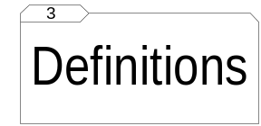


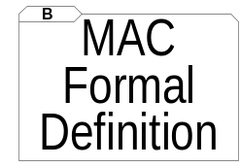
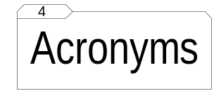
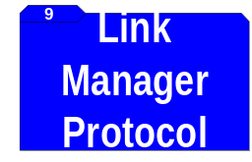
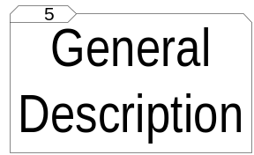
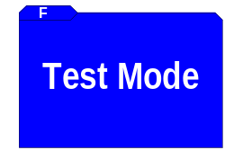

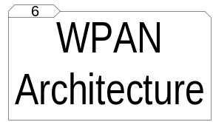



Constructing the Draft

Slide 40
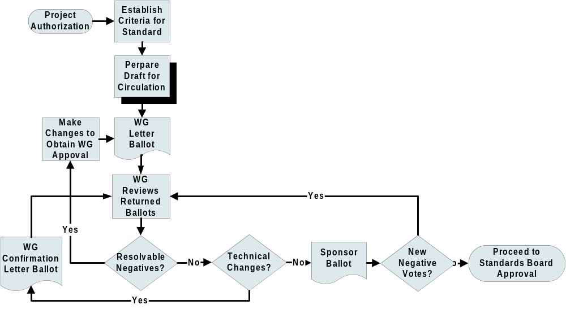
The Process of Creating a Standard
You are here

Slide 41
SDL Primer
Definition
Why SDL was created
Overview of the various SDL symbols

Slide 42
Specification and Description Language
Unambiguous graphical language used to specify and describe complex systems
Developed by CCITT (now ITU-T Z.100)
Specifically concerned with
  Behavior
  Structure
  Data
Can be Implementation Independent
Ability to analyze the correctness and completeness of specifications

Slide 43
Why SDL was created
First defined 1976
  Informal until 1984 when structure and data added
  Grew through use
Common Telecommunications medium of understanding
Ability to analyze correctness and completeness of specifications
Suitability for the use of computer-based tools

Slide 44
Overview of various SDL symbols
Block Types
Process Types
Procedures
Signal Paths
Signal Types (Input, Output)
Task Symbols
Create Processes

Slide 45
Block Reference Symbol
Sync_sig
Block_Z
Fundamental unit of lexical scope and structural hierarchy.
Each block contains
  Other blocks
  Processes
  Procedures
  Data declarations
Implicit or Explicit channels (signals) in the to/from the environment

Slide 46
Process Reference Symbol
Parent_Sig
Out_sig
Process_A (1,1)
Processes specify dynamic behavior using extended finite state machines.
Processes operate concurrently, communicating by means of signals and remote variables.
After the process name is the number of process instances at startup and the maximum number of instances.
For processes created dynamically, the dashed arrow connects the parent process to the offspring.

Slide 47
Procedure Reference Symbol
Procedure_Name
A procedure is defined and called in the process where this symbol appears.
If declared "remote" the procedure may be imported for calling from other processes.
A value-returning procedure, callable in assignment statements, is defined using the "returns" keyword in the formal parameter list.

Slide 48
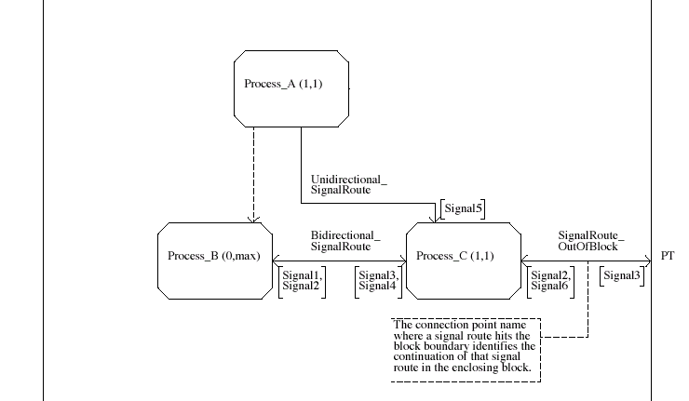
Signal Paths

Slide 49
Signal Types
In_Signal
Out_Signal
Symbols
  Inputs
  Outputs
May face left or right
Input signal transition occurs upon receipt of named signal
Output signal transition is zero time, but receipt is non-deterministic

Slide 50
Task Symbols
X := 2.4
Used to assign a new value to a variable
Part of a transition
Notes:
Part of transition

Slide 51
Creating Processes
Processes either created at initialization or by other processes in the same block
When created, all variables of the process are also created
Initial value may be specified for variables

Slide 52
802.15.1 SDL

Slide 53
802.15.1 SDL Summary
Derived a picture of what the structure of the BT spec is in IEEE terms.
Helped to uncover holes in existing spec
Enables bench testing and validating of components
Provides a common language between the SIG and the IEEE
Generation of TTCN from SDL is possible

Slide 54
Implications for the future of Standards
Normative SDL makes an unambiguous Standard
Working SDL models can be used to extend currently working Standards, minimizing the danger of breaking the protocol
SDL makes the relationship between Standards and Test Suites explicit

Slide 55
Questions?
Tom Siep
Texas Instruments
siep@ti.com
Chatschik Bisdikian
IBM Research
bisdik@us.ibm.com

