Slide 1
Project: IEEE 802.15 Working Group for Wireless Personal Area Networks (WPANs)
Submission Title: [TG3 Bluetooth SAP Discussion 14Jan01]
Date Submitted: [14Jan01]
Source: [John Barr] Company [Motorola]
Address [1750 E. Golf Road, Schuamburg, IL 60173]
Voice:[+1 847 576-8706], FAX: [+1 847 538-4253], E-Mail:[John.Barr@Motorola.com]
Re: [00191r1P802.15.3_TG3-BSIG-PM-Pitch-16Jun00.ppt]
Abstract: [TG3 Ad-hoc discussion of how to define a Bluetooth SAP for 802.15.3]
Purpose: [Start process to determine how to define a Bluetooth SAP for the 802.15.3 standard.]
Notice: This document has been prepared to assist the IEEE 802.15. It is offered as a basis for discussion and is not binding on the contributing individual(s) or organization(s). The material in this document is subject to change in form and content after further study. The contributor(s) reserve(s) the right to add, amend or withdraw material contained herein.
Release: The contributor acknowledges and accepts that this contribution becomes the property of IEEE and may be made publicly available by 802.15.
John Barr, Motorola

Slide 2
Bluetooth SAP Discussion
January 14, 2001
Monterey, CA

Slide 3
Question
What interface definition(s) are required to allow the 802.15.3 radio to be qualified to use the Bluetooth software profiles?
  Should not use any BT SIG owned interfaces.
  Should not require any changes to BT SIG qualified software.
  Should not require radio implementation knowledge

Slide 4
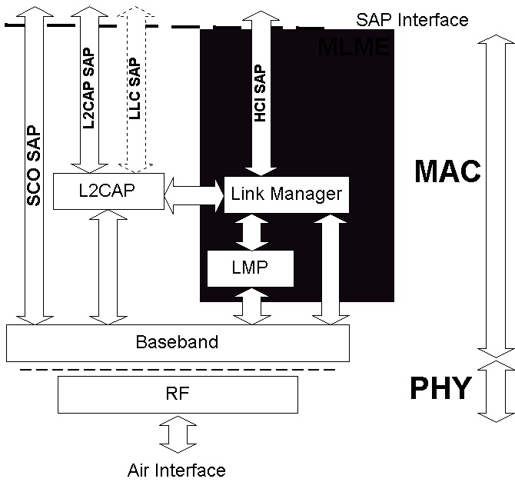
802.15.1 Radio Architecture
MLME
Radio

Slide 5
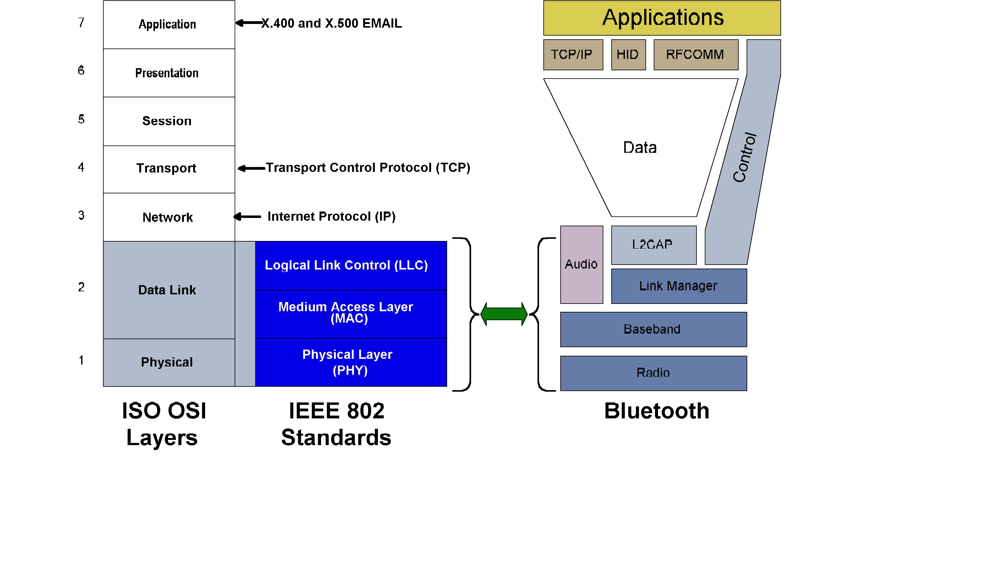
IEEE 802.15.1 and Bluetooth

Slide 6
Discussion Results
Not clear just what is required to provide an independent radio interface to the Bluetooth software profiles
  Study 802.15.1 to determine which interfaces are provided
Need mechanism to switch from 802.15.1 mode to 802.15.3 mode
  Define similar to what proposed by TI
Do not need to support all profiles
  Audio profile and SCO SAP could be unsupported since it would be provided by 802.15.1 mode

