Slide 1
IEEE 802.15.1 WPAN™ “Standardization” of Bluetooth™
Tom Siep
Member Group Technical Staff
Texas Instruments
WPAN is a trademark of the IEEE
Bluetooth is a trademark Telefonaktiebolaget L M Ericsson, Sweden

Slide 2
Overview
802.15.1 Status
Creating the Draft Standard
  Architecture of WPANs
  WPANs vs. WLANs
  802.15.1 LLC SAPs
  SDL
Future IEEE/Bluetooth collaboration

Slide 3
Project 802.15.1 Status
Presented to Working Group and then IEEE 802 Executive Committee September00
Delayed for Bluetooth V1.1 publication
Confirmation Letter Ballot started 9Feb01, ended 11Mar01: PASSED, 46/4/1 or 92% affirmation
Comment Resolution at March01 IEEE meeting in Hilton Head, SC.: all comments processed
Next step: editing; 10 day confirmation ballot ~2April01
LAN/MAN 802.15 Sponsor Ballot(s) during the Summer or Fall
RevCom will submit Final Draft Std for approval upon successful completion of the Sponsor Ballot

Slide 4
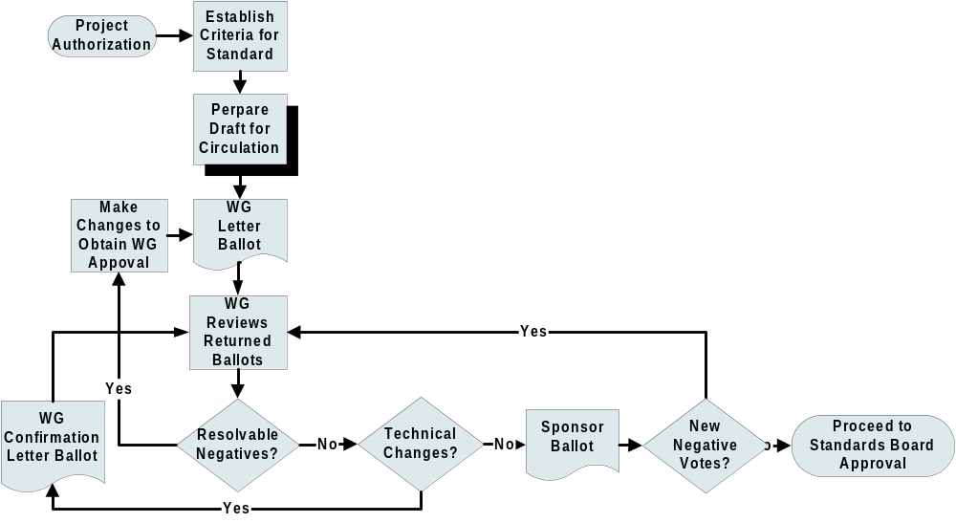
The Process of Creating an IEEE Standard
You are here

Slide 5
Bluetooth Specification (SIG version)
Applications
Other
TCS
RFCOMM
SDP
Data
Control
Audio
L2CAP
Link Manager
Baseband
RF

Slide 6
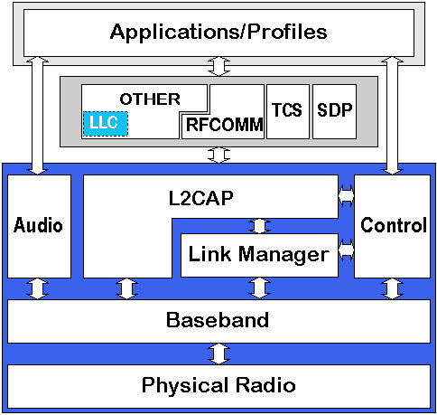
Bluetooth Specification (IEEE version)

Slide 7
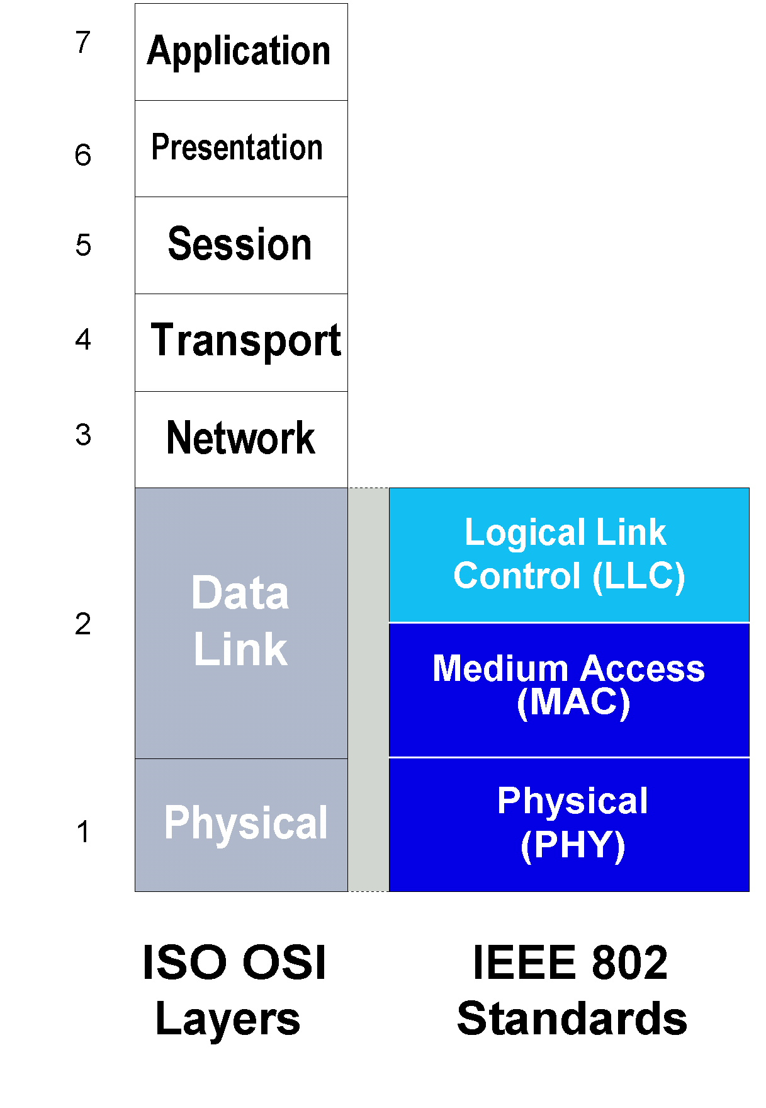
IEEE Project 802 Standards
x.400 and X.500 Email
Transport Control Protocol (TCP)
Internet Protocol (IP)
Hardware
Software

Slide 8
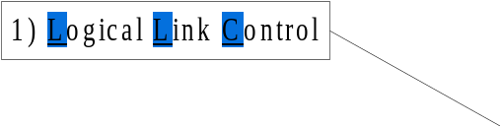
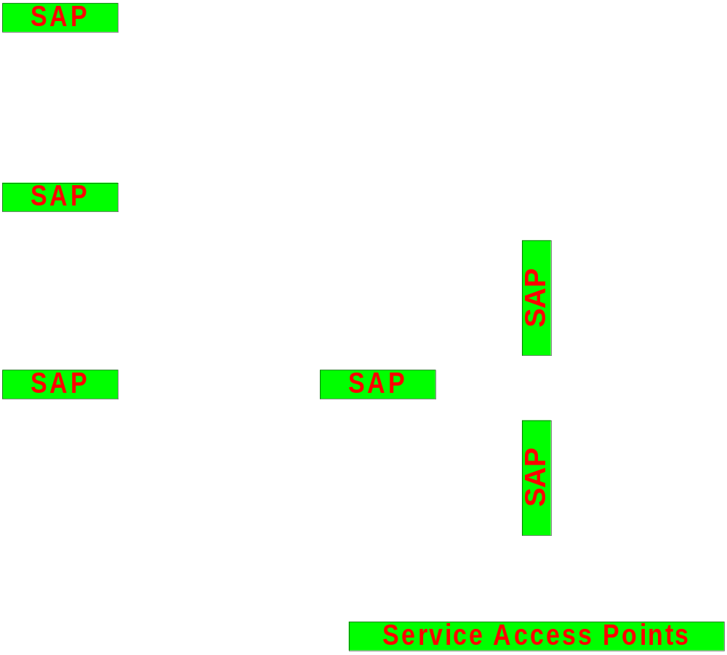
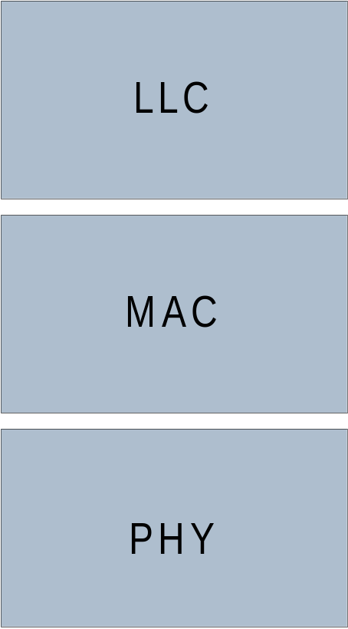
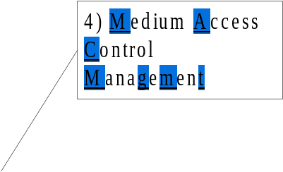

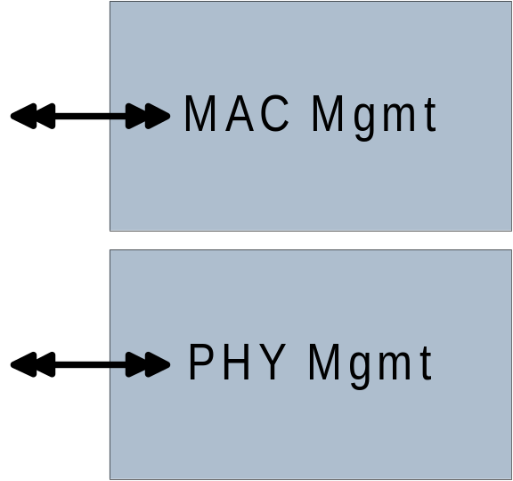

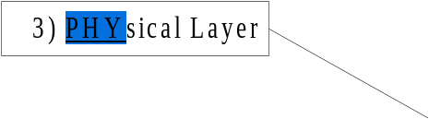
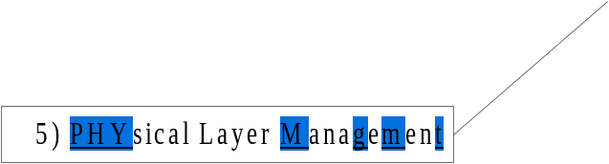
More Detail of IEEE P802 Structure

Slide 9
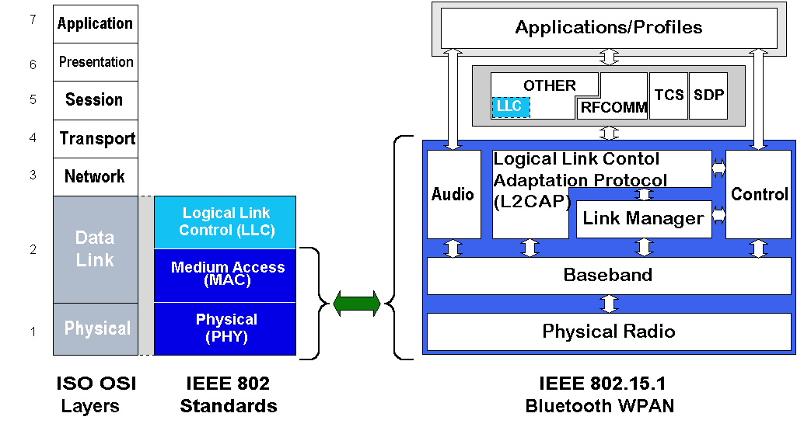
How Does That Relate to Bluetooth?

Slide 10







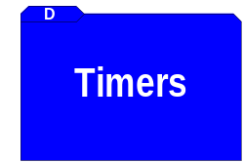





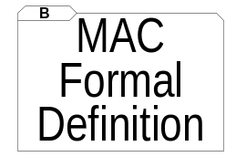
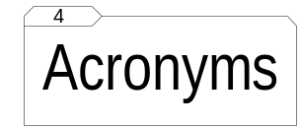
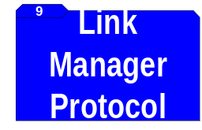

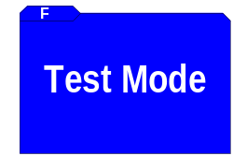





Constructing the Draft

Slide 11
WPAN Architecture
Wireless personal area networks are different than WLANs in several functional areas:
  Control of the media
  Range
  Power
  Number of participants
  Ownership of devices
  Nature of devices
  Lifetime of network
  Relative cost
These differences are a result of the topological differences between the two types

Slide 12
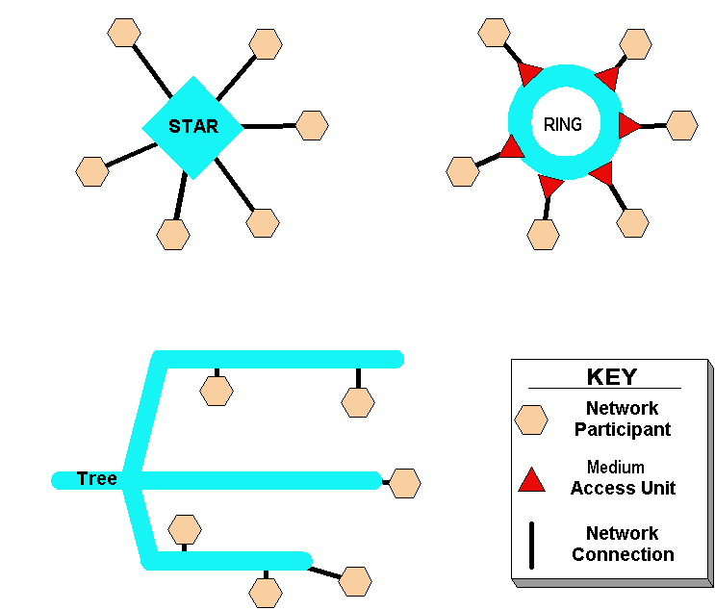
Topologies: Stars, Rings, Trees
WPANs
Token Ring
WLANs

Slide 13
WLANs verses WPANs
(WARNING:gross simplifications)
WLAN is outwardly looking
  Interacts with wired infrastructure (LANs)
  Network timeframe hours to days
  Portable devices
  “Wires are expensive”
WPAN is inwardly looking
  Interacts with personal objects
  Network timeframe seconds to hours
  Highly mobile devices
  “Wires get in the way”

Slide 14
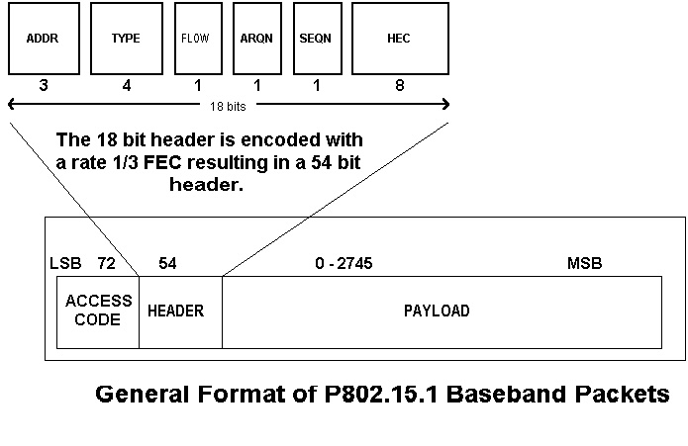
WPAN frames

Slide 15
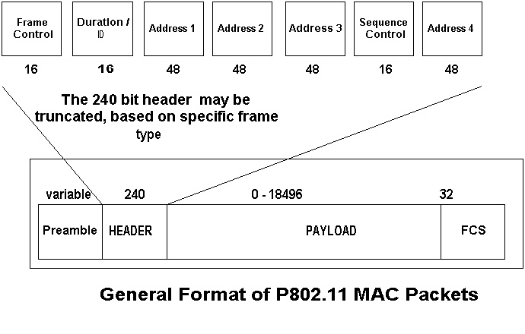
WLAN Frames

Slide 16
802.15.1 SAPs (1 of 4)
MA-UNITDATA request ( source_address,
destination_address,
routing_information,
data,
priority,
service_class
)

Slide 17
802.15.1 SAPs (2 of 4)
MA-UNITDATA indication ( source_address,
destination_address,
routing_information,
data,
reception_status,
priority,
service_class
)

Slide 18
802.15.1 SAPs (3 of 4)
MA-UNITDATA-STATUS indication ( source_address,
destination_address,
transmission_status,
provided_priority,
provided_service_class
)

Slide 19
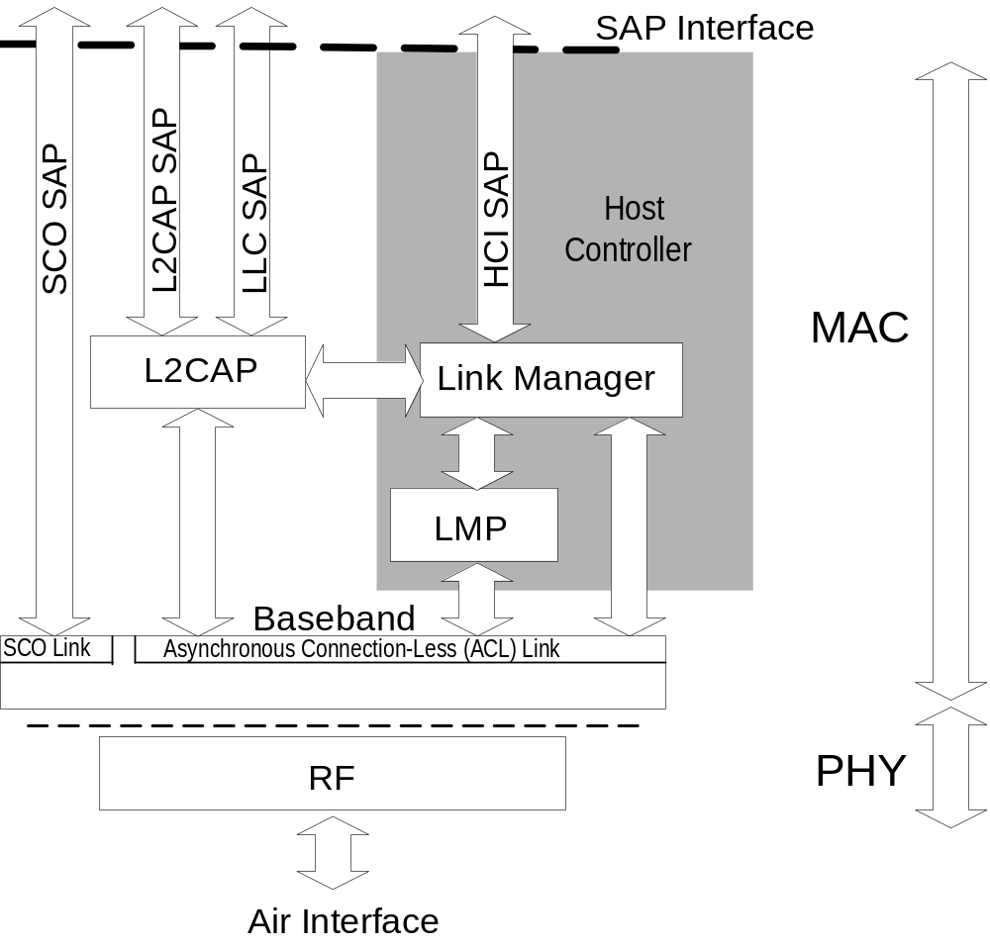
802.15.1 SAPs (4 of 4)

Slide 20
802.15.1 SDL
Derived a picture of what the structure of the BT spec is in IEEE terms.
Helped to uncover holes in existing spec
Enables bench testing and validating of components
Provides a common language between the SIG and the IEEE
Generation of TTCN from SDL is possible

Slide 21
Future Bluetooth/IEEE Collaboration
IEEE 802.15 continues to work with the Bluetooth Special Interest Group
  Submission of Errata
  “Early” updates of the Spec from the SIG – current version of Draft includes v1.1 Bluetooth Specification
  Plans for future revisions of
    Version 1.x
    Future versions
There now is an overlap of “ownership” of the two documents.

Slide 22
Backup Slides
(likely not shown)

Slide 23
IEEE: An Overview
Established in 1884 (AIEE & IRE)
Membership was 360,00 Dec99;
66% USA & 33% Non-USA
Produces 30 percent of the world's published literature in electrical engineering, computers and control technology,
Holds annually more than 300 major conferences
Has more than 800 active standards with 700 under development.

Slide 24
IEEE P802 LAN/MAN
IEEE Project 802 Local and Metropolitan Area Network Standards Committee
Accredited by ANSI, Sponsored by IEEE Computer Society
  Ethernet, Token Ring, Wireless, Cable Modem Standards
  Bridging, VLAN, Security Standards
Meets three times per year
(400 individuals, 15% non-US)
Develops equivalent IEC/ISO JTC 1 standards
  JTC 1 series of equivalent standards are ISO 8802-nnn
IEEE URLs
  802 http://www.ieee802.org/
  802.15 http://www.ieee802.org/15/

Slide 25
IEEE 802 Standards Principals
Due Process through established rules and procedures
Consensus highly desired, near unanimity is generally the rule
Openness where all individuals, world-wide, have access to the process
Balance maintained by having balloting group include both developers and users
Right to Appeal both procedural and technical issues at any time during the process

Slide 26
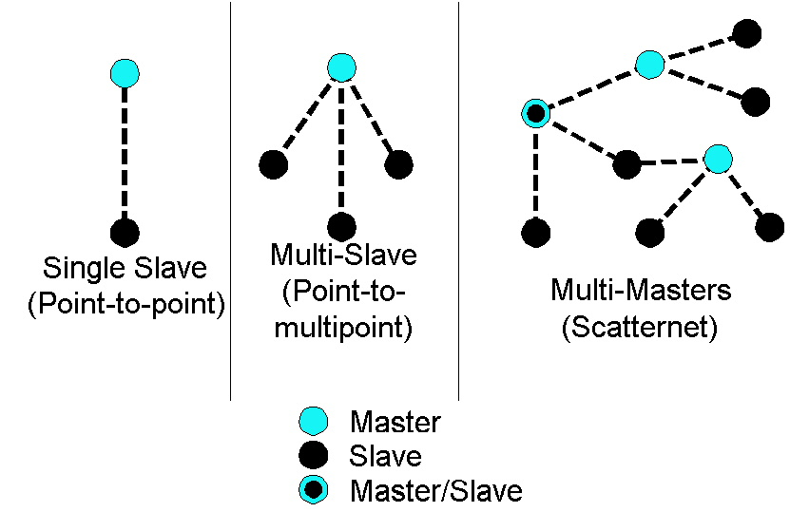
Scatternet

Slide 27
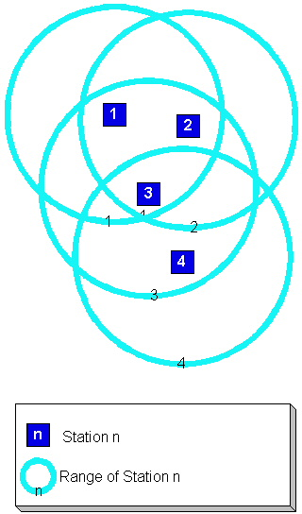
Hidden Node Problem

