Slide 1
Project: IEEE P802.15 Working Group for Wireless Personal Area Networks (WPANs)
Submission Title: [Draft Standard Overview]
Date Submitted: [7 November 1999]
Source: [Tom Siep] Company [Texas Instruments]
Address [8505 Forest Lane, m/s 8723,Dallas, TX, 75243]
Voice:[972.480.6786], FAX: [972.480.6552], E-Mail:[siep@ti.com]
Re: [Original Submission]
Abstract: [What is in the Draft being submitted to P802.15 Task Group 1]
Purpose: [Understand the origins and intent of the document.]
Notice: This document has been prepared to assist the IEEE P802.15. It is offered as a basis for discussion and is not binding on the contributing individual(s) or organization(s). The material in this document is subject to change in form and content after further study. The contributor(s) reserve(s) the right to add, amend or withdraw material contained herein.
Release: The contributor acknowledges and accepts that this contribution becomes the property of IEEE and may be made publicly available by P802.15.
NOTE: Update all red fields replacing with your information; they are required. This is a manual update in appropriate
fields. All Blue fields are informational and are to be deleted. Black stays. After updating delete this box/paragraph.
Slide <number>

Slide 2
P802.15.1 Draft Standard Overview
Tom Siep
Texas Instruments
siep@ti.com

Slide 3
Editors
Chief Technical Editor Tom Siep
Clauses 1 through 5 Ian Gifford
Clauses 6 and 7
  Overview 6 Rich Ditch
  Overview 7 David Cypher (Pat Kinney)
  Transliteration Tom Siep
Clause 8 Mike McInnis
PICS Proforma (unassigned)
Formal Definitions Allen Heberling
Generic Access Profiles (unassigned)

Slide 4
Standard P802 Introductory Material
1. Overview
1.1 Scope
1.2 Purpose
2. References
3. Definitions
4. Acronyms and abbreviations

Slide 5
Overview of Standard
5. General Description
5.1 Architecture view
5.2 The origin of the document and layout
5.3 How Wireless PAN Systems are Different
5.4 WPAN Architecture Overview
5.5 WPAN Layer Description
5.6 Profiles
5.7 Summary

Slide 6
Text from Radio Specification
6. Physical Layer (PHY)
6.1 Scope
6.2 Freq. Bands and Channel Arrangement
6.3 Transmitter Characteristics
6.4 Receiver Characteristics
6.5 Appendix A, Test Conditions

Slide 7
MAC Structure
7. Medium Access Control (MAC)
7.1 Overview
7.2 Baseband General Description
7.3 Link Manager Protocol
7.4 Logical Link Control Adaptation
Protocol

Slide 8
Lowest Layer MAC
7.2 Baseband General Description
7.2.1 Physical Channel
7.2.2 Physical Links
7.2.3 Packets
7.2.4 Error Correction
7.2.5 Error Checking
7.2.6 Logical Channels
7.2.7 Data Whitening
7.2.8 Transmit/receive Routines
7.2.9 Transmit/receive Timing
7.2.10 Channel Control
7.2.11 Hop Selection
7.2.12 Bluetooth Audio
7.2.13 Bluetooth Addressing
7.2.14 Bluetooth Security

Slide 9
Mid Layer MAC
7.3 Link Manager Protocol
7.3.1 General
7.3.2 Format Of LMP
7.3.3 The Procedure Rules And PDUs
7.3.4 Connection Establishment
7.3.5 Summary Of PDUs
7.3.6 Test Modes
7.3.7 Error Handling

Slide 10
Highest Layer MAC
7.4 Logical Link Control Adaptation Protocol
7.4.1 Introduction
7.4.2 General Operation
7.4.3 State Machine
7.4.4 Data Packet Format
7.4.5 Signaling
7.4.6 Configuration Parameter Options
7.4.7 Service Primitives
7.4.8 Summary

Slide 11
Clause 8: Service Access Points
Not explicit in Bluetooth
Requirement for 802.2
To be imputed from:
  Parts A, B, C, D
  Host Computer Interface specification

Slide 12
Annexes
A. Protocol Implementation Conformance Statement proforma
B. Formal Description of MAC operation
C. Formal Description of PHY operation
D. General Access Profile
F. Bibliography

Slide 13
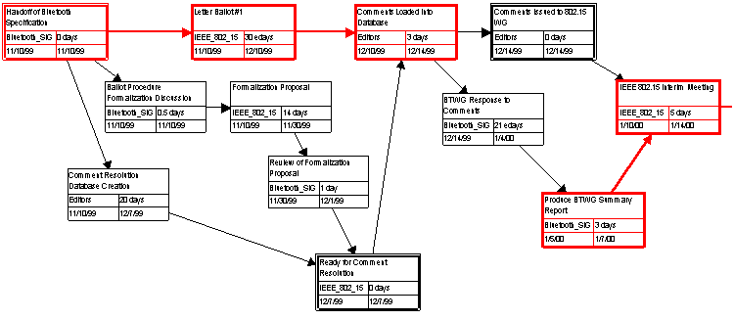
Tasks Related to First Ballot

Slide 14
New Outstanding Issue Posed by
IEEE/RAC (David V. James)
Organizationally Unique Identifiers (OUIs)
  Bluetooth has a potentially high rate of usage
  Bluetooth currently specifies 48-bit ID
  We will work with Bluetooth Program Management to address this issue and advise results

Slide 15
Questions?
Tom Siep
siep@ti.com

Slide 16
Backup Slide(s)

Slide 17
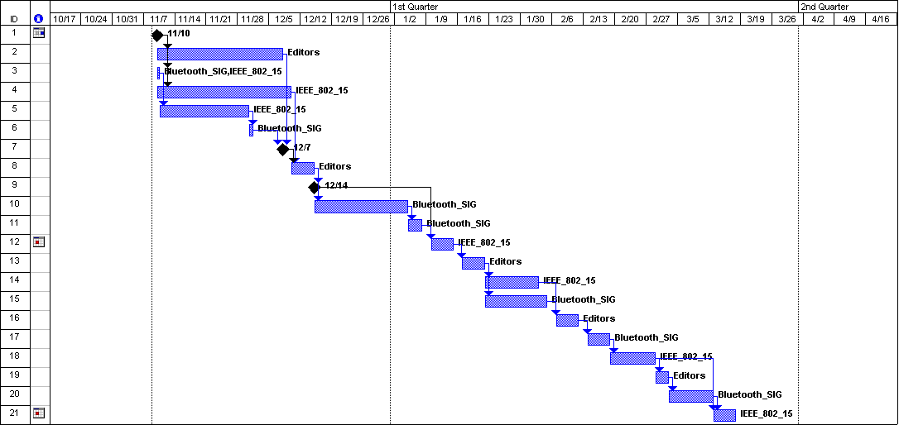
Unapproved Schedule

Slide 18
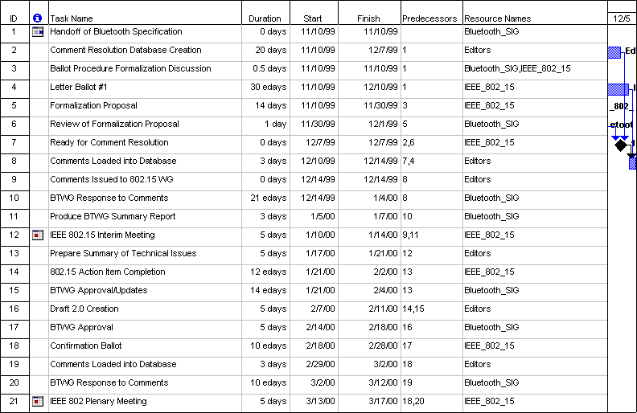
Text for Schedule

Slide 19
Outline of Bluetooth Specification
RADIO SPECIFICATION
A1 SCOPE
A2 FREQUENCY BANDS AND CHANNEL ARRANGEMENT
A3 TRANSMITTER CHARACTERISTICS
A4 RECEIVER CHARACTERISTICS
BASEBAND SPECIFICATION
B1 GENERAL DESCRIPTION
B2 PHYSICAL CHANNEL
B3 PHYSICAL LINKS
B4 PACKETS
B5 ERROR CORRECTION
B6 LOGICAL CHANNELS
B7 DATA WHITENING
B8 TRANSMIT/RECEIVE ROUTINES
B9 TRANSMIT/RECEIVE TIMING
B10 CHANNEL CONTROL B11 HOP SELECTION
B12 VOICE CODEC
B13 BLUETOOTH ADDRESSING
B14 BLUETOOTH SECURITY
LINK MANAGER PROTOCOL
C1 GENERAL
C2 FORMAT OF LMP
C3 THE PROCEDURE RULES AND PDUs
C4 CONNECTION ESTABLISHMENT
C5 SUMMARY OF PDUs
C6 TEST MODES
C7 ERROR HANDLING
L2CAP
D1 INTRODUCTION
D2 GENERAL OPERATION
D3 STATE MACHINE
D4 DATA PACKET FORMAT
D5 SIGNALLING
D6 CONFIGURATION PARAMETER OPTIONS
D7 SERVICE PRIMITIVES
D8 SUMMARY
L2CAP APPENDIX A: CONFIGURATION MSCS
L2CAP APPENDIX B: IMPLEMENTATION GUIDELINES

