Slide 1
OBESITY
the obesity crisis
rubie yuan
2019/12/12

Slide 2
0 1
What is obesity
Directory
0 2
Present Situation
0 3
What to cause
0 4
Many Diseases
0 5
Need to change

Slide 3
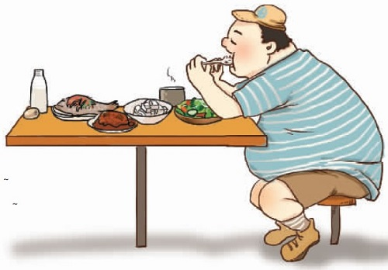
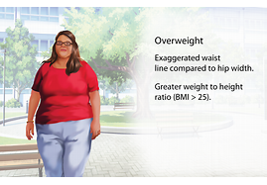
01
What is obesity
Obesity is a medical condition that occurs when a person carries excess weight or body fat that might affect their health.
LIKE THIS……

Slide 4
02
Present Situation
From the study,if the tendency continue,there will be 18% of man and 21%of women overweight in 2025

Slide 5
02
In 2017,China has become the world's largest obese country!,and the number is still increasing……

Slide 6
03
What to cause

Slide 7
FACTORS:
fast food,
fried foods,such as french fries,
fatty and oricessed meats
too much sugar
……
work in an office rather than doing manual labor
playing games on a computer instead of doing physical exercises
going to places by car instead of walking……
such as diabetes,cardiovascular disease, and high blood pressure.
the study find that
sleep deprivation significantly increasing obesity risk in both adults and children
some medicines caused people to gain weight over a period of months.
Too many calories
sedentary life
Not sleeping enough
Endocrine disruptors
Medications and weight gain

Slide 8
04
obesity will cause many other diseases:
obesity
high blood pressure
Diabetes
fatty liver
increase the heart load
it is a stealth killer around our bodies……

Slide 9
05
Need to change:
25%
50%
75%
100%
change bad lifestyle
healthy food
keep exercises
culture healthy life and habits

Slide 10
SUCCESS
a little suggestions:
be a part of your life
you will adapt the life
start
make a plan
keep
only you keep these habits and stay healthy life style
modify
make the plan to suit for you

Slide 11
THANKS
THANK YOU
rubie yuan
2012/12/12

