Slide 1
Online Language Learning Platform
Hackathon Submission
Developer: CHANDAN KUMAR

Slide 2
Problem Statement
Learners need an interactive, simple language learning solution.

Slide 3
Features
- Interactive lessons
- Quizzes
- Progress tracking
- Feedback

Slide 4
Tech Stack
Java, JSP, Servlets, HTML, CSS

Slide 5
Architecture
User → Servlet → JSP → Database → Output

Slide 6
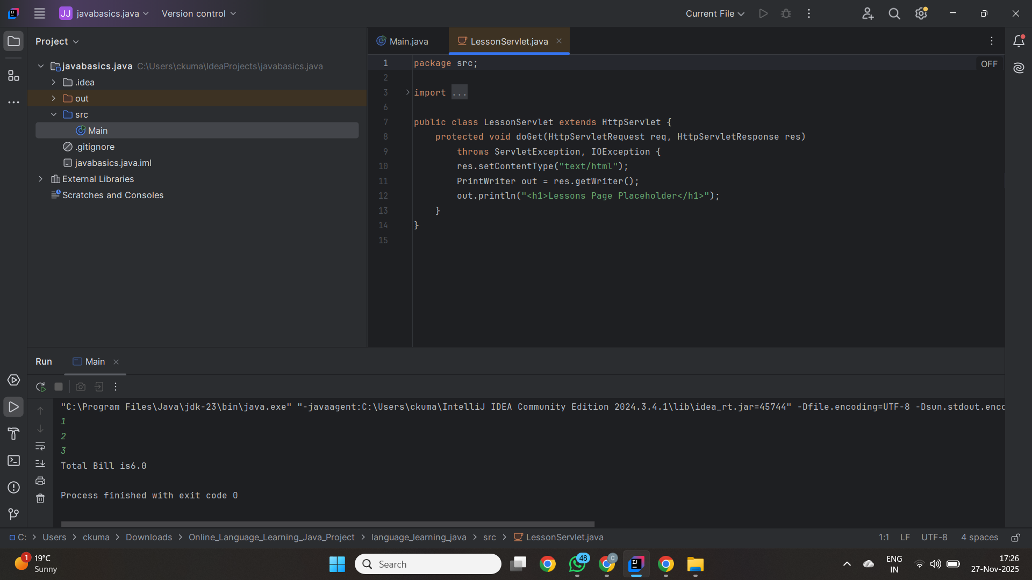
Screenshots

Slide 7
Conclusion
Interactive, Simple, Effective Learning Platform.

