Slide 1
Triad Workbench
5-slide beginner guide
A desktop app that helps multiple coding agents work safely on one repo.
Best first use: small git project + Code -> Review -> Fix -> Verify.
Beginner guide

Slide 2
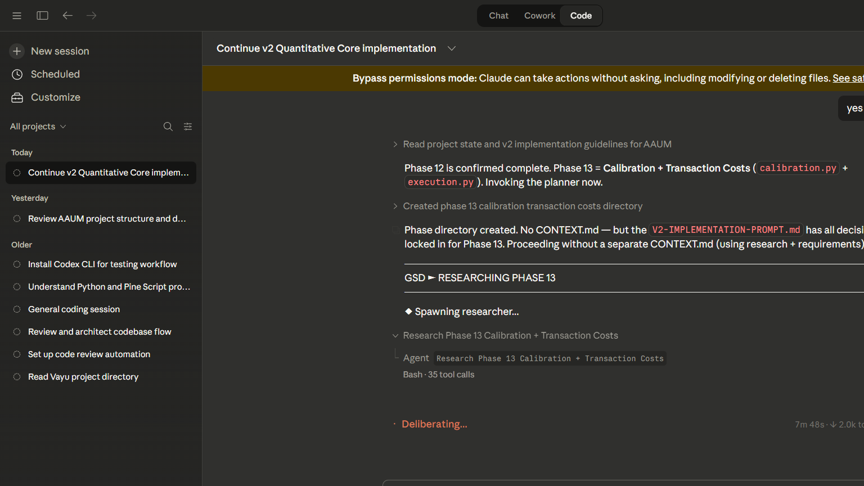
Step 1: Open A Project
Start with a real git repo
1. Click Open project
2. Choose a git-backed folder
3. Probe agents
4. Connect Claude and Codex first
Step 1

Slide 3
Step 2: Pick A Workflow
Use the safe default first
Recommended
Write a small brief
Code -> Review -> Fix -> Verify
One feature
One bug
One page
Ask for tests
Claude writes
Codex reviews
Claude fixes
Codex verifies
Step 2

Slide 4
Step 3: Review The Result
Never skip the review center
Check findings
Inspect the patch
Look at stdout / stderr if something failed
Only promote after review
Promotion buttons
Apply to main
Keep worktree
Open task branch
Step 3

Slide 5
Step 4: Try This First Prompt
A safe beginner task
Create a TypeScript CLI todo app with add, list, and done commands. Store data in a local JSON file. Add Vitest tests for the main flows. Keep the implementation simple and readable.
Small tasks work best
Keep your main branch clean
Use Save now if you want an archive snapshot
First real run

