Slide 1
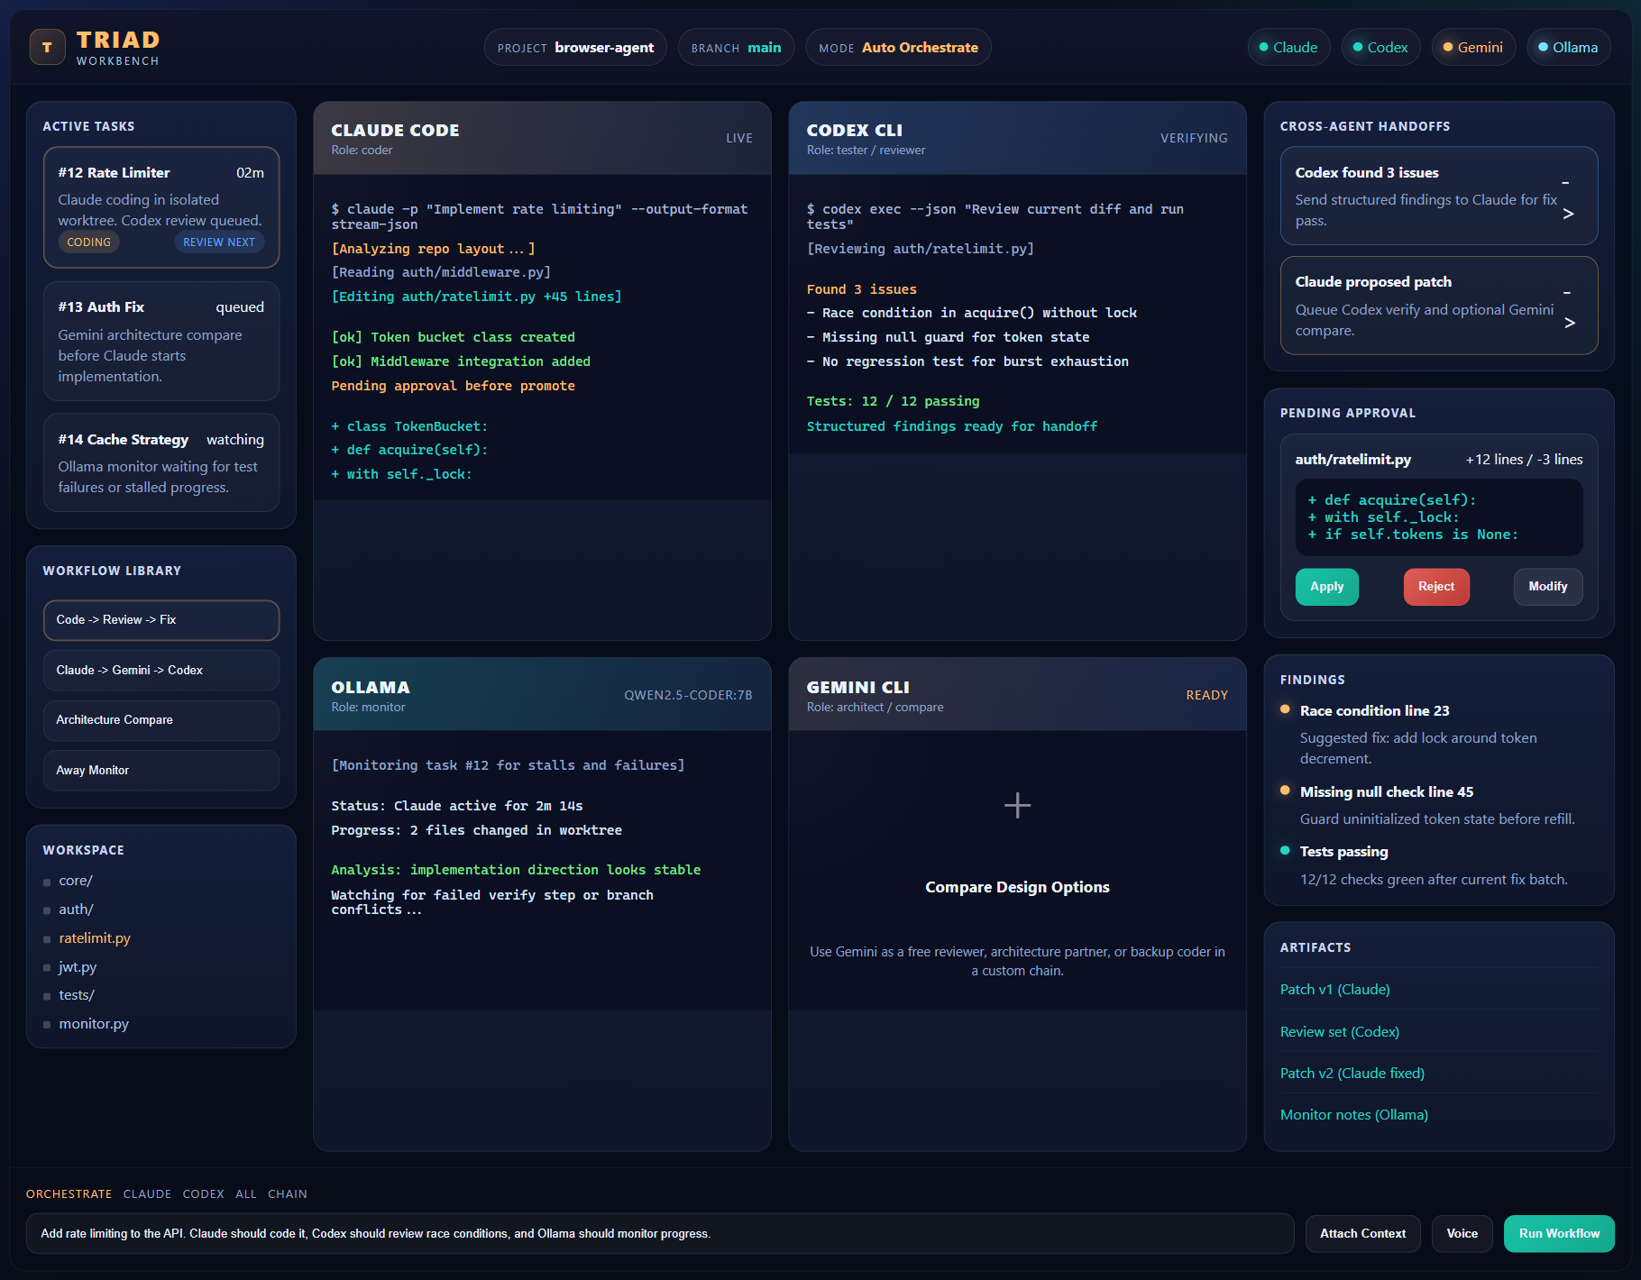
Triad Workbench
Client/demo deck
One desktop app for Claude, Codex, Gemini, and Ollama
Local-first orchestration with git worktree safety
Review, verify, and promote changes instead of blindly applying them
Why it matters
Safer than direct repo editing
Faster than juggling browser tabs
Auditable via project archive
Client/demo overview

Slide 2
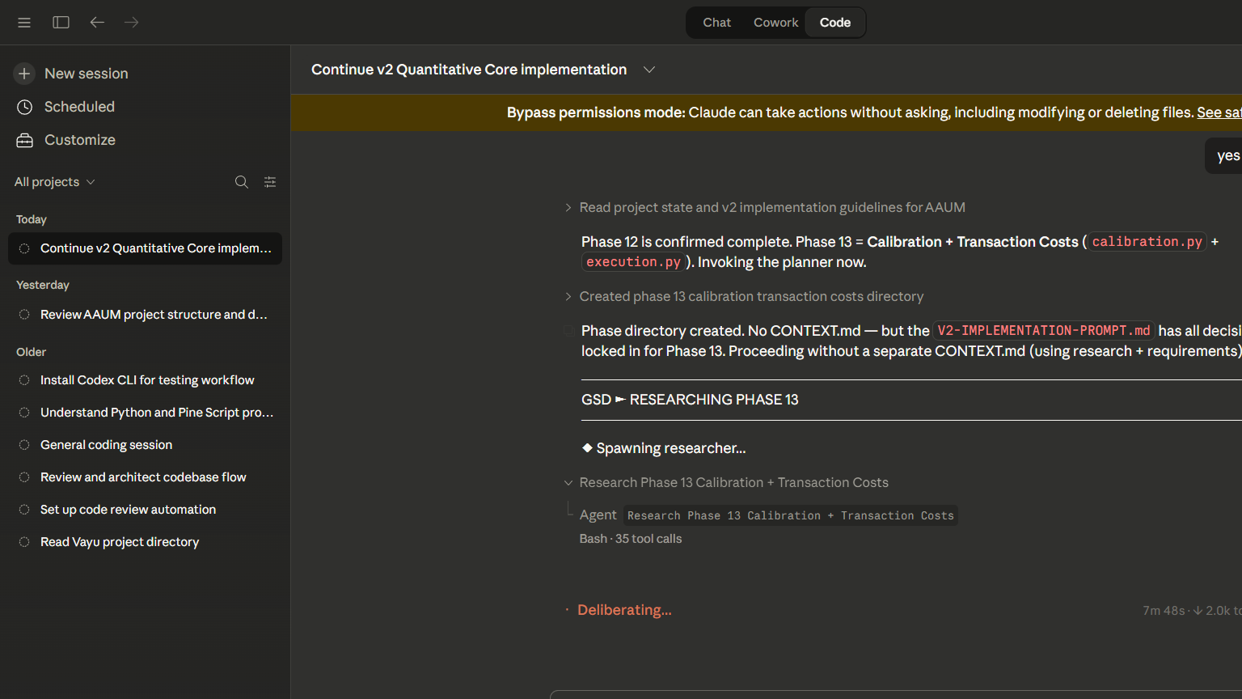
What You See In The App
A single mission-control screen
Top bar
Open project
Switch runner
Probe agents
Agent grid
Claude
Codex
Gemini
Ollama
Task system
Workflow list
Task history
Review detail
Visual tour

Slide 3
How The Safe Coding Loop Works
The built-in process
1. Open a git project
2. Run a workflow
3. Triad creates a dedicated task worktree
4. Agents work inside that isolated branch
5. Review the patch, logs, and findings
6. Promote only after approval
Default loop
Claude writes
Codex reviews
Claude fixes
Codex verifies
Safety promise
No direct main-checkout edits
Explicit promotion required
Project archive keeps evidence
Workflow model

Slide 4
Agent Roles At A Glance
Use each model for the right job
Claude
Codex
Gemini
Ollama
Primary implementation
Best for writing code and applying fixes
Review and verification
Great for bug-finding and test-minded critique
Architecture and second opinion
Useful in compare workflows
Local support model
Guide / Tester / Developer / Monitor
Direct terminals are available for CLI agents
Workflows are the main product experience
Ollama is strongest as local compare or monitor support
Agent positioning

Slide 5
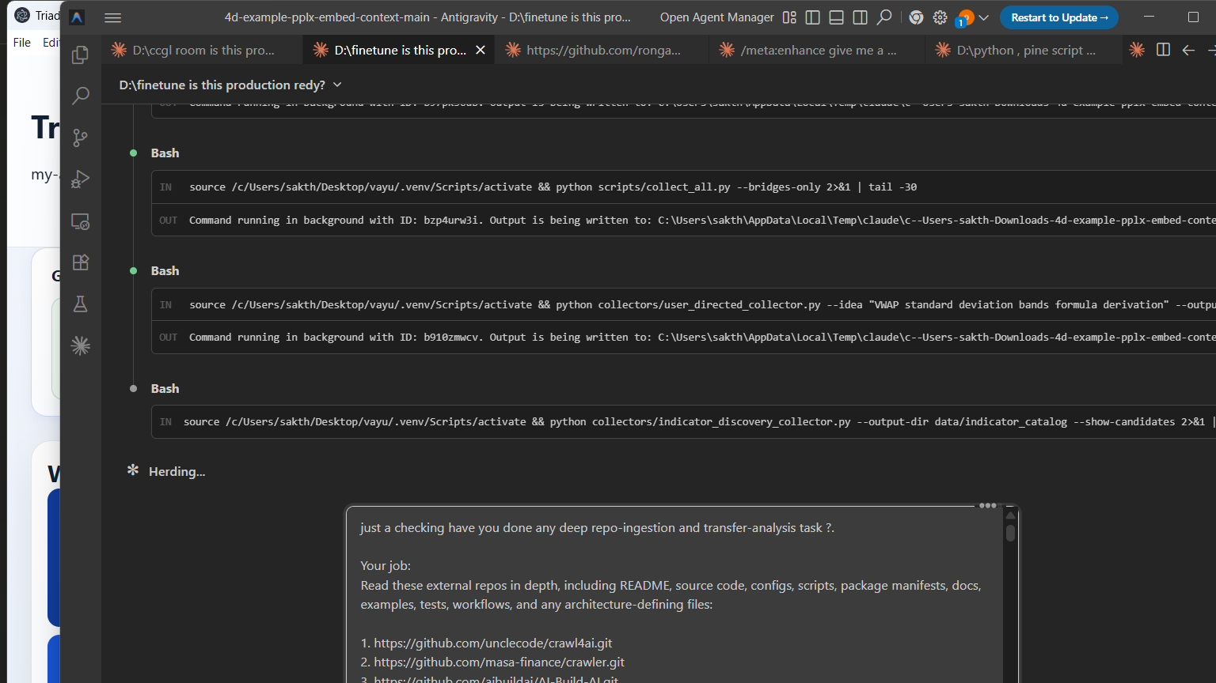
Using It On An Existing Repo
The normal daily flow
1. Open the repository
2. Connect the agents you need
3. Pick a workflow
4. Write a small, clear task brief
5. Review findings before promotion
Existing project use

Slide 6
Starting From Scratch
A simple new-project path
mkdir my-small-app cd my-small-app git init npm init -y git add . git commit -m "Initial scaffold"
Then in Triad
Open the folder
Connect Claude and Codex
Run a tiny first feature with tests
Best first task
Create one feature
Add tests
Keep scope narrow
Inspect before applying
New project use

Slide 7
Review And Promotion
Where the app becomes safer than normal agent use
Review center
Promotion actions
Archive
Summary
Prompt
Stdout / stderr
Patch
Findings
Apply to main
Keep worktree
Open task branch
Stores snapshots, artifacts, prompts, logs, transcripts, and events
This makes the app suitable for controlled team-style coding, not just solo prompting.
Safety layer

Slide 8
Best Current Use Cases
What to demo or start with first
Small to medium feature work
Safe code review loops
Architecture comparison before implementation
Projects where you want an auditable AI trail
Not the main v0.1 focus
Huge one-shot app generation
Per-agent full chat product
Blind auto-merge without review
Demo close

