Slide 1
Triad Workbench Team Training
How to use the app consistently across a team
Common workflow language
Safer review discipline
Example prompts and operating rules
Team training

Slide 2
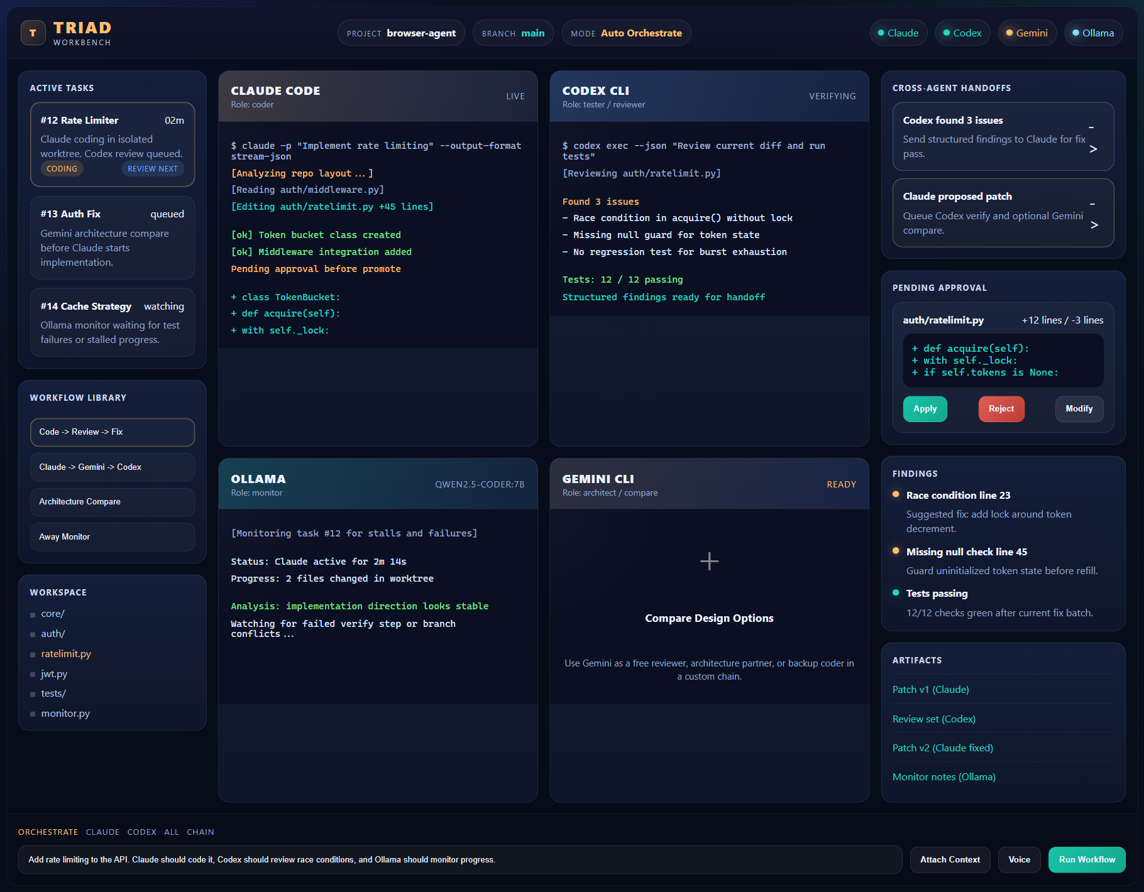
Operating Model
What the team should expect from Triad
Triad is workflow-first, not chat-first
Each task gets its own worktree
Artifacts and findings are part of the output, not optional extras
Promotion is a human decision point
Team model

Slide 3
Who To Use For What
Role guidance for the team
Claude
Codex
Gemini
Ollama
Implementation
Fixes
Main coding pass
Review
Verification
Bug-finding
Architecture compare
Extra critique
Low-cost second opinion
Local monitoring
Local compare
Support model
Agent roles

Slide 4
Standard Team Workflow
The recommended default
1. Open clean git repo
2. Connect required agents
3. Run Code -> Review -> Fix -> Verify
4. Inspect findings and patch
5. Promote only after acceptance
Use this for
Feature work
Bug fixes
Small refactors
Safe iterative changes
Default workflow

Slide 5
Team Rules
These reduce bad runs and messy diffs
One narrow task per run
Always ask for tests when code changes
Do not ask for a full app build in one prompt
Keep main checkout clean before Apply to main
Use Keep worktree when the result needs manual refinement
Team rules

Slide 6
Example Prompt: Small Feature
Ready to paste into the task brief box
Add a small React settings panel for notification preferences. Include a save button and simple local validation. Keep the UI responsive. Add tests for render and save behavior. Do not modify unrelated files.
Why this is good: narrow scope, stack named, tests required, unrelated files protected.
Prompt example 1

Slide 7
Example Prompt: API Task
Another good team-style prompt
Create an Express route for creating and listing notes. Use in-memory storage first. Return clean JSON responses. Add supertest coverage for create and list. Keep the implementation simple and readable.
Why this is good: one bounded backend slice, simple storage, explicit test framework.
Prompt example 2

Slide 8
Example Prompt: Architecture Compare
Use before implementation when the design is unclear
Compare three approaches for adding plugin support to this app: 1. local config-driven plugins 2. IPC-managed extension loader 3. MCP-backed extension model Evaluate complexity, safety, and maintainability. Do not write code; produce findings and recommendation only.
Use the Architecture Compare workflow for prompts like this.
Prompt example 3

Slide 9
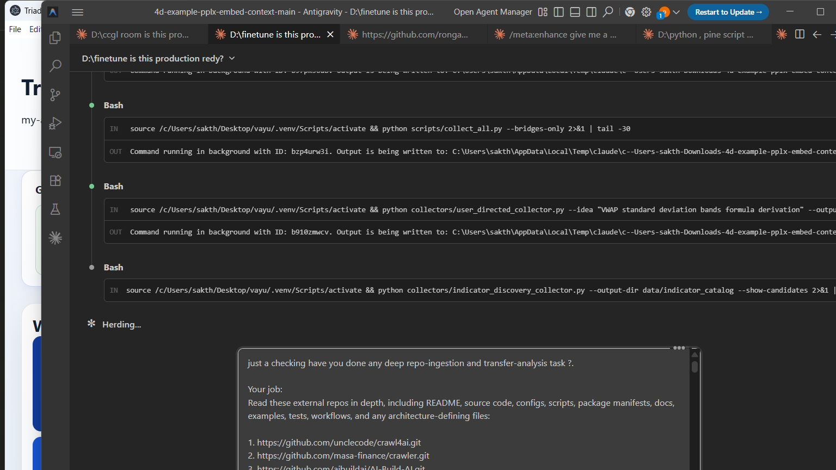
What Reviewers Should Check
How to read the output
Findings
Artifacts
Promotion
Severity
Evidence
Recommended action
Prompt
Stdout
Stderr
Patch
Apply to main
Keep worktree
Open task branch
Review habits

Slide 10
Common Mistakes To Avoid
What to coach during rollout
Running on a non-git folder
Using a giant vague prompt
Skipping Probe agents after changing runner
Treating Ollama like a full direct-chat pane
Applying to main without reading findings
Pitfalls

