Slide 1
CCGL / Triad Workbench
Multi-agent coding workbench guide
Understand what the app does and how the UI is organized
Learn each workflow, agent option, and promotion action
See the safe path for both new projects and existing repos
Core agents
Core promise
Claude Code
Codex CLI
Gemini CLI
Ollama
Local-first
CLI-native
Worktree-safe
Review before promotion
Triad Workbench user guide

Slide 2
What Triad Workbench Is
A local mission-control app for coding agents
Electron desktop app that orchestrates installed coding CLIs
Built around isolated git worktrees rather than direct main-branch edits
Best fit: controlled implementation, review, verification, and promotion
Primary loop: Claude writes -> Codex reviews -> Claude fixes -> Codex verifies

Slide 3
Why Use It
Safer than asking one AI to edit your repo directly
Keeps each task in its own worktree
Preserves prompts, logs, diffs, and findings in a project archive
Lets multiple agents critique the same task from different roles
Requires explicit promotion before code reaches your main checkout

Slide 4
Core Concepts
The mental model to keep in mind while using the app
Agent cards = current tool status, role, terminal, and quick actions
Workflow = built-in chain of agent steps
Task = one run with its own worktree, artifacts, findings, and stage history
Review center = inspect prompts, logs, patches, and findings before promoting
Archive = per-project evidence folder at .triad-workbench

Slide 5
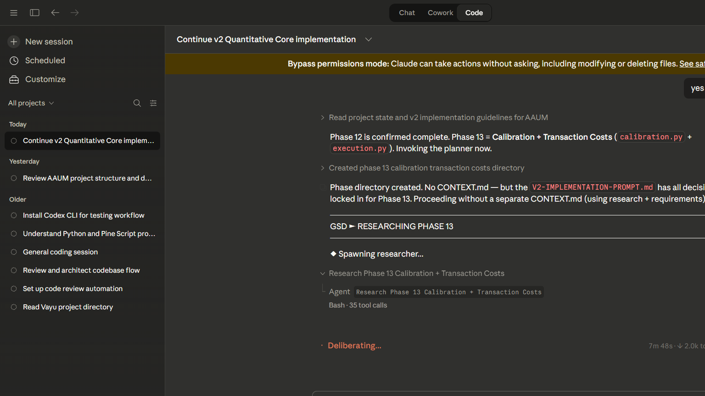
Main Screen Tour
What each area of the UI is for
Top bar
Right rail
Open project
Runner selector
Probe agents
Findings
Ollama model
Archive
Notifications
Left rail
Workflow picker
Task list
Run history
Bottom composer
Write the task brief
Pick a workflow
Run the task
Center grid
Claude
Codex
Gemini
Ollama
Screen tour

Slide 6
Agents And What To Use Them For
Each card has a different job in the system
Claude Code
Codex CLI
Gemini CLI
Ollama
Primary coder
Best for implementing features
Also used for fix passes
Reviewer / tester
Best for bug finding and verification
Used in final review steps
Architecture or extra critique
Good second opinion
Useful in compare workflows
Local model
Guide / Tester / Developer / Monitor personalities
Great for local compare or away-monitor
Connect = log in or authorize a CLI agent
Open terminal = direct interactive session with that CLI agent
Role / personality changes how the agent is used in workflows
Ready is required before a workflow can use that agent
Agent options

Slide 7
Built-In Workflows
Pick the workflow that matches the job
Code -> Review -> Fix -> Verify
Code -> Gemini Compare -> Codex Review
Architecture Compare
Away Monitor
Default and safest
Claude codes
Codex reviews
Claude fixes
Codex verifies
Adds Gemini as an extra critic
Good for architecture-sensitive changes
Runs side-by-side design critique
Claude + Codex + Gemini + Ollama
Uses Ollama as a local monitor
Good for long-running sessions or local observation
Use Code -> Review -> Fix -> Verify for your first real task
Use Architecture Compare before coding when the design is still unclear
Use Away Monitor when you want Ollama watching a longer task flow
Workflow guide

Slide 8
How A Task Works
What happens after you click Run workflow
1. Triad inspects the selected git project
2. A dedicated task worktree is created
3. The selected workflow runs one agent step at a time
4. Each step produces artifacts: prompt, stdout, stderr, summary, findings, patch
5. The review center shows the results
6. You explicitly promote, keep, or open the task worktree
Task lifecycle

Slide 9
Using Triad On An Existing Project
The normal way to use the app
1. Open a real git repository with Open project
2. Set the correct runner (Windows or WSL)
3. Probe agents and connect any that are missing login
4. Choose a workflow
5. Write a small, clear task brief
6. Run the workflow
7. Review findings, logs, and patch output
8. Apply to main, keep worktree, or open the task branch
Important rules
Project must be a git repo
Main checkout should be clean before Apply to main
Keep tasks small and reviewable
Use Save now if you want an archive snapshot immediately
Existing project flow

Slide 10
Starting A New Project From Scratch
Minimal safe path for a fresh repo
mkdir my-small-app cd my-small-app git init npm init -y git add . git commit -m "Initial scaffold"
Recommended first task
Create a TypeScript CLI todo app with add, list, and done commands.
Store data in a local JSON file.
Add Vitest tests for the main flows.
Keep the implementation simple and readable.
1. Create the folder and initialize git
2. Add a tiny starter file or package manifest
3. Make the first commit before asking Triad to change anything
4. Open the folder in Triad
5. Start with one small task, not a full app request
New project quickstart

Slide 11
How To Write Good Task Briefs
Small, explicit prompts work best
Say exactly what to build
Mention the language or framework
State constraints: keep simple, avoid unrelated files, add tests
Ask for the shape of success, not vague creativity
Build a small Express API with routes for create, list, and delete notes. Use in-memory storage first. Add tests with supertest. Do not modify unrelated files.
Avoid briefs like
Build the whole app from scratch
Refactor everything
Make it production ready in one step
Prompting guide

Slide 12
Review Center, Promotion, And Archive
The safety layer of the app
Review center
Promotion actions
Archive
Inspect summary, prompt, stdout, stderr, patch, findings, and command runs
Apply to main
Keep worktree
Open task branch
Save prompts, logs, artifacts, transcripts, and events to .triad-workbench
Apply to main is the final merge-back step
Keep worktree preserves the isolated branch for more manual work
Open task branch opens the task worktree folder
Archive helps you audit what every agent actually did
Safety and evidence

Slide 13
What Works Best Today
Recommended operating style for v0.1
Use Claude + Codex first for your main build loop
Use Gemini for extra critique or architecture compare
Use Ollama as local support, not as your only source of truth
Start with small to medium tasks
Review before promotion every time
Keep your main checkout clean
Best practices

Slide 14
Current Limitations And Troubleshooting
Things to know before daily use
Current limitations
Common fixes
Not a full per-agent chat product yet
Ollama is workflow-driven rather than full direct chat
Runner choice matters for CLI availability
Large one-shot tasks are less reliable than smaller steps
Use Probe agents after changing runner
Reconnect agents if auth expires
Use Open terminal for direct CLI interaction
If Apply to main is blocked, clean the main checkout first
If a workflow is disabled, check project git status and required agent readiness
If a connector behaves differently in WSL vs Windows, switch runner and probe again
If you want direct chat with every model, that is a future feature rather than the main v0.1 workflow
Limitations

Slide 15
Recommended First Run
The easiest way to learn the app
1. Open a small git repo
2. Connect Claude and Codex
3. Choose Code -> Review -> Fix -> Verify
4. Ask for one tiny feature plus tests
5. Inspect findings and patch
6. Apply to main only after review
Start here

