Slide 1
PROG8245 Final Project
Email Spam Detector
Arcadio -
Givors Ku -
Kyle - 8977010
Conestoga College
Applied Artificial Intelligence & Machine Learning
Islam Mahmoud
Apr 14 2024

Slide 2
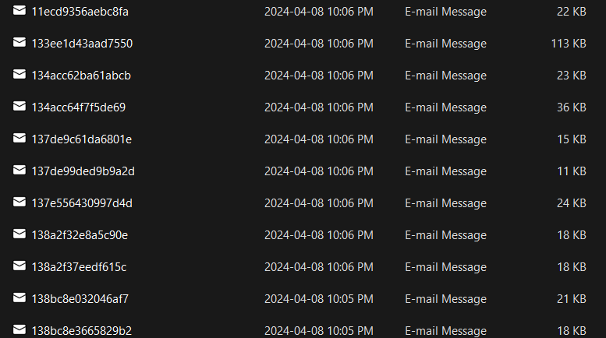
Data Collection
Export email from our Gmail Account
https://github.com/KajPe/bckgmail - Github

Slide 3
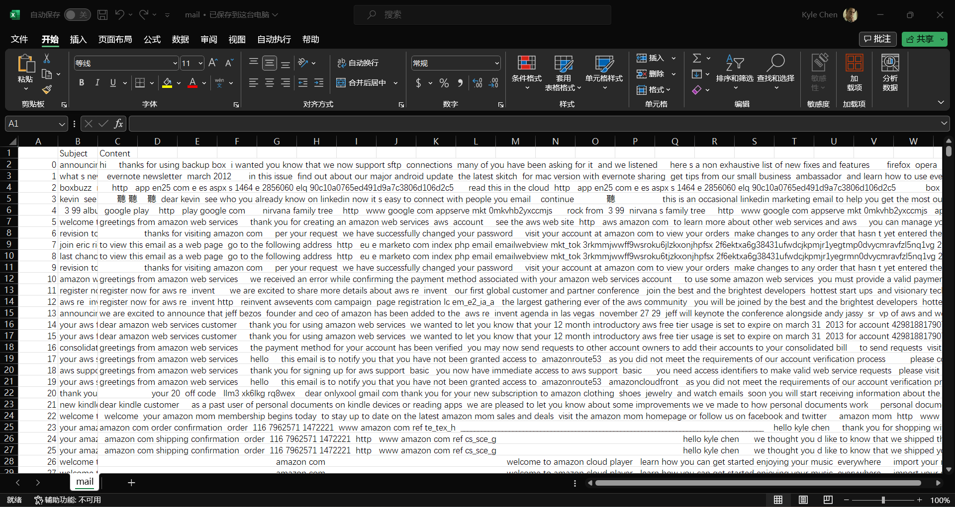
Data Collection
Parse the eml file to txt

Slide 4
Data Collection
Parse the eml file to txt
Challenges:
Get Google credentials.json
Remove escape character
Remove punctuation marks
Ignore the long content

Slide 5
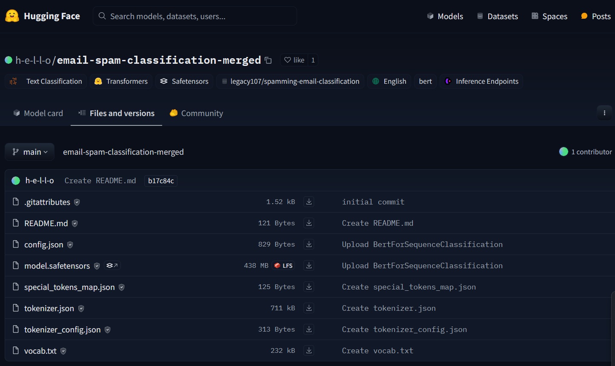
Data Labeling
Use Pre-Train model to labeling the dataset
https://huggingface.co/h-e-l-l-o/email-spam-classification-merged/tree/main - Hugging Face

Slide 6
Data Preprocessing
Vectorize the dataset with TF-IDF
— de Paula Fernandez, Arcadio

Slide 7
Modeling
Logistic Regression
—de Paula Fernandez, Arcadio
RandomForestClassifier
—de Paula Fernandez, Arcadio

Slide 8
Resources
Our Project:
https://github.com/onlyxool/PROG8245NLP
Source:
https://github.com/KajPe/bckgmail - Export Gmail
https://github.com/a16z-infra/llama2-chatbot - User Interface
https://huggingface.co/h-e-l-l-o/email-spam-classification-merged - Labeling Dataset

Slide 9

Thanks

