Slide 1
PROG8245 Final Project
Email Spam Detector
de Paula Fernandez, Arcadio - 8951215
Ku, Shih-Chieh - 8906826
Kyle - 8977010
Conestoga College
Applied Artificial Intelligence & Machine Learning
Islam Mahmoud
Apr, 14 2024

Slide 2
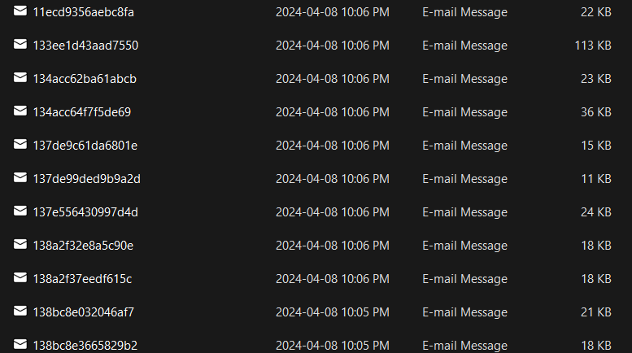
Data Collection
— Kyle (Chen, Kun)
Export email from our Gmail Account
https://github.com/KajPe/bckgmail - Github

Slide 3
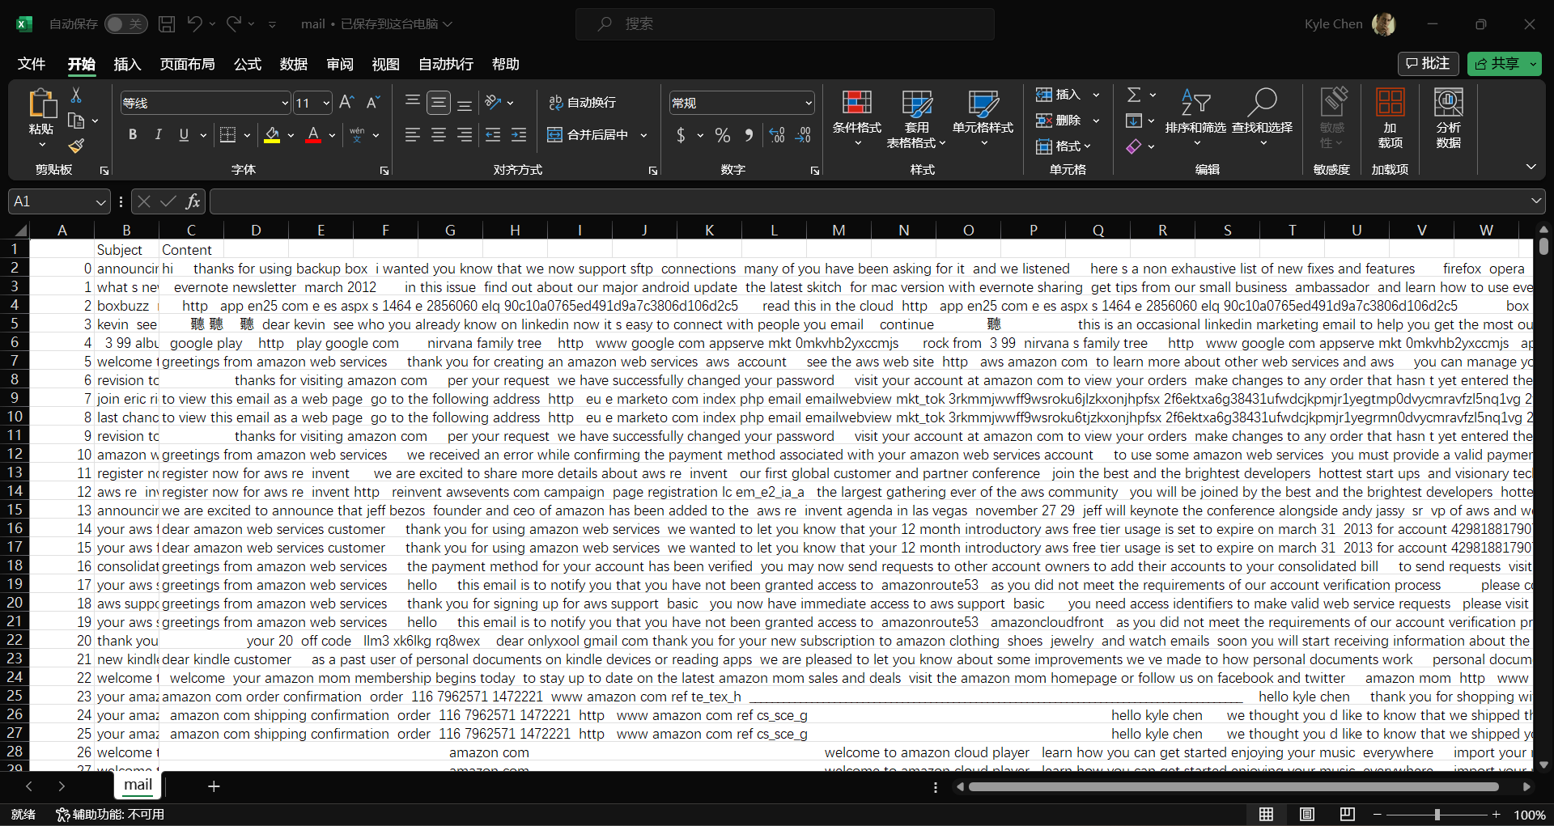
Data Collection
— Kyle (Chen, Kun)
Parse the eml file to txt

Slide 4
Data Collection
— Kyle (Chen, Kun)
Parse the eml file to txt
Challenges:
Get Google credentials.json
Remove escape character
Remove punctuation marks
Ignore the long content
Remove html label by BeautifulSoap

Slide 5
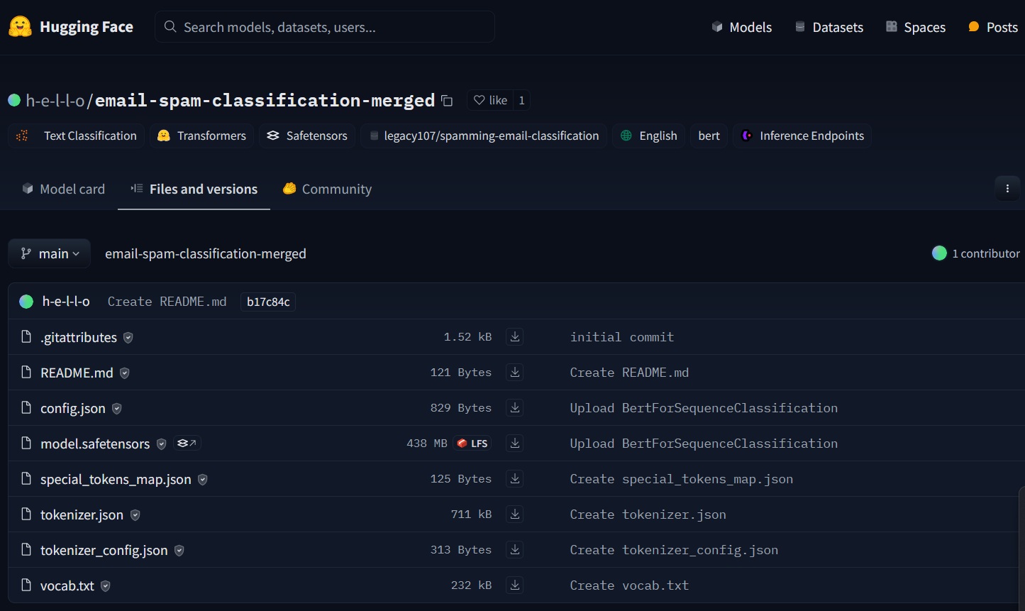
Data Labeling
— Givors (Ku, Shih-Chieh)
Use Pre-Train model to labeling the dataset
https://huggingface.co/h-e-l-l-o/email-spam-classification-merged/tree/main - Hugging Face

Slide 6
Data Preprocessing
Vectorize the dataset with TF-IDF
Predictive Model: Word2Vec
Sparse Matrix Factorization: Non-negative Matrix Factorization (NMF)
— de Paula Fernandez, Arcadio

Slide 7
Modeling
Logistic Regression
—de Paula Fernandez, Arcadio
RandomForestClassifier
—de Paula Fernandez, Arcadio

Slide 8
Resources
Our Project:
https://github.com/onlyxool/PROG8245NLP
Source:
https://github.com/KajPe/bckgmail - Export Gmail
https://github.com/a16z-infra/llama2-chatbot - User Interface
https://huggingface.co/h-e-l-l-o/email-spam-classification-merged - Labeling Dataset

Slide 9

Thanks

