Slide 1


ONNX as a Standard Format for Institution with Legacy
ONNX Community Virtual Meetup 18 Oct 2021
Haixuan Xavier Tao
Notes:
Generating insight as to why a legacy institution like ours need ONNX

Slide 2



Improving our activities with AI
Detecting fake banknotes with Computer Vision
Detecting fraudulent transaction with anomalie detection
Improving Retail Bank Supervision with NLP, NER, CV, clustering
Notes:
First one is around cv,
Second one is around classical banking ML
Bank regulation Mortgage loan, terrorist, money laundering

Slide 3



Case Study: Supervising a Bank
Credit supervision
Terrorism financing
Money laundering

Slide 4

Case Study: Supervising a Bank
Retail Bank high security
Banque de France Server Security
Data Protection

Slide 5

Case Study: Supervising a Bank
Retail Bank high security
Banque de France Server Security
Data Protection

Slide 6
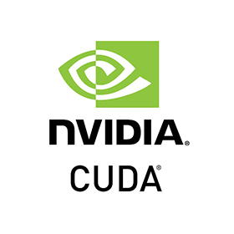

Accelerating our DL Models with Execution Provider
DirectML

Slide 7
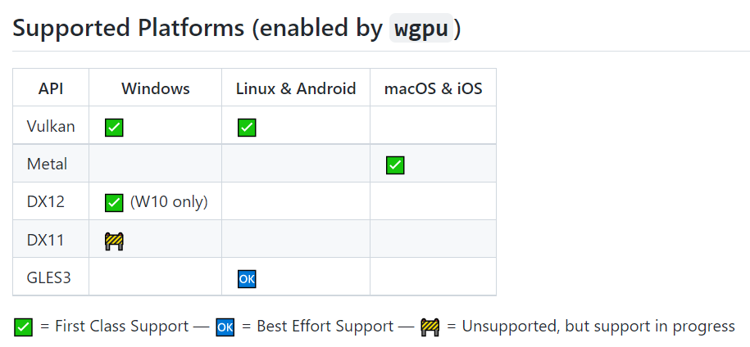
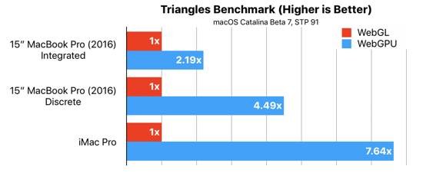
Rust and WebGPU based ONNX provider?

Slide 8
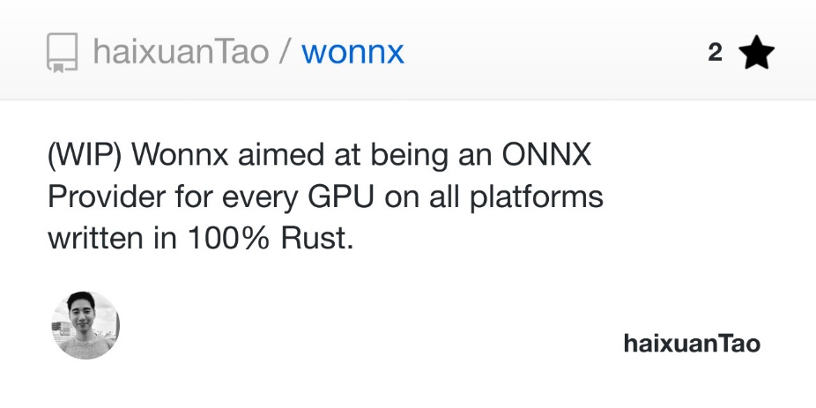
Wonnx, an ONNX Provider based on Rust and WebGPU
40% of ONNX Operators implemented.
Run Mnist and Squeezenet.
Squeezenet inference time with wonnx on par with CPU ONNX Runtime (~100ms)
Git: https://github.com/haixuanTao/wonnx

