Slide 1
ONNX Support in the MLIR Compiler Approach and Status
Alexandre Eichenberger
Collaborative effort from
IBM Watson/Tokyo Research Labs
and a growing number of external contributors.

Slide 2
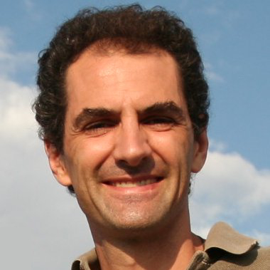
Presenter
Alexandre Eichenberger
Principal Research Staff Member
IBM T.J. Watson Research Center
alexe@us.ibm.com
Hired in 2001 to help program the IBM/Sony/Toshiba PlayStation 3, I have enjoyed doing research at IBM in Instruction-Level Parallelism, SIMD & thread level parallelism. The last few years, I have worked on supporting OpenMP on our supercomputers, from BG/Q to Coral machines. More recently, I am looking into supporting Deep Neural Networks on a wide range of machines. Just like OpenMP is a great standard to exploit parallelism for a wide range of supercomputers, ONNX is a great standard to support a wide range of frameworks for Deep Neural Networks and related AI tasks.

Slide 3
Multi-Level Intermediate Representation (MLIR)
Goals of MLIR.
Significantly reduce the cost of building domain specific compilers.
Connect existing compilers together through a shared infrastructure.
Part of LLVM compiler & governance.
TensorFlow (TF) & TensorFlow Runtime (TFRT)
dialects
CPU Optimized Computations
CPU binary
LinAlg
FLANG
(LLVM Fortran)
Affine
GPU Optimized Computations
GPU binary
NPComp
(Numerical Python Compiler)
Standard
Accelerator Optimized Computations
accelerator binary
ONNX MLIR
custom
backend

Slide 4
Architecture of ONNX-MLIR Compiler
Consumes ONNX model and produce inference executables using 2 new dialects:
ONNX: representation of native ONNX operations,
KRNL: representation to lower ONNX to loops.
Import with
ONNX
Converters
ONNX - MLIR
LLVM Backend
ONNX
KRNL
TensorFlow
PyTorch
Affine
Standard
Other Framework with ONNX converter
LLVM
Executable

Slide 5
Integration of ONNX Specs within MLIR Framework
Ingest ONNX Specs directly into MLIR.
Script transforms ONNX Specs into LLVM TableGen format.
Describes ONNX operations for MLIR (inputs, attributes, outputs, types).
Drives validation and shape inference.
Inference rules
Validation pass
ONNX
Specs
ONNX MLIR
Dialect
MLIR tools
Python script
Definitions of ONNX objects
Shape inference pass
ONNX Specs
LLVM TableGen
C++

Slide 6
Pattern-Matching Transformations in MLIR
High level description of ONNX to ONNX transformations.
E.g MatMul and Add into a GEMM operation.
%0 = "onnx.MatMul"(%a0, %a1) : (tensor<10x10xf32>, tensor<10x10xf32>) -> tensor<10x10xf32>
%1 = "onnx.Add"(%0, %a2) : (tensor<10x10xf32>, tensor
Pat<(ONNXAddOp (
ONNXMatMulOp:$res $m1, $m2),
$m3),
(ONNXGemmOp $m1, $m2, $m3,..) >
Rewrite rules
MLIR tools
ONNX Dialect Rewrites
LLVM TableGen
C++
%0 = "onnx.Gemm"(%a0, %a1, %a2)
{ alpha = 1.000000e+00, beta = 1.000000e+00, transA = 0, transB = 0} :
( tensor<10x10xf32>, tensor<10x10xf32>, tensor<10x10xf32>) -> tensor<10x10xf32>

Slide 7
Example: MNIST model to ONNX dialect
Output representation:
all shapes inferred, propagated, and verified,
all parameters verified and normalized.
ONNX
Model
func @main_graph(%arg0: tensor<1x1x28x28xf32>, %arg1: tensor<8x1x5x5xf32>,
%arg2: tensor<8x1x1xf32>, %arg3: tensor<16x8x5x5xf32>, %arg4: tensor<16x1x1xf32>,
%arg5: tensor<2xi64>, %arg6: tensor<16x4x4x10xf32>, %arg7: tensor<2xi64>,
%arg8: tensor<1x10xf32>) -> tensor<1x10xf32> {
%0 = "onnx.Constant"() { sparse_value = [], value = [256, 10]} : () -> tensor<2xi64>
%1 = "onnx.Reshape"(%arg6, %0) : (tensor<16x4x4x10xf32>, tensor<2xi64>) -> tensor<256x10xf32>
%2 = "onnx.Conv"( %arg0, %arg1, null)
{ auto_pad = ”NOT_SET", group = 1, kernel_shape = [5, 5], strides = [1, 1] dilations = [1, 1] } :
( tensor<1x1x28x28xf32>, tensor<8x1x5x5xf32>) -> tensor<1x8x28x28xf32>
%3 = "onnx.Add"(%2, %arg2) : (tensor<1x8x28x28xf32>, tensor<8x1x1xf32>) -> tensor<1x8x28x28xf32>
[…]
}
onnx-mlir
--EmitONNXIR
mnist.onnx

Slide 8
Motivation for KRNL Dialect
Dialect used to lower ONNX operations to loop code.
Designed for customizable optimizations such as tiling, fusion, parallelization.
It is hard to revert an optimization, except if…
Instead of performing the optimization, we just record it (i.e. build a recipe of optimizations).
And can alter it later as needed by other optimization.
Example:
Try to fuse 2 kernels that were tiled by different amount:
Make them compatible by simply edit B’s recipe from [2, 2] -> [5, 5]
Greater freedom and flexibility for compilers to traverse the schedule space!
A: blocks of 5x5
B: blocks of 2x2

Slide 9
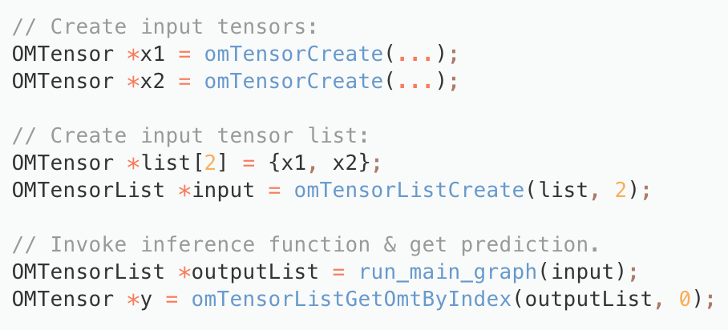
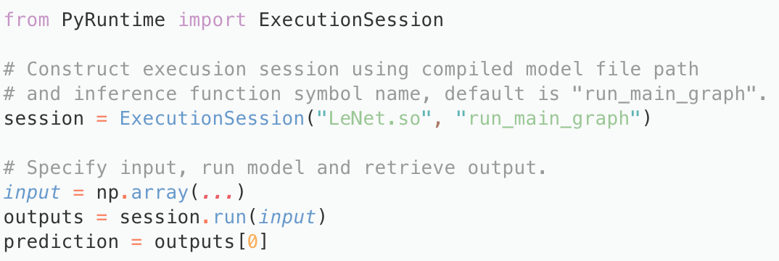
ONNX-MLIR Runtime Interface
C API.
invoked using run_main_graph function.
Python API.
use execution session,
input/ouput with numpy,
thanks @gperrotta.

Slide 10
Get Involved
Big thanks.
to the 15+ external contributors.
Learn more.
Code: https://github.com/onnx/onnx-mlir
Additional documentation: http://onnx.ai/onnx-mlir
Status.
Support 50+ commonly used ONNX operations.
Can compile mnist, resnet to LLVM.
Actively prototyping.
ONNX, KRNL & buffer optimizations.
ONNX-ML support.

