Slide 1


Operators sig
Emad Barsoum (Microsoft)
Michal Karzynski (Intel)
Breakout session

Slide 2
Agenda
Operators SIG
Add new operator update
Proposal / improvement
Discussion: Version converter
Discussion: PR and Issues

Slide 3
goal
Keep Up
Keep up with the latest progress in AI
Quality
Improve the quality of ONNX Operators
Clarity
Reduce ambiguity
Size
Avoid bloating ONNX spec
PRs and Issues
Keep up with PRs and operator issues

Slide 4
Participants
Akinlawon Solomon (Qualcomm)
Darren Crews (Intel)
Dilip Sequeira (NVidia)
Ganesan Ramalingam (Microsoft)
Itay Hubara (Habana)
Jianhao Zhang (JD)
Ke Zhang (Alibaba)
Leonid Goldgeisser (Habana)
Milan Oljaca (Qualcomm)
Ofer Rosenberg (Qualcomm)
Rajeev K Nalawadi (Intel)
Scott Cyphers (Intel)
Shlomo Raikin (Habana)
Simon Long (GraphCore)
Spandan Tiwari (Microsoft)
Wei-Sheng Chin (Microsoft)
Weiming Zhao (Alibaba)
Liqun Fu (Microsoft)

Slide 5
Communication
Slack channel: https://slack.lfai.foundation and join onnx-operators
Discussions on GitHub PRs and issues
Meetings announcement are on Slack and Gitter
Docs and meeting notes are in onnx/sigs https://github.com/onnx/sigs/tree/master/operators
Deprecated: Gitter channel: https://gitter.im/onnx/operators

Slide 6
Adding new operator issue
Reference implementation in Python isn’t enough.
Runtime and framework writers, start implementing new operators close or after ONNX release.
Any issue cause delay to the release.
Or worse, cause a patch release.
Operator behavior might not match existing framework, especially in corner cases.
Notes:
Python isn’t a strong typed language.
Who verify the reference implementation.

Slide 7
Adding new operator Update
Unit tests need to have the same coverage as the original framework.
Test data need to be generated from the original framework to match behavior.
[Optional] verify the new operator/function in a runtime/framework that support ONNX.

Slide 8
Proposal
Feel free to propose any improvements, such as:
Better testing, validation and coverage of ONNX operators.
Better documentation generation.
More operators.
A lot of existing manual steps need automation.
For any big proposal, you will be invited in the SIG meeting to present it.

Slide 9
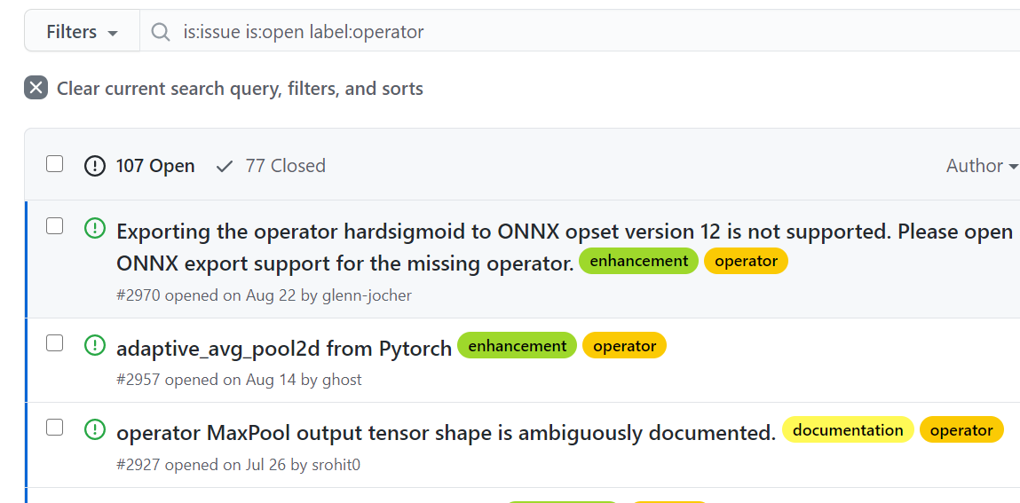
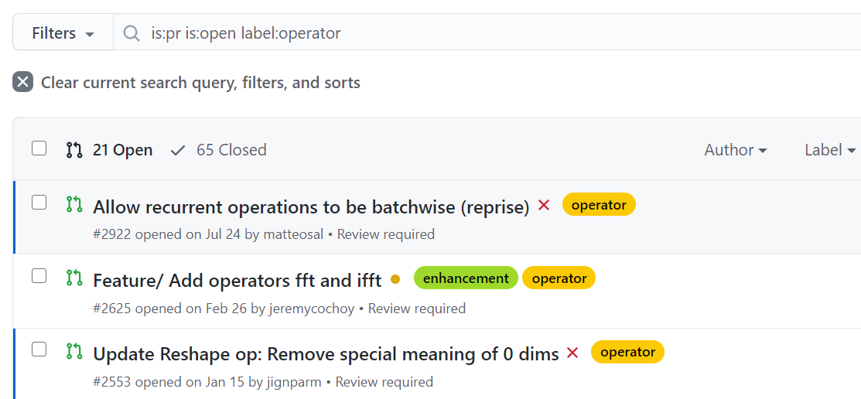
get involved: submit and review PRs

Slide 10
PR review
PRs should be marked with the Operator label
https://github.com/onnx/onnx/pulls?q=is:pr+is:open+label:operator
Ops Contributors Group should review the PRs according to guidelines
Mature PRs can be discussed during bi-weekly sync
Final approval by member of SIG-operators-approvers group

Slide 11
GitHub discussion issues
Many open discussions marked with Operator label
Ops Contributors Group should be active in discussions and encourage submission of PRs
We should decide which discussions can be closed
Still looking for best way to triage this large number of open issues

Slide 12
Version Converter
Used to convert from one OPSet to another or vice versa.
Currently, it is outdated.
Should we enforce every operator PR to update the version converter?

Slide 13
Time major flag for recurrent
Issue and PR:
https://github.com/onnx/onnx/issues/2159
https://github.com/onnx/onnx/pull/2922
https://github.com/onnx/onnx/pull/2284
Current recurrent operator in ONNX, operate on:
[seq_length, batch_size, input_size]
Most framework support:
[seq_length, batch_size, input_size] and [batch_size, seq_length, input_size]
Some framework hide the batch axis.

Slide 14
Thanks for coming!!!
Operator SIG resources
Slack channel: https://slack.lfai.foundation and join onnx-operators
Documents and artifacts: https://github.com/onnx/sigs/tree/master/operators

