Slide 1
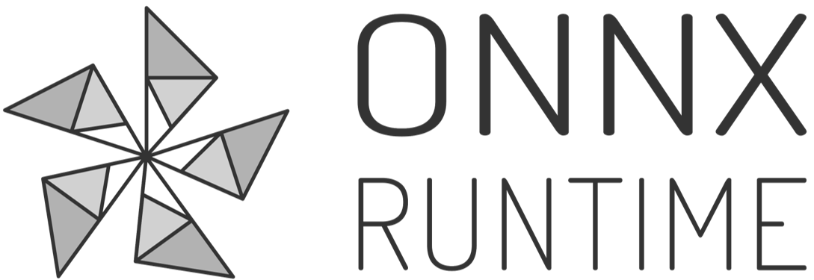

UPDATE (October 2020)
Mobile, Training, Quantization
Faith Xu | AI Frameworks @ Microsoft

Slide 2
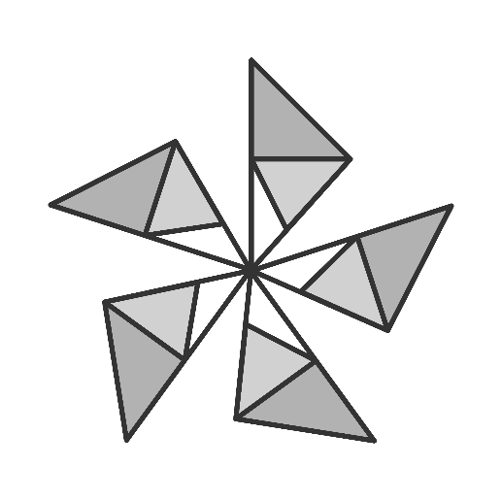
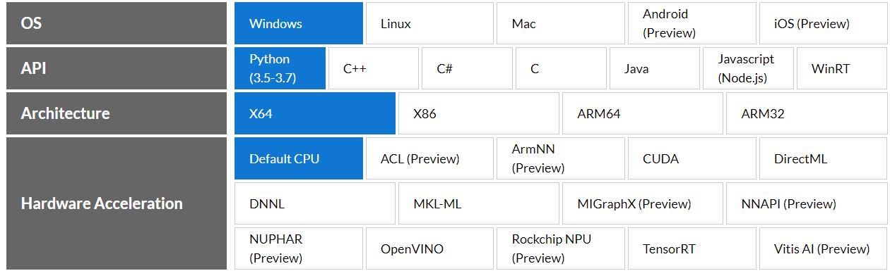
ONNX Runtime https://onnxruntime.ai
High performance cross-platform inferencing and training accelerator
Open source and production-ready
Supports full ONNX operator set with custom op option
Backwards compatible
Pluggable execution provider interface for hardware acceleration

Slide 3
Common problems ONNX Runtime can help with
Inference latency is too high to put into production​
Training in Python but need to deploy into a C#/C++/Java app​
Model needs to run on edge/IoT devices​
Same model needs to run on different hardware and operating systems​
Need to support running models created from several different frameworks​
Training very large models takes too long​

Slide 4
ONNX Runtime 1.5 Release
Highlights: Minimal Builds, Training, Quantization

Slide 5
Minimal Builds
Mobile and Embedded scenarios

Slide 6
ONNX Runtime Minimal Build for Mobile
Android, iOS, Linux
X86, ARM
Same API as existing ORT builds
Supports all ONNX models
Model-specific ORT build provides minimal footprint for inferencing on device
Uses an internal model format to minimize the build size for usage in mobile and embedded scenarios

Slide 7

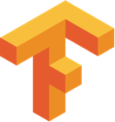

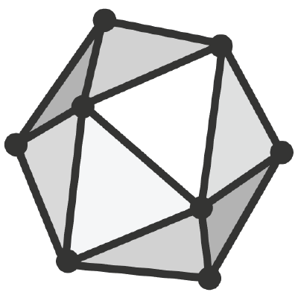
ML.NET
Convert model to ONNX
model.onnx
Optimization for Mobile
Optimized model file
Operator config file
model.ort
Build onnxruntime pkg
inference on device

Slide 8
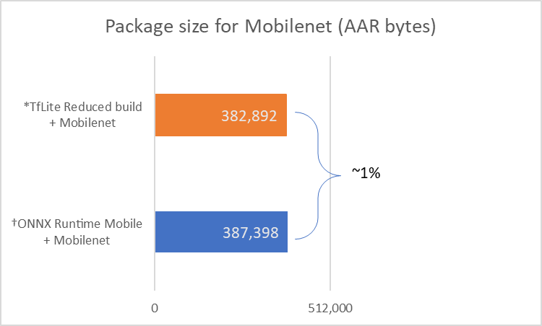
Size for ONNX Runtime Mobile
*TfLite package size from: Reduce TensorFlow Lite binary size †ONNX Runtime full build is 7,546,880 bytes

Slide 9
Training Acceleration
Transformer models

Slide 10
ONNX Runtime Training (Public Preview)
Seamless integration with existing training frameworks for accelerated training and fine tuning of large transformer models
Incorporates latest algorithms and techniques such as DeepSpeed/ZeRO and Parasail/Adasum
Integrates with GPU for distributed training
Frontend
PyTorch
TF/Keras
Other
IR
ONNX
Backend
ONNX Runtime
Graph Compiler (MLIR)
MSFT and 3P innovations
MSR DeepSpeed
Distributed Execution
MSR
Parasail
Accelerator SDKs
CPU
GPU
FPGA
VPU
DML
NPU
Nvidia Megatron

Slide 11
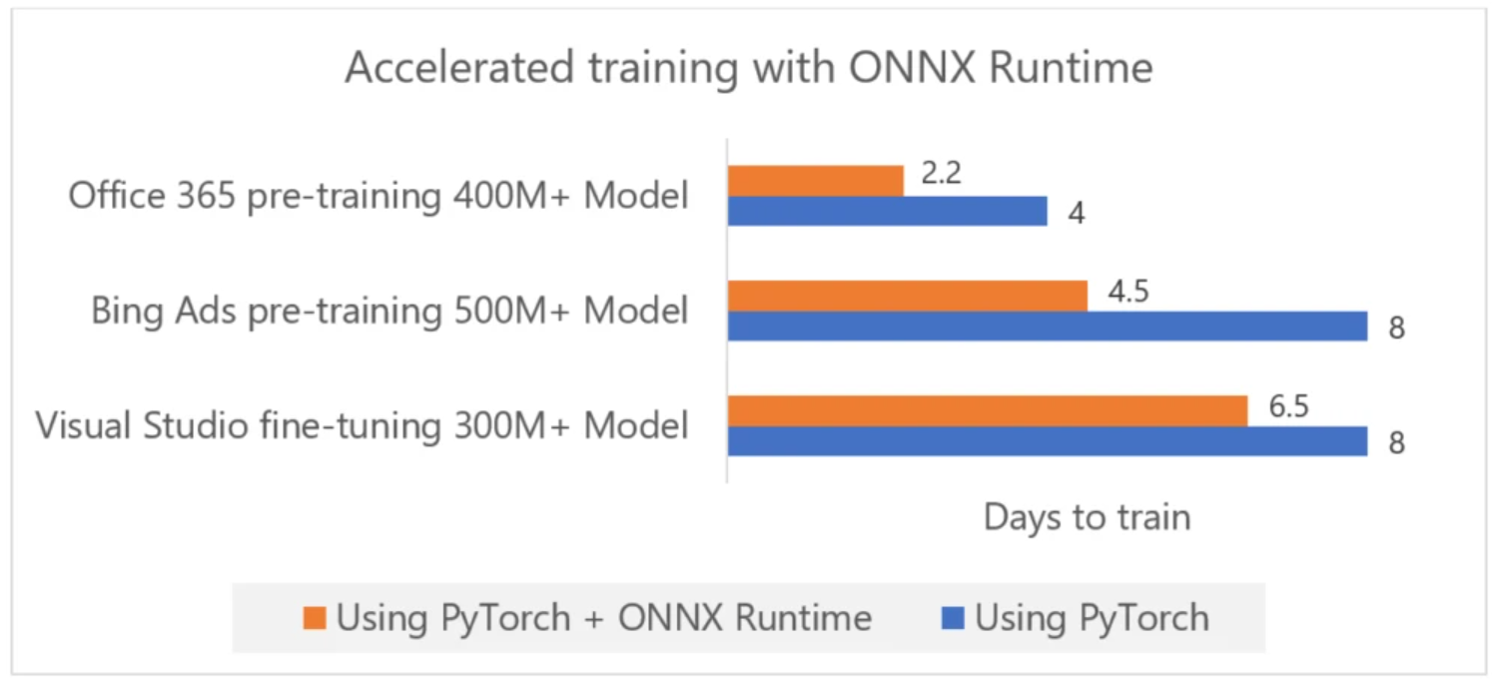
Usage of ORT Training at Microsoft
Team | Scenario / Model | Improvement
Office services | Pre-training TuringNLR | From 4 days to ~2 days (1.4x higher throughput)
Bing Ads | Pre-training RoBERTa-XL as base model | From 8 days to 4.5 days (1.4x higher throughput)
Office apps | Fine-tuning GPT-2 for word prediction | Now able to train; stock PyTorch could not train with data parallelism
Visual Studio | Pre-training GPT-2 Medium for IntelliSense | From 8 days to 6.5 days (1.19x higher throughput)

Slide 12
Quantization

Slide 13
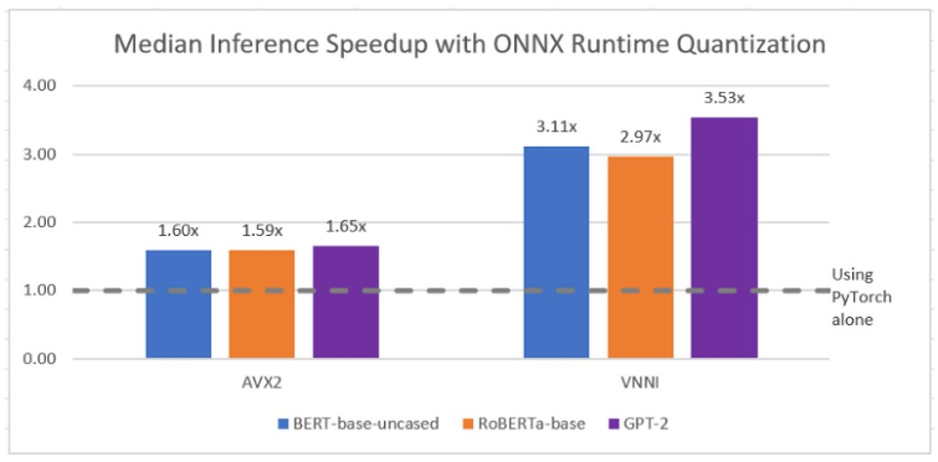
Latency improvement

Slide 14
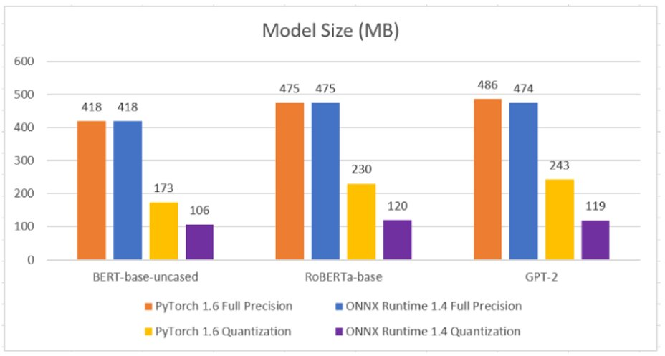
Model size reduction
Int8 quantization for 4x reduction in size

Slide 15
Model size reduction
Int8 quantization for 4x reduction in size
Half the size of quantized PyTorch model

Slide 16
Model size reduction
Int8 quantization for 4x reduction in size
Half the size of quantized PyTorch model

Slide 17
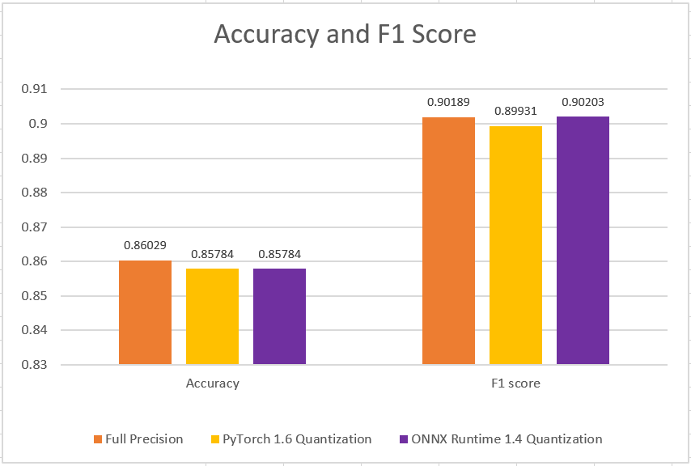
…with minimal accuracy tradeoff
Same accuracy as PyTorch
Slightly higher F1 score (precision + recall)

Slide 18
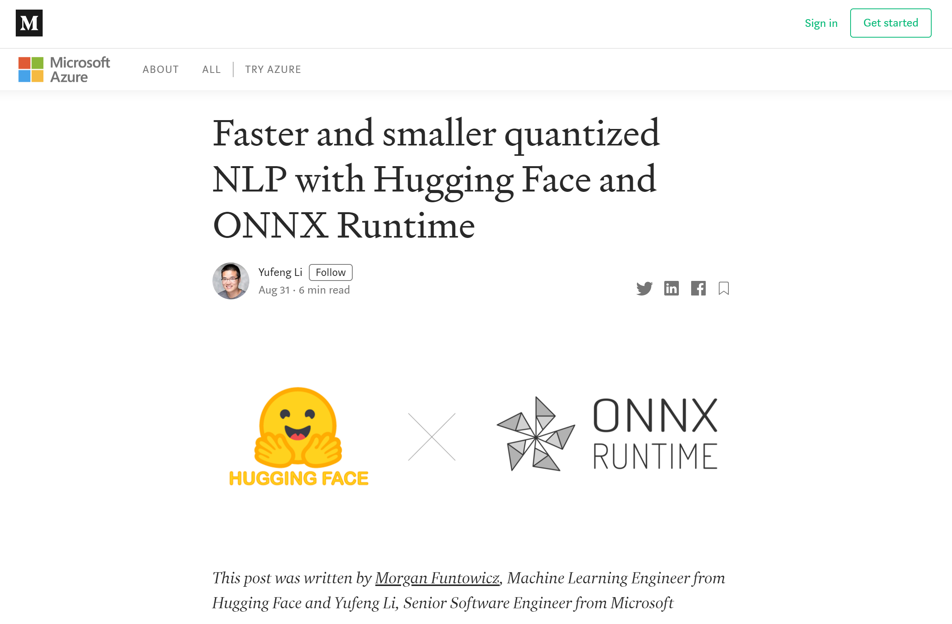
Blog post with more details and E2E Notebook​

Slide 19
Other updates

Slide 20
General
ONNX 1.7 (opset 12)
Function expansion support
Binary Size: Reduced Ops kernel, minimal build for mobile and embedded usage
Performance
Transformer models (DistilBERT, GPT2, BERT)
Improved threadpool support for better resource utilization
Improved performance for inferencing large batch sizes for traditional ML models
APIs and Packages
IO Bindings
Allocator sharing between sessions (memory utilization)
Java API and packages on Maven Central
NodeJS API
ARM64 Linux Python package
Windows ML
UWP apps targeting Windows Store deployment, .NET and .NET Framework applications
Execution Providers
Select Eps buildable as separate dll (TRT, DNNL, others to come)
CUDA: 10.2/cuDNN 8.0, CUDA 11 buildable
TensorRT: 7.1
OpenVINO: 2020.4
DirectML: operator coverage and performance improvements, package available on Nuget
NNAPI: rewritten for broader Android support with more data type and operator coverage, CPU fallback, and improved performance
AMD MiGraphX: additional data type and operator support, graph optimizations
ARM NN
Rockchip NPU
Xilinx FGPA Vitis-AI

