Slide 1

Apache TVM and ONNX
What can ONNX do for DL Compilers (and vice versa)?
Jason Knight - CPO
jknight@octoml.ai

Slide 2
Agenda
Intro to TVM
Cool results (TVM + ONNX)
How does it work?
OctoML’s wishlist for ONNX
… and in 10 minutes …
Let’s go!

Slide 3













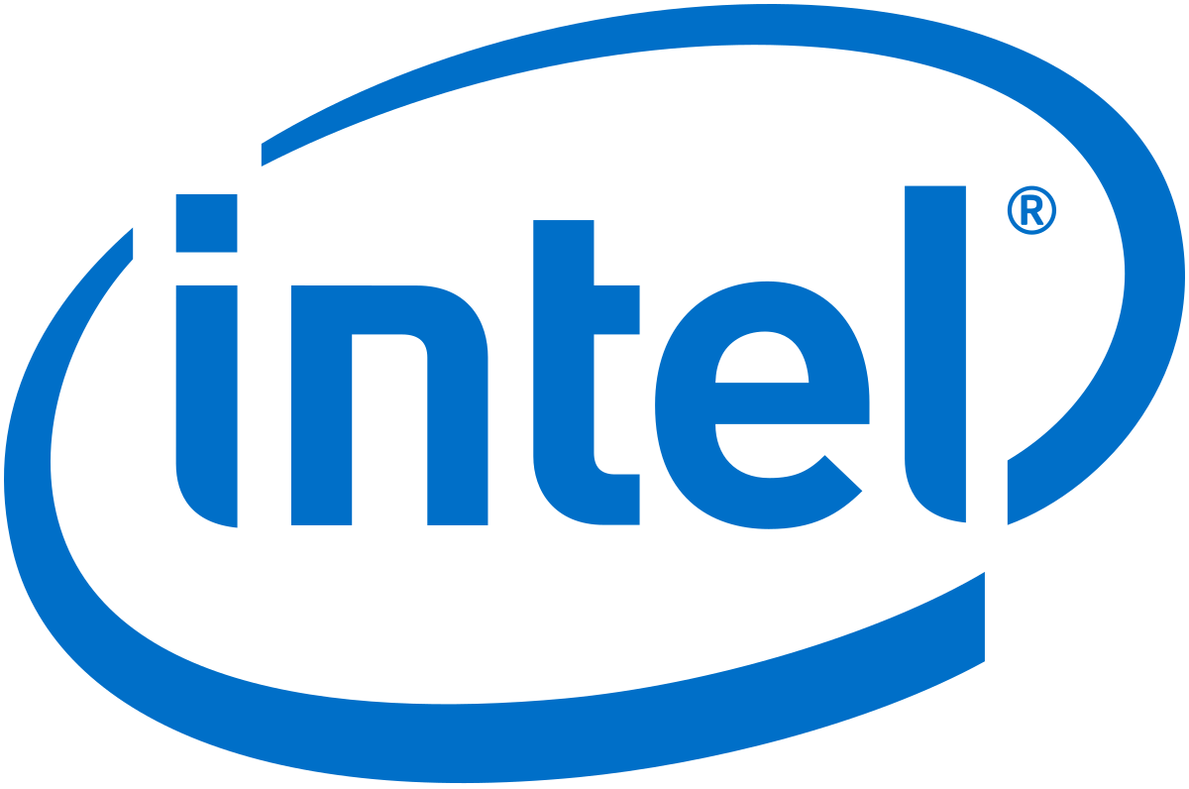
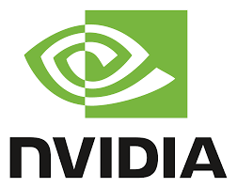

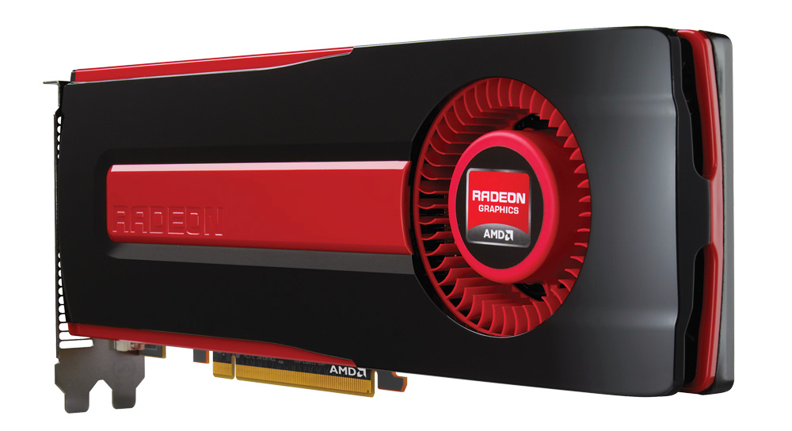
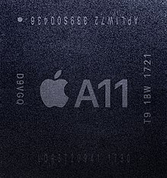
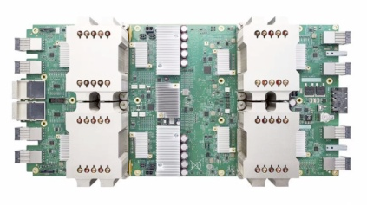


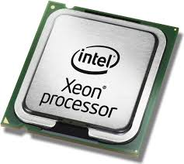
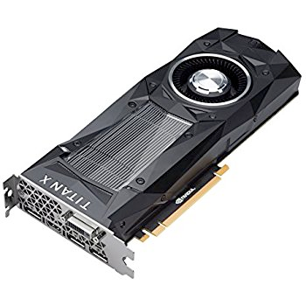
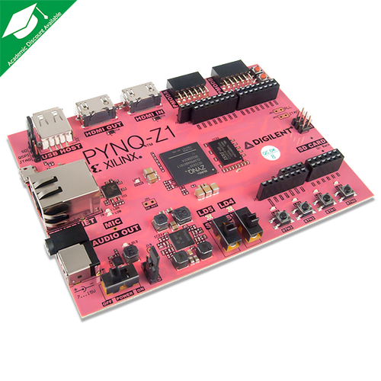


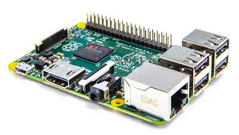


An exploding ecosystem makes deployment painful
Rapidly evolving ML software ecosystem
Cambrian explosion of HW backends

Slide 4

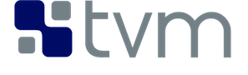

TVM: Bridging the gap as a DL compiler and runtime
Reduce model time-to-market
Build your model once, run anywhere
Open source, optimization framework for deep learning.
ML-based
Optimizations
Backends for x86, nVidia/CUDA, AMD, ARM, MIPS, RISC-V, etc
Cut capital and operational ML costs

Slide 5











TVM is an emerging industry standard ML stack
Open source
~428+ contributors from industry and academia.
Every “Alexa” wake-up today across all devices uses a model optimized with TVM
“[TVM enabled] real-time on mobile CPUs for free...We are excited about the performance TVM achieves.” More than 85x speed-up for speech recognition model.
Bing query understanding: 112ms (Tensorflow) -> 34ms (TVM). QnA bot: 73ms->28ms (CPU), 10.1ms->5.5ms (GPU)
“TVM is key to ML Access on Hexagon” - Jeff Gelharr, VP Technology

Slide 6
The power of
TVM + ONNX
(AKA Results)

Slide 7
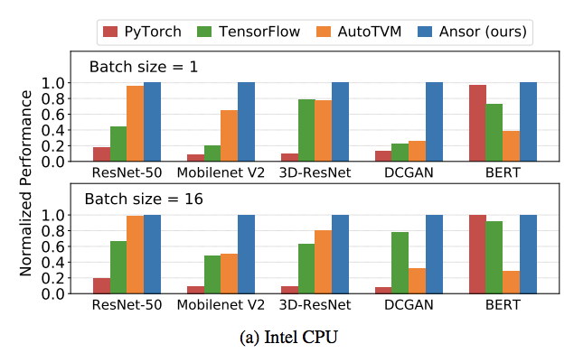
Performance: TVM on x86
PyTorch
TensorFlow
AutoTVM
AutoTVM 2.0
20 core Intel-Platinum-8269CY fp32 performance data from https://arxiv.org/pdf/2006.06762.pdf

Slide 8
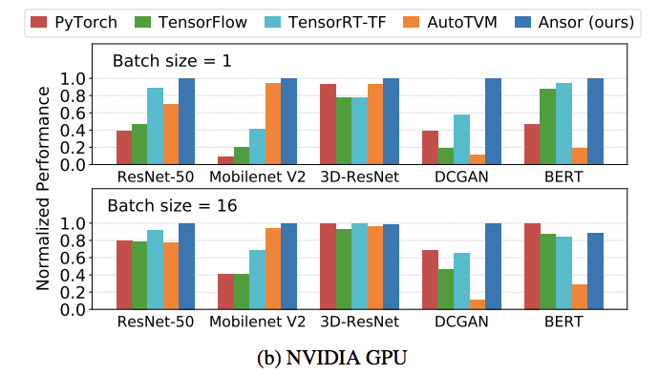
Performance: TVM on GPU
PyTorch
TensorFlow
TensorRT-TF
AutoTVM
AutoTVM 2.0
V100 fp32 performance data from https://arxiv.org/pdf/2006.06762.pdf

Slide 9
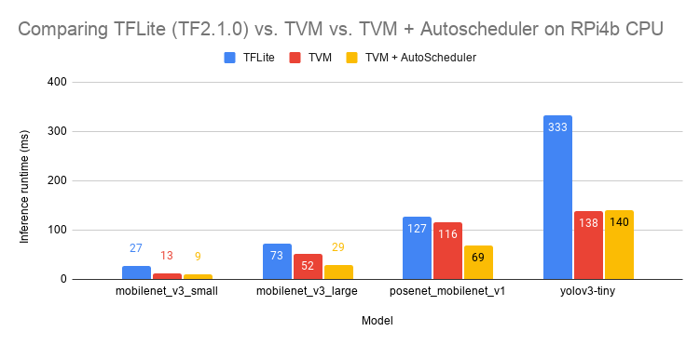
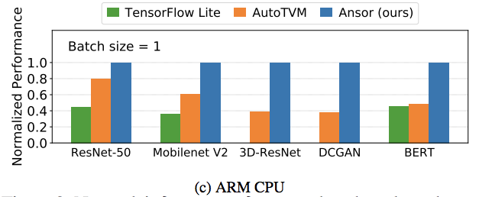
Performance: TVM on ARM
Four core Cortex-A72 @ 1.5GHz fp32 - internal data
TensorFlow Lite
AutoTVM
AutoTVM 2.0
Four core Cortex-A53 @ 1.4GHz fp32 - https://arxiv.org/pdf/2006.06762.pdf

Slide 10
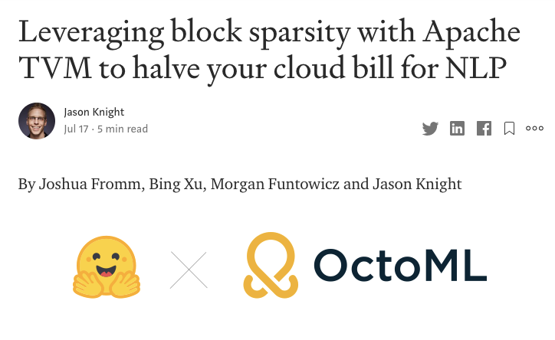
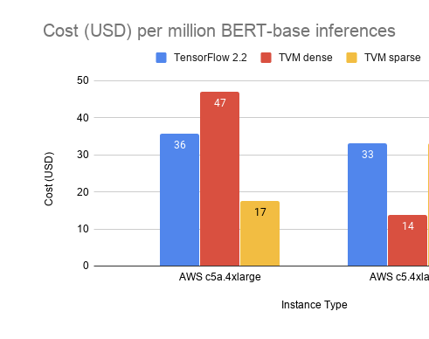
Case Study: 50% reduction in Cloud NLP inference costs
2x lower cost on AMD EPYC CPU

Slide 11
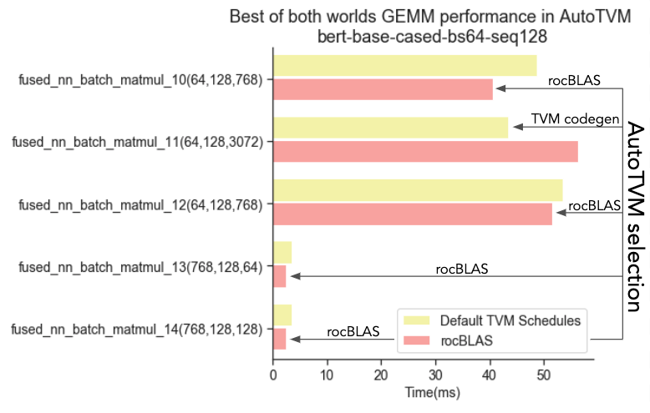
Best of both worlds

Slide 12
Not enough time!
TensorCore performance (better than cuBLAS)
Classical ML (better than XGBoost and RAPIDS)
uTVM for TinyML - ML for microcontrollers
Int{8,4,3,2,1} and posit quantization support
ML in your browser - WebGPU and WASM as TVM backends
… and more!

Slide 13
How does it work?

Slide 14
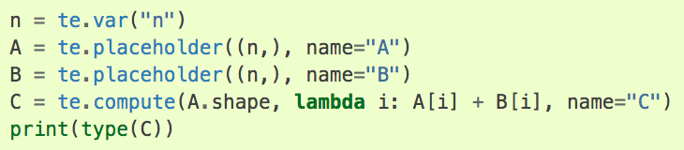
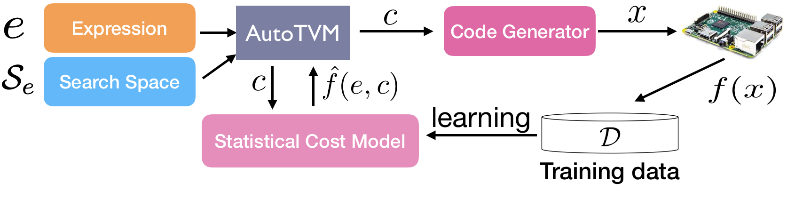
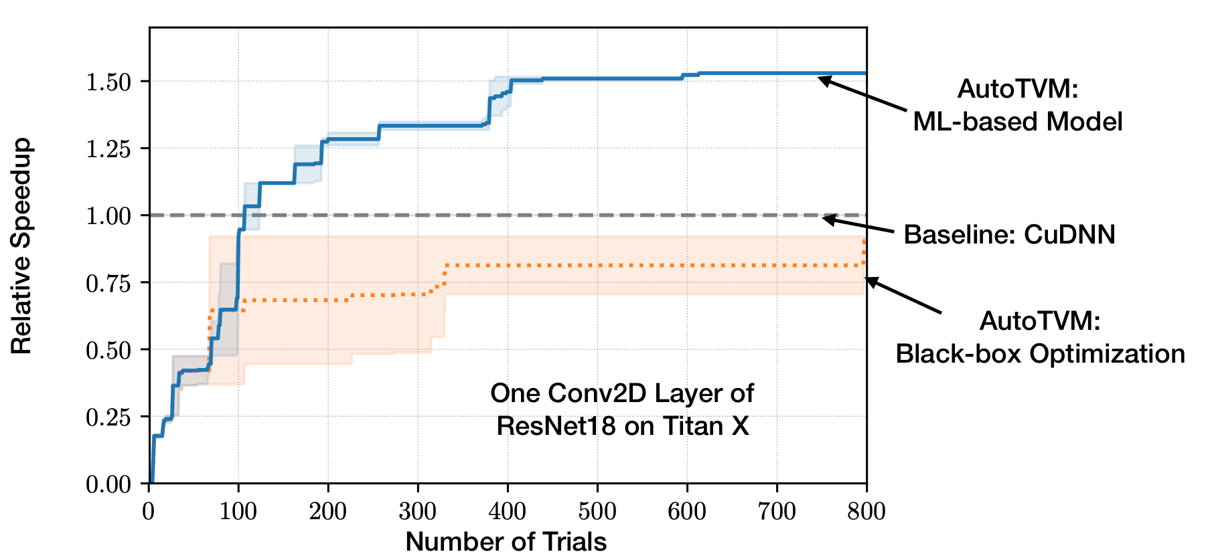
AutoTVM Overview
Automatically adapt to hardware type by learning

Slide 15
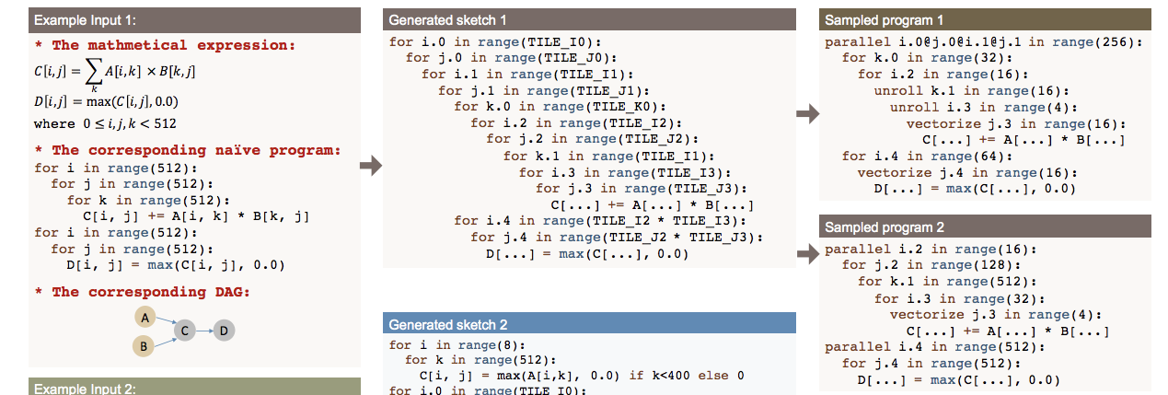
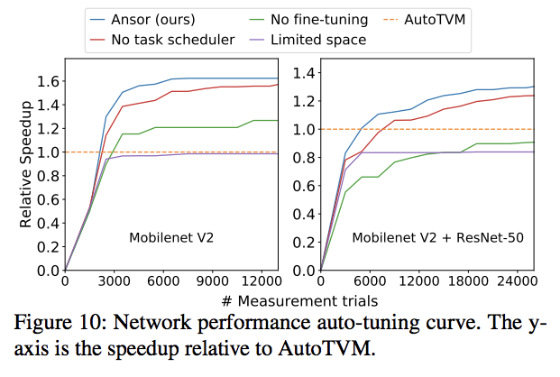
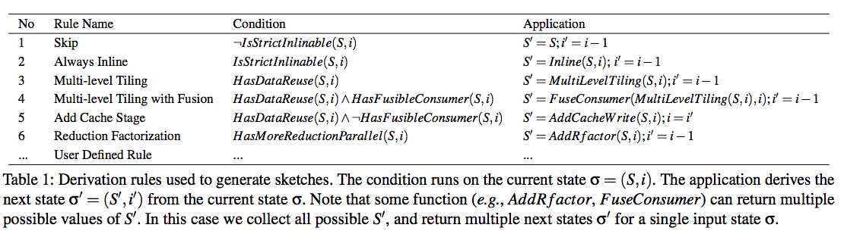
Auto-scheduling Overview
Widens search space even further than AutoTVM 1.0
...
Ansor: Generating High-Performance Tensor Programs for Deep Learning Zheng L, et al. 2020 https://arxiv.org/pdf/2006.06762.pdf

Slide 16
OctoML’s wishlist for ONNX

Slide 17
We wish ONNX had…
Even broader op coverage (eg EmbeddingBag)
Broader non-ML (but adjacent) support:
More classical ML
GCNN/DGL
Graph workloads (GraphBLAS, Metagraph)
And on the “pie-in-the-sky” list:
Framework integrations
PyTorch: so we don’t have to deal with torchscript
MLIR dialect so we can easily plug into TensorFlow (for runtime JIT)
Quantization-aware standardization
For eg: canonicalization of models coming out of Quantization-aware-training pipelines
Thanks!

