Slide 1
ONNX at OneFlow
Jianhao Zhang
OneFlow Inc.

Slide 2

About me
GitHub: daquexian
A developer at OneFlow Inc.
An active contributor from ONNX community, a member of operator SIG
ONNX-related work:
ONNX <-> OneFlow conversion (today’s presentation)
onnx-simplifier
onnx/optimizer
resize and softmax op spec
Also a presenter at ONNX workshop in Shanghai last year (about one of my previous work, integration of Android NNAPI and ONNX Runtime)

Slide 3

What is OneFlow
Oneflow is a brand-new open-source training framework focusing on distributed training. It makes distributed training on multi-machines and multi-devices as simple as on single device.
Perfectly support container platforms(k8s & docker)
Handle large models easily
Almost zero runtime overhead & linear speedup
Support multiple deep learning compilers (XLA, TensorRT etc)
Support automatic mixed precision

Slide 4
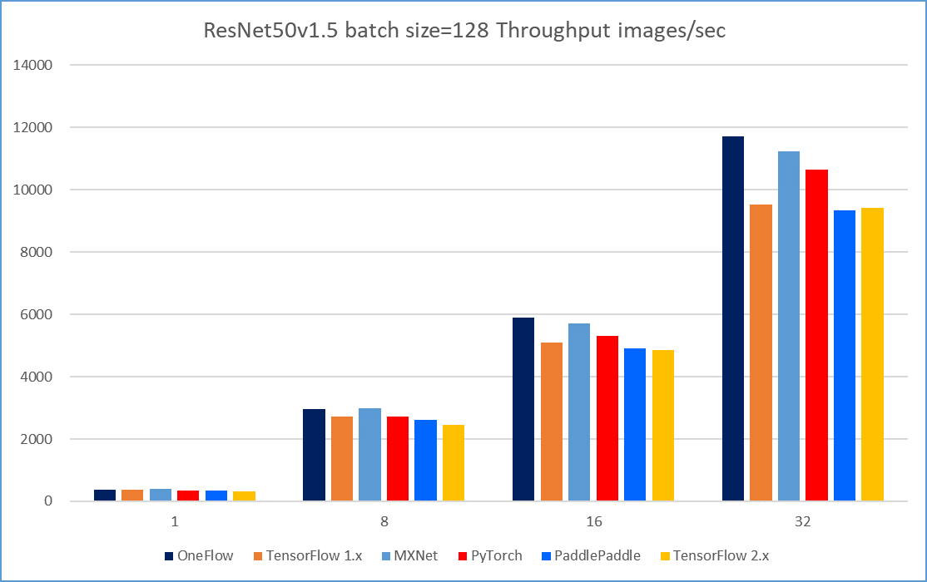
OneFlow Benchmark

Slide 5
OneFlow Benchmark
The detailed benchmark report is public at https://github.com/Oneflow-Inc/DLPerf!

Slide 6
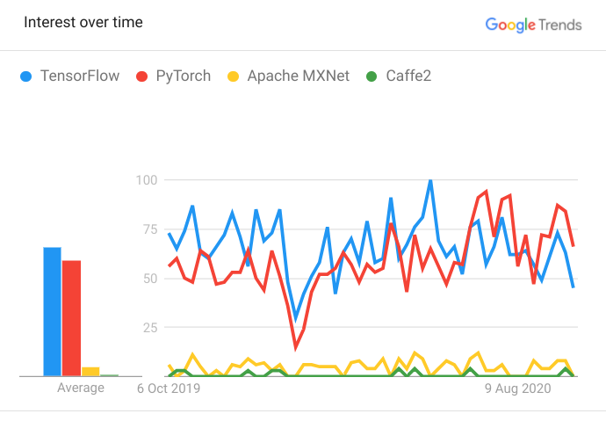
“Sounds Great, but..”
Most DL researchers/developers are familiar with TensorFlow/PyTorch/MXNet.
Even though OneFlow is faster, there is a cost to migrate their codecase (mostly the model) to OneFlow.

Slide 7
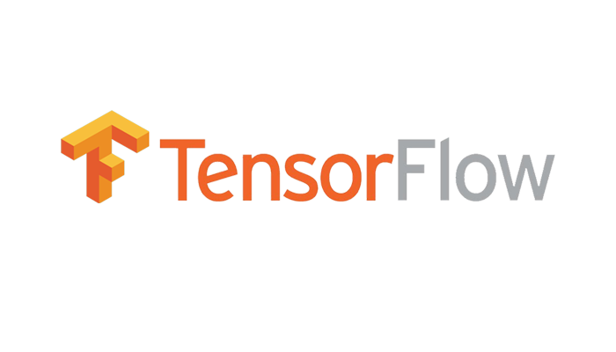



Solution: Convert TF/PT/MXNet to OneFlow via ONNX

Slide 8
Model to Model Conversion
import torchvision as tv
import oneflow as flow
import oneflow.typing as tp
pytorch_resnet18 = tv.models.resnet18()
@flow.global_function(type="train")
def job(x: tp.Numpy.Placeholder(bs, 3, 224, 224)) -> tp.Numpy:
y = flow.from_pytorch(pytorch_resnet18, x)
lr_scheduler = flow.optimizer.CosineScheduler(0.01, 90)
flow.optimizer.SGD(lr_scheduler).minimize(y)
return y

Slide 9
Model to Model Conversion
import torchvision as tv
import oneflow as flow
import oneflow.typing as tp
pytorch_resnet18 = tv.models.resnet18()
@flow.global_function(type="train")
def job(x: tp.Numpy.Placeholder(bs, 3, 224, 224)) -> tp.Numpy:
y = flow.from_pytorch(pytorch_resnet18, x)
lr_scheduler = flow.optimizer.CosineScheduler(0.01, 90)
flow.optimizer.SGD(lr_scheduler).minimize(y)
return y

Slide 10
Model to Model Conversion
import torchvision as tv
import oneflow as flow
import oneflow.typing as tp
pytorch_resnet18 = tv.models.resnet18()
@flow.global_function(type="train")
def job(x: tp.Numpy.Placeholder(bs, 3, 224, 224)) -> tp.Numpy:
y = flow.from_pytorch(pytorch_resnet18, x)
lr_scheduler = flow.optimizer.CosineScheduler(0.01, 90)
flow.optimizer.SGD(lr_scheduler).minimize(y)
return y

Slide 11
Code to Code conversion (WIP)
# OneFlow code
x2=flow.layers.conv2d(x1, filters=64,
kernel_size=7, strides=2, padding=3)
x3=flow.layer.batch_normalization(x2)
x4=flow.nn.relu(x3)
x5=flow.nn.max_pool2d(x4, ksize=3, strides=2, padding=1)
x6=flow.layers.conv2d(x5, filters=64,
kernel_size=3, padding=1)
.....
# PyTorch code
import torchvision as tv
model = tv.models.resnet18()

Slide 12


Also, ONNX Helps us Deploy Models on Mobile
As a startup team, we do not have the bandwidth to implement our own mobile inference framework.
Again, ONNX helps us a lot. We convert our model to the existing mobile inference frameworks, like ncnn from Tencent, via ONNX.

Slide 13

Thanks!
Our GitHub: https://github.com/Oneflow-Inc

