Slide 1
Compiling Traditional ML Pipelines into Tensor Computations for Unified Machine Learning Prediction Serving
Matteo Interlandi, Karla Saur, Supun Nakandala, Gyeong-In Yu, Markus Weimer, Konstantinos Karanasos, Carlo Curino

Slide 2
Outline
Motivate why model prediction for Traditional ML is an important problem
Briefly introduce how classical models can be compiled into tensor operations
Project status
Notes:
This slide is required. Do NOT delete. This should be the first slide after your Title Slide.
This slide should describe what your goals are for this session. This information lets your audience know what you are trying to accomplish with your talk or tutorial—ie, what value will attendees get by investing 25 minutes or 2 hours of their time listening to you.
You should not spend more than 1 minute presenting this slide.
General examples of session goals could be (you will have to create your own specific goals):
Introduce a new technique or approach to solve a customer problem
Compare two approaches and explain why one is superior
Describe a project and the learnings that audience members can apply from it
Teach audience members how to use a specific technology

Slide 3






Motivation
Specialized Systems have been developed (mostly focus on neural networks)
Support for traditional ML methods is largely overlooked (widely used in practice because state of the art on tabular data)

Slide 4
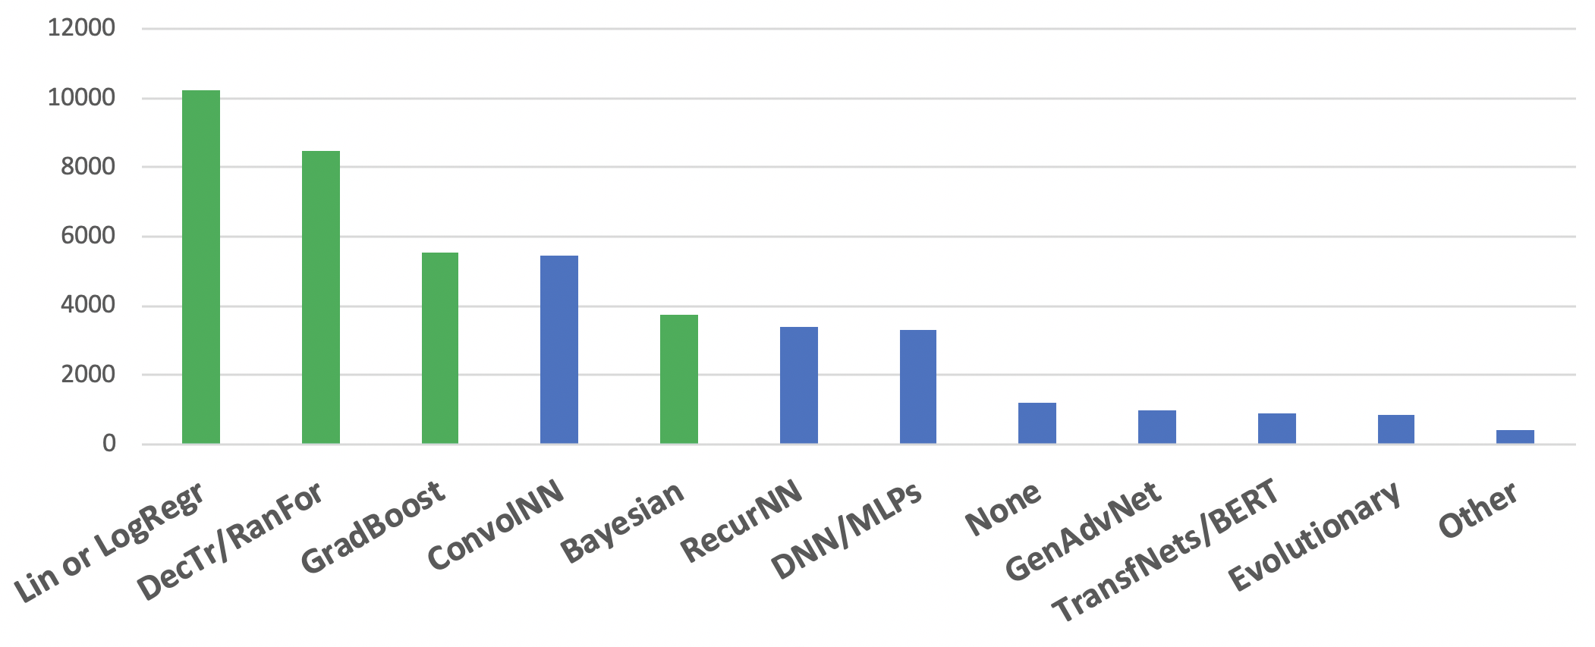
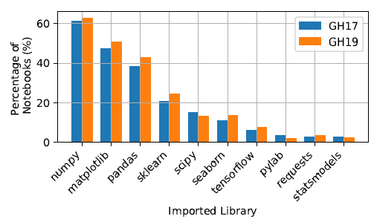
Traditional ML Models
2019 Kaggle Survey: The State of Data Science & Machine Learning
Data Science throw the looking glass: https://arxiv.org/abs/1912.09536

Slide 5
Hummingbird
A compiler translating traditional ML models into tensor computations for unified ML prediction serving
Benefits:
(1) Exploit the already available DNN runtimes
(2) Exploit current (and future DNN) optimizations
(3) Seamless hardware acceleration
(4) Significant reduction in engineering effort

Slide 6
Traditional ML Operators
Traditional ML models are composed by: featurizers and ML models
Each featurizer is defined by an algorithm
e.g., compute the one-hot encoded version of the input feature
Each trained model is defined by a prediction function
Prediction functions can be either algebraic (e.g., linear regression) or algorithmic (e.g., decision tree models)
Algebraic models are easy to translate: just implement the same formula in tensor algebra!

Slide 7






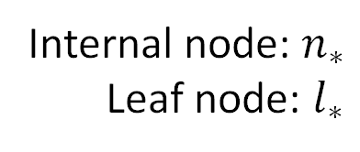








Translating Trees
$$𝕩∈ℝ^{6}$$
Internal node: $n_{∗}$
Leaf node: $l_{∗}$
$$n_{1}$$
$$𝕩_{3}>5.1$$
T
F
$$n_{2}$$
$$𝕩_{1}>1.8$$
$$n_{4}$$
$$𝕩_{5}>0.4$$
$$n_{3}$$
$$l_{1}$$
10
$$𝕩_{3}>2.4$$
$$l_{4}$$
40
50
$$l_{5}$$
$$l_{2}$$
20
30
$$l_{3}$$

Slide 8



















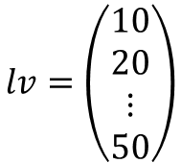


Translating Trees
$$n_{∗}, l_{∗}∈[0,1]$$
$$𝕩_{1}$$
$$l_{1}$$
$$𝕩∈ℝ^{6}$$
$$+1$$
$$𝕩_{2}$$
$$n_{1}$$
$$n_{1}$$
$$𝕩_{3}>5.1$$
$$+1$$
$$l_{2}$$
$$𝕩_{3}$$
$$n_{2}$$
T
F
$$n_{2}$$
$$𝕩_{1}>1.8$$
$$n_{4}$$
$$𝕩_{5}>0.4$$
$$+1$$
$$l_{3}$$
$$𝕩_{4}$$
$$n_{3}$$
$$n_{3}$$
10
$$𝕩_{3}>2.4$$
40
50
$$𝕩_{5}$$
$$l_{4}$$
$$l_{1}$$
$$l_{4}$$
$$l_{5}$$
$$+1$$
$$n_{4}$$
20
30
$$𝕩_{6}$$
$$l_{5}$$
$$l_{2}$$
$$l_{3}$$
$$lv=\left(\begin{matrix}10 \\ 20 \\ ⋮ \\ 50\end{matrix}\right)$$
$$+1$$
$$b=\left(\begin{matrix}−5.1 \\ −1.8 \\ −2.4 \\ −0.4\end{matrix}\right)$$

Slide 9
Translating Trees
Evaluate all conditions together
$$n_{∗}, l_{∗}∈[0,1]$$
$$𝕩_{1}$$
$$l_{1}$$
$$𝕩∈ℝ^{6}$$
$$+1$$
$$𝕩_{2}$$
$$n_{1}$$
$$n_{1}$$
$$𝕩_{3}>5.1$$
$$+1$$
$$l_{2}$$
$$𝕩_{3}$$
$$n_{2}$$
T
F
$$n_{2}$$
$$𝕩_{1}>1.8$$
$$n_{4}$$
$$𝕩_{5}>0.4$$
$$+1$$
$$l_{3}$$
$$𝕩_{4}$$
$$n_{3}$$
$$n_{3}$$
10
$$𝕩_{3}>2.4$$
40
50
$$𝕩_{5}$$
$$l_{4}$$
$$l_{1}$$
$$l_{4}$$
$$l_{5}$$
$$+1$$
$$n_{4}$$
20
30
$$𝕩_{6}$$
$$l_{5}$$
$$l_{2}$$
$$l_{3}$$
$$lv=\left(\begin{matrix}10 \\ 20 \\ ⋮ \\ 50\end{matrix}\right)$$
$$+1$$
$$b=\left(\begin{matrix}−5.1 \\ −1.8 \\ −2.4 \\ −0.4\end{matrix}\right)$$

Slide 10
Translating Trees
Evaluate all conditions together
$$n_{∗}, l_{∗}∈[0,1]$$
$$𝕩_{1}$$
$$l_{1}$$
$$𝕩∈ℝ^{6}$$
$$+1$$
$$𝕩_{2}$$
$$n_{1}$$
$$n_{1}$$
$$𝕩_{3}>5.1$$
$$+1$$
$$l_{2}$$
$$𝕩_{3}$$
$$n_{2}$$
T
F
$$n_{2}$$
$$𝕩_{1}>1.8$$
$$n_{4}$$
$$𝕩_{5}>0.4$$
$$+1$$
$$l_{3}$$
$$𝕩_{4}$$
$$n_{3}$$
$$n_{3}$$
10
$$𝕩_{3}>2.4$$
40
50
$$𝕩_{5}$$
$$l_{4}$$
$$l_{1}$$
$$l_{4}$$
$$l_{5}$$
$$+1$$
$$n_{4}$$
20
30
$$𝕩_{6}$$
$$l_{5}$$
$$l_{2}$$
$$l_{3}$$
$$lv=\left(\begin{matrix}10 \\ 20 \\ ⋮ \\ 50\end{matrix}\right)$$
$$+1$$
$$b=\left(\begin{matrix}−5.1 \\ −1.8 \\ −2.4 \\ −0.4\end{matrix}\right)$$
Evaluate all paths together

Slide 11
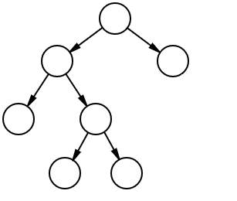










































Translating Trees
Random forest, boosting, …
$$𝕩_{1}$$
$$l_{1}$$
$$𝕩_{2}$$
$$n_{1}$$
$$𝕩_{1}$$
$$l_{1}$$
$$l_{2}$$
$$𝕩_{2}$$
$$n_{1}$$
$$𝕩_{1}$$
$$l_{1}$$
$$𝕩_{3}$$
$$n_{2}$$
$$l_{2}$$
$$𝕩_{2}$$
$$n_{1}$$
$$𝕩_{4}$$
$$l_{3}$$
$$𝕩_{3}$$
$$n_{2}$$
$$l_{2}$$
$$n_{3}$$
$$𝕩_{4}$$
$$l_{3}$$
$$𝕩_{3}$$
$$n_{2}$$
$$𝕩_{5}$$
$$l_{4}$$
$$n_{3}$$
$$𝕩_{4}$$
$$l_{3}$$
$$n_{4}$$
$$𝕩_{5}$$
$$l_{4}$$
$$n_{3}$$
$$𝕩_{6}$$
$$l_{5}$$
$$n_{4}$$
$$𝕩_{5}$$
$$l_{4}$$
$$+1$$
$$𝕩_{6}$$
$$l_{5}$$
$$n_{4}$$
$$+1$$
$$𝕩_{6}$$
$$l_{5}$$
$$+1$$
output
output

Slide 12
What we get
Competitive CPU performance
Seamless GPU acceleration---comparable to custom cuML kernels
Large reduction in engineering effort---one single implementation for CPU \ GPU (and eventually IPU \ TPU \ FPGA) executions
Performance

Slide 13



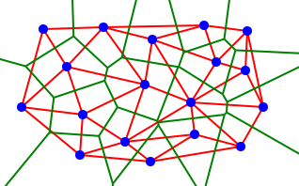

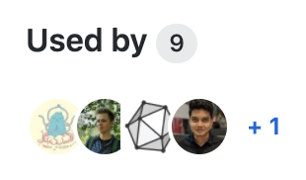
Hummingbird: Status
Open sourced in May: https://aka.ms/hb-code (See also: Blog Paper Demo)
Integration with ONNX converters (LightGBM): Blog
Hummingbird is part of the PyTorch Ecosystem
Paper will be presented at OSDI 2020
1.7K GitHub stars
136 GitHub forks
>20 external PRs (~5 regular/repeat contributors, 10 total external contributors), 20 issues filed by external users
6 user-created blog posts and a video tutorial with >1k views

Slide 14
Future work: Integration with other ONNX converters
Operator Group | Supported Operators
Linear Classifiers | Logistic Regression, Linear SVC, SVC, NuSVC, SGDClassifier, LogisticRegressionCV
Tree Methods | DecisionTreeClassifier/Regressor, RandomForestClassifier/Regressor, (Hist)GradientBoostingClassifier/Regressor, ExtraTreesClassifier/Regressor, XGBClassifier/Regressor, LGBMClassifier/Regressor/Ranker
Neural Networks | MLPClassifier
Others | BernouliNB, KMeans
Feature Selectors | SelectKBest
Decomposition | PCA, TruncatedSVD
Feature Pre-Processing | SimpleImputer, Imputer, ColumnTransformer, RobustScaler, MaxAbsScaler, MinMaxScaler, StandardScaler, Binarizer, KBinsDiscretizer, Normalizer, PolynomialFeatures, OneHotEncoder, LabelEncoder, FeatureHasher
Text Feature Extractor | CountVectorizer

Slide 15
Thank you!
hummingbird-dev@microsoft.com

