Slide 1


Efficient inference of transformers models Collaboration highlights between Hugging Face & ONNX Runtime
Morgan Funtowicz ML Engineer

Slide 2



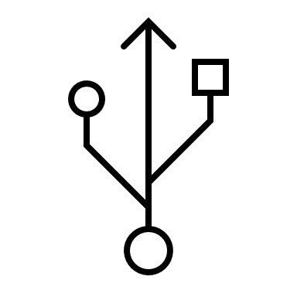

Hugging Face OSS
U+1F5FD
25+ employees in 2 offices (NYC & Paris)
Raised 15 M$ in Serie B
transformers ( +34,000 )
tokenizers ( +3,800 )
datasets ( +4,200 )
Community model hub with more than 3,000 models
More than 3To of models stored in the cloud
More than 5 models uploaded each day

Slide 3
Collaboration with ONNX Runtime
Looking for a solution to export from PyTorch & TensorFlow.
Initial integration with transformers to easily export wide variety of our models (25 architectures, from BERT to Reformer & more recently RAG).
Leverage ONNX Runtime optimizations to speed-up inference on variety of hardwares and platformes.
Enable quantization for efficient inference.

Slide 4
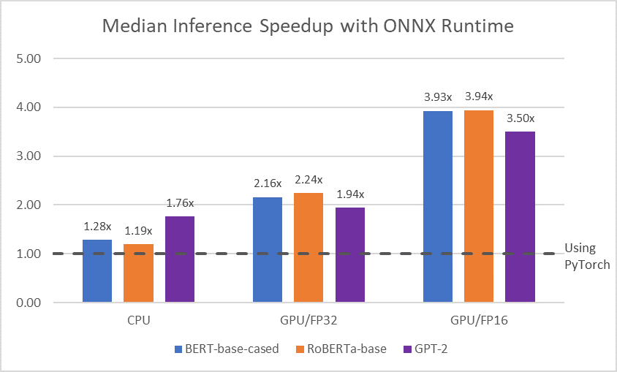
Collaboration with ONNX Runtime
More information: Accelerate your NLP pipelines using Hugging Face Transformers and ONNX Runtime

Slide 5
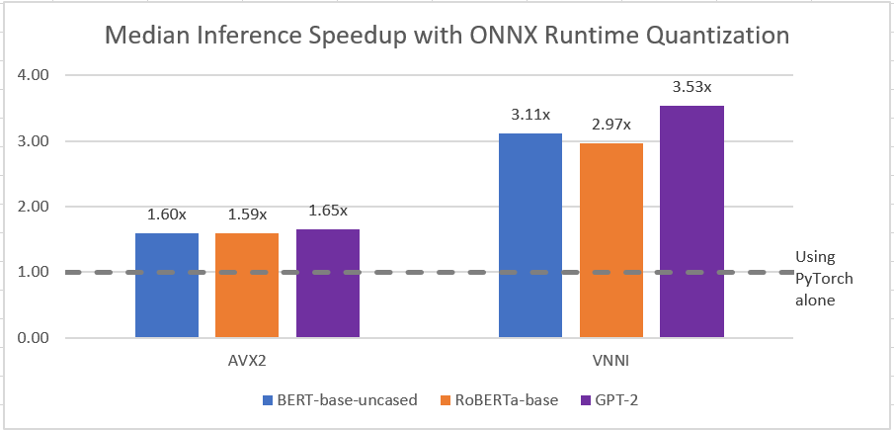
Collaboration with ONNX Runtime
More information: Faster and smaller quantized NLP with Hugging Face and ONNX Runtime

Slide 6
Potential direction
Integrate data processing operators such as tokenization from our Rust backed tokenizers library
Supports exporting end-to-end NLP pipelines
PoC new training features from ONNX Runtime
PoC for inferencing such models with such various architectures

Slide 7
Conclusion
ONNX integration has very good perspectives at Hugging Face both for open source projects & internal.
Well received by the transformers community, especially for the ones looking to put models in production.
Issues and PRs continues to improve the overall coverage, for instance with recent T5 support.

