Slide 1
ONNX Model Zoo + Tutorials SIG Update
Wenbing Li, Microsoft
Vinitra Swamy, EPFL
10/14/2020

Slide 2


ONNX Model Zoo
Model Zoo CI is active! (onnx#307)
Running the ONNX Checker on each new model, working towards ONNX Runtime testing on model inputs / outputs
New and Updated Models
EfficientNet-Lite 4 (onnx#324)
YOLO V4 (onnx#322)
roBERTa (onnx#338)
SSD MobileNet v1 (onnx#328)
RetinaNet (onnx#308)
Updates to SuperResolution, GoogLeNet, GPT-2, SqueezeNet, MNIST
ShuffleNet (onnx#250)
Git LFS Migration complete! (onnx#271)
Download all models in the zoo with one command
All models are stored within the model zoo for long-term storage
T5 (onnx#357)
git lfs pull --include="*" --exclude=""
The ONNX Model Zoo is a collection of pre-trained, state-of-the-art model set

Slide 3

Key numbers
More than 50+ models
1
Contributed by 40+ community members
2
10+ categories (like Image classification, object detection, LM etc.)
3
2.7K Stargazers
4
image classification
object detection and image segmentation
body, face and gesture analysis
image manipulation
machine comprehension

Slide 4
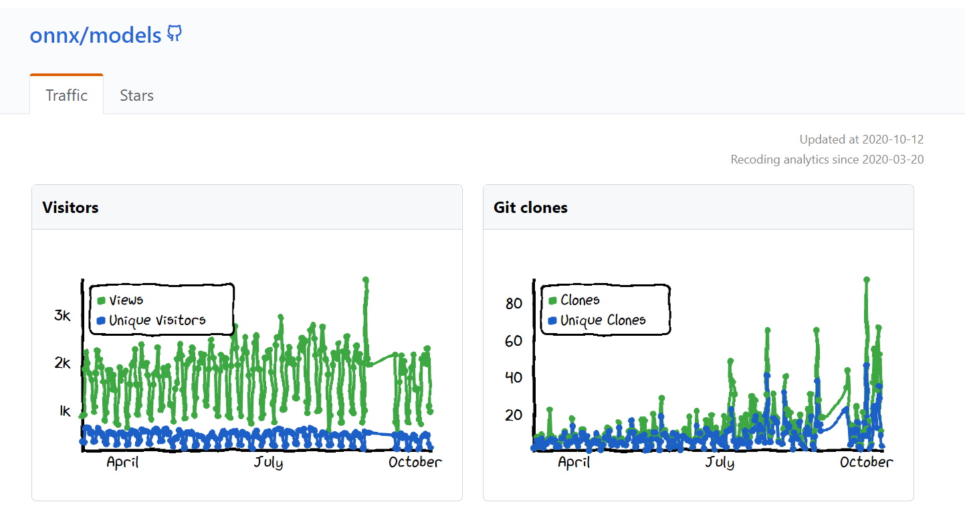
Most popular models: Mobilenet, ResNet, YoloV4, ArcFace

Slide 5
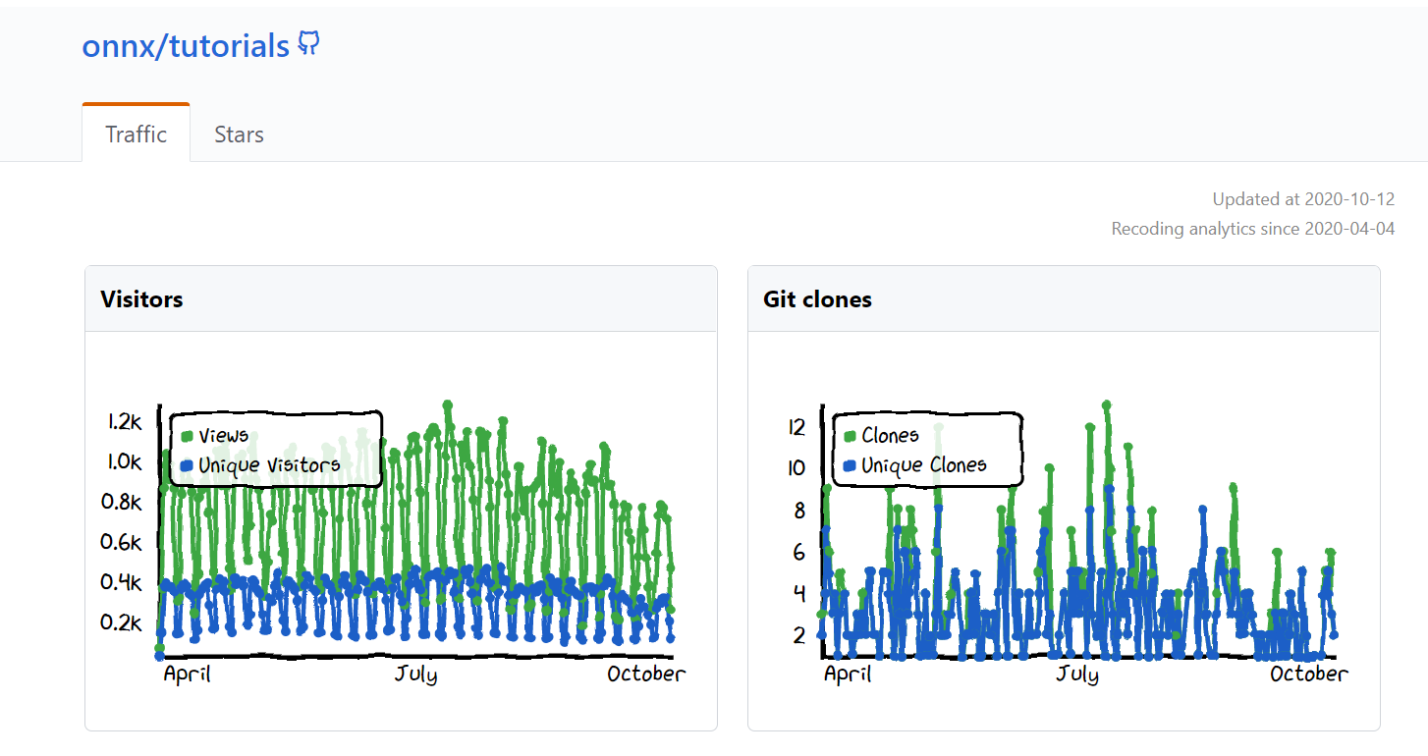
Most popular tutorials: Tensorflow->ONNX, Visualizing an ONNX model,
Pytorch->ONNX, ONNX RT server with SSD

Slide 6
The coming hot topics
Vinitra Swamy has recently left Microsoft to begin her PhD in Switzerland (at EPFL). She is stepping down as SIG lead but will still be an active member in the model zoo efforts.
Wenbing Li is a core contributor to the ONNX converter efforts and is taking over leadership of the Model Zoo + Tutorials SIG.
More models for mobile/embedded scenarios
Quantized model
State of art models
ONNX opset upgrading

Slide 7
Contribute your models
Files needed for PR
ONNX Model File
Test input data
Inference example/ tutorial if applicable
ReadME.md
Model verification
onnx.checker
Inference checker by the test data

Slide 8

Model Zoo SIG Resources
Join us!
Slack Channel: https://slack.lfai.foundation and join onnx-modelzoo
Monthly meetup
Info page: https://github.com/onnx/sigs/tree/master/models-tutorials

