Slide 1
Converters SIG Updates
ONNX Workshop 10/14/2020
Chin Huang, IBM
Guenther Schmuelling, Microsoft Kevin Chen, Nvidia

Slide 2
Converters SIG Updates
Converters updates
Frontend converters
Backend converters
General discussions
What we would like to see…
What we would like to clarify…
Interesting operators

Slide 3
Frontend Converter Updates - keras2onnx
Opset 12 fully supported in keras2onnx v1.7.0​
Support for most huggingface/transformers​ models
Improved RNN model conversion​
Validated successful conversion for 120+ models in github​
Bug fixes​

Slide 4
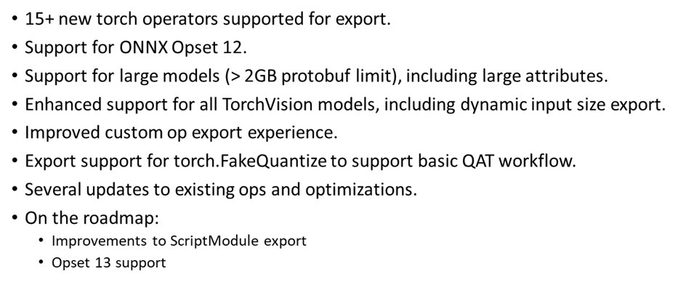
Frontend Converter Updates - pytorch exporter

Slide 5
Frontend Converter Updates - tf2onnx
Fixes for tf-2.x, tested up to tf-2.3​
Support for models > 2GB (--large_model)​
Support for quantization aware training​ (using QDQ)
Improvements to optimizer pass​
Constant folding for almost all TF ops​
More fusing of nodes, ie. Batchnorm with Conv​
Major improvements for conversion speed on large models​ (3 to 5 times faster)​
Bug fixes​
Currently supported: tensorflow: up to tf-1.15, tf-2.3 | onnx: opset-7 - opset-12 | python 3.6-3.8
We are now working on improving out of the box conversion rates.​

Slide 6
Backend Converter Updates – ONNX-TensorRT
TensorRT 7.2.1
Support for parsing models with external data
New API for interfacing with TensorRT’s refit feature
New tooling (link)
ONNX-GS - Custom wrapper around the existing ONNX python API for easier creation and modification of ONNX graphs
Polygraphy - Toolkit that allows running and debugging DL models between different backends.
Future plans
Continuously improve operator support
Work more closely with front-end converters

Slide 7
Backend Converter Updates – ONNX-TF
Tensorflow 2.0 native support, export as saved model, instead of graph pb
User choice of target device, CPU vs GPU, for optimized graph
Auto and user input for data type cast
Supported Tensorflow versions: 1.15 and 2.3
ONNX opset 12 support
Upcoming
ONNX opset 13 support
Investigation in training and onnx-ml

Slide 8
General discussions
What we would like to see…
Custom ops best practices: 1. convert to backend framework models 2. execute in backend runtime
Consistency between op schema, doc, and unit tests
Use of checker to ensure model quality and integrity in frontend and backend
Working standard backend tests
Sequence as an input type
New data type in opset 13: bfloat16
ONNX-ML reference implementation and unit tests at operator/node level, and more ML models in model zoo
Visualization of subgraphs (loop, if, scan): helpful onnx runtime tool dump_subgraphs.py, https://github.com/microsoft/onnxruntime/blob/master/tools/python/dump_subgraphs.py

Slide 9
General discussions
What we would like to clarify…
Inference accuracy could be slightly off between backend frameworks
Optional inputs with default values or blank input names?
Move between attributes and inputs might cause issues for backend frameworks
Model training use cases specifically for frontend and backend converters, APIs, models in model zoo

Slide 10
General discussions
Operators we discussed
Resize (variants difficult to understand and execute, if not impossible, leading to partial support from framework converters)
Loop (and nested loops, might need access to initializers out of loop scope)
Clip (optional input with blank input name in unit test)
OneHot, NonMaxSuppression (depth input is documented as a scalar, which could be a scalar or 1-d tensor of size 1 in schema and unit tests)
SplitToSequence (split input could be a scalar or a 1-d tensor)
NegativeLogLikelihoodLoss, SoftmaxCrossEntropyLoss (no direct mappings in some frameworks)

Slide 11
Thank You and Join our Slack and Meetings
#onnx-converters
https://lists.lfai.foundation/g/onnx-sig-converters/

