Slide 1
ONNX Converters
June 17th 26
What’s new in 2026?
Xavier Dupré
Notes:
I’m Xavier Dupré, one of the contributors to onnx ecosystem, the maintenir of sklearn-onnx, onnxmltools
I’ll steal a couple of minutes of yours to tell some some about converters

Slide 2
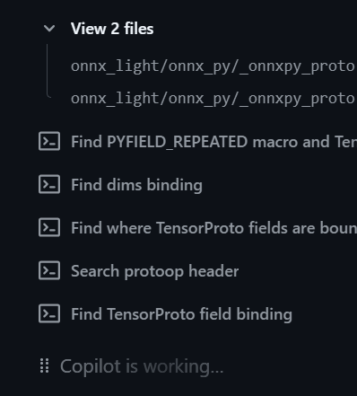
Coding with Agents
The quality of agent writing code reached a gap in 2026 where converting a model into ONNX is just a matter of translation.
It is reliable and it is a lot faster than posting an issue and waiting for it to be resolved.
The model is as expected and does not need post-processing.
It works with every machine learning library.
Notes:
* Unless you slept for a year, I’m pretty sure you all now agents and how fast they can be.
And they really do a pretty good job when it comes to translate a piece of code into another language such as ONNX.
Faster, and more reliable. And documented also.

Slide 3
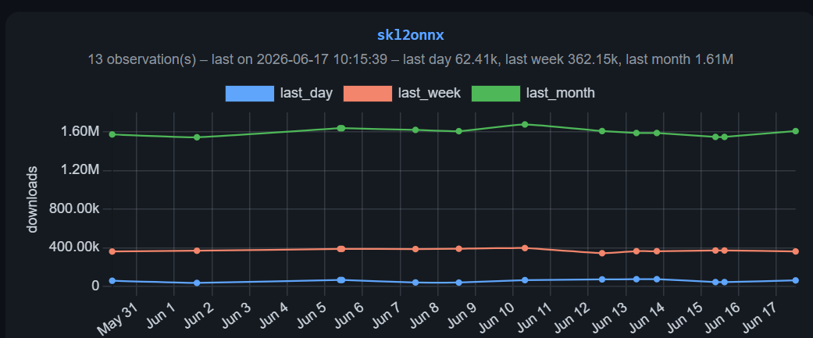
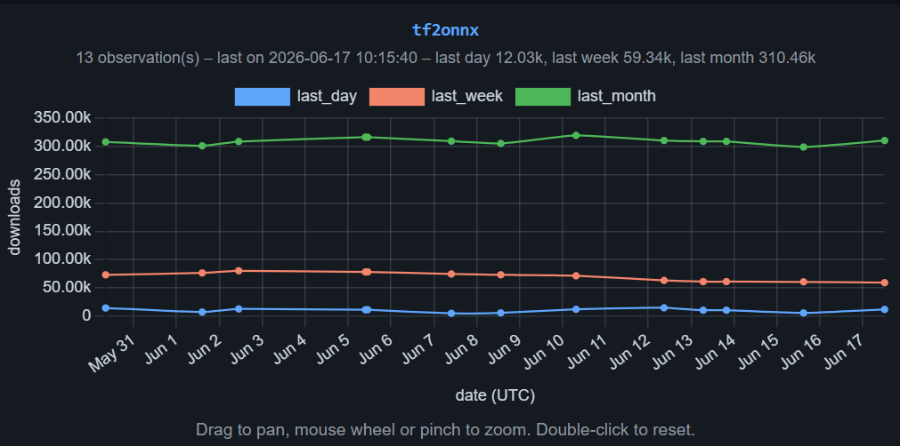
Side effects
If sklearn-onnx, tensorflow are still downloaded on PyPI, we see less and less issues.
Notes:
sklearn-onnx are still used but I see less and less issues these days. It is so easy to do without my help now. And I’m pretty sure you were tired of waiting my reviews anyway.

Slide 4
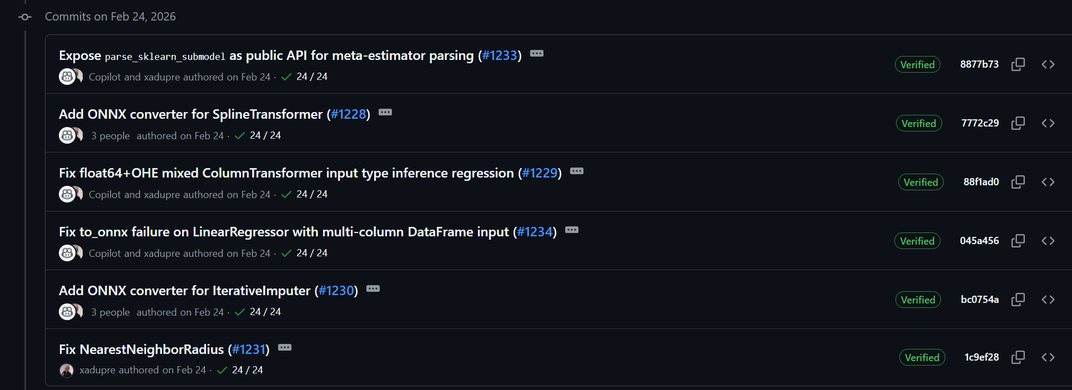
Add a new converter in no time
Create an issue on GitHub, assign it to an Agent.
Three converters added in a day.
Notes:
One day, I was on fire. I raised 3 issues and assigned them right away. Waiting, waiting, having lunch and it was done at the end of the day.

Slide 5
Do you still need a framework? Yes
A model is usually a pipeline of estimators (scikit-learn) or modules (transformers)
It is safer to export piece by piece.
Agents cannot do a whole model fast.
A new model means a couple of new pieces to add.
Agents need a structure to rely on and a few converters to replicate.
When it grows, it becomes a framework no matter what you do.
Notes:
A framework what for? Just ask the model you want? But wait, how big it is? Waouh, the agent is lost, he does not come back. Oh now, it took a shortcut. Yes a framework, because, you need to translate piece by piece.

Slide 6
Core Pieces
You need a GraphBuilder: to add nodes into an ONNX graph.
A naming logic: how to name the intermediate results
A logic to register a function to convert a piece.
A logic to walk through a model, call every converter and connect them.
A test infrastructure to check discrepancies, speed up and to help the agents automatically check what they do
Notes:
Something you find in every converting library, a GraphBuilder to stack up nodes, a way to give unique name to the results, a way to tell which function converts which piece or estimator. And unit tests or course otherwise, you might end up with the wrong puzzle.

Slide 7
Optional Pieces
Optimization
The converted ONNX models may not be optimal (remove duplicated transpose, …).
Models are written differently on different providers.
Shape Inference
Allows an optimizer or a runtime to take better decisions.
Partially provided by onnx.
Notes:
In addition, some translation adds useless or not efficient nodes or maybe you run the model on GPU, or you need to fuse nodes into more efficient ones. But to do that, you need to infer the shapes to avoid creating inconsistency. Oh no, the shapes don’t match.

Slide 8
Demo: fuse skl2onnx, tf2onnx, onnxmltools
We don’t write code, we review what agents do.
A common framework speeds up this part.
No dependency except onnx: you don’t want to wait for an issue somewhere to be fixed.
95% written with agents.
Fusing all converters into a single project and share the core and optional pieces.
Notes:
A quick demo. I rewrite my own code into a nice framework, I merged all converters into a single one to experiment. 50 PRs in a day, one minute I was driving at high speed, next one, I was stuck in a huge traffic jam among agents.

Slide 9
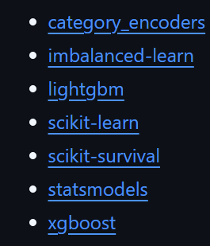

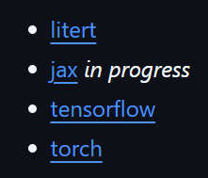
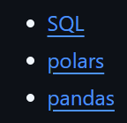
yet-another-onnx-builder
xadupre/yet-another-onnx-builder: yet another onnx builder
Fuse sklearn-onnx, tensorflow-onnx, onnxmltools…
Extends it to SQL, Pandas, JAX, category_encoders…
One function to convert all
Notes:
But, I fused the converters into a single one, extended the framework to handle SQL, Pandas, and other things and get one function to convert everything.

Slide 10

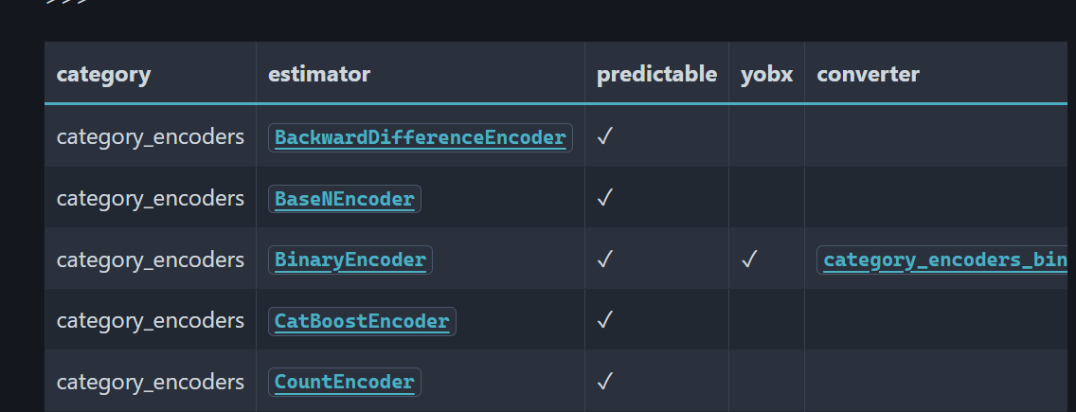
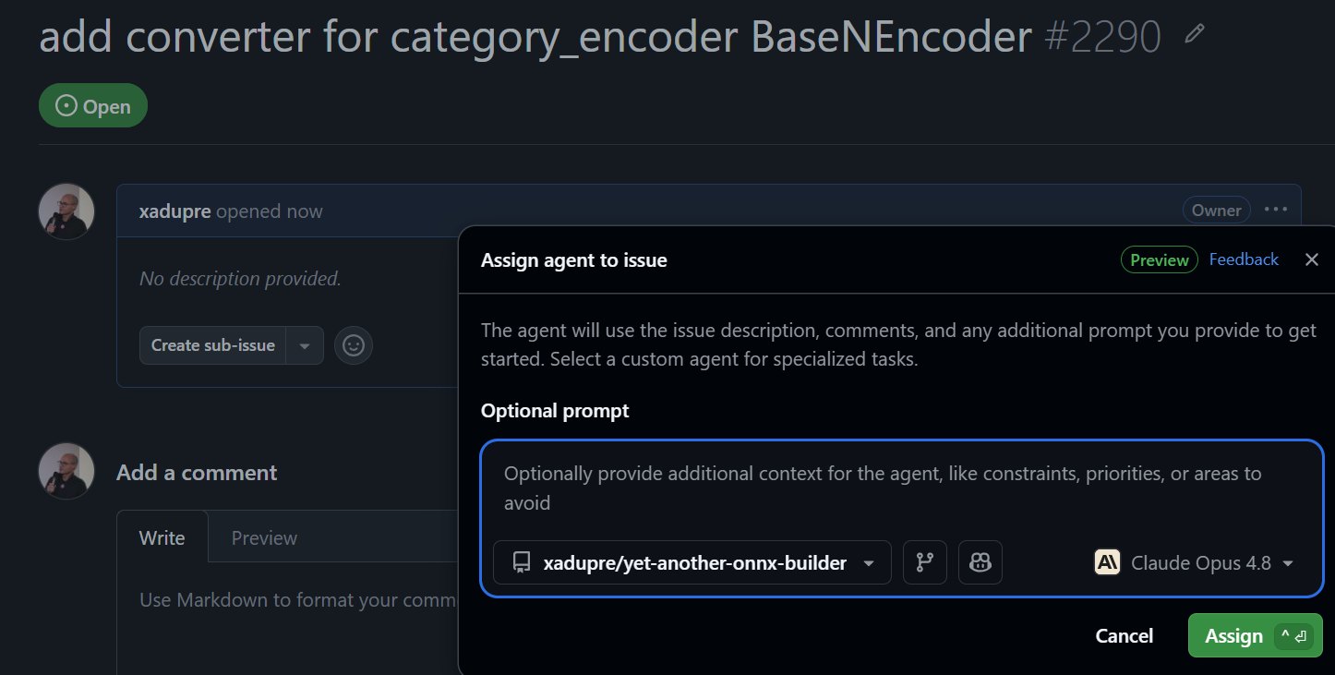
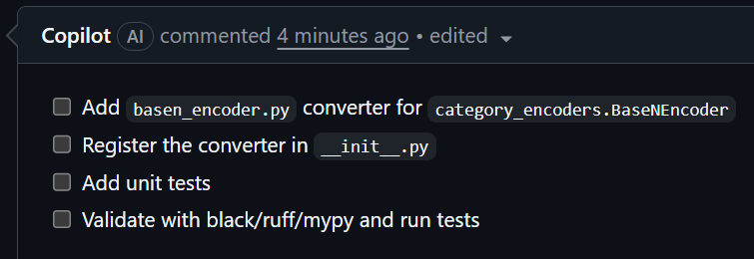
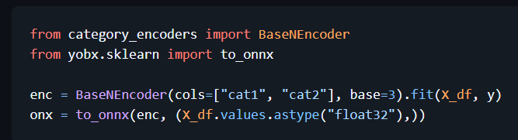
New converter
Add ONNX converter for category_encoders BaseNEncoder by Copilot · Pull Request #2291 · xadupre/yet-another-onnx-builder
Notes:
Today, I look into the coverage table. Picked one missing converter. Raised an issue. Looked at the plan (or not). And voilà ! Done.

Slide 11
Conclusion
Do you still code?
Notes:
Do you still need me?

