Slide 1
onnx-light onnx protobuf free
C++ only
parallelized
…
Xavier Dupré
Notes:
Hi, I’m Xavier Dupré, I usually work on converters or kernels or onnx or anything related to onnx in fact. But today, I’d like to talk about freedom: I imagined a world without protobuf, the core piece of onnx.

Slide 2
Protobuf…
Since I started my journey on ONNX, protobuf has always been a pain:
Frequent conflicts between the installed version and the one used by ONNX
Unable to switch from Python to C++ without serialization
Complex compilation since we need to generate a header first.
Unable to extend the API.
2 Gb limitation
Let’s try without.
Notes:
Why get rid of protobuf? Well, when I first heard about it, I thought why do i need a such complex tool to serialize and it was so difficult to compile it on windows.

Slide 3
First question?
Can we do protobuf without protobuf?
ONNX2: prototype for a replacement of protobuf = same API, same format as ONNX but without protobuf by xadupre · Pull Request #7208 · onnx/onnx
So it is possible.
What’s next? Smooth rewriting or complete rewriting from scratch?
Maybe two ONNX are better: users can implement a switch and check both at the same time rather than introducing major breaking changes. Let’s rewrite.
Notes:
I learned a lot about the format while trying to remove it. Because if I could remove protobuf, I had to keep the format. So I did that also to learn.

Slide 4
No protobuf but also
No protobuf
removes the 2 GB limitation
Parallelization
Implement custom loading strategies (read only part of a model without loading the entire file, etc.), alignment
Native C++ support for weight files
Minimize dependencies and security issues
No serialization layer between Python and C++.
Same C++ and Python APIs
No auto-generated Markdown files in the repository: no longer PR with 200 files modified.
import onnx_light.onnx as onnx

Slide 5
Other requirements (or things I’d like to change)
No backend tests stored as files: backend tests implemented as C++ functions.
Backend tests are generated from a shared random test suite
Expected outputs are produced by C++ kernels.
Kernels can be parallelized except reductions to ensure deterministic results.
Flexible C++ linking: users can link only the reading/writing/serialization components, or include schemas, kernels, and/or backend tests as needed.

Slide 6
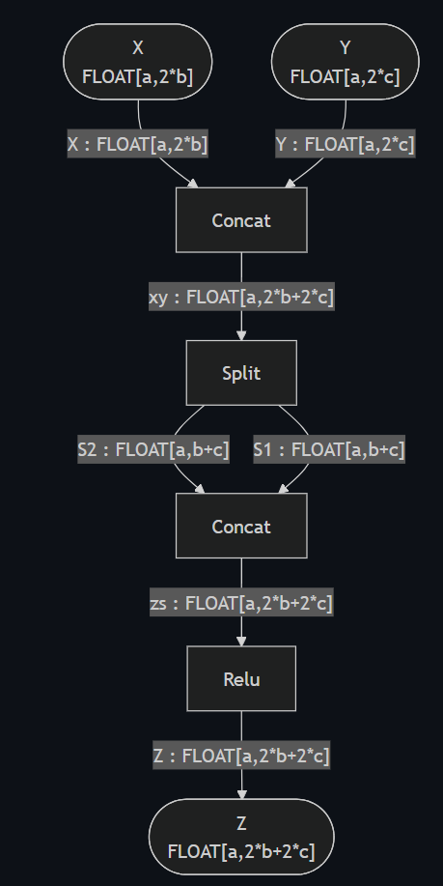
And Symbolic Shape Inference
We need symbolic shapes instead of unk__0, unk__1…

Slide 7
What did I get?

Slide 8
Core pieces: take what you need
2000+ C++ Backend tests (7 Mb)
C++ Kernels (4.8 Mb)
Existing C++ onnx library, no change (5Mb)
New Shape Inference (1.5Mb)
Light Schema (2Mb) (not loaded as static variable)
Graph manipulations (0.6 Mb)
Parse and serialize, no schema needed (1.5Mb)

Slide 9
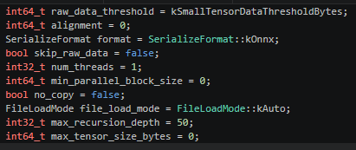
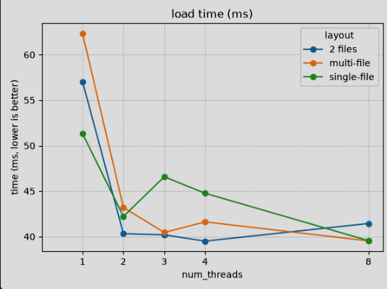
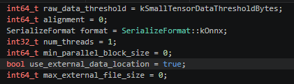
Parsing and Serializing Options
Data can be aligned when loading tensor
Parallelization is possible.
Onnxruntime flatbuffers is supported
More secure: limit recursivity
Other scenarios can be implemented such a callback to allocate directly on GPU or any other memory.

Slide 10
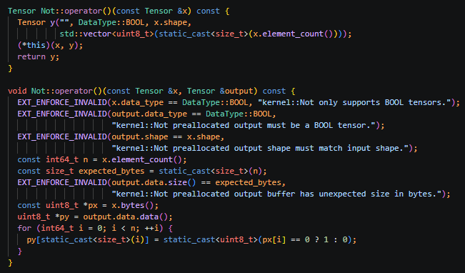
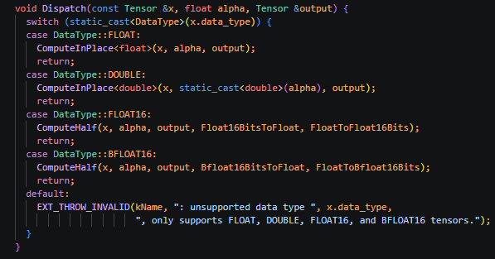
A kernel
Dispatch mechanism to support all types.
Simple kernel

Slide 11
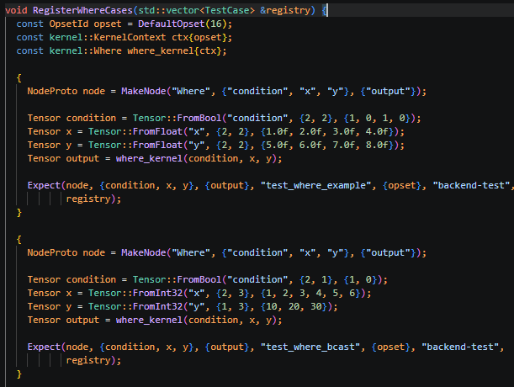
Backend test
Very similar to the existing ones except it does not write any file.

Slide 12
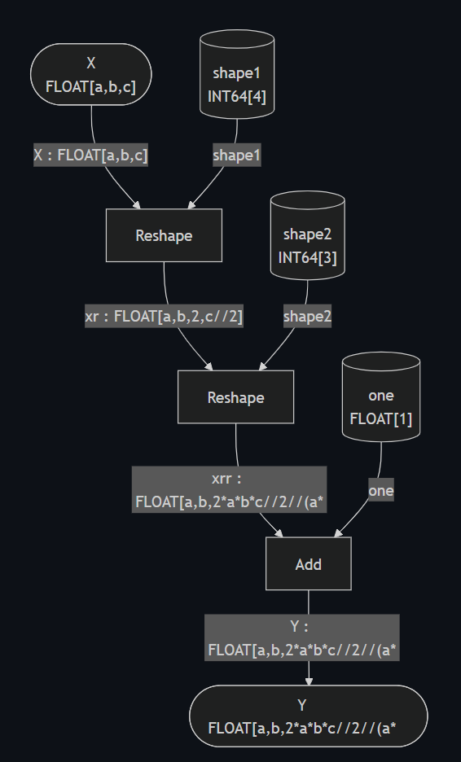
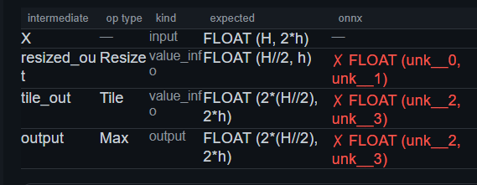
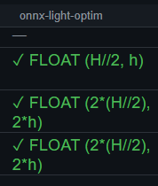
New tests related to shape inference
value_info is filled with expected values.

Slide 13
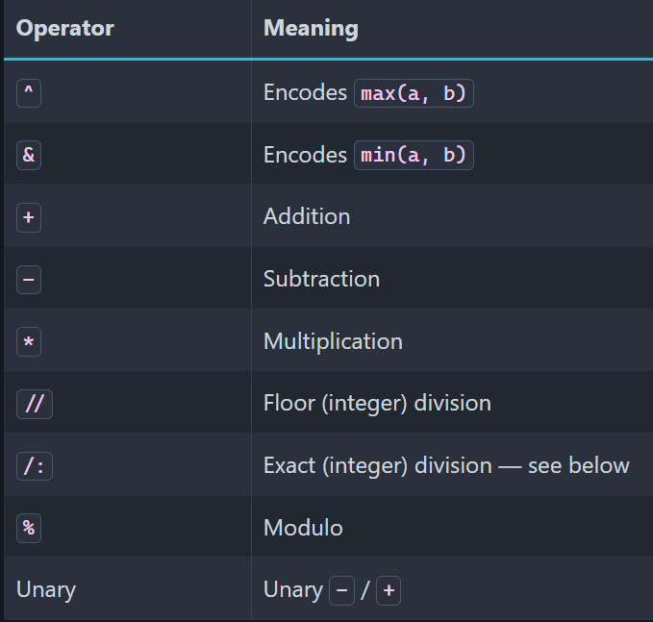

Symbolic Expressions
Only symbols, no function to keep short expressions
2 divisions: // and /:
// to round the results
/: when the exact result is an integer
When Reshape(x[N], [-1, 2]), we know that N is even so we use N/:2 and not N//2.
2*(N/:2) == N but 2*(N//2) may be different.

Slide 14
Next steps
✓
Implements a switch in ir-py to check it is compatible with onnx_light.onnx
Do the same for onnxruntime and validate the C++ API
Supports more loading/saving scenarios
Expose standard graph transformations (dead end removal, …)

Slide 15
Source and Documentation
Source: xadupre/onnx-light: onnx without protobuf
Documentation: onnx-light — onnx-light 0.1.1 documentation
Evaluation of onnx-light on onnx backend tests: onnx — backend node test coverage
All backend tests in onnx-light: onnx-light — backend test coverage (onnxruntime vs reference vs onnx-light)
Comparison of shape inference algorithms: onnx-light — shape inference coverage (onnx-light vs onnx-light.onnx_optim vs onnx vs onnx-shape-inference vs onnxruntime.transformers vs yobx)

