Slide 1
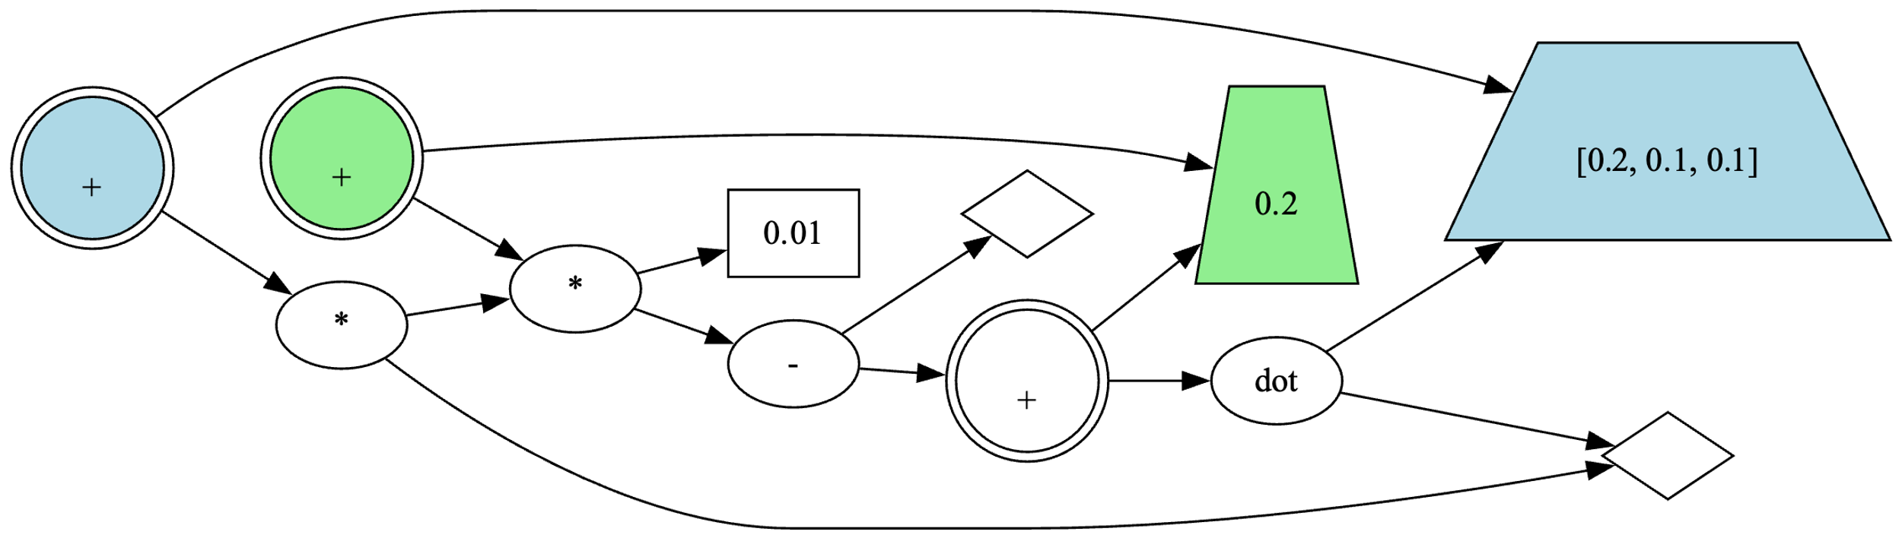



















$$v6$$
$$s7$$
$$v6$$
$$u_{lpn,1}$$
$$s7$$
$$u_{lp,2}$$
$$u_{lpn,2}$$
$$u_{lp,1}$$
$$s3$$
$$u_{c}$$
$$s6$$
$$s0$$
$$v3$$
$$u_{p}$$
$$s4$$
$$s2$$
$$s1$$
$$u_{f}$$
$$v0$$

Slide 2
$$u_{lpn,1}$$
$$u_{lp,2}$$
$$u_{lpn,2}$$
$$u_{lp,1}$$
$$u_{c}$$
$$u_{p}$$
$$u_{f}$$

Slide 3
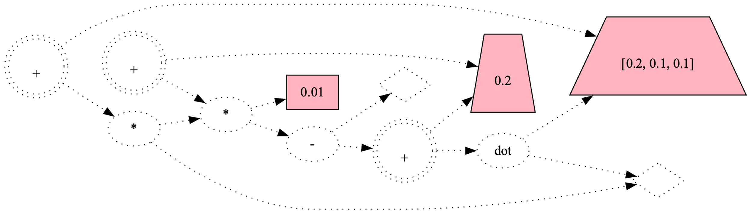
Setup関数実行時に定数ノードの値とLPノードの初期値を設定
$$u_{lpn,1}$$
$$u_{lp,2}$$
$$u_{lpn,2}$$
$$u_{lp,1}$$
$$u_{c}$$
$$u_{p}$$
$$u_{f}$$

Slide 4
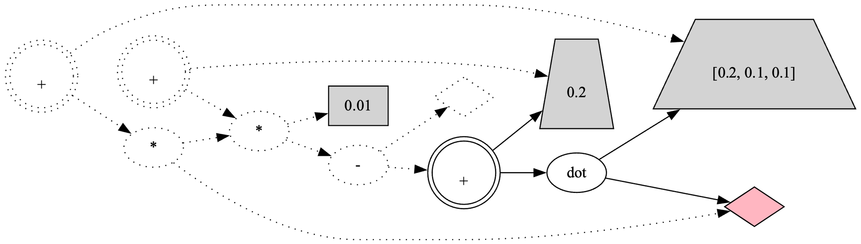
Predict関数実行前に入力ベクトルノードに入力ベクトルを代入
$$u_{lpn,1}$$
$$u_{lp,2}$$
$$u_{lpn,2}$$
$$u_{lp,1}$$
$$u_{c}$$
$$u_{p}$$
$$u_{f}$$
$$v0$$

Slide 5
Predict関数実行前に入力ベクトルノードに入力ベクトルを代入
$$u_{lpn,1}$$
$$u_{lp,2}$$
$$u_{lpn,2}$$
$$u_{lp,1}$$
$$u_{c}$$
$$u_{p}$$
$$u_{f}$$

Slide 6
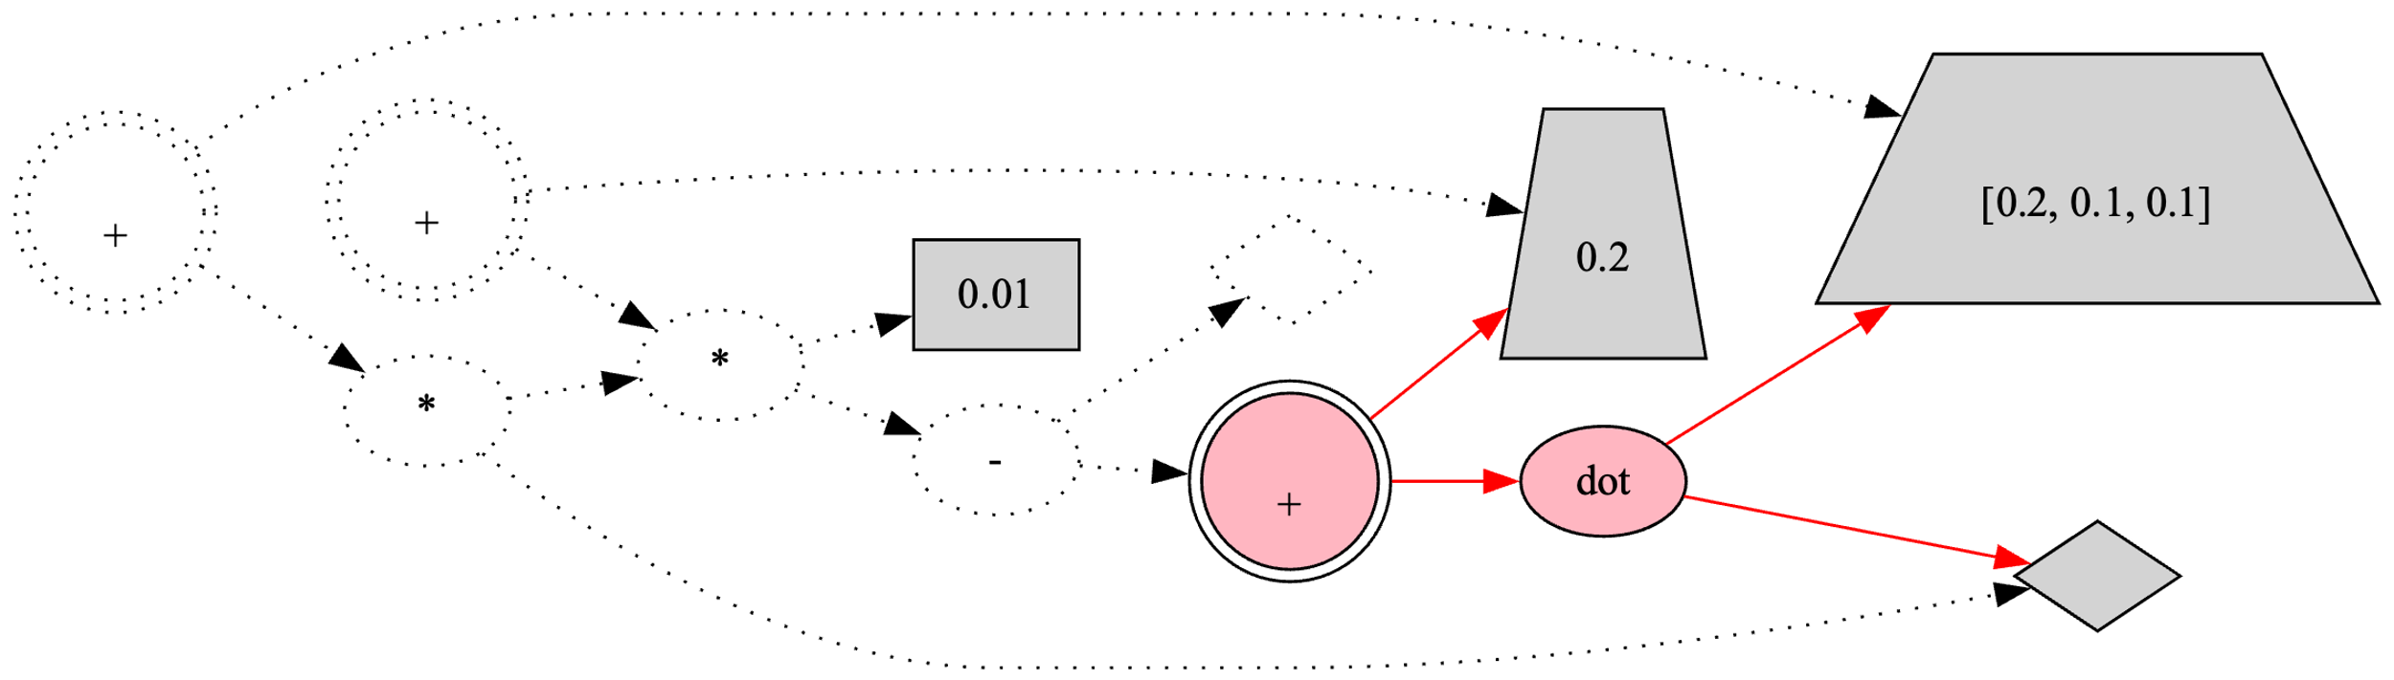


Predict関数実行時は予測ノードの子孫ノードを順に実行
$$u_{lp,2}$$
$$v1$$
$$u_{lpn,2}$$
$$u_{lpn,1}$$
$$u_{lp,1}$$
$$s3$$
$$u_{c}$$
$$u_{p}$$
②
①
$$s1$$
$$s2$$
$$u_{f}$$
$$v0$$

Slide 7
Predict関数実行時は予測ノードの子孫ノードを順に実行
$$u_{lpn,1}$$
$$u_{lp,2}$$
$$u_{lpn,2}$$
$$u_{lp,1}$$
$$u_{c}$$
$$u_{p}$$
②
①
$$u_{f}$$

Slide 8
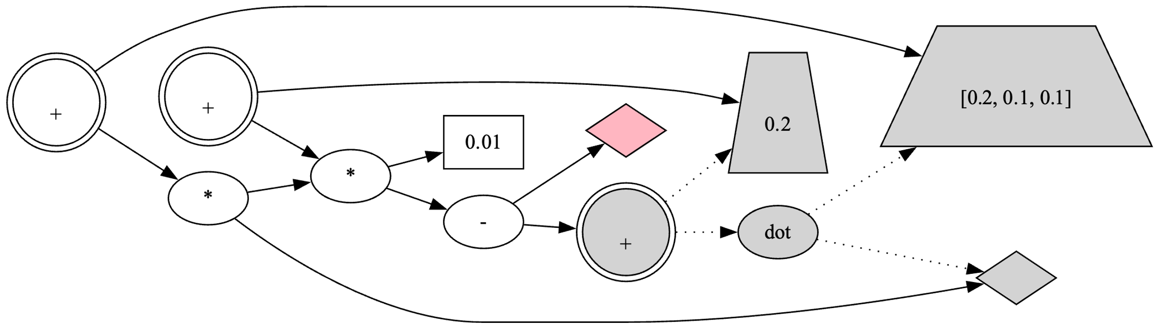
Learn関数実行前に正解ラベルノードに正解ラベルを代入
$$u_{lp,2}$$
$$v1$$
$$u_{lpn,2}$$
$$u_{lpn,1}$$
$$u_{lp,1}$$
$$s3$$
$$u_{c}$$
$$s0$$
$$u_{p}$$
$$s1$$
$$s2$$
$$u_{f}$$
$$v0$$

Slide 9
Learn関数実行前に正解ラベルノードに正解ラベルを代入
$$u_{lpn,1}$$
$$u_{lp,2}$$
$$u_{lpn,2}$$
$$u_{lp,1}$$
$$u_{c}$$
$$u_{p}$$
$$u_{f}$$

Slide 10
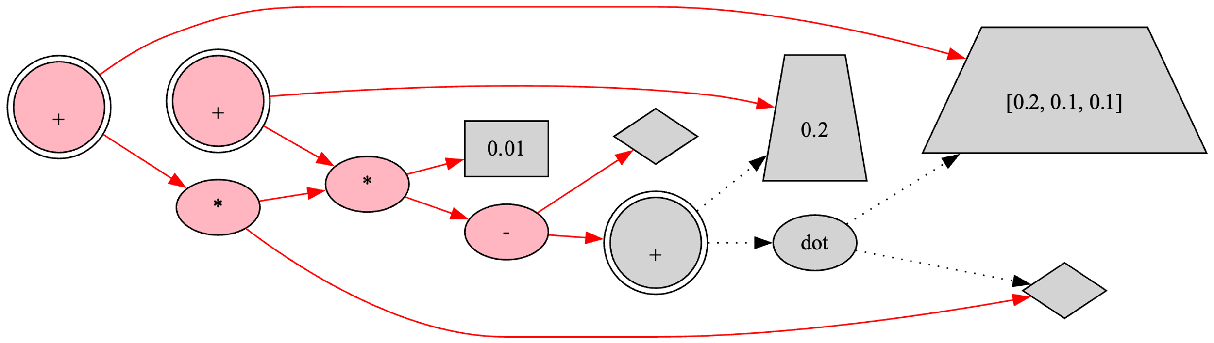




Learn関数実行時はNLPノードの子孫ノードで未計算のノードを順に実行
$$v1$$
$$s3$$
$$v1$$
$$u_{lpn,1}$$
$$s3$$
$$u_{lp,2}$$
$$u_{lpn,2}$$
④
⑤
$$u_{lp,1}$$
$$s5$$
$$u_{c}$$
$$s6$$
$$s0$$
$$v2$$
②
③
①
$$u_{p}$$
$$s4$$
$$s2$$
$$s1$$
$$u_{f}$$
$$v0$$

Slide 11
Learn関数実行時はNLPノードの子孫ノードで未計算のノードを順に実行
$$u_{lpn,1}$$
$$u_{lp,2}$$
$$u_{lpn,2}$$
④
⑤
$$u_{lp,1}$$
$$u_{c}$$
②
③
①
$$u_{p}$$
$$u_{f}$$

Slide 12
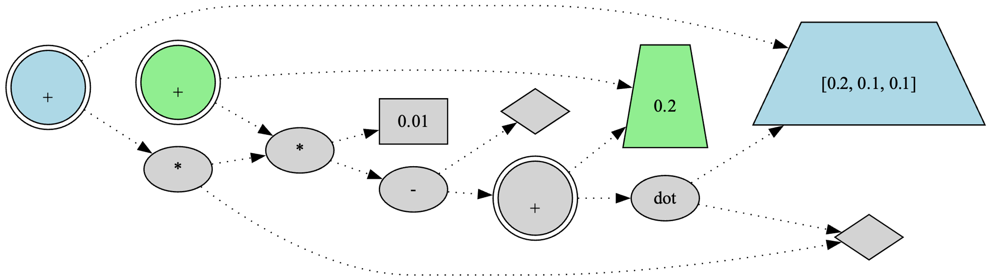
NLPノードで計算された値は次のステップで対応するLPノードで利用
$$v1$$
$$s3$$
$$v1$$
$$u_{lpn,1}$$
$$s3$$
$$u_{lp,2}$$
$$u_{lpn,2}$$
$$u_{lp,1}$$
$$s5$$
$$u_{c}$$
$$s6$$
$$s0$$
$$v2$$
$$u_{p}$$
$$s4$$
$$s2$$
$$s1$$
$$u_{f}$$
$$v0$$

Slide 13
NLPノードで計算された値は次のステップで対応するLPノードで利用
$$u_{lpn,1}$$
$$u_{lp,2}$$
$$u_{lpn,2}$$
$$u_{lp,1}$$
$$u_{c}$$
$$u_{p}$$
$$u_{f}$$

Slide 14
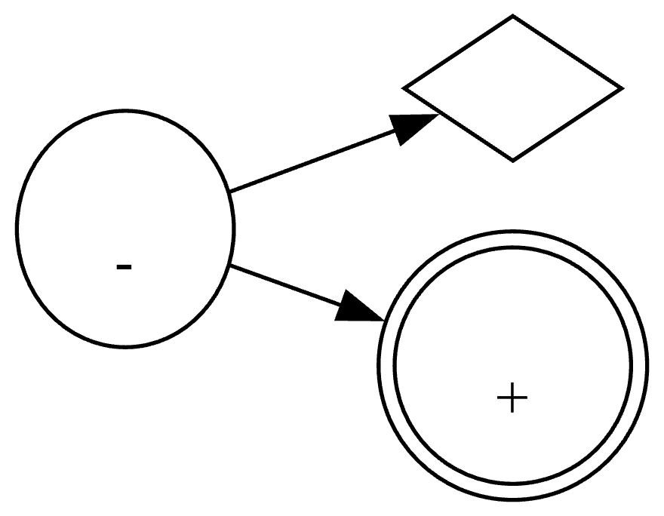









$$(u_{op}, 1,u_{c})$$
$$u_{c}$$
$$u_{op}$$
$$s0$$
$$s4$$
$$u_{p}$$
$$(u_{op}, 2,u_{p})$$
$$s4=s0−s1$$
$$s1$$

Slide 15
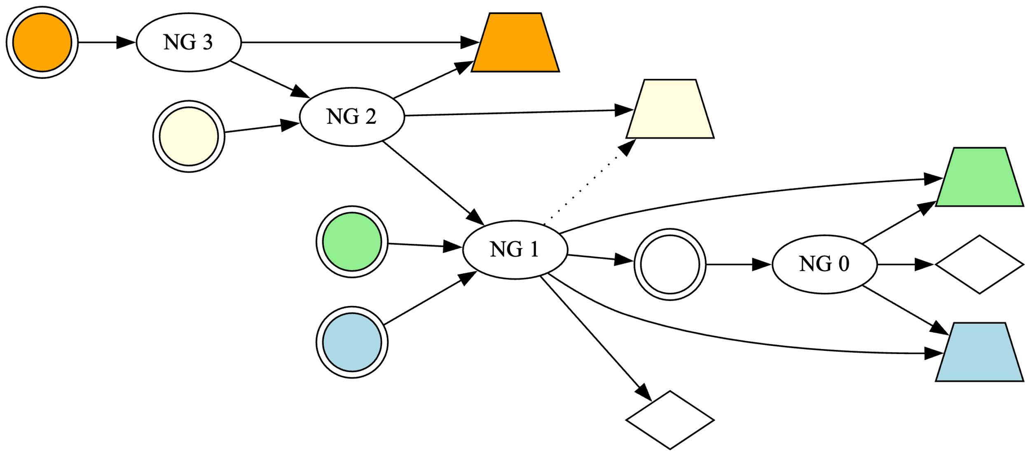











$$u_{nlp,4}$$
$$u_{lp,4}$$
$$u_{lp,3}$$
$$u_{nlp,3}$$
$$u_{lp,1}$$
$$u_{nlp,1}$$
$$u_{p}$$
$$u_{f}$$
$$u_{nlp,2}$$
$$u_{lp,2}$$
$$u_{c}$$

Slide 16

$$u_{nlp,4}$$
$$u_{lp,4}$$
$$u_{lp,3}$$
$$u_{nlp,3}$$
$$u_{lp,1}$$
$$u_{nlp,1}$$
$$u_{p}$$
$$u_{f}$$
$$u_{nlp,2}$$
$$u_{lp,2}$$
$$u_{c}$$

Slide 17

アフィン回帰と解釈可能なアルゴリズムグラフ
$$u_{lpn,1}$$
$$u_{lp,2}$$
$$u_{lpn,2}$$
$$u_{lp,1}$$
$$u_{c}$$
$$u_{p}$$
$$u_{f}$$

Slide 18
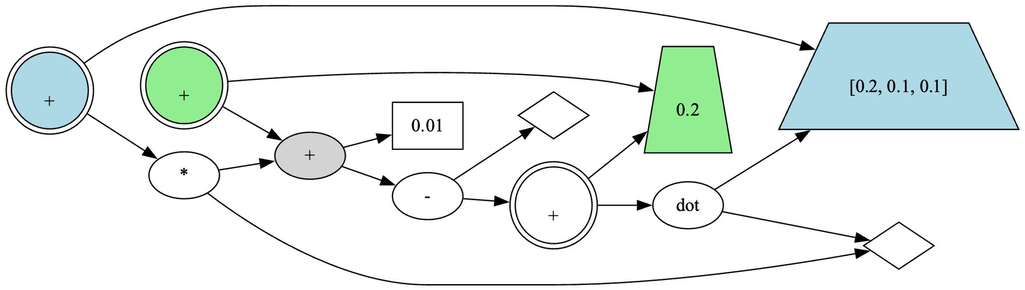
$$u_{lpn,1}$$
$$u_{lp,2}$$
$$u_{lpn,2}$$
$$u_{lp,1}$$
$$u_{c}$$
$$u_{p}$$
$$u_{f}$$

Slide 19
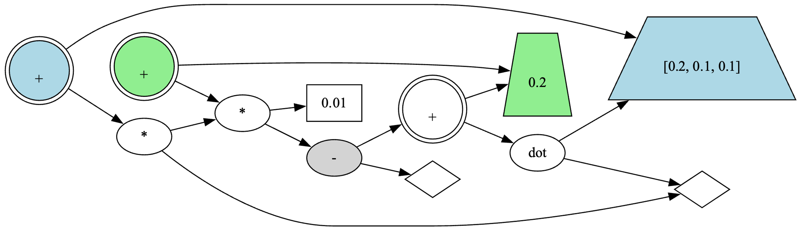







$$u_{lpn,1}$$
$$u_{lp,2}$$
$$u_{lpn,2}$$
$$u_{lp,1}$$
$$u_{c}$$
$$u_{p}$$
$$u_{f}$$

Slide 22
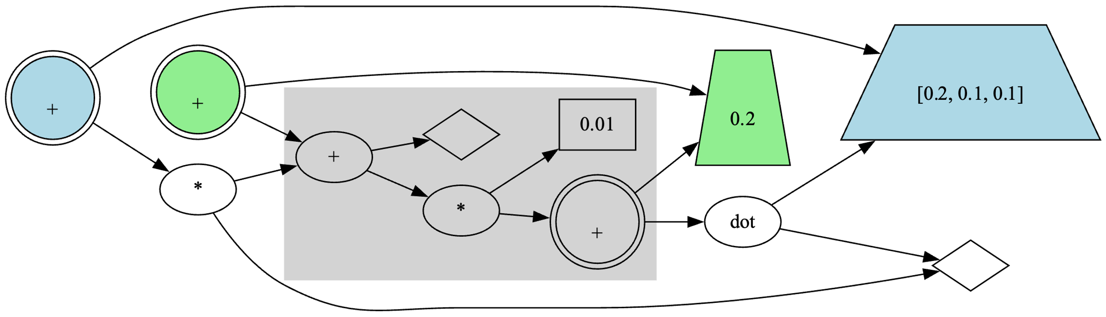

$$u_{lpn,1}$$
$$u_{lp,2}$$
$$u_{lpn,2}$$
$$u_{lp,1}$$
$$u_{c}$$
$$u_{p}$$
$$u_{f}$$

Slide 23

$$u_{lpn,1}$$
$$u_{lp,2}$$
$$u_{lpn,2}$$
$$u_{lp,1}$$
$$u_{c}$$
$$u_{p}$$
$$u_{f}$$

Slide 24
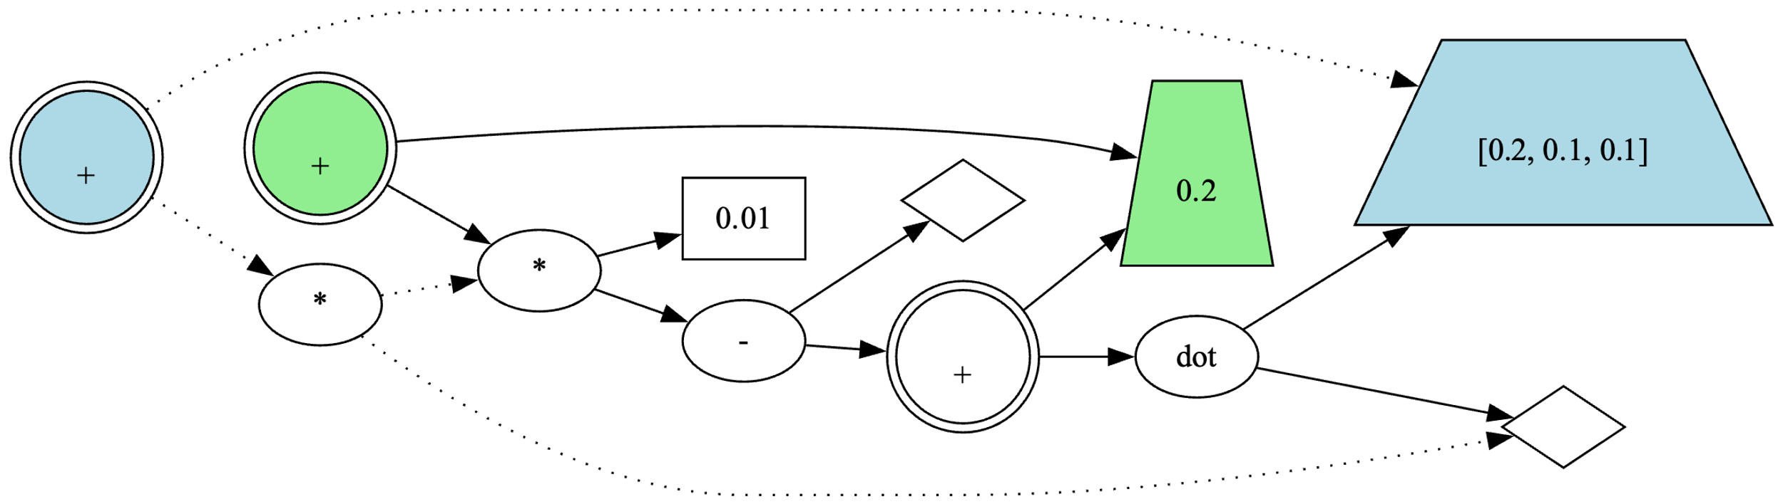
$$u_{lpn,1}$$
$$u_{lp,2}$$
$$u_{lpn,2}$$
$$u_{lp,1}$$
$$u_{c}$$
$$u_{p}$$
$$u_{f}$$

