Slide 1
OKR(FY2026 2Q : Jul. - Sep.
(Name: Yuki WATANABE)
Annual Objective
Will build a workflow that uses dialogue with an LLM to translate development plans into scenarios that allow for the prediction of pedestrian flow, and will gradually expand from implementation in a single scenario to application and evaluation across multiple scenarios.
Key Result
1. Using a central urban development case as a use case, implement a dialogue-based workflow that gradually concretizes a low-granularity development concept into a scenario that can be used for pedestrian flow forecasting through interaction with an LLM.
・Implement a function that extracts and organizes key planning conditions from natural language input, such as target area, development purpose, main use, scale, and assumed users.
・Implement a function that identifies missing information required for scenario concretization and prompts the user to provide or confirm additional details.
2. Submit a paper to the GIS conference by the end of August, based on the proposed LLM-assisted workflow for concretizing urban development scenarios and connecting them to pedestrian flow forecasting.

Slide 2
Natural-Language Flow Scenarios
Comparing the Impact of Multiple Conditions
— Meitetsu Nagoya Station Case Study
Notes:
Today I will introduce a research concept for generating pedestrian-flow scenarios from natural-language planning ideas. The case study focuses on the area around Meitetsu Nagoya Station. The central question is whether an LLM can help translate an early, loosely defined development concept into structured conditions that a pedestrian-flow model can evaluate. We then compare how different planning assumptions, access conditions, and demand scenarios change expected movement patterns. The goal is not to replace planners or simulation experts, but to connect their work earlier and make alternative concepts easier to test.

Slide 3
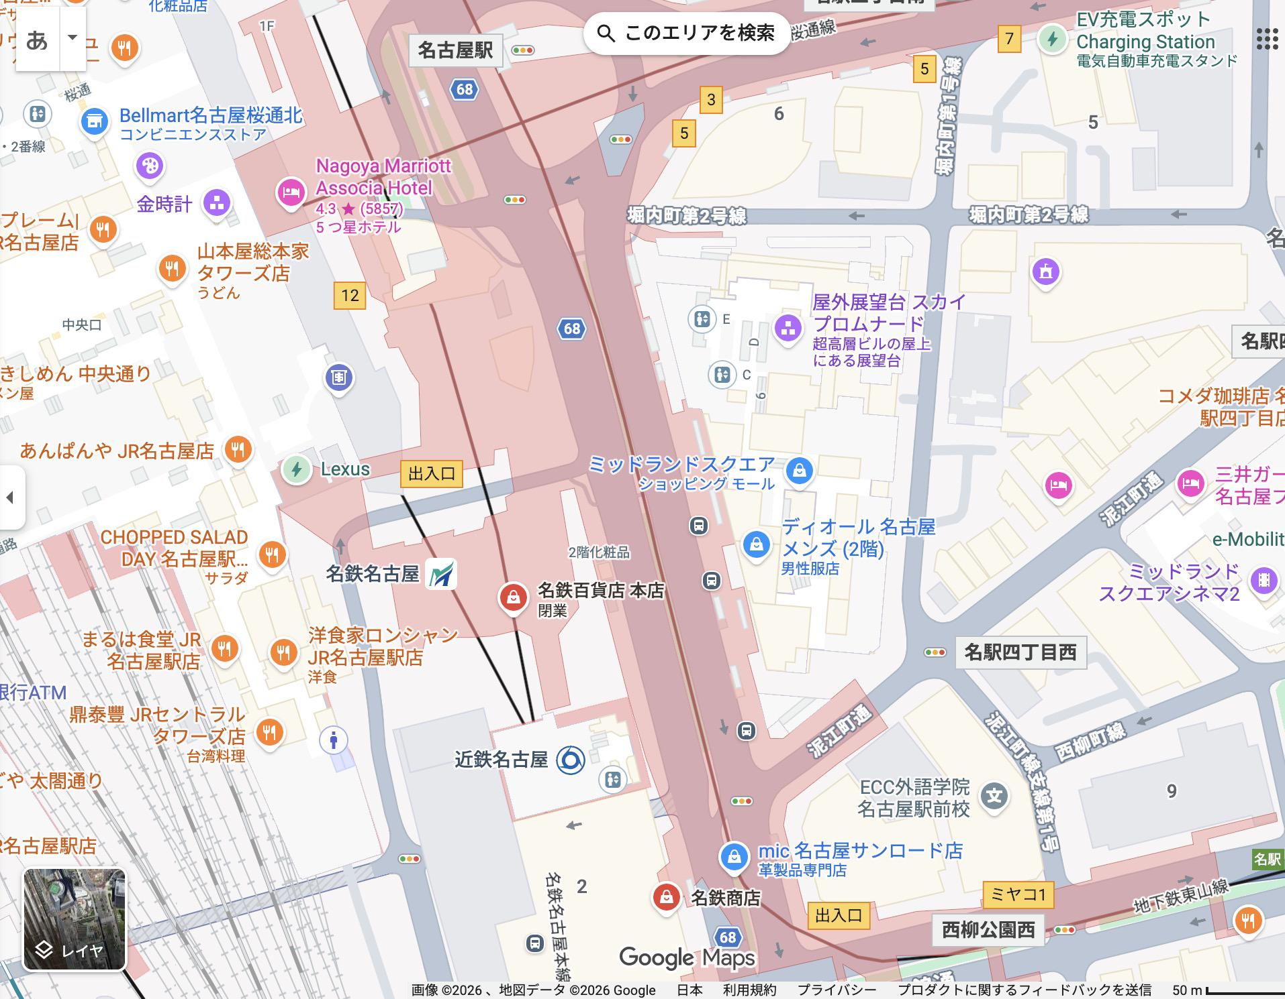
First Three Months (Q2: Jul–Sep): Defining Site Conditions
Through dialogue with an LLM agent, station, former-store, and nearby-facility conditions are progressively converted into pedestrian-flow model inputs.
1
Define Study Area
3
Building Specs
* Hypothetical case for validation
Example: Former Store Area
LLM
User
LLM
User
After the Meitetsu Department Store closes, I want to test a hypothetical interim use of the existing building.
Use floors 1–4.
GFA: about 4,000 m², mainly retail, with dining and social spaces.
Former Meitetsu store area; about 1,000 m²; well connected to gates, bus center, and station.
Assume 80% retail, 20% dining; open 10:00–18:00.
2
Proceed with these conditions.
Area
2
Define Use & Scale
4
Access & Connections
1
Based on nearby facilities, I’ll define candidate uses and scale.
Site
Use gates, passages, and street entrances as nodes.
4
A place where station users can shop, eat, and rest.
3
Include transfers to the bus center, Kintetsu, and JR.
Area | Hours | Use Mix
Former store | 10:00–18:00 | 80% retail / 20% dining
Candidate: a mixed retail and dining facility.
Place dining for easy direct access from transfer passages.
Focus on the lower floors.
Set it as a low-rise retail and rest facility in front of the station.
Output pedestrian-flow model inputs from the dialogue.
Notes:
This slide shows how we define the conditions during the first three months. The process begins with a planner describing the study area and an interim-use concept in ordinary language. Through dialogue, the LLM clarifies four groups of inputs: the study area, the proposed use and scale, building parameters, and access connections. In this hypothetical case, we assume a low-rise mixed retail and dining facility using floors one through four. Ticket gates, underground passages, street entrances, and transfers to Kintetsu, JR, and the bus center become explicit connection points. The final output is a structured set of inputs for pedestrian-flow evaluation.

Slide 4
First Three Months (Q2: Jul–Sep): Pedestrian-Flow Analysis Around Meitetsu
Simulate pedestrian flow under different scenarios and estimate the range of outcomes.
* Hypothetical case for validation
Example: Former Store Area
before
after
Scenario Comparison
1. Plan Change
Compare against a retail + event-space plan.
Visitors change to XX0,000.
2
2. Construction Detour
Area
Show the impact of all-day rain.
In rain, weekday visitors fall to XX0,000 and weekend visitors to YY0,000.
1
Site
4
3. Demand Range
3
Predict pedestrian flow.
Show upside and downside cases if the project performs well over one year.
Predicted pedestrian flow
Weekday: XX0,000 visitors
Weekend: YY0,000 visitors
Route ~~ shows the largest increase.
Create and compare upside and downside cases.
Notes:
Once the conditions are structured, we can run pedestrian-flow simulations and compare outcomes. The center illustrates a before-and-after comparison, while the right side shows three kinds of scenario tests. We can change the plan itself, introduce a construction detour or adverse weather, and test upside and downside demand assumptions. The visitor figures on this slide are placeholders, not measured results. Actual values will be calculated after the relevant observed or partner-provided data become available. At this stage, the important contribution is defining consistent comparison conditions and evaluation metrics across multiple scenarios.

Slide 5
Positioning of This Research
LLM-based planning support structures concepts, but rarely connects to pedestrian-flow evaluation.
Pedestrian-flow models assess layout and policy impacts, but struggle to interpret natural-language planning intent.
This research connects plan specification and flow prediction, enabling early-stage concepts to be evaluated.
LLM Planning Support
Pedestrian-Flow Models
This Research: Integrated Workflow
○
Plans and land-use options from natural language
○
Tests layout and policy changes
○
Clarifies early concepts via LLM dialogue
○
Dialogue-based requirements and scenarios
○
Estimates visitors, congestion, and dwell
○
Converts concepts into model parameters
×
No pedestrian-flow input link
×
Cannot interpret ambiguous intent
○
Compares scenario flow impacts
×
Impact checks stay qualitative
×
No scenarios from early concepts
○
Unifies plan definition and flow evaluation
Ex. PlanGPT, Large language model empowered participatory urban planning
Ex. CausalPOI, SeMob
Notes:
This slide positions the research between two established streams. LLM-based planning support is useful for organizing concepts, refining requirements, and generating scenarios, but it is usually not connected directly to pedestrian-flow model inputs. Pedestrian-flow research can estimate changes in visitors, congestion, and dwell time, but it does not easily interpret ambiguous natural-language planning intent or develop scenarios from early concepts. Our research bridges these gaps. It uses dialogue to refine a low-detail concept, converts the result into parameters that a flow model can process, and compares multiple specified scenarios through an integrated workflow.

Slide 6
Roadmap for the Rest of the Fiscal Year (Q3–Q4: Oct–Mar)
During the fiscal year, we will build a workflow that turns development plans into pedestrian-flow-ready scenarios through LLM dialogue, then expand from one implementation to multiple scenarios and evaluation.
Period | Scope | Details
Q2 (Jul–Sep) | Implement one representative scenario from plan specification through pedestrian-flow prediction | Use LLM dialogue to specify the plan and predict pedestrian flow. Deliver one complete scenario.
Q3 (Oct–Dec) | Apply to other scenarios | Extend the Q2 workflow to additional scenarios.
Q4 (Jan–Mar) | Apply to five representative scenarios and validate outputs | Cover five scenarios and their variants, then evaluate output validity.
Notes:
The work is planned in stages across the fiscal year. In Q2, the priority is to complete one representative scenario end to end: clarify the plan through LLM dialogue, structure the conditions, and run pedestrian-flow prediction. In Q3, we will reuse that workflow for additional scenario types and identify where the process needs to become more general. In Q4, we will cover five representative scenarios and their variations, then evaluate the validity and usefulness of the generated outputs. This phased approach lets us prove the complete workflow first and broaden coverage only after the core process is stable.

Slide 7
Benefits for Development Partners
We aim to turn natural-language development concepts into pedestrian-flow-ready scenarios through LLM dialogue and compare the impacts of multiple alternatives.
The application can support faster planning, quantitative decisions, discovery of alternatives, and reuse in future projects.
Area | Benefit
Faster early-stage planning | Organize rough inputs for comparison in days or weeks, instead of several months.
Quantitative decision support | Compare visitor counts, congestion hotspots, and spillover to nearby facilities.
Discover alternatives | LLM dialogue may reveal unexpected use mixes, routes, and layouts.
Reuse for future projects | Build a reusable workflow for other redevelopments and station-area projects.
Notes:
For development partners, the application is intended to create value in four ways. First, it can compress early-stage comparison work by turning rough inputs into a structured set of alternatives within days or weeks. Second, it provides quantitative material such as visitor counts, congestion hotspots, and effects on nearby facilities. Third, dialogue may reveal alternative use mixes, routes, or layouts that were not included in the initial concept. Finally, the workflow can be reused beyond this specific site, supporting future redevelopment and station-area projects. These benefits remain hypotheses to validate together with practitioners through realistic cases and feedback.

Slide 8
Support Requested from Development Partners
1. Share basic development concept information
Please share the following in text form where possible:
Site boundary
Intended uses (e.g., retail, hotel, office, plaza, passageways)
Approximate scale (e.g., floors, gross floor area, lower/upper-floor uses)
Alternatives or scenarios to compare (e.g., upside and downside cases)
2. Provide feedback on generated scenarios and estimates
Please review the scenarios and pedestrian-flow estimates from these perspectives:
Any major gaps from planning expectations
Reasonableness of use mix and scale assumptions
Plausibility of visitor and congestion estimates
Additional conditions or alternatives to examine
We will update the scenarios and estimates based on your feedback.
Notes:
To make the research practical, we would appreciate two forms of collaboration. First, please share basic information about a development concept where possible: the site boundary, intended uses, approximate scale, and the alternatives or scenarios you would like to compare. Text-based information is sufficient at the initial stage. Second, please review the generated scenarios and pedestrian-flow estimates. We want to know whether the assumptions match planning expectations, whether the use mix and scale are reasonable, whether the estimates feel plausible, and what additional conditions should be tested. We will use that feedback to update the conditions, scenarios, and predictions iteratively.

