Slide 1
Generation and Evaluation of Various Patterns Based on the Level of Detail in Development Plans:
A Case Study of the Shibata 1-chome Development Plan

Slide 2
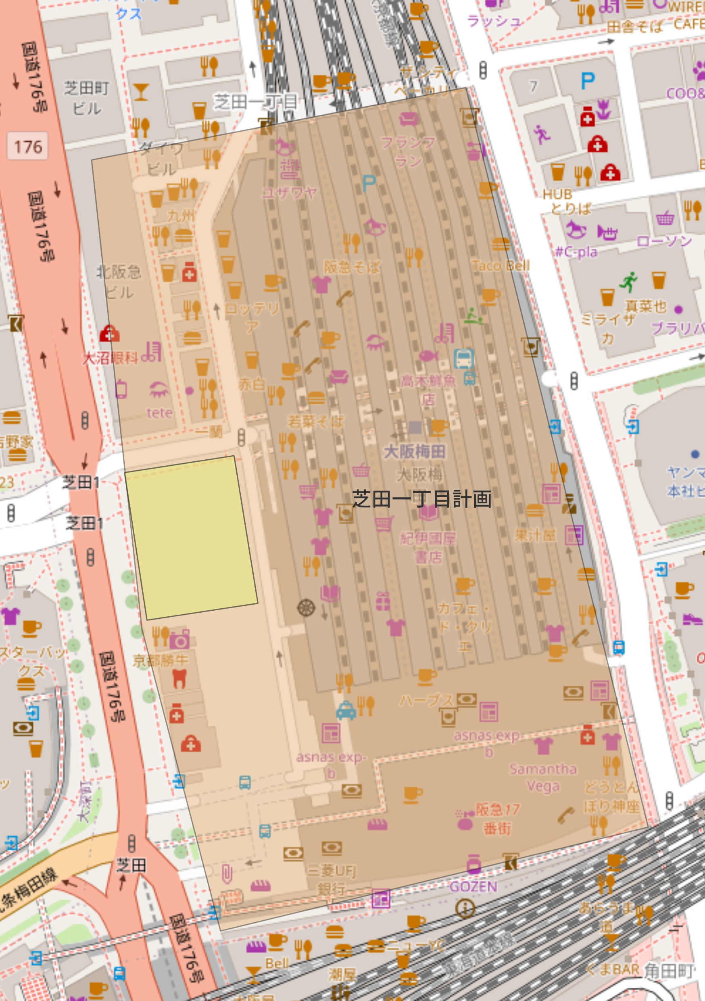
Overview of Initiatives for the First Three Months
(2Q: July–September)
1. Refining the draft plan through dialogue with the LLM
Through dialogue with the LLM, the development concept is gradually converted into the parameters necessary for predicting pedestrian flow.
Example: New hotel in front of Osaka Umeda Station
1
Organizing the Target Area
3
Building Attributes
Development plans in front of Osaka Umeda Station.
The construction of a high-rise building is under consideration.
The site is approximately 2,000 square meters and is located on the west side of Osaka Umeda Station, facing a pedestrian walkway.
We will assume that the hotel portion covers approximately 25,000 square meters.
We estimate that the hotel has approximately 500 guest rooms, with an average room size of about 27 square meters.
Is this site acceptable? It has an area of 1,980 square meters. Currently, it consists of walkways and open spaces, serving as a link between the station and nearby facilities.
We will classify the proportion of guest rooms as approximately 60%.
2
User
25 floor
Please proceed under those conditions.
2
Purpose and Scale
1
4
Layout and Connections
Given its location in front of the station, this site is suitable for mixed-use development, such as a hotel, offices, and retail space.
1,980㎡
On the first floor, a layout that preserves the pedestrian walkway and plaza is preferable.
4
The primary use will be a hotel, and we would like to include commercial facilities on the lower floors.
3
I would like to connect the station ticket gates and the surrounding commercial facilities to the hotel.
Proportion of Guest Rooms | Average Guest Room Size | Number of guest rooms
60% | 27㎡ | 200 rooms
Let's assume that the first through third floors are commercial space and the upper floors are a hotel.
I will organize the proposal for creating a through passageway within the building.
We are considering a 25-story building.
LLM
We estimate the total floor area to be approximately 30,000 square meters.
These conditions will be output as a scenario for evaluating pedestrian traffic.
Notes:
This slide shows how we develop a planning proposal through dialogue with an LLM.
First, we identify the target area, Shibata 1-chome, and confirm its surrounding stations and pedestrian networks. Then, we organize basic planning conditions, such as land use, scale, pedestrian flow, functions, and constraints.
Next, we compare several planning directions, such as commercial-focused, circulation-focused, and office-focused plans. Through this process, the user and the LLM gradually narrow down the proposal.
Finally, the selected direction is translated into a concrete development plan, including commercial functions, offices, public open space, and improved pedestrian connections.

Slide 3

Overview of Initiatives for the First Three Months
(2Q: July–September)
2. Make predictions using simulated pedestrian flow
・ Refine plans based on foot traffic forecasts and conduct simulations for various scenarios.
Example: New hotel in front of Osaka Umeda Station
Before
After
Comparison of Pedestrian Traffic by Situation
Ex. 1: Change in Plans
Maybe I'll adjust the balance of the commercial facilities... something like this.
In that case, the number of visitors will change to 〇〇 thousands people.
2
Ex. 2: A Specific Scenario
25 floor
I'd like to see how the numbers change when it rains all day.
1
When it rains, the number of visitors on weekdays drops to 〇〇 thousands people, and on weekends to △△ thousands people.
1,980㎡
4
Ex. 3: Upward and Downward Scenarios
3
Please predict the flow of people.
I'd like to know the best-case and worst-case scenarios for the first year of business if it becomes a hit and goes well.
This chart shows the pedestrian traffic forecast.
Weekday visitors: 〇〇 thousands people
Weekend visitors: △△ thousands people
There has been a particularly sharp increase in the number of people using ~~Street.
We will create and compare two scenarios: an upside scenario and a downside scenario.

Slide 4
Positioning of This Research
Research on using LLM to support urban development planning is effective for organizing conceptual frameworks, but its integration with pflow analysis is limited.
Research on pedestrian flow prediction is effective for evaluating the effectiveness of facility placement and policy measures, but it is difficult to directly handle planning intentions expressed in natural language.
This study links the use of LLMs to concretize development plans with pedestrian flow prediction, enabling the evaluation of initial conceptual frameworks.
Implementing Urban Planning Using LLMs
Research on Pedestrian Flow Forecasting
This research
○
Organizing Planning Proposals and Land Use Proposals from Natural Language
○
Assessing the Impact of Facility Layout and Policy Changes
○
Fleshing Out Low-Level Development Concepts Through Dialogue with an LLM
○
Requirement Clarification and Scenario Generation Through Dialogue
○
Estimating Changes in Visitor Numbers, Crowding, and Length of Stay
○
Structured Transformation of Pedestrian Flow into Predictable Parameters
×
Not connected to the input format for the pedestrian flow prediction model
×
It is difficult to directly address the ambiguity of the plan's intent
○
Comparative evaluation of multiple detailed scenarios from the perspective of pedestrian flow
×
Effectiveness evaluations tend to remain qualitative
×
eveloping a scenario based on the initial concept is not within the scope of this project.
○
A Workflow That Integrates Plan Development and Pedestrian Flow Analysis
Ex. PlanGPT, Large language model empowered participatory urban planning
Ex. CausalPOI, SeMob

Slide 5
その後の年度内（3-4Q:10-3月）の取組イメージ
年度内は、LLMとの対話を通じて開発計画を人流予測可能なシナリオへ具体化するワークフローを構築し、1シナリオでの実装から複数シナリオへの適用・評価へ段階的に拡張する。
期間 | 概要 | 詳細
2Q(7-9月) | 典型的な1シナリオにおける計画具体化から人流予測までの実装 | LLMとの対話の中で計画案を具体化していき、人流予測を行う。 特定の1シナリオで実現する。
3Q(10-12月) | 他のシナリオへの応用 | 2Qで完成させたフローを応用させ、別のシナリオにも対応可能にする。
4Q(1-3月) | 典型的な5シナリオへの適用と、生成結果の妥当性評価 | 典型的な5シナリオとそれぞれのバリエーションを抑え、生成結果の妥当性を評価する。

