Slide 1


hackathon
Technical Challenge - DevOps
Design a CI/CD to allow a Product Ordering application to allow developers and productions team to make sure the application has the quality to reach production.
If possible implement live the solution.
INDEX
DevOps Environment
  Development Perspective
  Macro Perspective (Hybrid Cloud Environment)
  Skip the dishes (Design Proposal)
Humberto Rovida de Oliveira

Slide 2
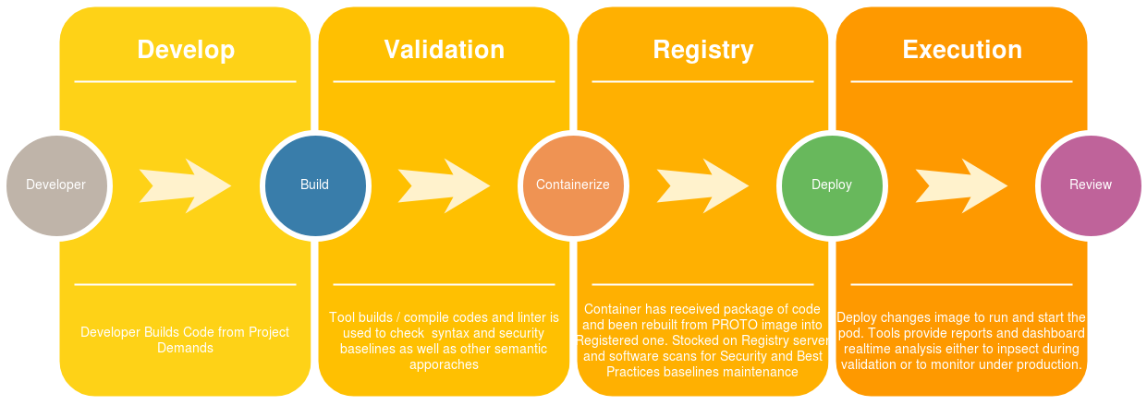
Development Perspective – DevOps Environment
Consultancy – Presentation – Provisioning
Development
DevOps
FeedBack – Updates – Support

Slide 3
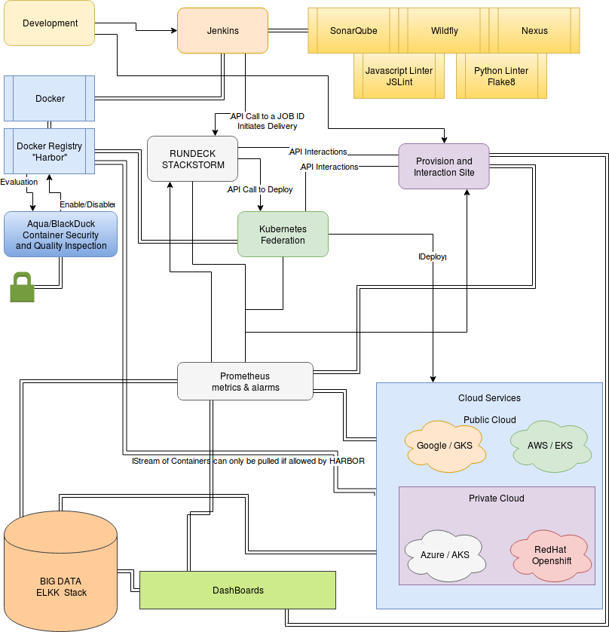
Macro Perspective – DevOps Environment
The design intents to provide a functional architecture design for any Cloud environment, whether it may be public, private or hybrid.

Slide 4
Macro Perspective – DevOps Environment
The Macro Prespective indicates procedures towards hybrid environments.
Development builds the code and Jenkins is used for the following integrations into CI
    Validate Code – Linters (Sonar, Flake8, JSLint)
    Promote the code (Compile, Copmact, Store)
    Trigger Continuous Delivery once presets are met.
Container are built from PROTO Container Images towards project registry directory and app can be used on bothways below:
    Container is maintained as proto image and artifact is inserted during Dockerfile execution collecting the artifact(s) while deploy is being made by cloudprovider.
      This process enables a shorter ammount of containers, focusing the reuse of them. Example a JAVA Springboot container which can have inserted any kind of JAVA Springboot designed app. If company uses this a lot, this way saves docker registry space.
    Container is altered to have inserted artifact previously alongside other dependancies and entrypoints and pulled up to registry as container+appversion. Later deploy only pulls image to run on POD directly. Env Vars and cloud functionalities still need to comply the project.
      This process enables more fast deployments under a very hybrid and diverse environment of apps. So all containers released and authorised to run have their flavors and versions, implicating on a bigger registry storage volume at the end.
The deployment of a ready made app can then be triggered by a running tasks server such as RUNDECK ou STACKSTORM.
    Such importance of a intermediate tool relies on prevent code dependancy from JENKINS, promoting easy usability for operation and support teams.
    Once deployment happens through them either by triggering only or by executing complex tasks such as on the docker plus artifact scenario, to change ENV VAR artifact app name+version, alter number of replicas required (whether dev/hk or production number of pods) and start deployhment by running commands through API towards cloud providers with CLI commands well designed for each cloud platform thus ensuring HYBRID development without any hassle and allowing multiple deploys as in AWS, Azure, Google, Bluemix, Openshift having all of them consumig the same registry,
    Consolidated information over full orchestration the company does.

Slide 5
Macro Perspective – DevOps Environment
The Macro Prespective indicates procedures towards hybrid environments.
Project or Cluster of PODs (alongside a specific software app or stack)
    Development – need only one POD for each app
      Example an app with front and backend = 2 pods
    Homologation – can have autoscaled PODs
      Example an app with frontend and backend
        Frontend for scalability can bear autoscaling rules (if over 80% scale new replica).
        Backend for persistance cannot have autoscaling rules once need only one database
          If backend works as an integrator towards the real DataBase, then autoscaled can be triggered but with caution towards the number of pool connections available to prevent connection outage to the DB.
    Production – works ith Blue and Green set of PODs
      Example – an authorized app to run under production should be used as shown below:
        First the PODs from blue channel are deployed and services + routes are still intact. Blue channel receives “ok go” from running the same volume of pods required on Green channel (which is actual under production).
        Green routes and services are then pointed to Blue channel and Blue routes and services are pointed to Green channel, thus crossing the productoin environment allowing blue channel takes the charge. Monitoring is mostly important on such phase so Prometheus, ELK/Big Data stdou output of applications and Databases must be monitored realtime.
        Blue channel holds up the charge so new package is elligible for production. Deployment of green channel pods (with blue routes and services) begins towards both blue and green beholds same software versions.
        Routes and Services are then swapped one more time, restoring green and blue structure. It will leave green on attending with previous blue validated app version and blue is released to new deployment of updated version again.
Most challenges these days goes to the need of realtime monitoring into so many technical depths it is really required a great set of tools to provide full information. Prometheus has become a mature tool being opensource, it can be easily integrated with clients into the containers and later built towards metrics fo the whole cloud environment allowing much clearer costs, performance and fostering prediction procedures towards reliability and safer operation.

Slide 6
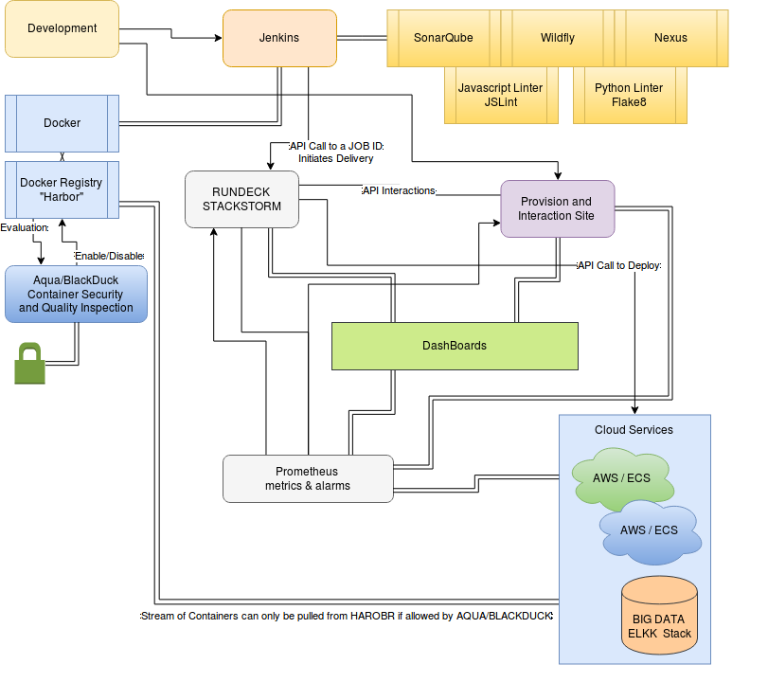
Skip the Dishes – DevOps Environment
Understanding Skip the Dishes are over 90% AWS stack, another Functional Architecture Design is proposed, keeping the increasing quality assurance not only over code but also over containers and production pods environment.
What is Prometheus?
Prometheus is an open-source systems monitoring and alerting toolkit originally built at SoundCloud. Prometheus joined the Cloud Native Computing Foundation in 2016 as the second hosted project, after Kubernetes.
Why use RUNDECK or STACKSTORM?
Both tools will assist to run and integrate complex deployments as well as to support monitoring of deployment events on development, homologation and into production.
It also is very helpful for blue/green environments switching once for that some external components to the pod are required to be orchestrated accordingly.

Slide 7
Skip the Dishes – DevOps Environment
Understanding Skip the Dishes are over 90% AWS stack, another Functional Architecture Design is proposed, keeping the increasing quality assurance not only over code but also over containers and production pods environment.
The Skip the dishes Prespective indicates procedures towards mono cloud provider environment.
Development builds the code and Jenkins is used for the following integrations into CI
    Validate Code – Linters (Sonar, Flake8, JSLint)
    Promote the code (Compile, Copmact, Store)
    Trigger Continuous Delivery once presets are met
Container are built from PROTO Container Images towards project registry directory and app can be used on bothways below:
    Container is maintained as proto image and artifact is inserted during Dockerfile execution collecting the artifact(s) while deploy is being made by cloudprovider.
      This process enables a shorter ammount of containers, focusing the reuse of them. Example a JAVA Springboot container which can have inserted any kind of JAVA Springboot designed app. If company uses this a lot, this way saves docker registry space.
    Container is altered to have inserted artifact previously alongside other dependancies and entrypoints and pulled up to registry as container+appversion. Later deploy only pulls image to run on POD directly. Env Vars and cloud functionalities still need to comply the project.
      This process enables more fast deployments under a very hybrid and diverse environment of apps. So all containers released and authorised to run have their flavors and versions, implicating on a bigger registry storage volume at the end.
The deployment of a ready made app can then be triggered by a running tasks server such as RUNDECK ou STACKSTORM.
    Such importance of a intermediate tool relies on prevent code dependancy from JENKINS, promoting easy usability for operation and support teams.
    Once deployment happens through them either by triggering only or by executing complex tasks such as on the docker plus artifact scenario, to change ENV VAR artifact app name+version, alter number of replicas required (whether dev/hk or production number of pods) and start deployhment by running commands through API towards cloud provider having it consuming the registry,
    Consolidated information over full orchestration the company does.

Slide 8
Skip the Dishes – DevOps Environment
The Skip the dishes Prespective indicates procedures towards mono cloud provider environment.
Project or Cluster of PODs (alongside a specific software app or stack)
    Development – need only one POD for each app
      Example an app with front and backend = 2 pods
    Homologation – can have autoscaled PODs
      Example an app with frontend and backend
        Frontend for scalability can bear autoscaling rules (if over 80% scale new replica).
        Backend for persistance cannot have autoscaling rules once need only one database
          If backend works as an integrator towards the real DataBase, then autoscaled can be triggered but with caution towards the number of pool connections available to prevent connection outage to the DB.
    Production – works ith Blue and Green set of PODs
      Example – an authorized app to run under production should be used as shown below:
        First the PODs from blue channel are deployed and services + routes are still intact. Blue channel receives “ok go” from running the same volume of pods required on Green channel (which is actual under production).
        Green routes and services are then pointed to Blue channel and Blue routes and services are pointed to Green channel, thus crossing the productoin environment allowing blue channel takes the charge. Monitoring is mostly important on such phase so Prometheus, ELK/Big Data stdou output of applications and Databases must be monitored realtime.
        Blue channel holds up the charge so new package is elligible for production. Deployment of green channel pods (with blue routes and services) begins towards both blue and green beholds same software versions.
        Routes and Services are then swapped one more time, restoring green and blue structure. It will leave green on attending with previous blue validated app version and blue is released to new deployment of updated version again.
Most challenges these days goes to the need of realtime monitoring into so many technical depths it is really required a great set of tools to provide full information. Prometheus has become a mature tool being opensource, it can be easily integrated with clients into the containers and later built towards metrics fo the whole cloud environment allowing much clearer costs, performance and fostering prediction procedures towards reliability and safer operation.

Slide 9
Skip the Dishes – DevOps Environment
Practicle presentation of technology.
Once the presented scenarion implicated a multiple set of tools and some of them would require more than a simple PC to run, below I deliver some excerpts of codes regarding their use as well.
JSON prototype of app
{
"app":{
"region":"cmps",
"route":"monkeyjob",
"project":"solr-lfr-dev",
"hostname":"monkeyjob.dev.appls.corp",
"service":"nodejs-mdb",
"path":"/teste"
}
}
The prototype to the left bears additional information because it is more felxible. For AWS, remember routes and hostname should be completed under network/routing options but would also comply the specification shown.
Following AWS baseline for a Fargate Cluster aka Cloud Project, the JSON delivers the base definitions of the objects which later should bear deeper settings.
The following steps will help you set up a cluster, register a task definition, run a task, and perform other common scenarios in Amazon ECS with the AWS CLI. Ensure you are using the latest version of the AWS CLI. For more information on how to upgrade to the latest version, see Installing the AWS Command Line Interface.
Prerequisites
Step 1: (Optional) Create a Cluster
Step 2: Register a Task Definition
Step 3: List Task Definitions
Step 4: Create a Service
Step 5: List Services
Step 6: Describe the Running Service
Source : https://docs.aws.amazon.com/AmazonECS/latest/developerguide/ECS_AWSCLI_Fargate.html

Slide 10
Skip the Dishes – DevOps Environment
Practicle presentation of technology.
Once the presented scenarion implicated a multiple set of tools and some of them would require more than a simple PC to run, below I deliver some excerpts of codes regarding their use as well.
Bash examples for RUNDECK or STACKSTORM Jobs of scalling to 0 aka stopping services
Example of downscalling from Openshift CLI
do_downscaleService(){
objProjeto=$1
# Ler todas os apps
for SERVICE in $(oc get dc -n $objProjeto | grep -v NAME | awk '{ print $1 }' )
do
# echo "$SERVICE"
echo "-> Escalando para 0 o deployment config - $DEPLOYMENT_CONFIG"
oc scale dc $SERVICE --replicas 0 -n $objProjeto || panic Erro ao escalar DCs
done
}
Example of downscalling from AWS Fargate CLI
do_downscaleService(){
AWS_task_of_service=$TASK
# Ler todas os apps
for SERVICE in $(fargate service list | awk '{ print $1 }' )
do
# echo "$SERVICE"
echo "-> Scalling to Zero - $SERVICE"
fargate service scale $SERVICE 0 || panic Erro ao escalar DCs
done
}
The similarity between the concepts must be held by the “Infra as a code” developer but as shown both scripts could be used under a same JOB on RUNDECK or STACKSTORM, once each type of cloud provider would have a toggle, changing the starting line of script to run and still being for support or operators, easy to manage different platforms seamlessly.

Slide 11
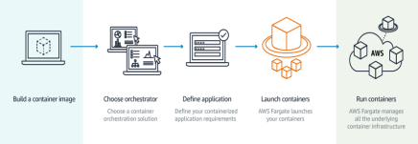
Skip the Dishes – AWS Fargate Details
Concept
AWS Fargate is a technology for Amazon ECS and EKS (in 2018) that allows you to run containers without having to manage servers or clusters. With AWS Fargate, you no longer have to provision, confgure, and scale clusters of virtual machines to run containers. This removes the need to choose server types, decide when to scale your clusters, or optimize cluster packing. AWS Fargate removes the need for you to interact with or think about servers or clusters. Fargate lets you focus on designing and building your applications instead of managing the infrastructure that runs them. Amazon ECS and EKS have two modes: Fargate launch type and EC2 launch type. With Fargate launch type, all you have to do is package your application in containers, specify the CPU and memory requirements, defne networking and AA, policies, and launch the application.
Costs and Control
AWS Fargate is an easy way to deploy your containers on AWS. To put it simply, Fargate is like EC2 but instead of giving you a virtual machine you get a container. It’s a technology that allows you to use containers as a fundamental compute primitive without having to manage the underlying instances. All you need to do is build your container image, specify the CPU and memory requirements, define your networking and IAM policies, and launch. With Fargate, you have flexible configuration options to closely match your application needs and you’re billed with per-second granularity.

Slide 12
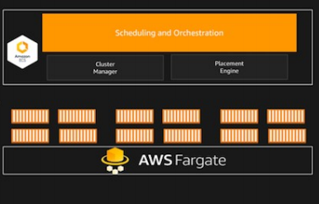
Skip the Dishes – AWS Fargate Details
Use Cases
By using Fargate in conjuction with produban’s own gsnet, we can leverage the cloud use for atipical use scenarios, such has:
● Peak usage (like black friday or mothers day)
● Scheduled down time (when upgrading gsnet)
● Unpredicted behavior (region going down in gsnet)
● App performance testing without taxing our own cloud.
● Financial fexibility (you can pay per second for testing application, while leaving the more expensive gsnet for production uses) OR use production applications in peak usages far cheaper then buying new equipment.
Conclusion
By using AWS Fargate technology together with our own cloud infrastructure, we gain several benefits in resilience, high availability, financial and infrastructure flexibility. The fact that the billing is done per second allows incredible financial control and fast deployment windows.

Slide 13


